Slide 1
Task 4 – Dashboard Design

Slide 2
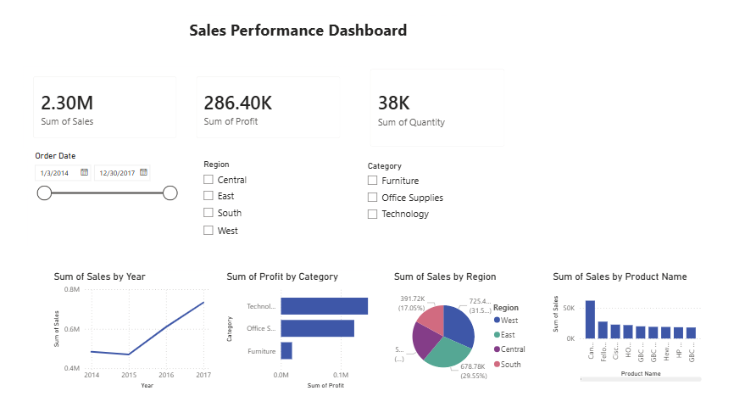
Dashboard Screenshot

Slide 3
KPIs Used
Total Sales: 2.30M
Total Profit: 286.40K
Total Quantity: 38K

Slide 4
Insights
West region generated the highest sales.
Technology category earned the highest profit.
Sales increased steadily from 2015 to 2017.

Slide 5
Conclusion
The dashboard helps stakeholders analyze sales performance, profit trends, and regional performance using interactive filters.

