Slide 1
Supervised by:
Ms. Raiyan Janik Monir
Lecturer
Department of Software Engineering
Daffodil International University
Presented by:
Name: Ali Ahsan Mujahid
ID: 182-35-363

Slide 2

Project Title
FasHion & LifeStyle Marketplace

Slide 3
Content
Introduction
Motivation
Why choose this Idea?
Functional Requirements
Non-Functional Requirements
Tools and Technologies
Stakeholder
Use case diagram
Activity diagram
ER diagram
Future Scope

Slide 4
Introduction
It will be a Fashion & LifeStyle-related marketplace where each user can create their own profile. each authenticated user can access their dashboard they can upload their product and each user can handle their sales and purchase. each user can chat with sellers and make an order. Each user can manage their order in their profile and many more.

Slide 5
Motivation
Nowadays, online selling become popular. Many of our women,s started selling online but for lack of a marketplace, they can not reach the customers. I think by a Marketplace they will reach out to many customers and generate more sales.

Slide 6
Why Choose This Idea?
To make a difference
Inspired by family or friends
Focus on the positives rather than the negatives.
There enough demand for this service in your market

Slide 7
Functional Requirements
Sing Up
Login
Product details
Live Chat,
Order Create,
Product Create,
Secure Authentication,
Live Communication,
Smart Cart System,

Slide 8
Functional Requirements
Individual Seller page,
Seller Dashboard,
login, Signup
Product category
Add to cart
Confirm order
Order details
Update status
Check Out

Slide 9
Non-Functional Requirements
Enabled Authentication & Validation.
Easy of use.
Proper routing.
Always available.
Payment validation.

Slide 10
TOOLS AND TECHNOLOGIES
Front-end: HTML, CSS, JAVASCRIPT, TYPESCRIPT,ANGULAR, etc.
Back-end: NODE.JS, SQL, etc.
Database: SQL Server

Slide 11
Stakeholder
Admin(Seller)
Customers
Developer
Management Team

Slide 12
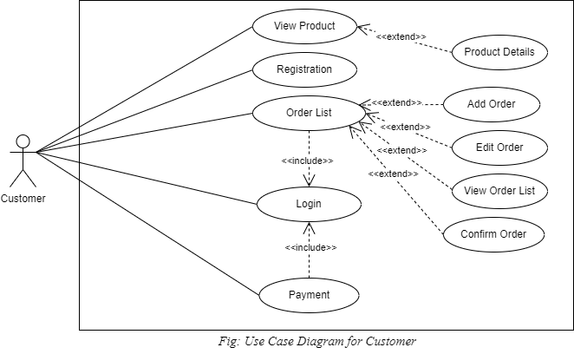
Use case diagram for customer

Slide 13
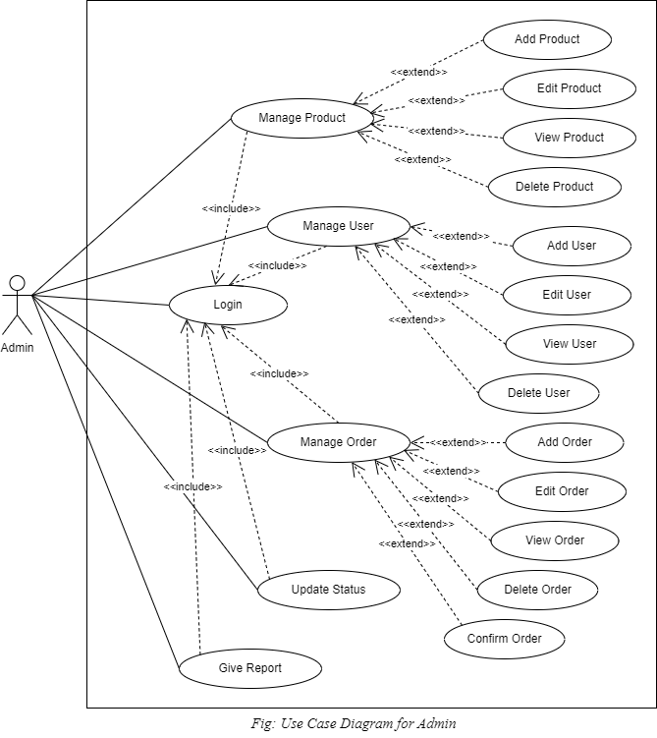
Use case diagram for admin

Slide 14
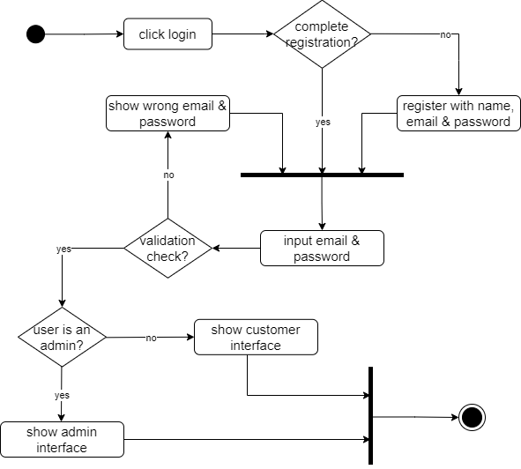
Activity diagram for Login and Registration

Slide 15
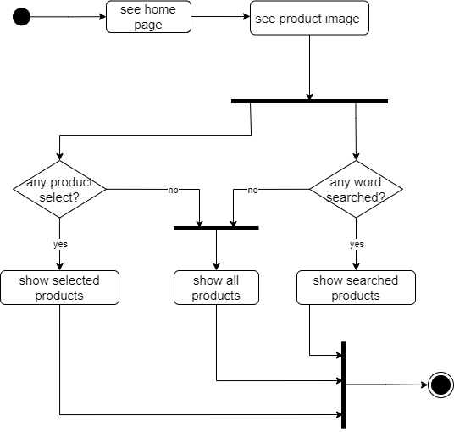
Activity diagram for User to view home page

Slide 16
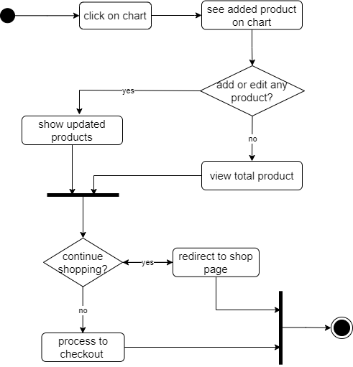
Activity diagram for Users to see cart

Slide 17
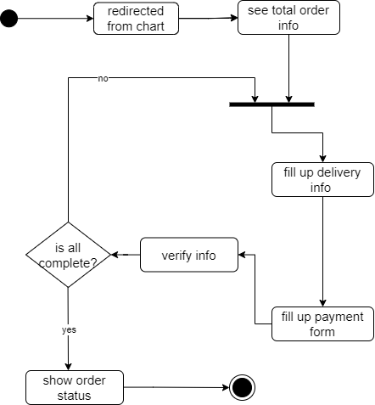
Activity diagram for User to make payment

Slide 18
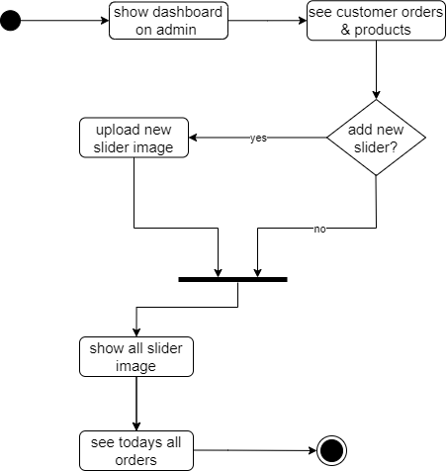
Activity diagram for viewing dashboard (Admin)

Slide 19
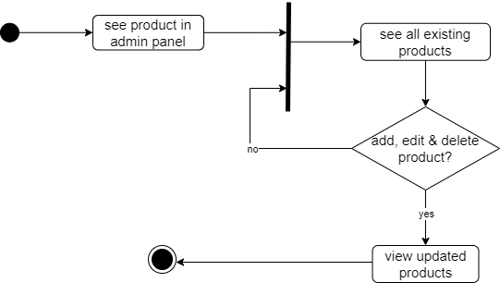
Activity diagram for interacting with products (Admin)

Slide 20
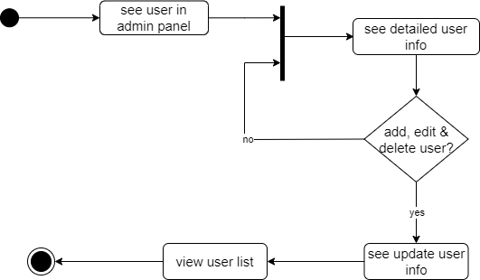
Activity diagram for interacting with user (Admin)

Slide 21
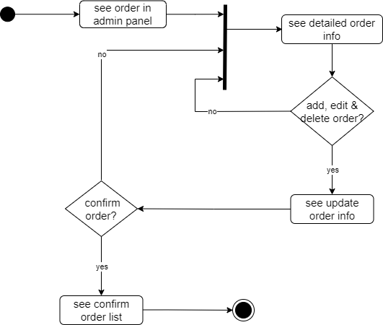
Activity diagram for interacting with order (Admin)

Slide 22
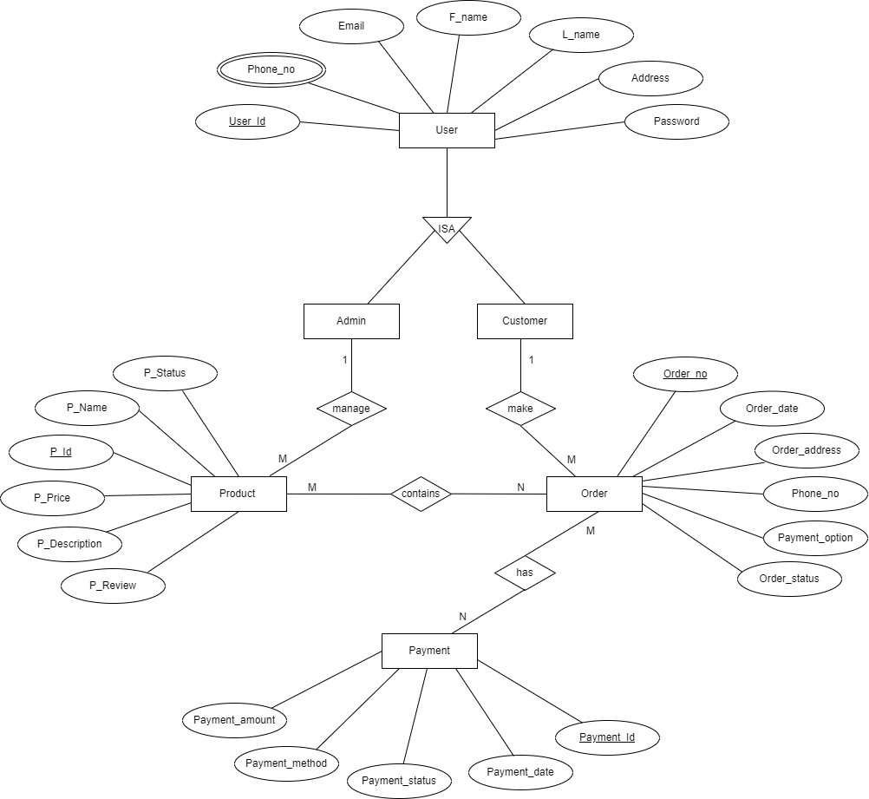
Entity Relationship Diagram

Slide 23
Future Scope:
By 2040, around 95% of all purchases are expected to be via eCommerce. Online stores with a loud social media presence will get 32% more sales on average those who do not. On average, 52% of eCommerce businesses have omnichannel capabilities.

Slide 24
Thanks Any Question?

