Slide 1
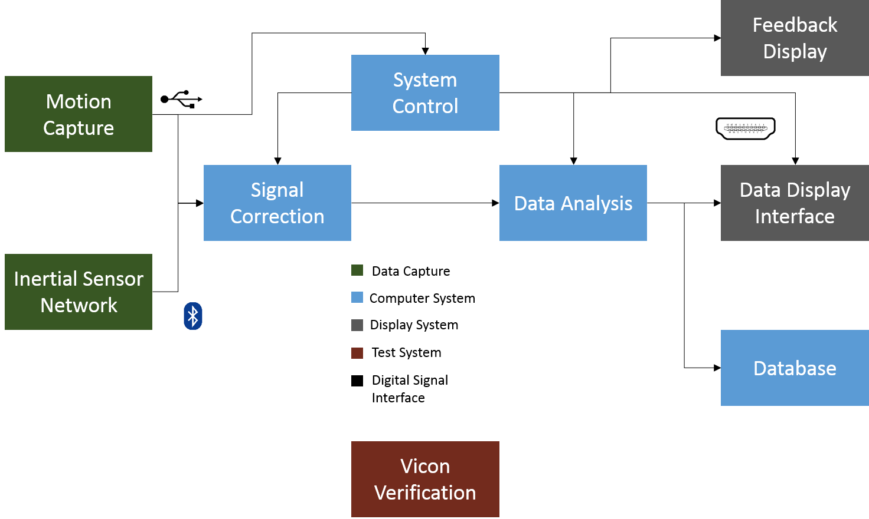

Slide 2
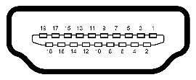


Feedback Display
System Control
Motion Capture
Signal Correction
Data Analysis
Data Display Interface
Inertial Sensor Network
Database
Integrated
Requires integration refinement
Not yet integrated

Slide 3

