Slide 1
The City of New York and food

Slide 2
Introduction
The City of New York, is the most populous city in the United States. It provides lot of business opportunities and business friendly environment. It has attracted many different players into the market. It is a global hub of business and commerce. The city is a major center for banking and finance, retailing, world trade, transportation, tourism, real estate, new media, traditional media, advertising, legal services, accountancy, insurance, theater, fashion, and the arts in the United States. This also means that the market is highly competitive. As it is highly developed city so cost of doing business is also one of the highest. Thus, any new business venture or expansion needs to be analyzed carefully. The insights derived from analysis will give good understanding of the business environment which help in strategically targeting the market. This will help in reduction of risk. And the Return on Investment will be reasonable.

Slide 3
Business problem
The City of New York is famous for its excellent cuisine. It's food culture includes an array of international cuisines influenced by the city's immigrant history. Sushi restaurants have become so popular in the United States now it seems that there is one on every corner, not only in major cities but also in smaller cities. Starting a sushi restaurant can be a great business opportunity, but you need to distinguish yourself from others to enjoy long-term success.

Slide 4
Target Audience:
My Client wants to open his business in Manhattan area, so I only focus on that borough during my analysis.

Slide 5
Data
-Newyork has a total of 5 boroughs and 306 neighborhoods. In order to segement the neighborhoods and explore them, we will essentially need a dataset that contains the 5 boroughs and the neighborhoods that exist in each borough as well as the the latitude and logitude coordinates of each neighborhood.
From Foursquare Venues Categories

Slide 6
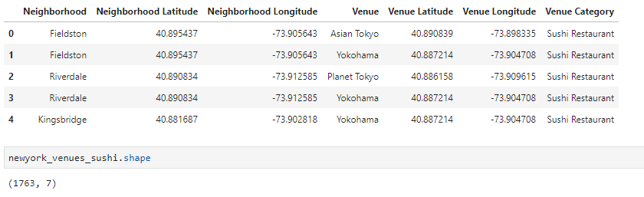
Methodology
Convert addresses into their equivalent latitude and longitude values.
Use the Foursquare API to explore neighborhoods in Manhattan, New York.
Explore function to get sushi restaurant categories in each neighborhood.
use this feature to group the neighborhoods into clusters K-means clustering algorithm will be use to complete this task.

Slide 7
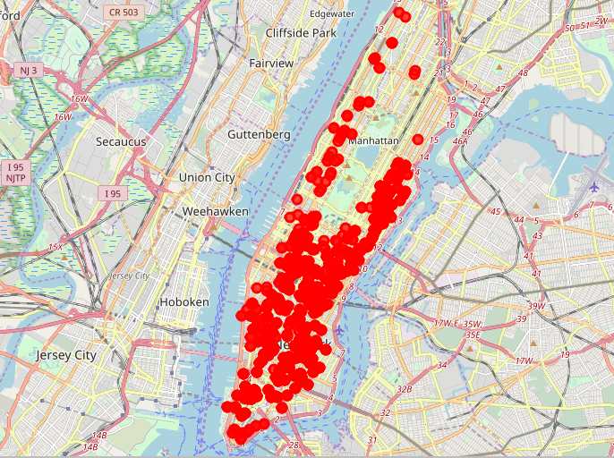
Sushi bars in Manhattan

Slide 8
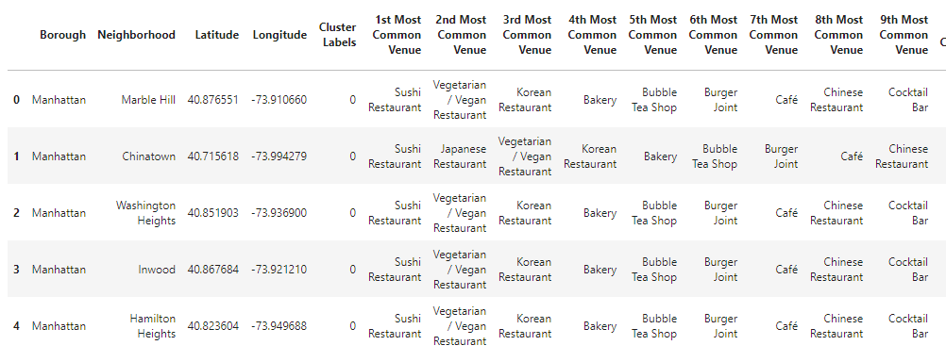
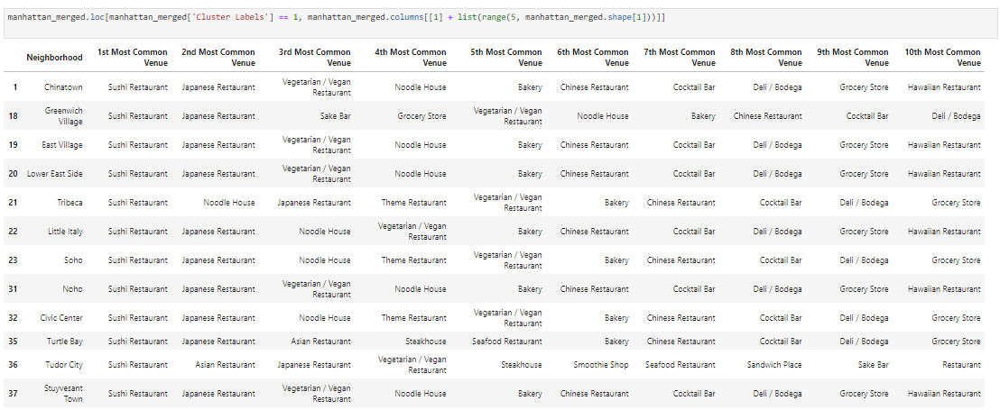
Results -K-mean Cluster
Cluster 0
Cluster 1

Slide 9
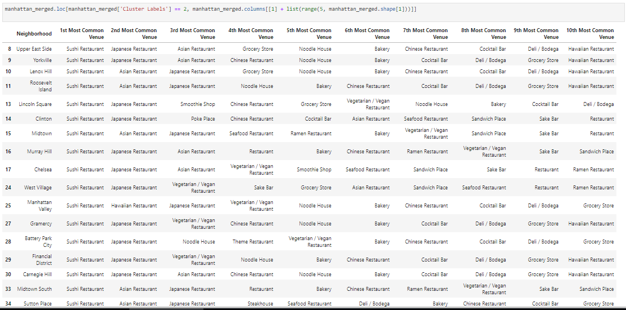
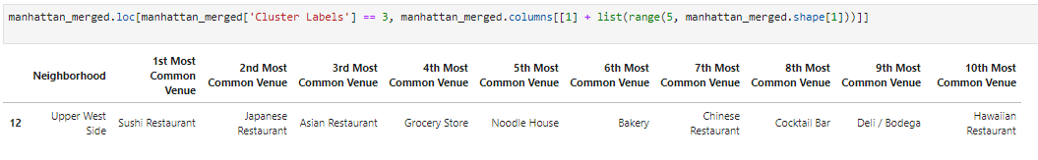
Cluster 2
Cluster 3

Slide 10
Discussion
This analysis is performed on limited data. This may be right or may be wrong. But if good amount of data is available there is scope to come up with better results.
There is high competition in Midtown and Soho so it is very risky to open business in these areas.
Central Harlem has also potential where closes to Morningside Heights area.
It can be done more detailed analysis by adding other factors such as transportation, demographics of inhabitants.

Slide 11
Conclusion
Although all of the goals of this project were met there is definitely room for further improvement and development as noted below. However, the goals of the project were met and, with some more work, could easily be devleoped into a fully phledged application that could support the opening a business idea in an unknown location.

