Slide 1
STAT340 - Introduction
Aliaksandr Hubin, KBM, NMBU
03.02.2025

Slide 2
Teachers
Lecturer: Ass. Prof. Aliaksandr Hubin, KBM
Office: M252 - Old diary science building, (Meieribygningen)
Email: aliaksandr.hubin@nmbu.no
Assistant teacher: Elias Bye Rossetnes

Slide 3
STAT340 – Applied Methods in Statistics
Lectures Tuesdays 14:15-16:00,
Room: T330
First lecture Feb 3 .Egeland@nmbu.no
Group exercises Thursdays, 12:15-14:00 or 14:15-16:00,
Room: BT3A10.
First ocurrence Feb 5
Individual exercises Mondays 10:15-12:00,
Room: T132.
First ocurrence: Feb 9
Notes:
Me You About the course

Slide 4
Practical info
Mandatory activity: There will be one compulsory assignment. Deadline near the end of the course.
Exam: Multiple choice (100%)
Learning activities:
Lectures: 2 hours per week.
Exercises: 2 hours per week.
Individual work: 2 hours per week.
Examination details: One written exam: A - E , Not-passed. All calculators and specified written aids are allowed. May 18, 9:00 – 12:00.
I am not involved into registration and organization of the exam
No date change possible

Slide 5
Assumed background («STAT100»)
It is assumed that the student is familiar with:
Basic rules of probability,
Common probability distributions:
Binomial, Gaussian, Student’s
One-sample, two-sample and paired sample t-tests
One-way Analysis of Variance
Simple linear regression (one predictor variable)
Contingency tables
Software. Rstudio for R programming language:
Practical analysis in R using various statistical methods followed by theoretical and practical interpretation of the results (you may use other software if methods are available)
Data: R library BIAS.data (first Thursday exercise)

Slide 6
Content
Short introduction to R and R Studio. Practical analysis in R using various statistical methods followed by theoretical and practical interpretation of the results.
Multiple regression, ANOVA
Multivariate analysis
PCA (Principal Component Analysis)
Classification
Clustering
Generalized linear models
Binomial, Bernoulli (logisic), Poisson regression
Mixed models: Random effects, repeated measurements

Slide 7
Lecture presentations
All exercises
Text book available online, consult if and when needed:
R Book: Michael J Crawley, Wiley, Second edition
https://www.cs.upc.edu/~robert/teaching/estadistica/TheRBook.pdf Chapters 1-9 (as needed), 10-13, 17, 19, 25
Supplementary. Contains more mathematical details
ISL: James et al. “An Introduction to Statistical Learning”.
https://www.statlearning.com/
Chapters 1-4, 6.1, 7.1, 10

Slide 8
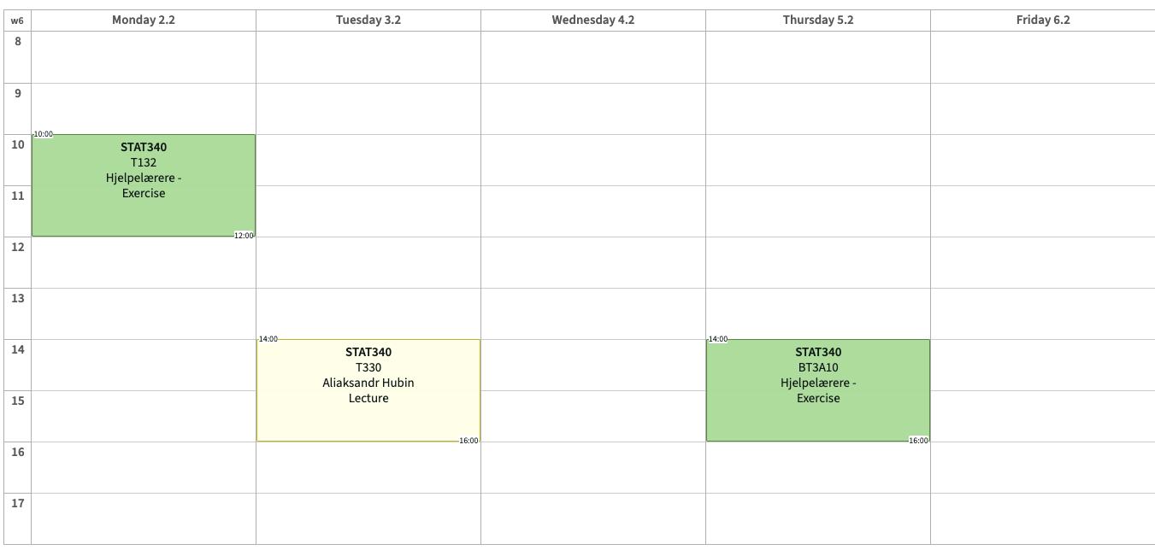
Typical week
Choose

Slide 9
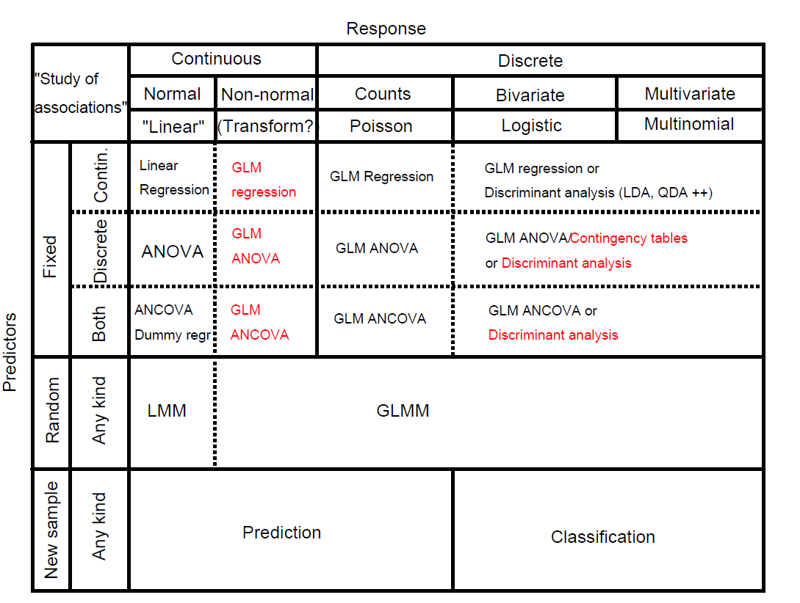

Slide 10
Reflection
Turn to your neighbour(s) and discuss for a few minutes:
Do you know what kind of random variables you will be/are dealing with in your work?
Do you have any idea what kind of association studies or methods that are relevant?

