Slide 1
NFT
Non-fungible token

Slide 2
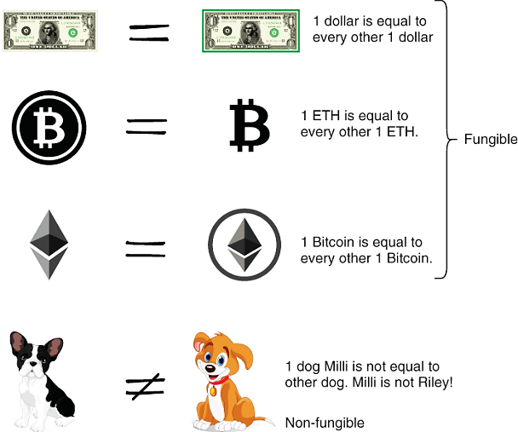
NFT
NFT is unique which cannot be exchanged like-for-like (equivalently, non-fungible), making it suitable for identifying something or someone in a unique way.
Fungible
Non-fungible

Slide 3
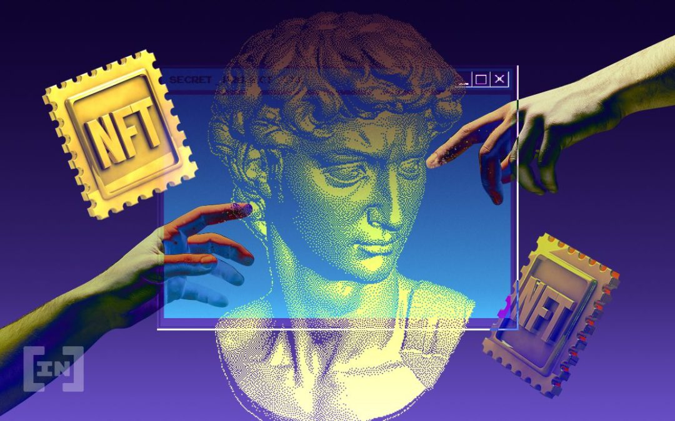
NFT
By using NFTs on smart contracts (in Ethereum), a creator can easily prove the existence and ownership of digital assets in the form of videos, images, arts, event tickets, etc. The creator can also earn royalties each time of a successful trade on any NFT market or by peer-to-peer exchanging.

Slide 4
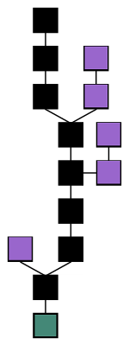
Blockchain
Genesis block (green block): The first block in the chain
Main chain (black blocks): This is the continuous sequence of blocks, starting with the genesis block (green block) and ending with the most recently added block
Orphan blocks (purple blocks): Blocks that have not been added to the main chain.

Slide 5
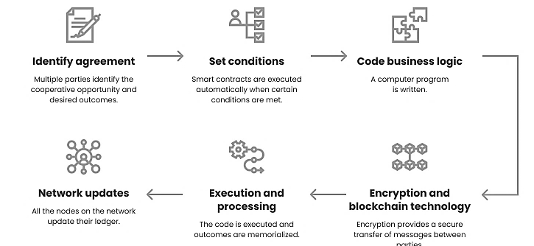
Smart contract

Slide 6
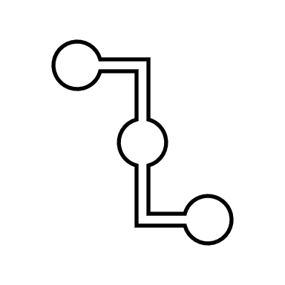
The process of placing a smart contract on the blockchain
Smart contract code
Bytecode
Вlockchain
The main characteristics of NFTs:
Unique identifier (tokenID)
Metadata
Ownership and transfer mechanisms:
Mint functions
Transfer functions
BalanceOf functions
OwnerOf functions
Additional functions:
Royalties
Lock
Burn
608060405234801561001057600080fd5b506040516020806100206000a3457060405060405a4
The transaction is sent to the blockchain network
Compiled into bytecode
that can be understood by the Ethereum Virtual Machine
The transaction will return the address of the deployed contract
Contract address
0x1234567890abcdef1234567890abcdef1234567890abcdef

Slide 7


Protocols. Top to Bottom

Slide 8

Protocols. Top to Bottom
Creator digitizes the raw data into a proper format

Slide 9


Protocols. Top to Bottom
External Storage
Creator digitizes the raw data into a proper format

Slide 10


Protocols. Top to Bottom
External Storage
On-Chain Storage
Creator digitizes the raw data into a proper format

Slide 11

Protocols. Top to Bottom
External Storage
On-Chain Storage
Creator digitizes the raw data into a proper format
Smart Contract

Slide 12
Protocols. Top to Bottom
External Storage
On-Chain Storage
Creator digitizes the raw data into a proper format
Smart Contract

Slide 13


Protocols. Top to Bottom
External Storage
On-Chain Storage
Creator digitizes the raw data into a proper format
Smart Contract
ID ***
NFT
The minting and trading process begins

Slide 14
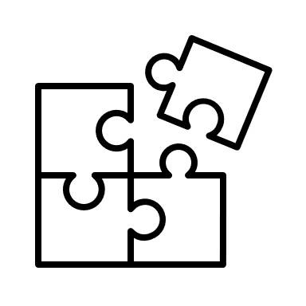

Protocols. Bottom to Top
Template Creation
Creator

Slide 15
Protocols. Bottom to Top
Smart Contract
Template Creation
Creator

Slide 16
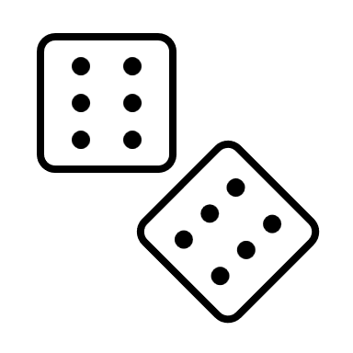
Protocols. Bottom to Top
Smart Contract
Template Creation
Randomization
Creator
ID ***
NFT
The minting and trading process begins

Slide 17


Protocols. Bottom to Top
Smart Contract
Template Creation
Randomization
Creator
Buyer
ID ***
NFT
The minting and trading process begins

Slide 18

Protocols. Bottom to Top
Smart Contract
Template Creation
Randomization
Creator
Buyer
ID ***
Customization
NFT
The minting and trading process begins

Slide 19
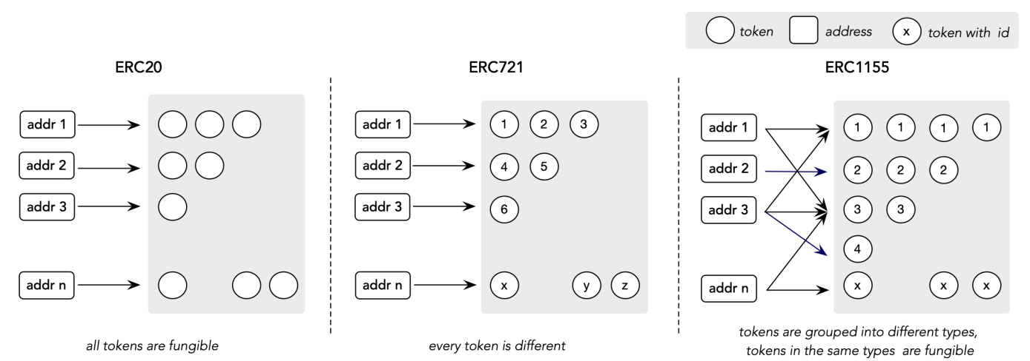
Token Standards ERC-20, ERC-721, and ERC-1155
Token Standards are a set of rules and guidelines that govern how tokens, especially digital assets on blockchains, function. These standards ensure interoperability and compatibility between different decentralized applications (DApps).

Slide 20

What is Remix?
Remix is a powerful, web-based Integrated Development Environment (IDE) specifically designed for writing, deploying, testing, and debugging Ethereum smart contracts
Web-Based: No installation is required; it runs directly in your browser.
Built-In Solidity Compiler: Easily compile your smart contracts without additional setup.
Deploy and Test: Deploy contracts to test networks or the Ethereum mainnet and interact with them in real time.
Debugging Tools: Step-by-step debugging for tracing and resolving issues in your smart contract code.
Plugin Ecosystem: Additional plugins for linting, security analysis, and more.

Slide 21
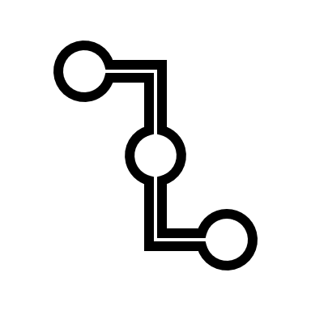

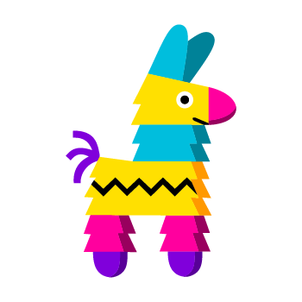
Preparing a digital asset
Metadata
JSON file
On-Chain Storage
Name
Description
URL
Creator
NFT picture
Storing NFT data off-chain
InterPlanetary File System
Pinata Cloud
Centralized Cloud Storage:
Amazon S3, Google Cloud Storage, and others

Slide 22
JSON file example
{
"name": "UniqueNFT",
"description": "Description of unique NFT",
"image": "https://salmon-payable-tahr-551.mypinata.cloud/files/bafkreiefllwpr2ao6ozq2fz2nw67itpebqb2y4wubowwciz7cc272bxb7m?X-Algorithm=PINATA1&X-Date=1736695131&X-Expires=30&X-Method=GET&X-Signature=2d140a5cf38c656a05b1b32f1bb61b33f8df9a8b31fc2dd08798cbf9eea0d611",
"attributes": [
{
"trait_type": "Attribute 1",
"value": "length"
},
{
"trait_type": "Attribute 2",
"value": "width"
},
]
}

Slide 23
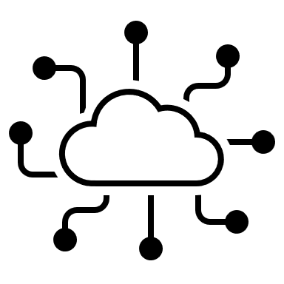
Create a transaction
Contract address
Smart contract
0x1234567890abcdef1234567890abcdef1234567890abcdef
mint
listToken
updatePrice
buyToken
burnToken
Transaction
Network validators
Contract address
Function
Function parameters
Gas

Slide 24
Example of using NFT smart contract
Smart contract
- Transaction
- Creator
- Buyer/new owner
mint
listToken
updatePrice
buyToken
burnToken
- Вlockchain

Slide 25

Example of using NFT smart contract
Smart contract
mint(tokenURI)
- Transaction
- Creator
ID ***
- Buyer/new owner
mint
listToken
updatePrice
buyToken
burnToken
- Вlockchain

Slide 26
Example of using NFT smart contract
Smart contract
mint
listToken(price)
- Transaction
- Creator
ID ***
- Buyer/new owner
mint
listToken
updatePrice
buyToken
burnToken
- Вlockchain

Slide 27

Example of using NFT smart contract
Smart contract
mint
listToken
updatePrice(newPrice)
- Transaction
- Creator
- Buyer/new owner
mint
listToken
updatePrice
buyToken
burnToken
- Вlockchain

Slide 28

Example of using NFT smart contract
Smart contract
mint
listToken
updatePrice
1
buy
- Transaction
- Creator
1
- Buyer/new owner
mint
listToken
updatePrice
buyToken
burnToken
ID ***
- Вlockchain
1

Slide 29
Example of using NFT smart contract
Smart contract
mint
listToken
updatePrice
1
buy
- Transaction
- Creator
- Buyer/new owner
ID ***
mint
listToken
updatePrice
buyToken
burnToken
- Вlockchain
listToken
1

Slide 30
Example of using NFT smart contract
Smart contract
mint
listToken
updatePrice
1
buy
- Transaction
- Creator
- Buyer/new owner
mint
listToken
updatePrice
buyToken
burnToken
- Вlockchain
updatePrice
listToken
1
1

Slide 31
Example of using NFT smart contract
Smart contract
mint
listToken
updatePrice
1
buy
- Transaction
- Creator
2
- Buyer/new owner
1
- Вlockchain
buy
updatePrice
listToken
1
1
2

Slide 32

Example of using NFT smart contract
Smart contract
mint
listToken
updatePrice
1
buy
- Transaction
- Creator
ID ---
- Buyer/new owner
- Вlockchain
burnToken
buy
updatePrice
listToken
2
2
1
1

Slide 33
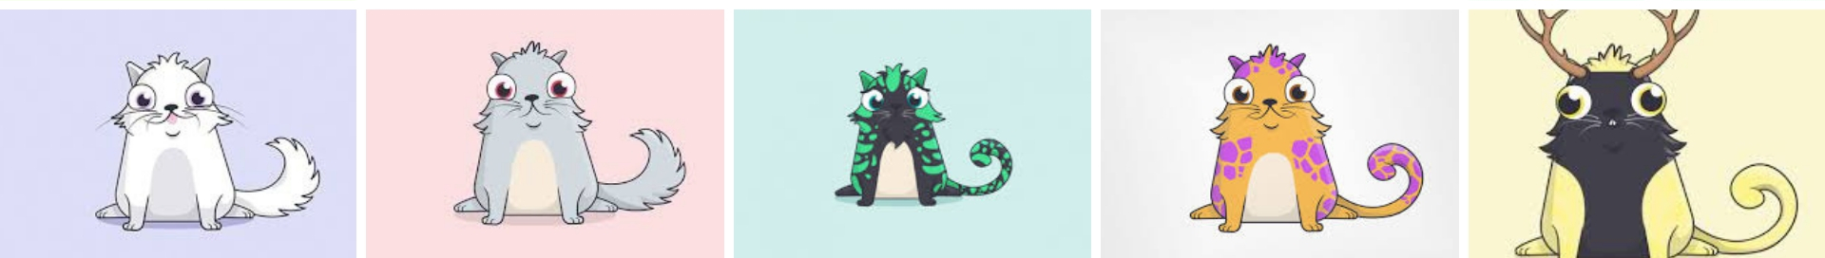
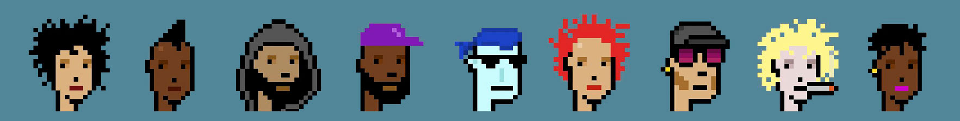
Opportunities
Boosting Gaming Industry. NFT has great potential in the gaming industry. There already exist some crypto games are CrytpoKitties, Cryptocats, CryptoPunks, Meebits, Axie Infinity, Gods Unchanged
The players can obtain personal exclusivity game items. This will
create a mutually beneficial business model in which both players and developers profit from the secondary NFT market.

Slide 34
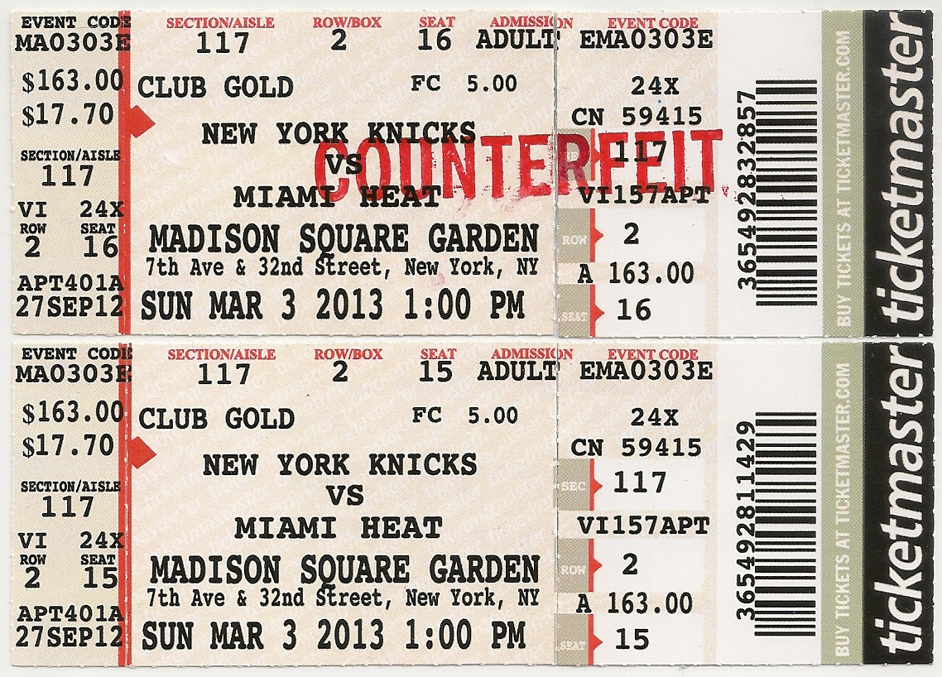
Opportunities
Flourishing Virtual Events. When buying tickets in a traditional event ticket market, consumers must trust the third party.
“NFT-based ticket” represents a ticket issued by the blockchain to demonstrate entitlement to access to any event such as culture or sports. An NFT-based ticket is unique and scarce, meaning that the ticket holder cannot resell the ticket after it is sold.

Slide 35

Opportunities
Inspiring the Metaverse. Metaverse is a collective virtual shared space that allows all types of digital activities.
Blockchain provides an ideal decentralized environment for the virtual online world. Participants under this blockchain-fueled alternative realities can have many types of intriguing use cases like enjoying games, displaying self-made arts, trading assets and virtual properties (arts, land parcels, names, video shots, wearables), etc. In addition, users also have opportunities to get profits from the virtual economy.

Slide 36
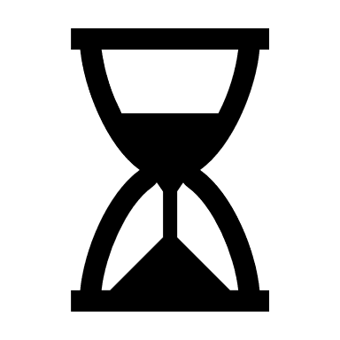

Challenges. Usability Challenges
Slow Confirmation. Current NFT systems are closely coupled with their underlying blockchain platforms, which makes them suffer from low performance. This results in extremely slow confirmation of NFTs.
High Gas Prices. High gas prices have become a major problem for NFT marketplaces, especially when minting the NFTs at a large scale that requires uploading the metadata to the blockchain network.

Slide 37
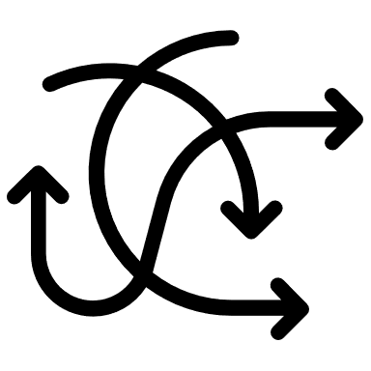

Challenges. Security and Privacy Issues
NFT Data Inaccessibility. When the users “upload” NFT metadata toa specialized file storage system the original file might be lost or damaged. Also, an NFT might point to an erroneous file address.
Anonymity/Privacy. Most NFT transactions rely on their underlying Ethereum platform, which only provides pseudo-anonymity rather than strict anonymity or privacy. Users can partially hide their identities if the links between their real identities and corresponding addresses are unknown by the public.

Slide 38


Challenges. Governance Consideration
Legal Pitfalls. The lack of clear laws in different countries, copyright and tax issues create uncertainty for investors. Before investing in NFTs, it is necessary to carefully study the legislation and consult with lawyers.
Taxable property Issues. NFTs, while treated differently from traditional IP, are subject to tax implications. As many countries haven't established specific regulations, there's uncertainty surrounding taxation on NFT sales and trades.

Slide 39
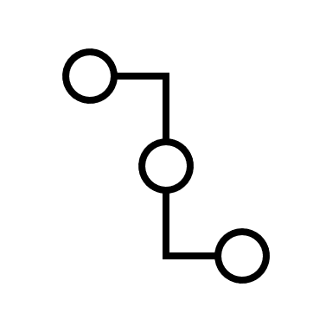
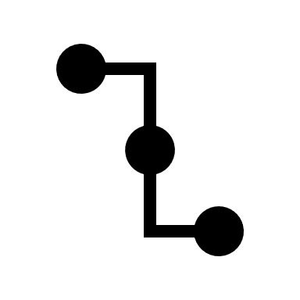

Challenges. Extensibility Issues
NFT Interoperability (cross-chain). NFTs are currently limited to their respective blockchains, hindering interoperability and cross-chain transactions. While solutions exist, they often rely on third-party intermediaries, compromising decentralization.
Updatable NFTs. To ensure smooth operation and security, blockchain protocols undergo updates through soft and hard forks. As NFT systems evolve, they must carefully consider the implications of these updates to maintain their functionality and security.

