Slide 1
Analyse des Mental Health Datensatzes
Katsar, Vardanian

Slide 2
Datensatz
Age | Gender | Occupation | Days_Indoors | Growing_Stress | Quarantine_Frustrations | Changes_Habits | Mental_Health_History | Weight_Change | Mood_Swings | Coping_Struggles | Work_Interest | Social_Weakness
20-25 | Female | Corporate | 1-14 days | Yes | Yes | No | Yes | Yes | Medium | No | No | Yes
30-Above | Male | Others | 31-60 days | Yes | Yes | Maybe | No | No | High | No | No | Yes
30-Above | Female | Student | Go out Every day | No | No | Yes | No | No | Medium | Yes | Maybe | No
25-30 | Male | Others | 1-14 days | Yes | No | Maybe | No | Maybe | Medium | No | Maybe | Yes

Slide 3
Ziele
Zusammenhänge finden (Unabhängigkeitsanalyse)
Schlüssfolgerungen über Wohlbefinden ziehen
Prognose erstellen

Slide 4
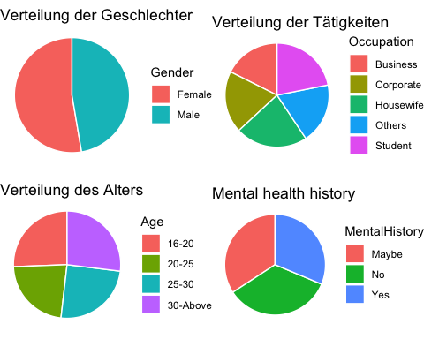
Explorative Datenanalyse

Slide 5
Neue Varible fürs Wohlbefinden
Age | Gender | Occupation | Days_Indoors | Growing_Stress | Quarantine_Frustrations | Changes_Habits | Mental_Health_History | Weight_Change | Mood_Swings | Coping_Struggles | Work_Interest | Social_Weakness | Mental_Unwellness
20-25 | Female | Corporate | 1-14 days | Yes | Yes | No | Yes | Yes | Medium | No | No | Yes | 6.5
30-Above | Male | Others | 31-60 days | Yes | Yes | Maybe | No | No | High | No | No | Yes | 6.5
30-Above | Female | Student | Go out Every day | No | No | Yes | No | No | Medium | Yes | Maybe | No | 2.0
25-30 | Male | Others | 1-14 days | Yes | No | Maybe | No | Maybe | Medium | No | Maybe | Yes | 5.0

Slide 6
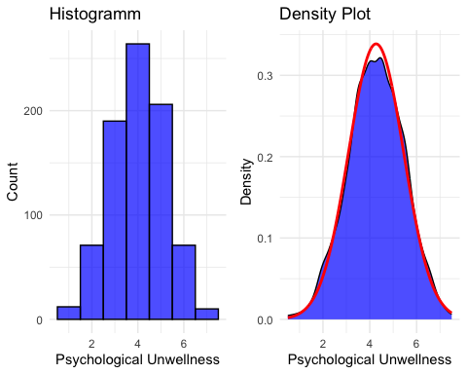
“Mental_Unwellness” Verteilung

Slide 7
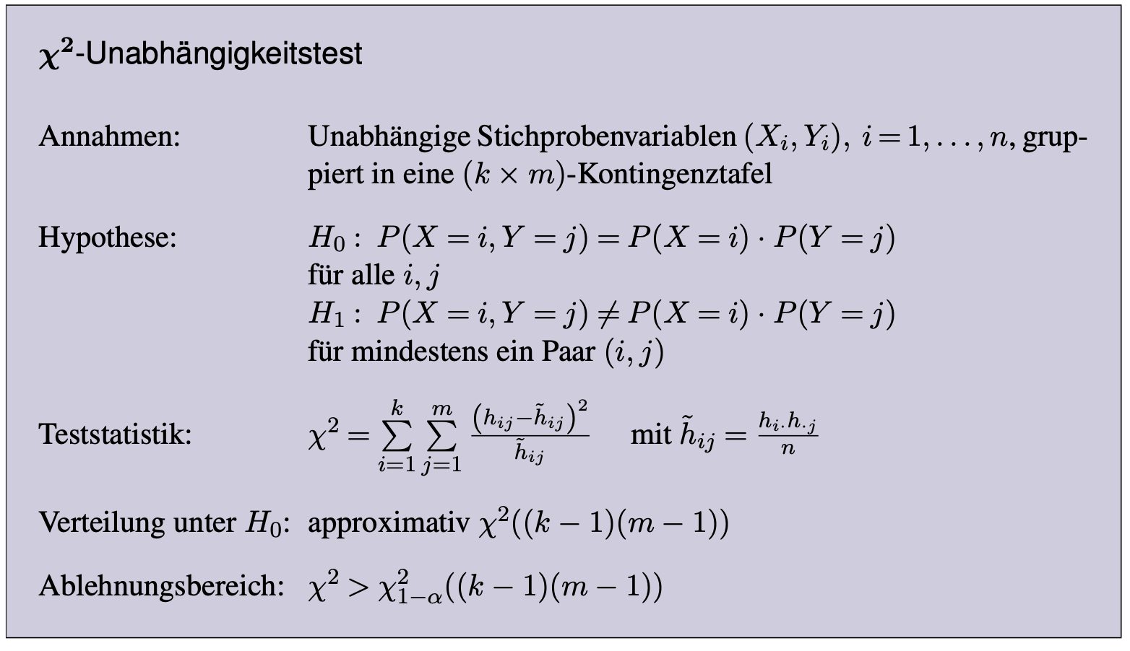
Unabhängigkeitsanalyse

Slide 8
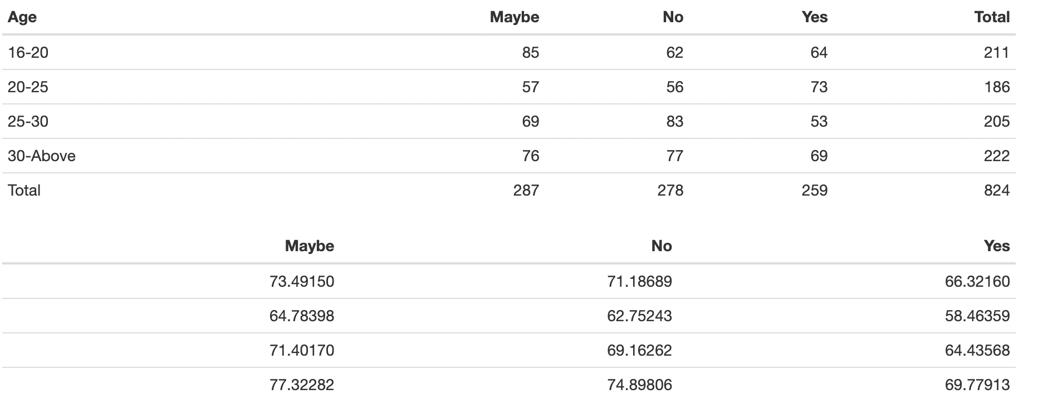
Kontingenztabelle mit den erwarteten Häufigkeiten

Slide 9
## X = 13.31434
## qchisq(o.95, df) = 12.59159
## decision = FALSE

Slide 10
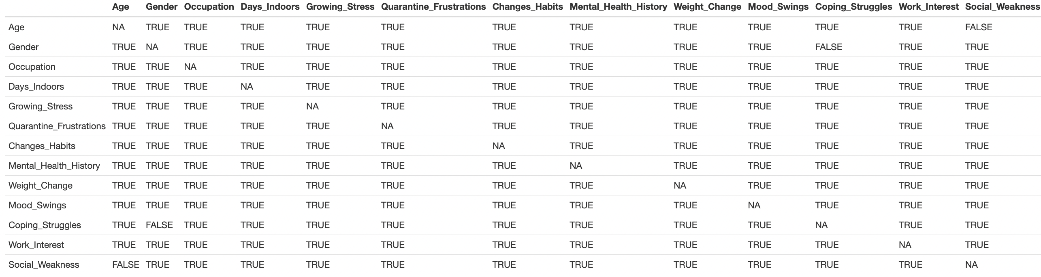
Big Independence Table

Slide 11
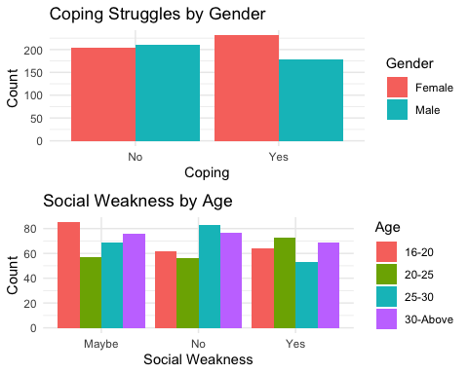

Slide 12
Einfluss des Alters auf Wohlbefinden
## ## Pearson's Chi-squared test ## ## data: MentalHealth_wellness$Age and MentalHealth_wellness$Mental_Unwellness ## X-squared = 2.2415, df = 3, p-value = 0.5238

Slide 13
Einfluss des Geschlechts auf Wohlbefinden
## ## Pearson's Chi-squared test with Yates' continuity correction ## ## data: MentalHealth_wellness$Gender and MentalHealth_wellness$Mental_Unwellness ## X-squared = 0.35029, df = 1, p-value = 0.5539

Slide 14
Einfluss der Tätigkeit auf Wohlbefinden
## ## Pearson's Chi-squared test ## ## data: MentalHealth_wellness$Occupation and MentalHealth_wellness$Mental_Unwellness ## X-squared = 4.4673, df = 4, p-value = 0.3464

Slide 15
Einfluss der vorherigen psychischen Problem
## ## Pearson's Chi-squared test ## ## data: MentalHealth_wellness$Mental_Health_History and MentalHealth_wellness$Mental_Unwellness ## X-squared = 7.2554, df = 2, p-value = 0.02658

Slide 16
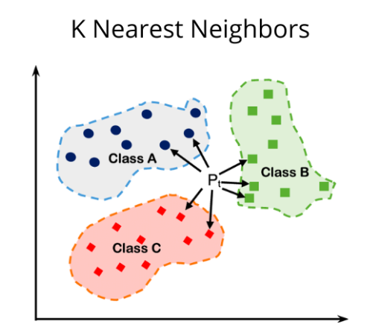
KNN

Slide 17
prediction <- knn(train = data_train, test = data_test, cl = classification, k = round(sqrt(ncol(MentalHealth))))
## success rate = 0.6432039

Slide 18
VIELEN DANK FÜR DIE AUFMERKSAMKEIT!
https://github.com/aliaksei-katsar/mental_health.git

