Slide 1


DELIVERY REVIEW
Aliaksandr Parkhomenka

Slide 2
CONTEXT
Achievements
Problems
Solutions

Slide 3


2018 vs. 2017
Review score
Order Approval Time
Order value
More Late orders
Sales
Active Sellers

Slide 4
Delivery Time
12 days

Slide 5
Review Score
Customer Satisfaction in danger
4.2
Late Orders On time
2.3 4.3
Only 60% of customers are fully satisfied

Slide 6
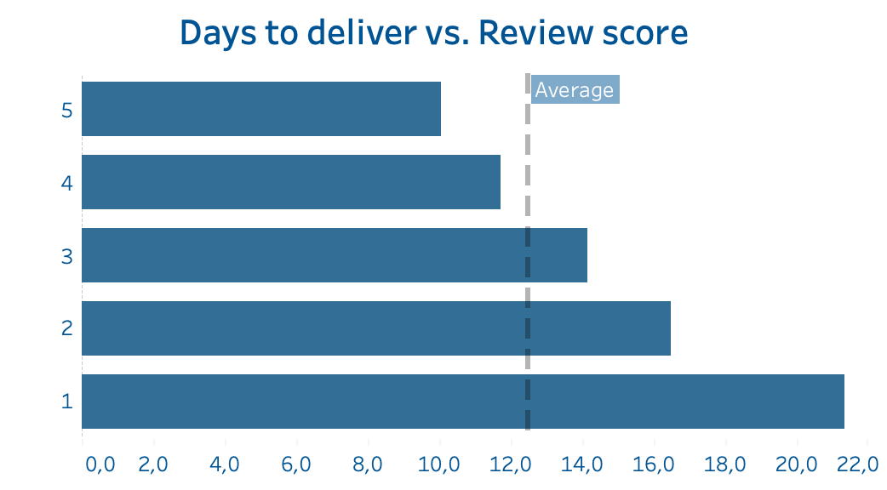
Less to wait – More satisfied
review score
6 out of 10 customers who had delayed order fully disssatisfied with the experience

Slide 7
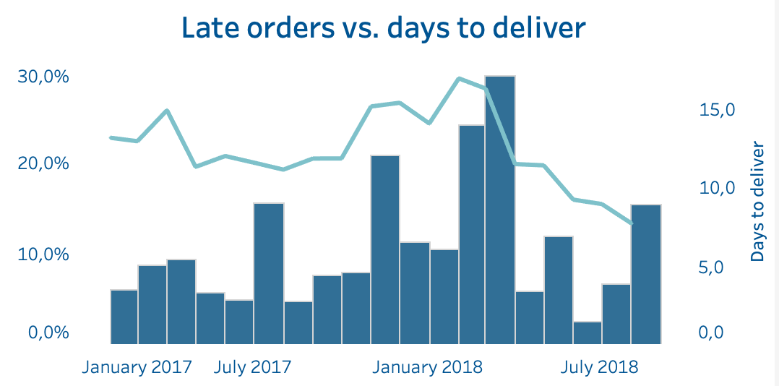
Share of Late orders increased from 10.5% to 13.5%
Industry benchmark 3-5%

Slide 8
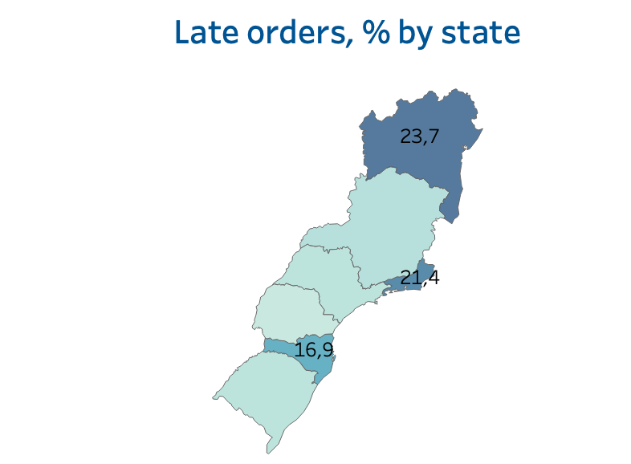
3 out of 7 ‘Priority States’ had a higher-than-average % of late orders in 8M 2018
Bahia
Rio de Janeiro
Santa Catarina

Slide 9
How can we help?

Slide 10
Actions we have to do now
Sellers
Customers
Inventory tracking and alerts for sellers to ensure timely restocking and avoid delays.
Launch region-specific workshops on packaging, shipping best practices, and delivery time optimization.
Offer compensation options for delayed orders.
Real-time updates at each critical stage: shipped, in transit, out for delivery, and delivered.

Slide 11

THANK YOU FOR ATTENTION

