Slide 1


SALES DURATION OVERVIEW
Aliaksandr Parkhomenka

Slide 2
CONTEXT
1. KPIs at glance
2. Main findings
3. Recommendations

Slide 3
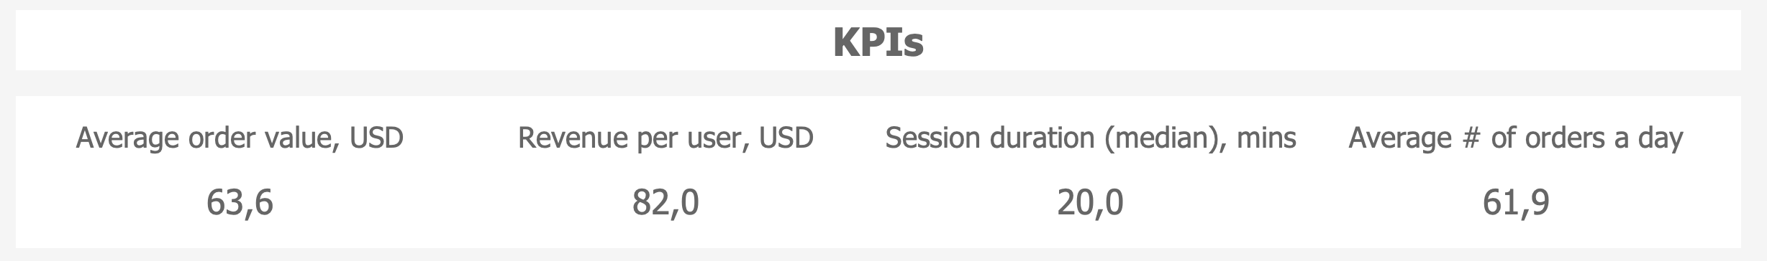
KPIs
Half Of Users Make A Purchase Within 20 Mins

Slide 4

For How Long? How many? When? and Where? Orders Are Made?

Slide 5
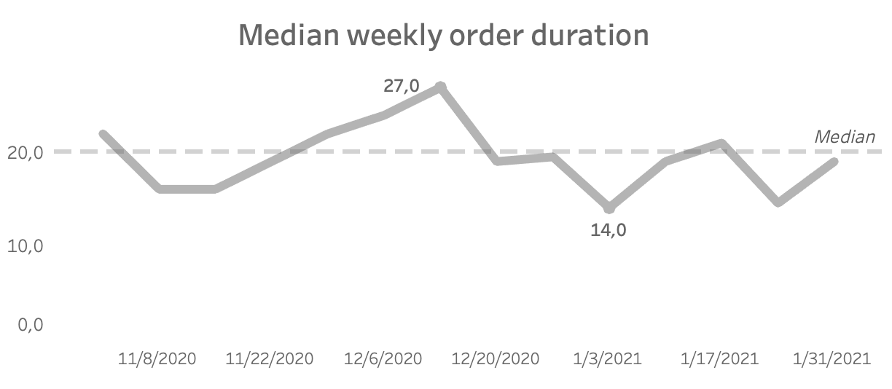
Customers Spent More Time at pre-X-mas Period

Slide 6
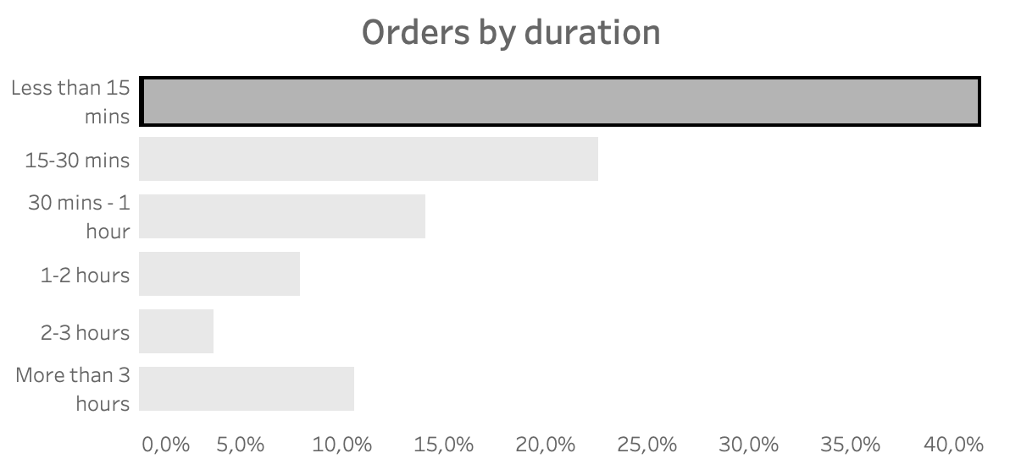
More Than 41% Of Orders Completed For Less Than 15 Mins

Slide 7
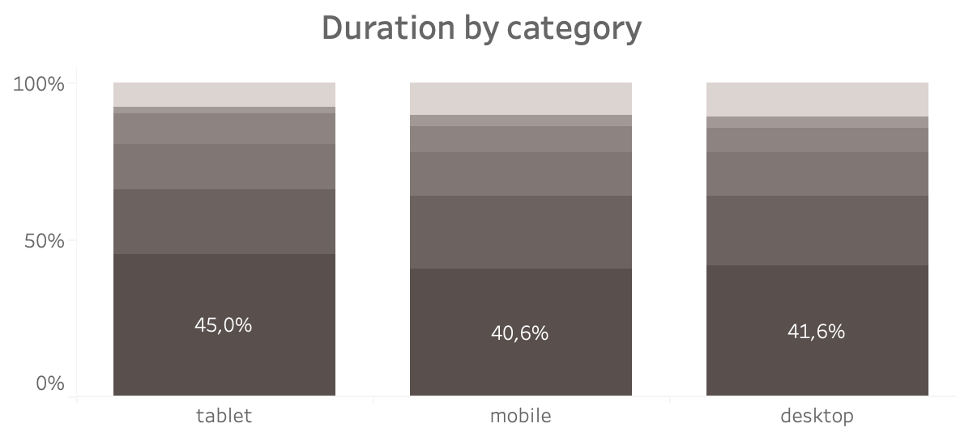
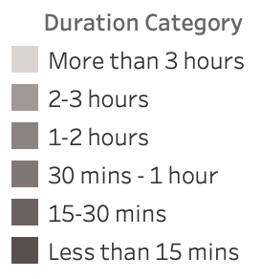
While Even More Orders Made On Tablets Are Completed Below 15 Mins (45%)

Slide 8
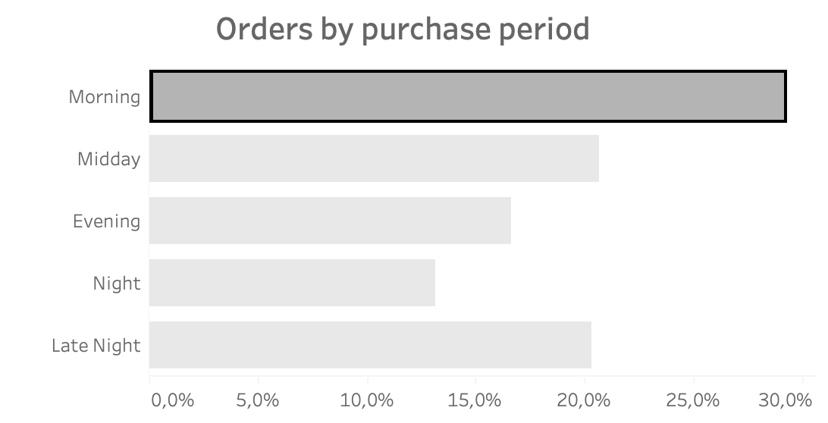
29% of Orders Are Made In The Morning 33% At Night And Late Night
29%

Slide 9
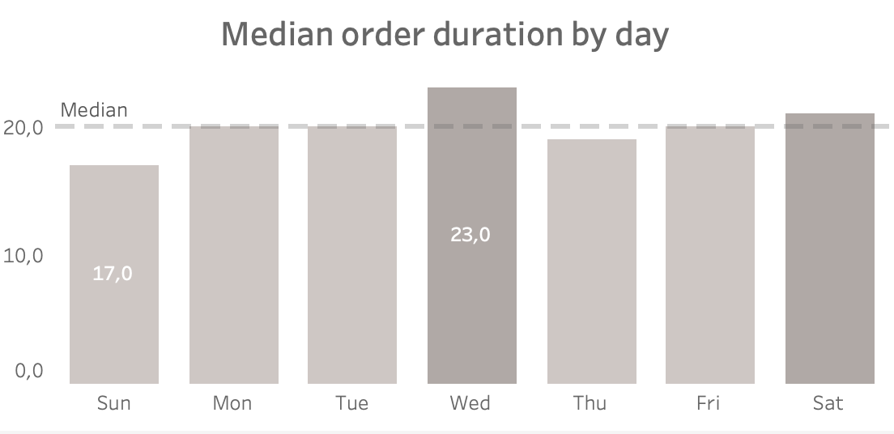
On Sundays Orders Are Completed By 6 Mins Faster Than On Wednesdays

Slide 10
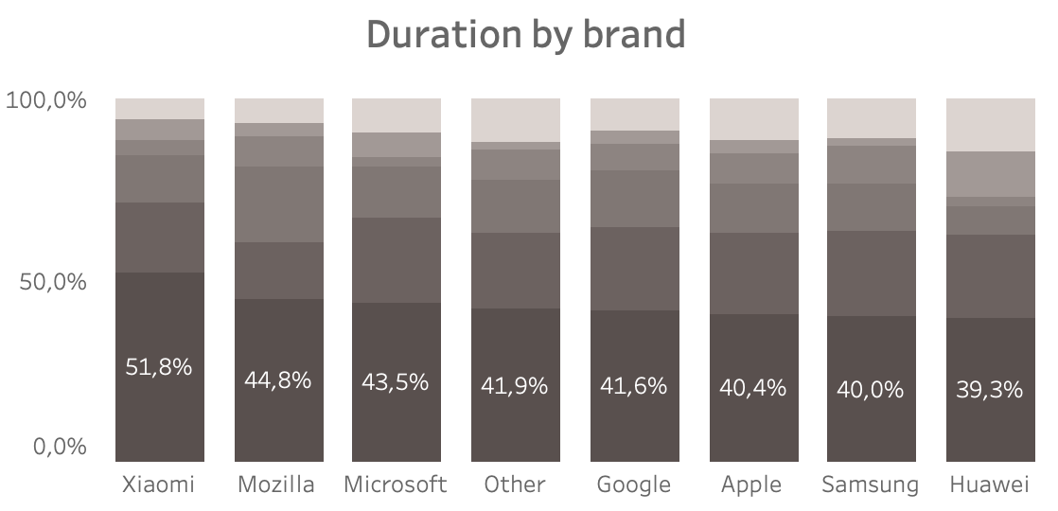
15% Of Orders Made On Huawei Devices Are Taking Over Three Hours

Slide 11
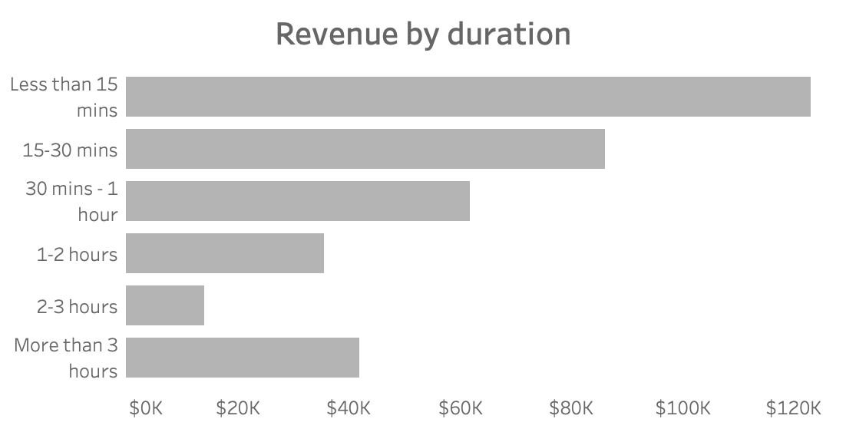
Revenue Generated From “Quick Purchases” Totalled 123K USD
123k

Slide 12
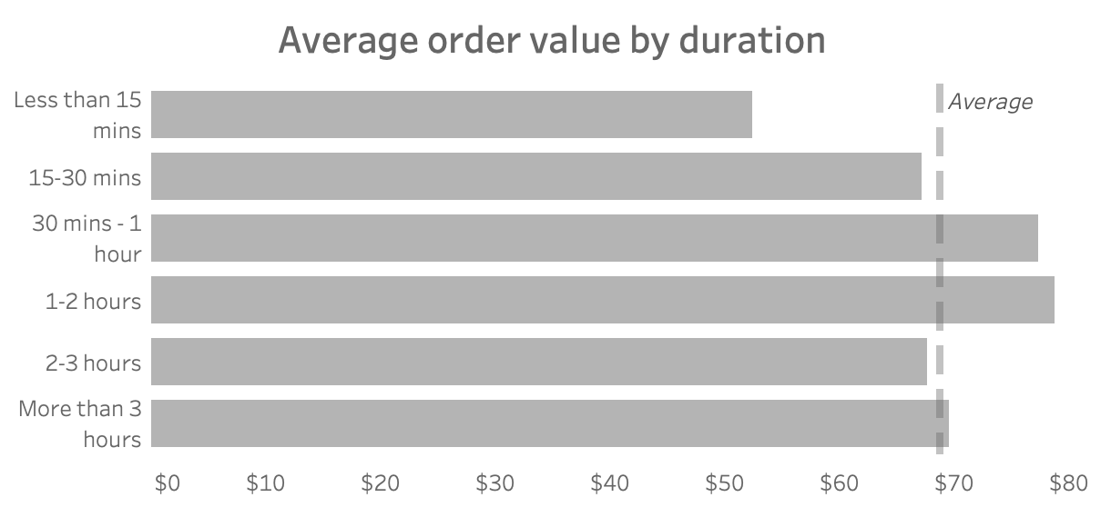
However, Quick Purchases Are Less Marginal
52$
79$

Slide 13
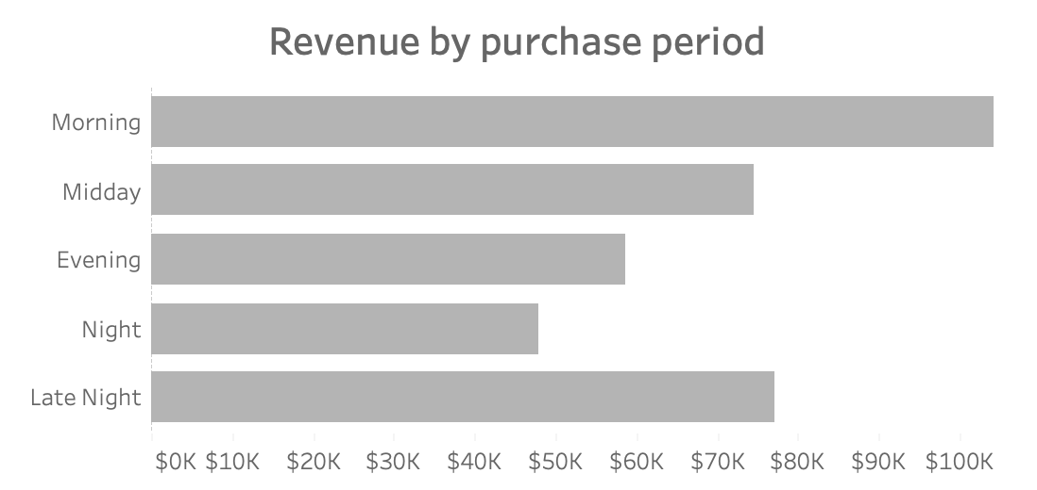
104k USD was spent in the morning over 3 months
104k
48k

Slide 14
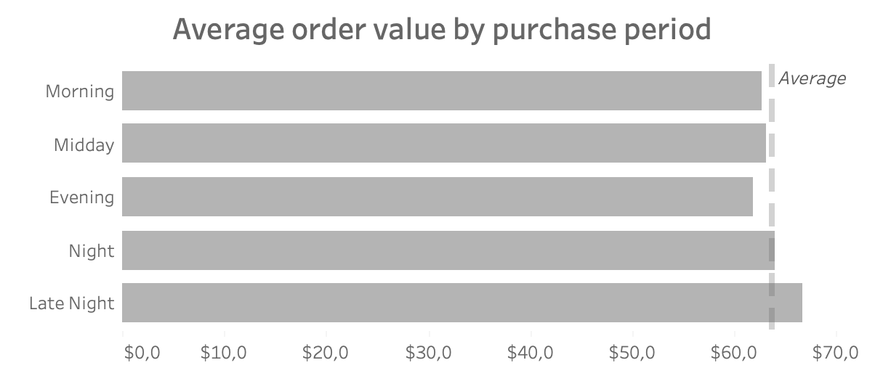
Late Night Purchases Are The Most Lucrative
66.7$

Slide 15
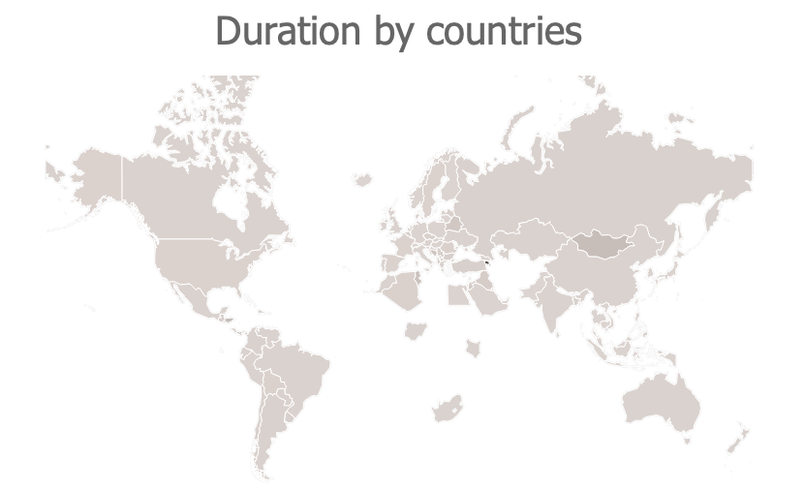
Orders In The US Are Completed Faster (19 Mins), Comparing To Canada And India (Both 21 Mins)
21 mins
19 mins
21 mins

Slide 16
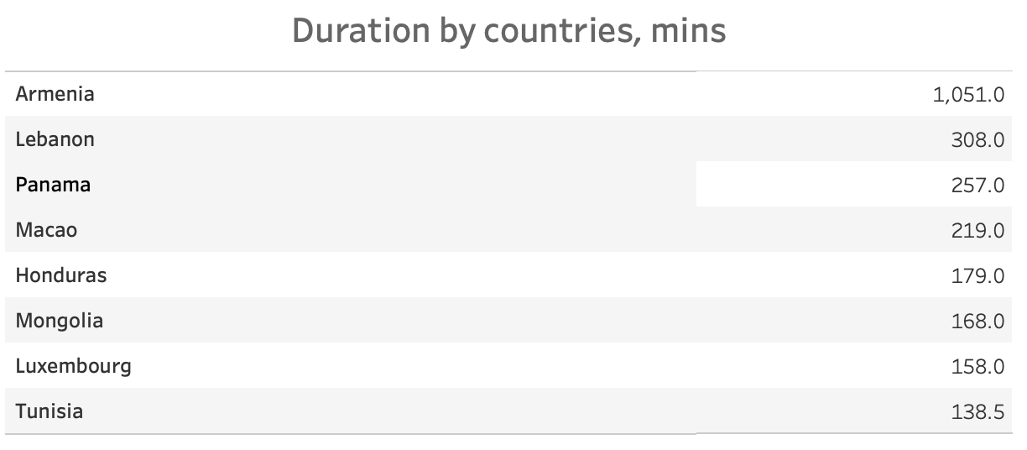
Orders in these countries are too slow

Slide 17
Recommendations
Enhancing Average Order Value for Quick Purchases:
Encourage higher-value purchases by offering personalized product bundles, implementing strategic upselling at checkout, and highlighting limited-time discounts to prompt larger transactions.
Optimizing Purchase Flow for Mobile Users:
Simplify and streamline the checkout process, reduce the number of steps required, and leverage single-click purchasing options to minimize friction for mobile transactions.

Slide 18
Recommendations
Engaging Users Through Timely Notifications:
Send follow-up notifications or emails within two hours of product viewing to re-engage potential customers, providing relevant recommendations or reminders for items in their cart.
Refining the User Journey for Apple, Samsung, and Huawei Users:
Create device-specific UX enhancements, optimize page loading speeds, and ensure seamless compatibility across these platforms to elevate the shopping experience.

Slide 19
Recommendations
Improve Sales Duration in Key Markets (Canada and India):
Tailor the timing and length of sales events to local purchasing behaviors, considering cultural and seasonal preferences to maximize engagement and revenue.
Improving the User Journey in Slower-Performing Countries via A/B Testing:
Conduct A/B tests across different stages of the purchase funnel to identify and address points of friction, refining the experience based on user behavior insights to enhance conversion rates.

Slide 20
THANK YOU FOR ATTENTION

