Slide 1
DB CENTER
Supervised By
Dr. Sultan Alqahtani
Ali Khalifaha Alhawas (439015852) - Coordinator
Abdulrahman Mubasher Alghurman (4380009996)
Nasser Hamad Alkhurayji (438011631)
Anas Eissa Alzhrani (438011286)
Nawaf Khalid Aldaham (439011864)

Slide 2

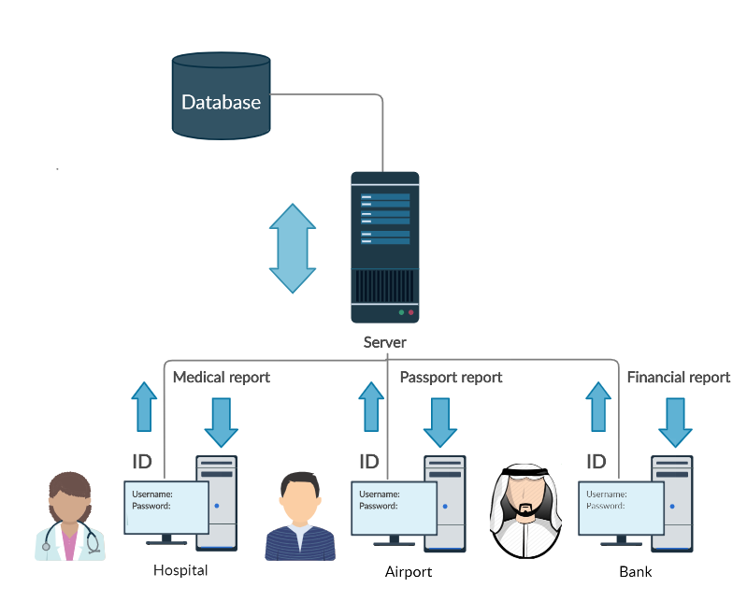
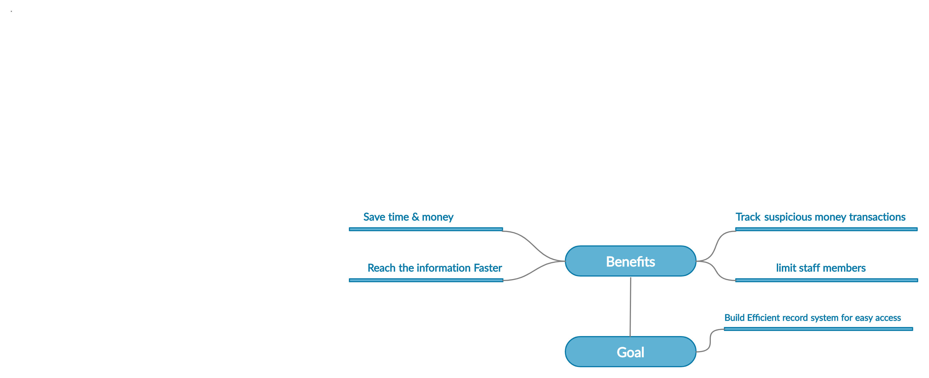
Introduction
The Main Goal of this Project is to Build a System that save and keep Track of all medical, financial, permanent record and Crash Reports. it will Gather all These Information in one system for The Each Department of the Government and Provide Them with Custom Report of the Information They Need. This project will save time in lines for the citizens and it will speed up the prosses in the visits in the government departments, Also It will save time for the government to focus on more things

Slide 3

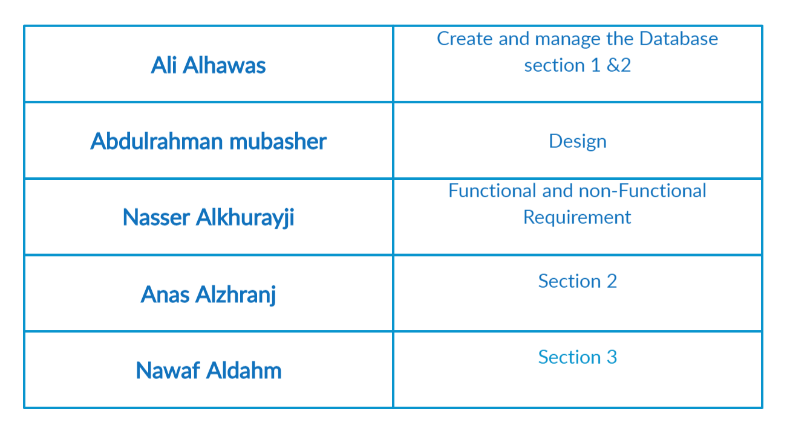
Roles and Responsibilities

Slide 4

Work Status We have completed the entire Phase 0 & 1

Slide 5
Work Status what we will be completed at this time is some improvements and changes in Phase 1 and we are expecting to start phase 2 which contains Use-case Diagram and the Class Diagram

Slide 6
Work Status We Need the Function and Non-Function Requirement for the Phase 2, it will make it easier to Create Class Method Descriptions and class Diagram

Slide 7

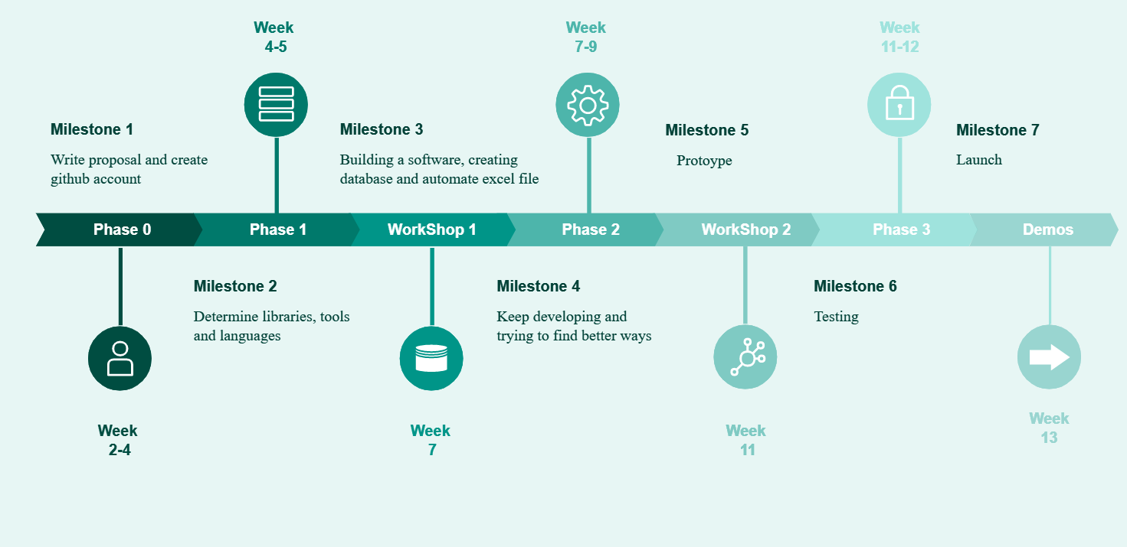
Project TimeLine

Slide 8

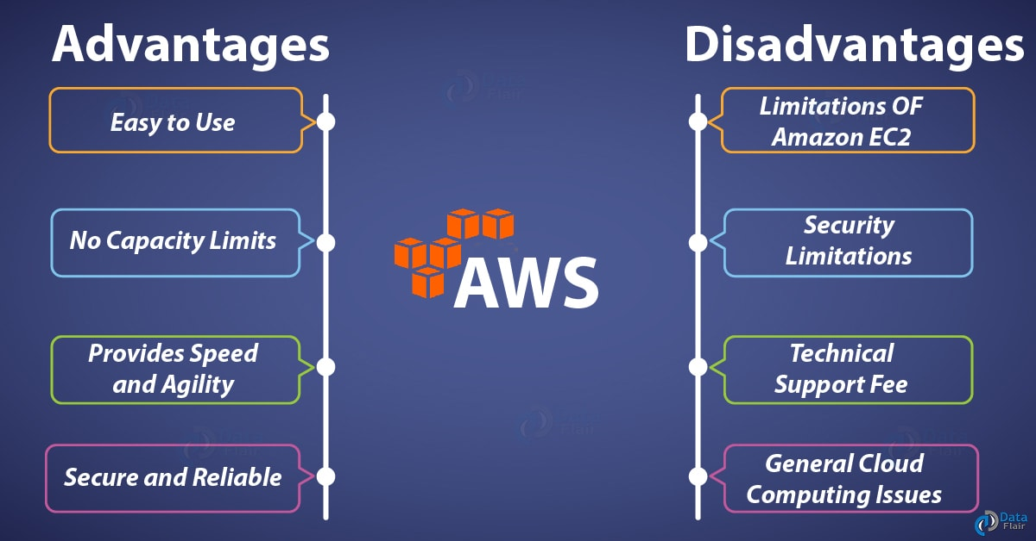
Problem Encountered
How and Where to put the servers
The Solution is cloud servers.

Slide 9
Conclusion The Main Goal of this Project is to Build a System that save and keep Tracking of citizen information and we are right on schedule with the Project TimeLine to achieve that, we will start building software and database every soon to stay on track with the timeline

