Slide 1
C++
Presentation
Ali Al Housseini - 5482
Dr. Jihad Fahes

Slide 2
Before starting
This program coded by C++ has many benefits like the arranging and the explanation.
The project is coded in 1210 lines using CODE::BLOCKS.
The program contains also the .txt files to understand the arranging of elements.

Slide 3
Contents
1
Location class
4
Inventory class
Informations about it.
All about the function of this class
2
Solid Product
5
Main function
How we have coded the S.P
The design of the main.
3
Liquid Products
6
The End
How we have coded the L.P

Slide 4
Location class
The location class contains:
Setters and getters.
Two private strings , block and shelf.
Any products (solid or liquid) usually will take the same location of its inventory automatically.
Noting that when you want to load informations to the program, you will enter only one location that would be the location of all the products…

Slide 5
SOLID PRODUCTS
Setters and Getters
Total_Price
isFragile
Constuctor
Destructor
The solid product is a class that contains on private , the id of the products, name, quantity on hand, and the price, and if it is fragile or not.
Don’t worry about anything, the program will detect automatically if an ID is already founded in another product ( solid or liquid ).
There are many functions in this class which is the same in the liquid class, i’ll talk about all of these briefly.

Slide 6
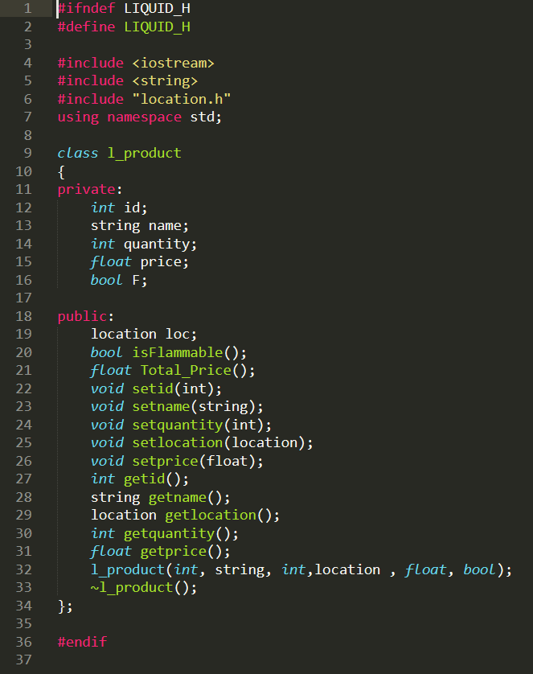
Liquid Product class
Same functions as solid product class
This class contains the same function of solid product but the difference is with the Boolean function that called in this class “isFlammable” to detect if it is flammable or not, there exist also a constructor that takes ( id,name,location,
price,quantity,if it’s flammable or not ) … And a destructor.
The special thing, is that the program detect if the product is a solid or liquid and if it is liquid , the quantity will be “amount” and the price will be “per litre”.

Slide 7
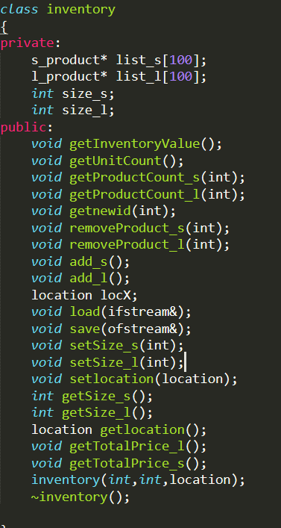
Inventory class
We can say, all the program is HERE!!
Because everything is related by this class.
The inventory class , contains as a private , two lists , one for the solid products, and the other for the liquid products, and two integers that represents the size of each list…
There are many functions in this list, first we can’t forget two talk about the setters and getters , that set and get the sizes of the lists..
The constructor that takes 3 parameters, size of liquid products, size of solid products and the location of the inventory…
Well, the user will be very happy using this program, because it contains many conditions for the mistakes of the user… for example, setting a negative id , or an id already setted….
Let’s talk about every function in this class….

Slide 8
The function load
This function of type void , is the most important part in the program, at first it should be to select the location of the inventory.
The user at first will input the name of the file that contains the products…
If the name of the file doesn’t exists, it can be re-enter it …
Now after selecting the file , the program needs to read all the informations in the file, noting that if any informations isn’t correct ( for example the id is a string ) , the program will detect this error and show a message…
But first of all, a message will be shown to the user to choose between (1/2 and 3)
The first choice is for the solid products, the program will put all the products at the list of solid products…
The same way for the second choice but it is for only liquid products…
WHAT IF MY FILE CONTAINS THE TWO TYPES ?
Don’t worry, the third choice will ask you before every product if it is solid or liquid ….
A message will be shown when the loading is complete
NOTE: If the inventory isn’t empty, don’t care , because everything will be stay saved !

Slide 9
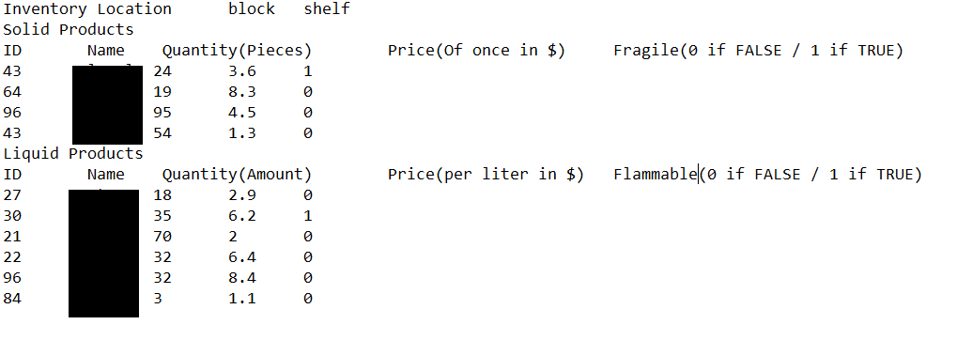
The save function
This function will print your products in the inventory…
It will print at first the location of the inventory.
Then the solids products
( id, name ,quantity ,price , 0 or 1 for fragility )
And finally, the liquid products at the same way.

Slide 10
Adding Functions
There exists in this program two adding function, one for adding a solid products,
And the other for the liquid products…
The functions will detect if an entered ID is already exist.
You can after adding your product check the new form of your products using the function save.
These functions give you another way to adding a product, is with randomly generates the new id , you can choose to input the id manually or getting it randomly.

Slide 11
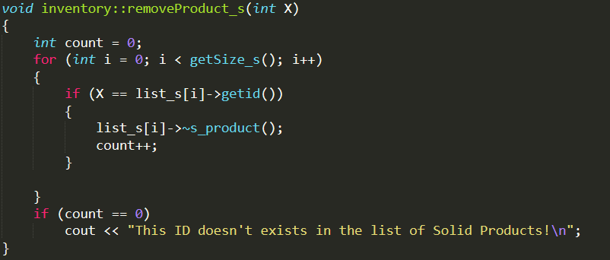
Remove Functions
We have also two functions, one for removing a solid product and the other for a liquid product…
If the ID for removing doesn’t exist, a message will be shown to the user.
You can check if the removing is completed by using the save function.

Slide 12
Get New ID
You can change the id of a product by selecting the old id….
The program will find automatically if it is a solid or liquid product…
If the id doesn’t exist, you will write the id again…
And if the new id is already exist, you will choose another ID.

Slide 13
Other Functions
Meet our awesome members…
Get Inventory Value
Get Unit Count
Get Product Count (S/L)
This function calculates the value of the inventory
This function will show the user the quantity of all the products in the inventory, in the same time, the count of solid products , and the liquid products.
This function will show the user the quantity of a SOLID OR LIQUID product, the user will be select the product by it’s ID.

Slide 14
The main function
3
The number 0 is used if you have finish to use the program.
Third note
2
Some functions can’t be used directly, if the inventory is empty, so don’t worry , the program will return you to the main.
Second note
1
You can choose a number between 0 and 14 ...
Every number represents a function that you can use it.
First note

Slide 15
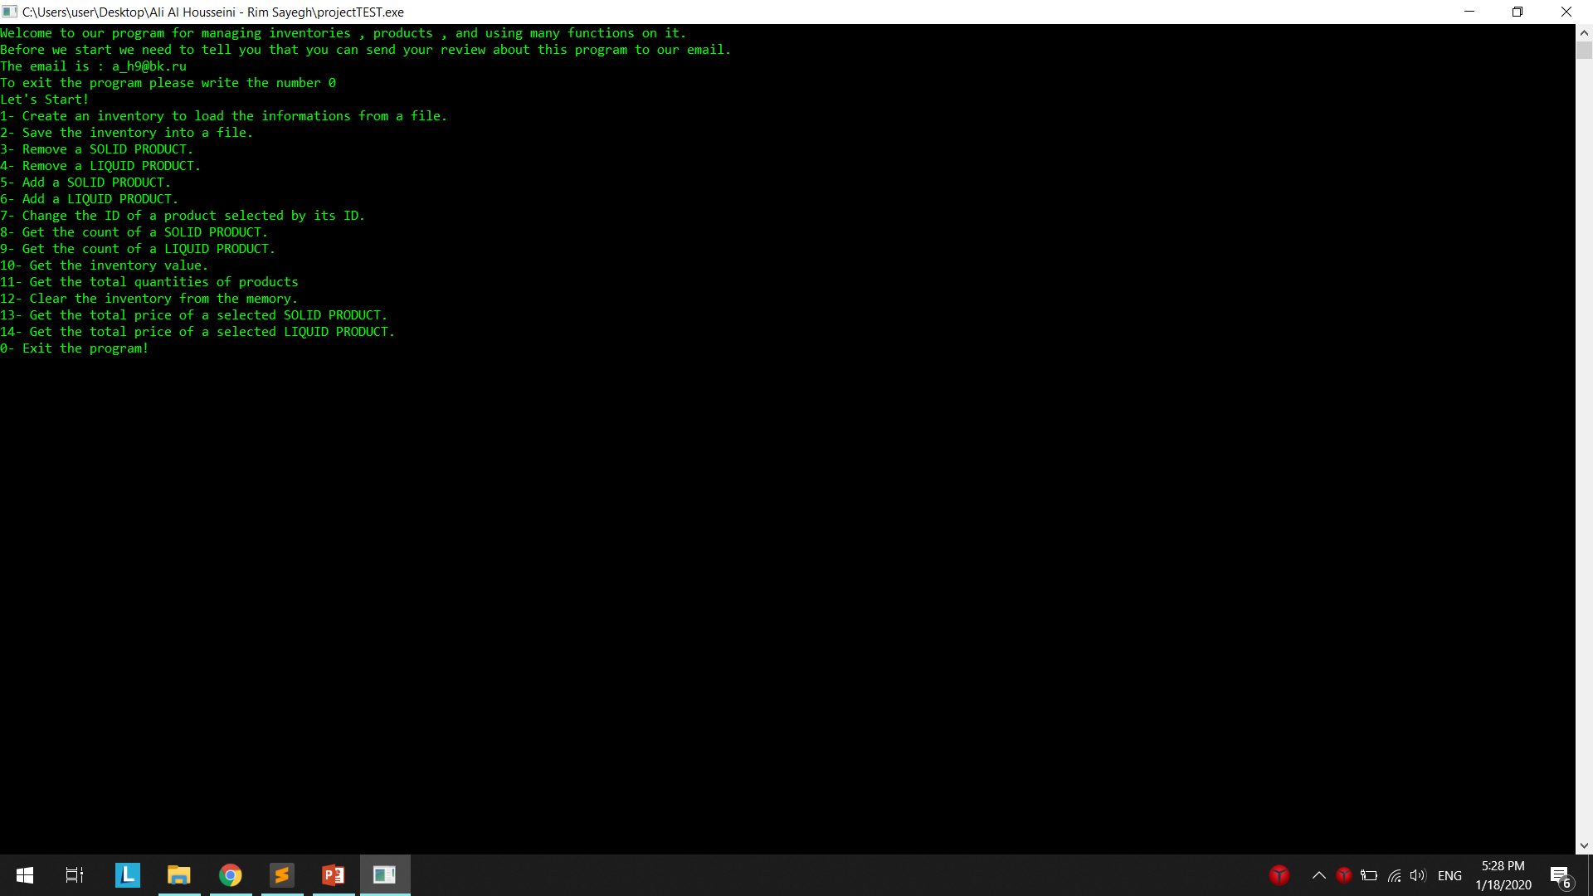
The output
This is what you will see when you use the program…
ENJOYING IT!

Slide 16
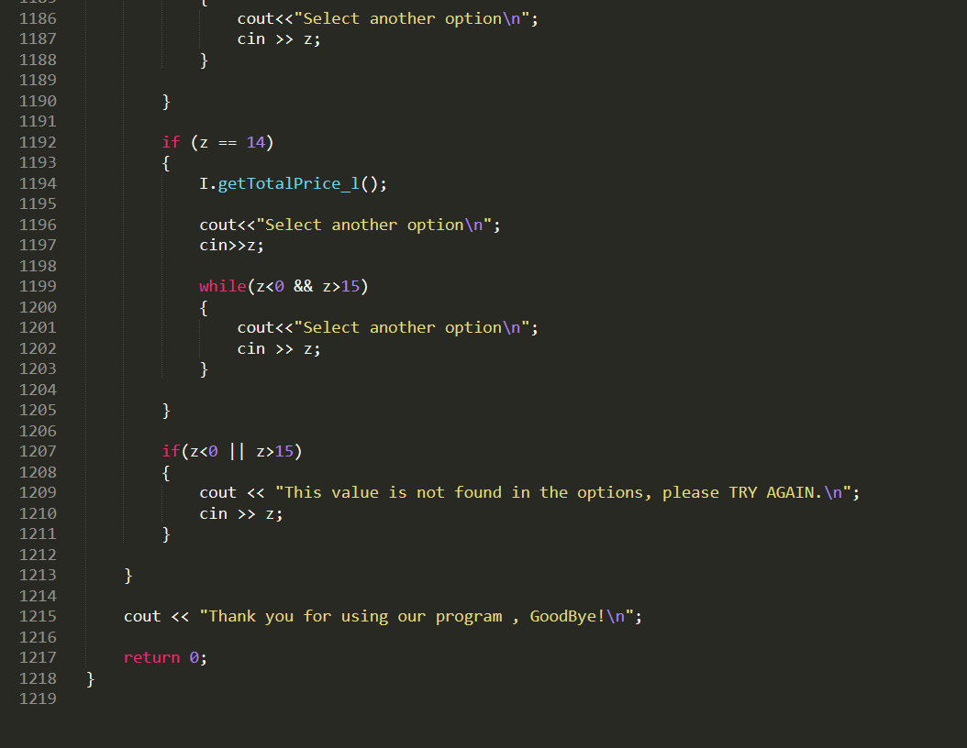
THE END…
Presentation of C++ Project
Dr. Jihad Fahs
Ali Al Housseini – 5482

