Slide 1

GIT 2
Ali Al-khaz’aly

Slide 2

Todays Goals
SHOW MY BUG, OMG
Show added slides to clear things up
Git branching
Git conflicts
Integrating git into eclipse and doing some work with Java if we have time
www.pages.cpsc.ucalgary.ca/~ali.alkhazaly/SENG300
ali.alkhazaly@ucalgary.ca

Slide 3
What was wrong?
When you first use git, it prompts you for a username and password, and stores that and then repeatedly uses it after that
I made a new account for GIT to use for tutorials, but my git credentials was based on the old one
So it was using the credentials it had from before to authenticate me, and thus was giving me the error
Notes:
Tell them how you need to be accepted as a contributor on a project before you can actually make changes, and that’s why it was rejecting.
Imagine if anyone could make changes, that would be chaos

Slide 4
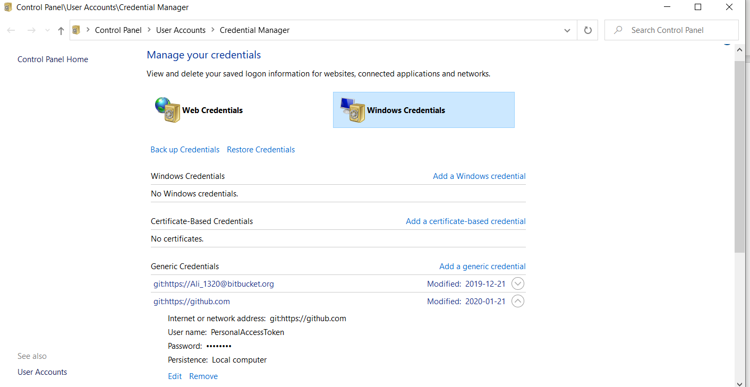

Slide 5
Other things to Know
These windows computers:
Hide hidden files
Hide extensions
Have weird storage directories
Suck
In short, they suck for CPSC majors. They’re okay for non-CPSC majors taking classes like CPSC 217
My suggestion:
Uses your personal computers
Use the linux computers

Slide 6

Remote Repo
To set the remote repo you will be storing your project on
git remote add origin <remote url>
To remove a remote: git remote remove <remote name>
To check a remote: git remote -v

Slide 7
Ali’s Analogy UPDATED
How to make a change in life :
Get on the stage -> git add
Commit yourself to the act -> git commit
Do (Push) the act -> git push

Slide 8
Adding / Removing files from staging area
git add . (. means everything)
git add <fileName>
git reset . (. means everything)
git reset <fileName>

Slide 9
Commit
Commit changes to be sent to the remote repo, after theyre staged
Git commit –m “<commit message>”

Slide 10
Cloning
Say you are a programmer who recently joined a project which is already in progress and you want to get the code off github:
git clone <directory> <directory> is usually the weblink to your project

Slide 11
Push
Initially you must define that you are pushing to the master branch
For the first push:
git push –u origin master
Afterwards it will assume the branch and you can do:
git push

Slide 12
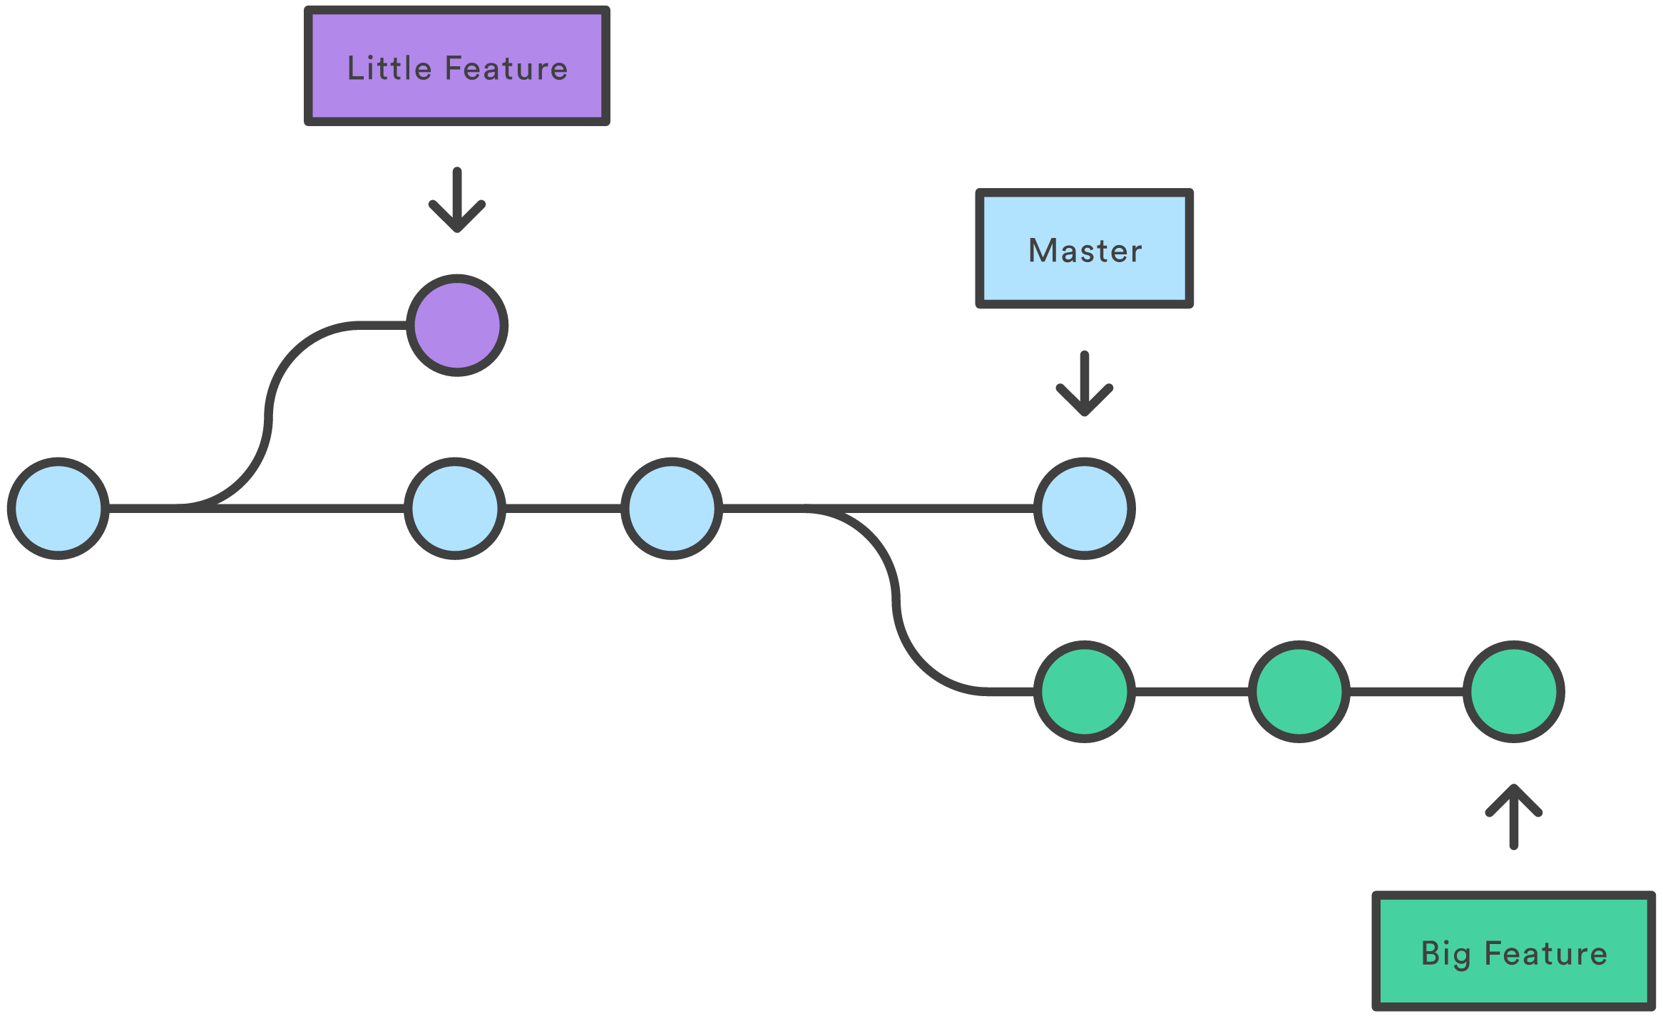
Git branching
Image courtesty of https://medium.com/mindorks/what-is-git-diff-git-branch-4bd9890d68b0
Notes:
At any one time you can be at the front of any branch.
Say youre working on implementing a new feature on a project, and then you get a report from a user that they want a bug fix done on the stable master branch, you can very easily switch to the master branch and do the fix, then return to the new feature branch. This is the versatility that git brings.

Slide 13
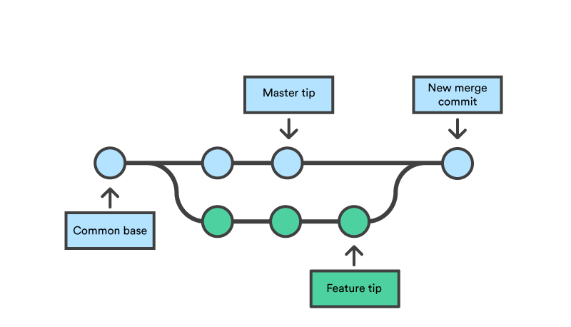
Git merging

Slide 14
Now let’s try branching

Slide 15
Branching Commands
git branch newBranch - Create a new branch locally
git checkout newBranch - lets move our head to the branch
git push origin –u newBranch - push the new branch to the remote repo
git checkout master - Lets move our head to master
git pull origin master - make sure we have the most recent version
git merge newBranch - Merge the newBranch in with master
git push origin master - Now make the remote repo do the same
git branch –d newBranch - Delete the branch locally
git push origin –-delete newBranch - Delete it on the remote repo

Slide 16
Quiz Information

Slide 17
Conflicts
Imagine one java application that two people are working on:
First Version:
public static void main(String[] args)
{
System.out.println(“Hello World!”);
}

Slide 18
Second version:
public static void main(String[] args)
{
System.out.println(“Goodbye Cruel World!”);
}

Slide 19
How will the conflict be resolved?
First person to commit their changes is fine and has no issues to deal with
Second person will need to resolve the conflict before his changes can be made

Slide 20

Conflict Demonstration

Slide 21
How Conflicts get laid out
<<<< HEAD
YourCode
====== (Seperator)
TheCodeYoureConflictingWith
>>>>> SHA6 id of commit youre conflicting with
Notes:
After resolving conflict: Do git add .
Git commit –m “commit message”
Git push

Slide 22
intro to Eclipse

Slide 23
Next Tutorial
Either quizzes, or
Eclipse Introduction
Eclipse Debugger
Basic java project in eclipse

