Slide 1

SENG300 – T10
Ali Al-Khaz’Aly

Slide 2

Todays Goals
Introduce Myself
Introduce SENG300
Get started on git
File state, pushing, pulling, seeing differences
If we have time, git cloning

Slide 3

A little about me
Family
My Sisters
My parents
My Origin – Iraq
Interests:
Teaching
Gaming
Age of the Empires 2
20 years old, and still being widely played

Slide 4


My Research
Keras, Tensorflow
Retinal Imagery
Biomedical technology

Slide 5
Now that you’ve seen my Interests,
What are your interests in computer science?
How many of you want to:
1. Work for a company
2. Have your own tech Startup
3. Stay in Academics
4. Do something else?

Slide 6
Administrative Stuff
How to contact me:
By Email: ali.alkhazaly@ucalgary.ca
Office hours on request
Only reachable by email
Quick Response
My Website:
https://pages.cpsc.ucalgary.ca/~ali.alkhazaly/SENG300
Will post slides, and the work that we do on the website

Slide 7
My Opinion on SENG 300
Based on what I have seen
Easy Concepts, lots of work
Keep on top of it, make a habit of reviewing every weekend
Great Professor
This course is based on procedure, NOT ON CODE
Don’t think that because you’re an amazing programmer you’ll be amazing at this course
I don’t suggest going code-crazy with the project

Slide 8
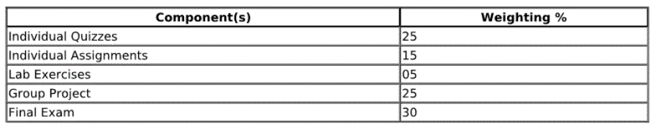
Tutorial Purpose, Importance
Attendance is not mandatory, but will be mandatory somedays

Slide 9
Lets GIT started

Slide 10
Motivation
How do we program as a group? How do we ensure that we can maintain the same version across all devices? How does one person make changes without messing up the changes of another person?
How do we ensure code quality on changes that programmers make?
The Answer is Git version control, this is industry standard!
Notes:
Our

Slide 11
The Main Ideas
All programmers can access the remote version of the project (which is usually the stable one)
Programmers have a local version of the project on their devices that they can work on
To make changes to the remote version, you must sync up to the remote repository, get your local version up to date with it
pull before you push
This is where you will eliminate conflicts

Slide 12
Now let's see this for ourselves
Notes:
2 Cases:
Where we create a repo on github
rm –rf .git is SPECIFIC FOR LINUX
SHOW GIT IGNORE
Do some git status stuff
Good practice is to make small commits that help us to keep track of changes as they occur.
Git branch is how we tell the branch and all the branches

Slide 13
Remote Repo
To set the remote repo you will be storing your project on
git remote add origin <remote url>
To remove a remote: git remote remove <remote name>
To check a remote: git remote -v

Slide 14
Ali’s Analogy
How to be successful in life:
Get on the stage -> git add
Commit yourself to the act -> git commit
Do (Push) the act -> git push

Slide 15
Adding / Removing files from staging area
git add .
git add <fileName>
git reset .
git reset <fileName>

Slide 16
Commit
Commit changes to be sent to the remote repo, after theyre staged
Git commit –m “<commit message>”

Slide 17
Push
Initially you must define that you are pushing to the master branch
For the first push: git push –u origin master
For all pushes afterwards you can do either the same or : git push

Slide 18

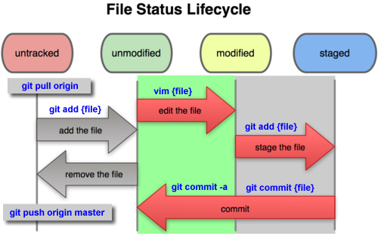
Staging Area – Like a prep area for your commits, its where you can fine tune and change your commits before they’re committed Your files will always be in one of the 4 below states, and to check the state of your files, simply type “git status” Difference between untracked and unmodified? – Was it found in the last commit? If it wasn’t then its untracked as of now.

Slide 19
Good to know
Git diff – shows difference between last commit and current working tree
.gitignore file – Lists files that you do not want to be tracked and pushed to the repo
Git status – Shows the staged changes and current directory status

Slide 20
Next Tutorial
Git in Eclipse
Branching
Conflict Resolution
Possibly Pull Requests???

