Slide 1
What is a flag for? Social media reporting tools and the vocabulary of complaint
Presented by Ali Alkhatib to the Reading With Friends* group
April 6, 2015
*open to new names
Crawford, Kate, and Tarleton Gillespie. "What is a flag for? Social media reporting tools and the vocabulary of complaint." New Media & Society (2014): 1461444814543163.

Slide 2
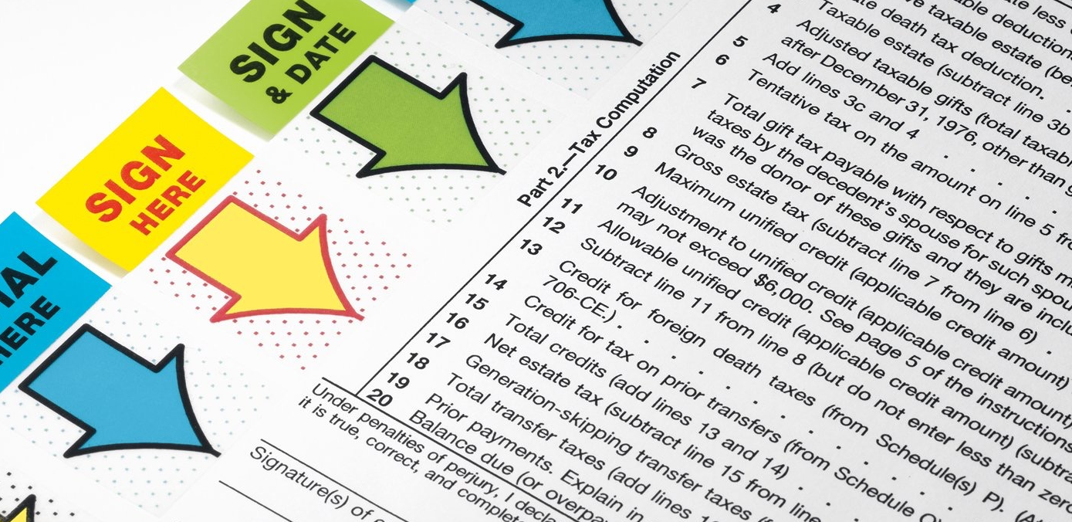
Background on Flags
Historical meanings: military, nautical, nationalistic, bureaucratic
Bureaucratic is what we’re interested in here
There’s some interesting historical trivia in the paper if you have time for that sort of thing, but we don’t

Slide 3


Flagging in online communities
Great way to moderate massive scales of user-generated data
Youtube: ~300 hours uploaded/minute
Approximate length of this video
Great solution to scaling moderation problems
Good pretext to curate site in seemingly legitimate way

Slide 4
Flagging in CSCW/HCI research
Gives insight into taboo topics (what’s flag-worthy)
obviously no media here
“…complex interplay between users and platforms…”
diverse audience + shared cultural objects = disagreements
Makes algorithmic sense about nuanced social transgressions

Slide 5
Variations in approaches
Entirely or partially crowd-driven?
Facebook uses reviewers and flagging in tandem
Youtube and Twitter rely exclusively on flags
flag content vs flag user
Expressiveness?
single-bit (“I object”)
more expressive (“This post has (spam|harassment|trolling|a disquieting parallel to Foucault’s panopticon) in it.”)

Slide 6
Circumstantial policies
Your specific circumstances should guide your flagging paradigm
Facebook was criticized for being unresponsive; flagging support dashboard was a tactical response to that criticism.
YouTube created its own list of “super flaggers” - people whose flags are worth more than others
Flickr asks users to self-report (safe, moderate, or restricted), and patrols ratings, not content per se

Slide 7
Flagging paradigms differ according to space
Flickr raciness
YouTube’s genres of bad content
NYT’s “values of proper debate in news spaces”
Vine: binary
Ultimately, an objection, but little to no degree of concern or context of complaint
No discussion of concern among community

Slide 8
Flagging is thin on meaning Maybe that’s a good thing?
Regulation is messy
Opacity means less controversy if admins ignore a flag for widely criticized, but valuable content
Also means they can remove content (even if not flagged) and claim it was requested by the community

Slide 9
Legal stuff
DMCA
Don’t really want to talk about this much, does anyone else want to?
No? Great

Slide 10
Non-flaggers
Some people just don’t care
Like me, at this point in making slides
Just kidding, I’m having fun
Some users don’t know that they’re expected to flag
Some think someone else did it
Some think it’s offensive, but that the content nevertheless has value

Slide 11
Gaming flags
Flag bombing
Pranks
Social commentary, e.g…
mass flagging of pro-gay groups on Facebook
mass flagging of pro-Muslim content on YouTube
“user-generated warfare” (quoted from Fiore-Silfvast, look it up)

Slide 12
Alternative suggestions?
Flagging as a(n automatic) prompt for debate or discussion
A flag generates a thread for referendum
Community consensus
Wikipedia strives for this, as does Reddit
Wikipedia is more agonistic than consensus-driven
League of Legends - “The Tribunal” for frequent players

Slide 13
Thanks you were all great
Or not but probably yes great
There’s more if you didn’t get to read it, in particular:
the anecdotes on gaming and mass flag-bombing
More in-depth theory/history on flags and flagging
More exploration of a social model for flagging

