Slide 1
Step 3 — Fusion (AGAF)
What we tested on the ToN-IoT graph, and what it told us
Short version: the fusion is not the problem — the data at this level of aggregation is.
6 findings · 5 fusion designs · 3 random seeds
Notes:
Goal of this deck: explain in plain language what the fusion step does, what went wrong, and why the honest conclusion is a negative result.

Slide 2
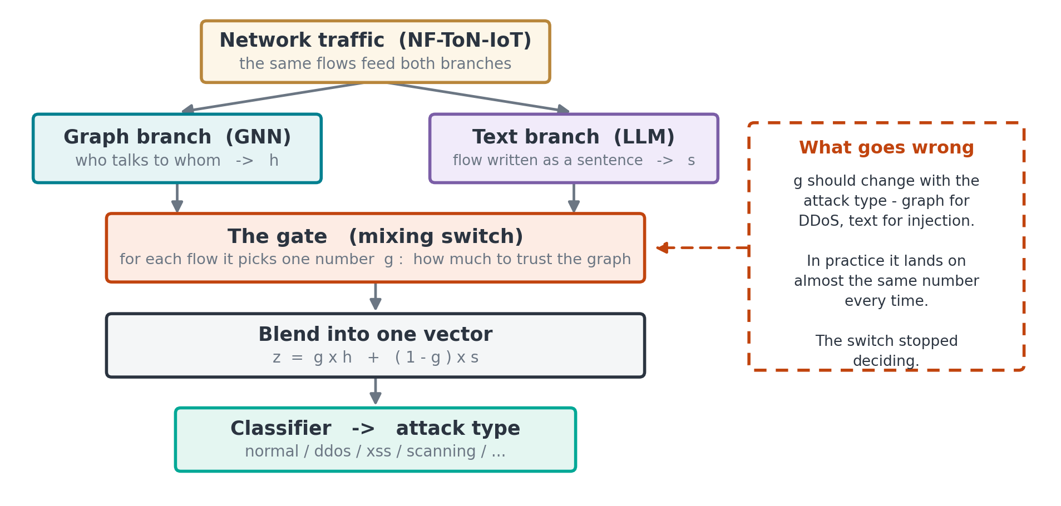
How our fusion works today
Two views of the same traffic, mixed by one learned number, then classified
Notes:
Walk the instructor down the diagram: same flows -> graph view and text view -> the gate decides how much to trust each -> blend -> classify. The gate is the part that is meant to be clever, and it is the part that failed.

Slide 3
Finding 1 & 2 — fusion helps the rare attacks, but the switch froze
1
Fusion helps where it matters
2
The switch stopped choosing
Fusion works. It raises macro-F1 from 0.340 to 0.445.
The gain is concentrated in the rare attacks.
scanning 0.12 → 0.39, xss 0.06 → 0.22, password 0.09 → 0.33.
It should say: trust the graph for DDoS, the text for injection.
Instead it gives almost the same answer to every attack type.
It settled on one fixed setting for everything.
0.340
0.445
3×
0.72
0.38 – 0.48
same
GNN alone (macro-F1)
GNN + LLM fused
rare-class F1 gain
accuracy (down from 0.80)
gate value, all classes
DDoS and XSS treated alike
Fusion trades bulk accuracy for rare-attack recall — which is the trade we want.
Finding 2 caveat: our loss contains a term that rewards a balanced gate (λ=0.01). Part of the freeze is self-inflicted. Not yet re-run with it off.
Notes:
Finding 1: the ladder is broken - AGAF sits below the GNN rung. Finding 2: the gate collapsed to a constant.

Slide 4
Finding 3 & 4 — the switch earns nothing
3
The switch does no work
4
The repair we expected to work did not
We removed it and simply handed both sources to the classifier.
The score did not move.
So the gate is decoration — it is not earning its place.
We thought the two sources speak different numeric 'languages'.
So we added an alignment step before mixing (from the literature).
It made results worse. Our diagnosis was wrong.
0.393
0.391
0.347
0.298
plain concatenation
our learned gate
with alignment, low
with alignment, high
Difference between gate and no gate: 0.002 — nothing.
Notes:
Finding 3: gate vs concatenation is a 0.002 gap. Finding 4: the DCVD-style alignment loss hurt at both lambda settings.

Slide 5
Finding 5 & 6 — the differences are just noise
5
The gaps we measured are not real
We tested five fusion designs, then repeated each with three random seeds.
One design won, then lost, then won again — same data, different seed.
Randomness moves the score more than the design does.
6
The cause is the data, not the design
Some attack types appear only a handful of times in this graph.
ransomware 3 edges · dos 4 · xss 12 · scanning 13 · backdoor 16.
One wrong prediction swings the whole score.
Swing across seeds: 0.114. Best gap between methods: 0.048.
The noise is bigger than the effect.
Notes:
Finding 5: seed variance beats method variance. Finding 6: rare classes are tiny, so a couple of edges decide the score.

Slide 6
Conclusion
We built five fusion designs from the literature and tested them on the ToN-IoT aggregated graph. None of them can be told apart, because random variation on this graph is larger than the difference between the methods. The limiting factor is the strength of the structural branch, not the fusion mechanism.
1
Why it still counts
2
What it protects us from
3
Where effort goes next
We now know the gate adds nothing — we could not have known without testing.
Any improvement reported on this graph would not be trustworthy.
Make the graph branch see more, so the fusion has something worth weighing.
Honest note: two of our predictions were wrong — the alignment loss hurt, and the self-attention win was seed luck. Both are recorded as measured. A negative result is only embarrassing when you find it after publishing.
Notes:
Close on the framing: this is a real, useful negative result and it points the next step at the structural branch.

