Slide 1
Munaafa.ai
Stock Market Portfolio Builder

Slide 2
PURPOSE OF THE PROJECT
Munaafa.ai is a modern way of investing that leverages artificial intelligence to make investment decisions that are optimized for maximum returns.
High Active Fund Managers Fees
Management, administration, custodian fees associated with managing equity funds
Growth Potential
Only 0.1% of the population invests in stocks. Automated stock investment can increase market cap significantly.
Low Saving Rate/ High Spending Rate
The gross national savings rate in Pakistan was as low as 3.8% of the GDP in June 2022

Slide 3
Methodology of Data Collection and Cleaning
01
DATA RESOURCES
Historical price data, stock exchanges, financial websites
02
DATA ACQUISITION
We acquired stock data of 8 US companies in the form of historical stock data
03
DATA PREPROCESSING
Handling missing values, removing duplicates

Slide 4
Types of Predictors Used And Reason
Our initial approach utilized 44 predictors that were broadly classified into following categories on the basis of their nature:
Price and Volume: 25%
Moving Averages and Exponential Moving Averages: 20%
Technical Indicators: 30%
Lagged Features: 15%
Other Features: 10%
Problem: Low accuracy of results

Slide 5
Feature Engineering
Combining Predictors
Performing mathematical operations to aggregate predictors e.g RSI (Relative Strength Index) is computed as :
Creating Interaction Terms
Recording the combined effect of two or more predictors in a feature e.g ForceIndex1 is computed as:
RS = Average Gain / Average Loss RSI = 100 - (100 / (1 + RS))
ForceIndex1 = (Close - Close_previous) * Volume

Slide 6
Use of Machine-Learning Models And Methodology
We used Ensemble learning to train our model , and one with maximum accuracy was selected by Voting classifier
There were 8 files from US stocks and each file contain >3000 entities
We kept files in google drive to read it quicker
85% of data has been used to train the model and 15% is used to test the model.

Slide 7
Classifiers used in Model (Ensemble Learning)
AdaBoost Classifier
-> N_estimator =10 (Less accurate but less likely to overfit)
SVM
-> Linear SVM 40% accuracy
->Sigmoid SVM 80% accuracy
Random Forest Classifier
-> N_estimator =50 , Max depth = 5
DecisionTreeClassifier
-> K_neighbourrs = 20

Slide 8
Classifiers used in Model (Ensemble Learning)
5. KNeighborsClassifier
-> K_Neighbors = 20
6. GradientBoostingClassifier
-> N_estimators =100
7. MLP Classifier
-> Activation Function = Logistic (Sigmoid)
-> Hidden Layer (100,50)

Slide 9
Stocks Used in Portfolio Building
APPL (Apple 31.912%)
GE (General Electric 1.272%)
GOOGL (Alphabet Google 17.663%)
GS (Goldman Sachs 1.251%)
IBM (1.313%)
MSFT (Microsoft 27.084%)
TSLA (Tesla 6.198%)
AMZN (Amazon 13.306%)

Slide 10
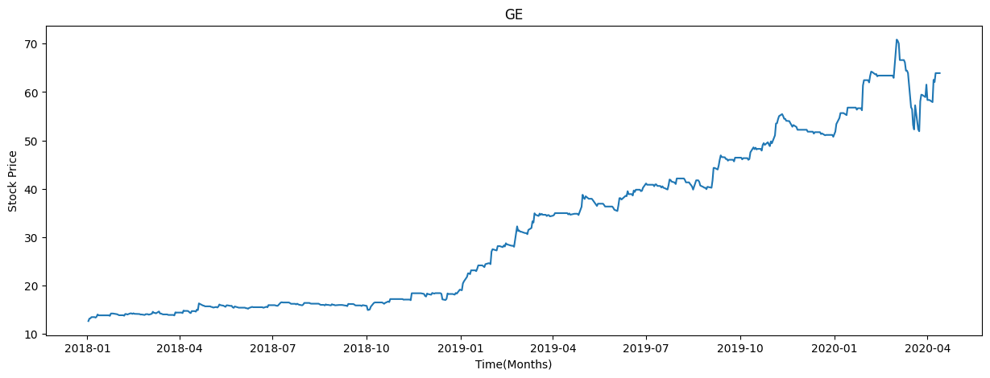
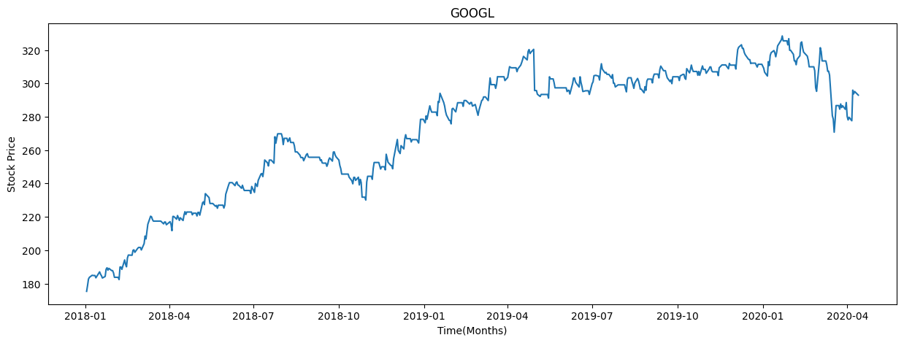
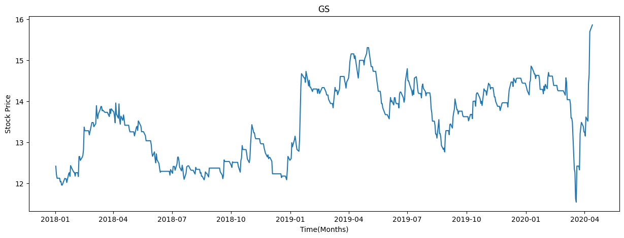
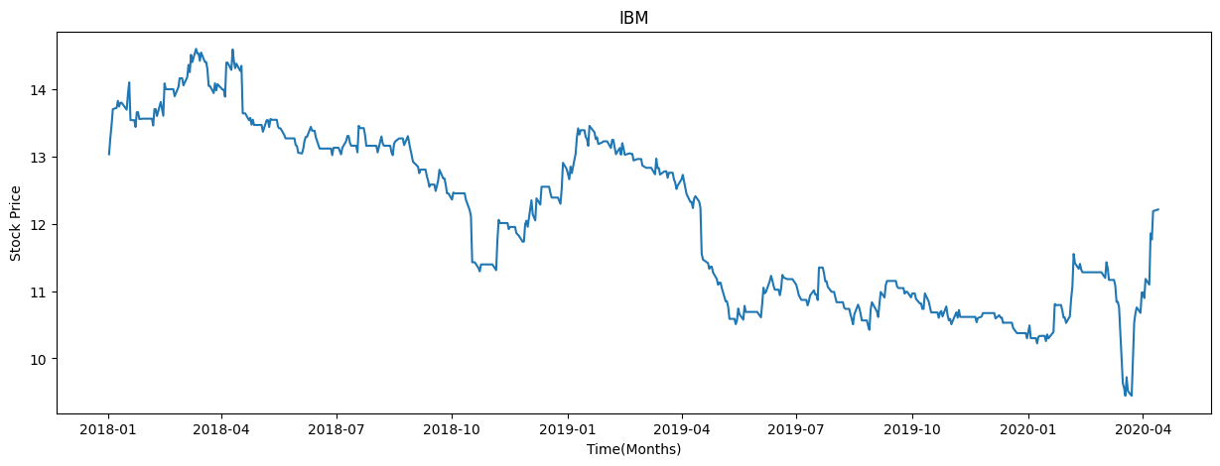
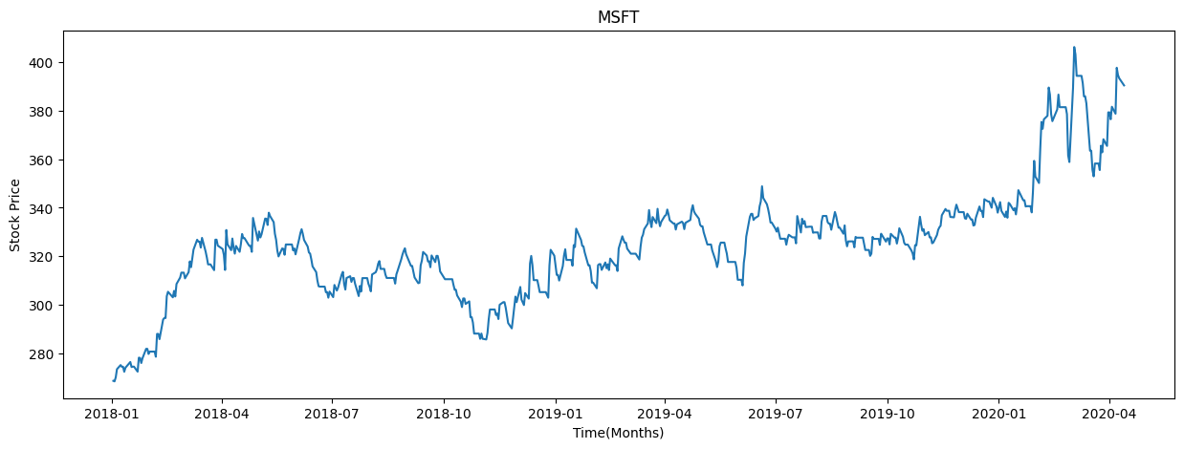
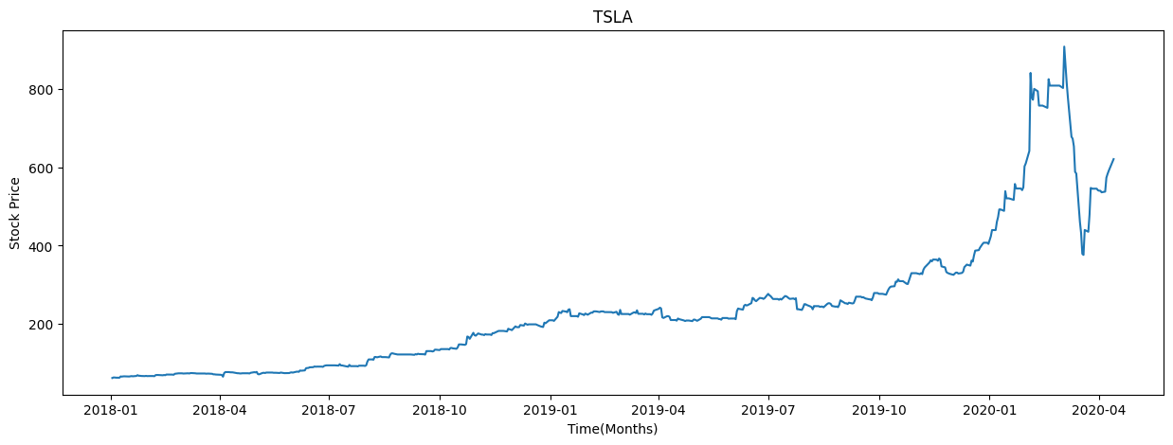
Results of the Project
Graphs of All Stocks in the portfolio:
APPL
GE
GOOGL
GS
IBM
MSFT
TSLA
AMZN

Slide 11
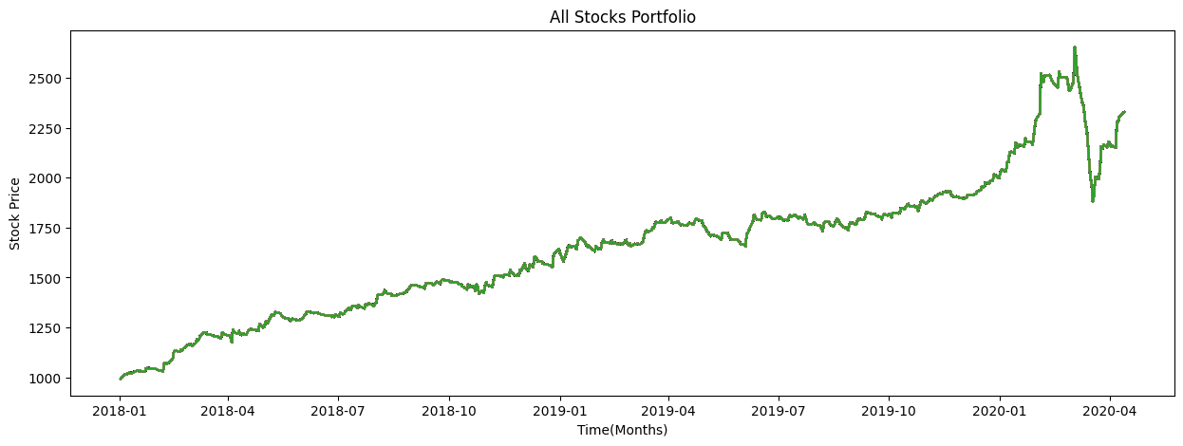
Portfolio Graph
The graph shows the graph started at $1000 at start of January-2018.
The AI per day generated buy/sell signal each day till June-2020.
The above graph maps the price fluctuation plotted for each day market value of the shares in the portfolio in that time period.
Total Produced By Stocks(Normal Trade):$ 1631.33831
Total Produced By Stocks(AI Trade):$ 2327.233
Difference In Performance: 44.66 %.

Slide 12
Metrics of the Project
Stocks | Accuracy | Precision | Recall | F1 score
APPL | 81.25% | 81.22% | 81.21% | 81.22%
GE | 83.98% | 83.62% | 83.81% | 83.70%
GOOGL | 82.68 % | 82.68 % | 82.68 % | 82.688 %
GS | 82.86 % | 82.92 % | 83.03 % | 82.84 %
IBM | 85.98 % | 85.978 % | 85.98 % | 85.97 %
MSFT | 84.29 % | 84.294 % | 84.28% | 84.28 %
TSLA | 83.06 % | 82.244 % | 83.58% | 83.06 %
AMZN | 83.29 % | 83.29 % | 83.32% | 83.28 %

Slide 13
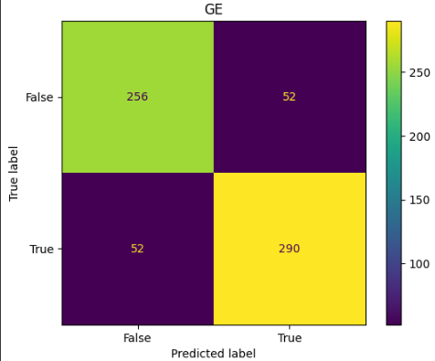
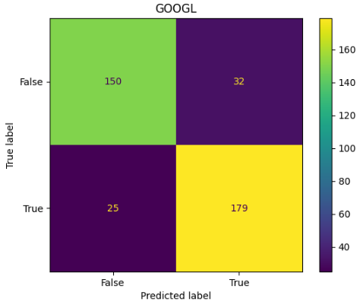
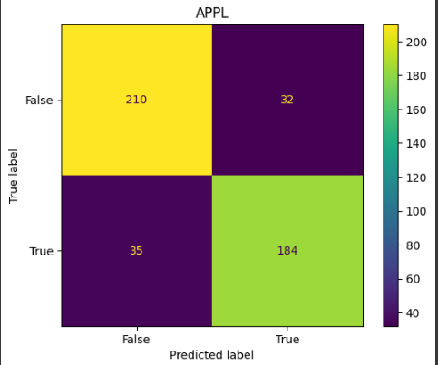
Confusion Matrices

Slide 14
Code Working and Demonstration
On Google Colab Link:
https://colab.research.google.com/drive/1g5wy9mOLV4aLn9EmQ92fUQ0-s_QFo7OX#scrollTo=BaYOaeksb3yE

Slide 15
Thank You Questions?

