Slide 1

DataVault Managing Data with Simplicity

Slide 2
Introduction to DBMS Project
The primary purpose of this DBMS is to provide a lightweight system for managing data, so we focused on building a basic database management system (DBMS) from scratch. This system aims to store, manage, and manipulate records in a structured way using files and folders.
Key Points:
Purpose: To manage records in a systematic and organized way.
Objective: Implement CRUD operations (Create, Read, Update, Delete) with file handling and schema management.

Slide 3
DataVault Features
The system supports the basic functionality of a DBMS, including CRUD operations. These allow the user to create databases, add records, update data, and delete records when necessary.
Key Points:
Database: Allows users to Create new databases / View existing databases / and Delete databases. Represented as folders.
Tables Menu: Allows users to Create new tables / View existing tables / and Delete tables in the form of CSV files.
Add, Update, Delete Records: Enables users to manage data within the tables.
Display and Search Records: Shows existing records in tables for viewing or modification.
Schema Handling: Appropriate handling of tables attribute values

Slide 4
How Records are Managed?
Records in DataVault are stored as arrays within CSV files, representing the data for each table. Each record corresponds to a row in the table, with individual attributes stored as columns. Users can add, update, delete, or display records through simple menu options.
The system allows efficient record handling by managing data directly in files, ensuring ease of access and modification.

Slide 5
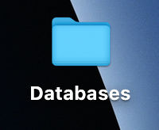
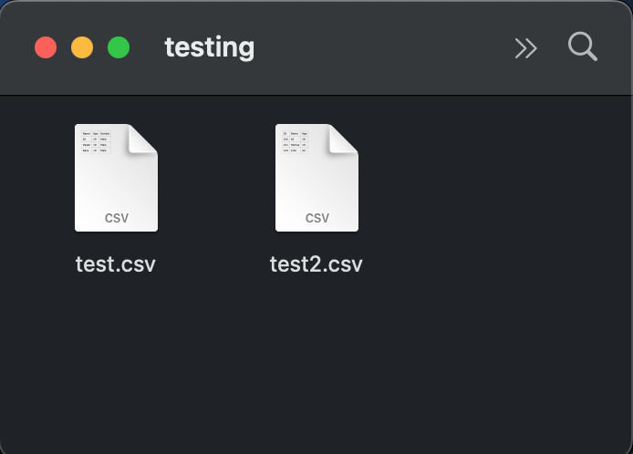
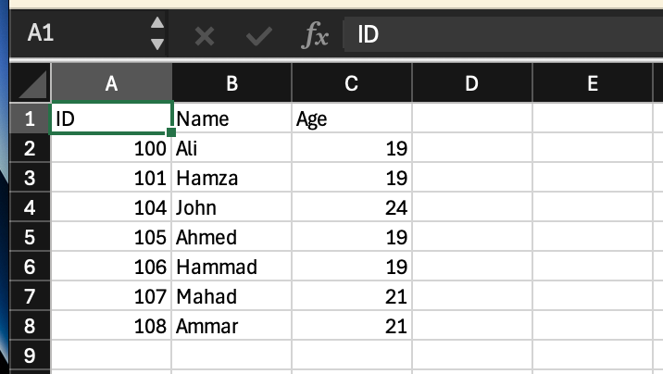
Project Architecture
The DBMS uses a simple folder and file-based structure to represent databases and tables. Each database is a folder, and each table within the database is represented as a CSV file.
Key Points:
Databases: Represented as folders on the file system.
Tables: Represented as CSV files inside the respective database folder.
Records: Stored as rows in CSV files, with each row representing a record.

Slide 6
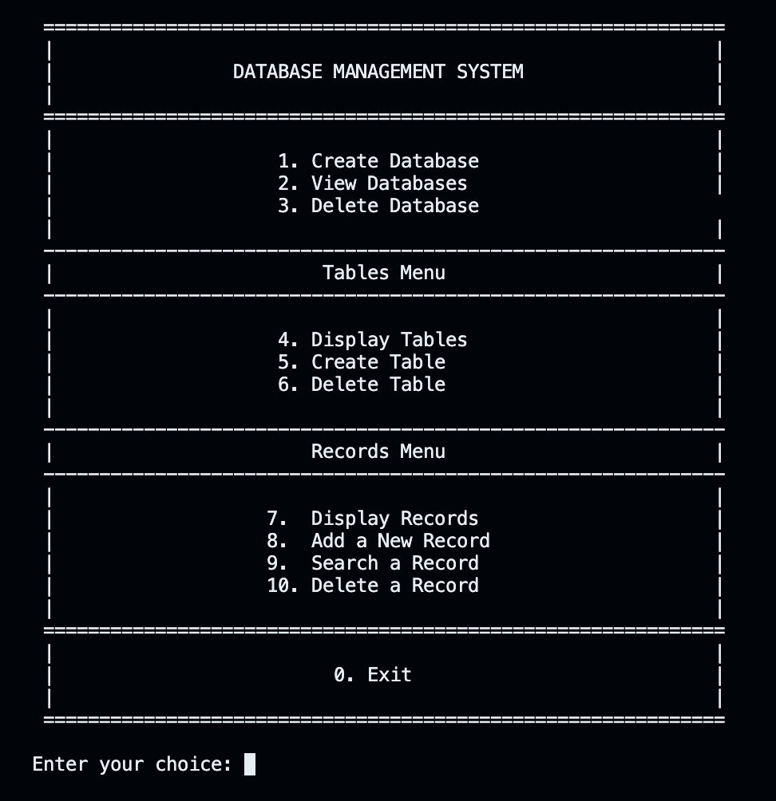
User Menu
The DBMS is controlled through a simple text-based menu system that guides users through various actions like creating databases, managing tables, and performing CRUD operations.
Database Operations (1-3)
Table Operations (4-6)
Record Operations (7-10)

Slide 7
Conclusion
This DBMS project provides a simple yet effective solution for managing small datasets. It mimics a relational database system by using CSV files for storing tables and records. Though there are areas for improvement, the project serves as a great starting point for learning about database management systems.
Key Points:
The project offers a basic, file-based DBMS with CRUD operations.
Provides hands-on experience in building a DBMS from scratch.
Future enhancements will improve the system’s scalability, security, and user experience.

Slide 8
Thank you for exploring DataVault with us!

