Slide 1

JUnit Testing for FitManage App
Evaluating Trainer & Member Features Using Two LLMs

Slide 2
LLMs Used for JUnit Testing
- LLM 1: OpenAI ChatGPT
- LLM 2: Google Gemini
These models were used to generate and evaluate JUnit test cases.

Slide 3
Scenarios Evaluated
Adding a session to a trainer’s calendar
Canceling a session
Checking for upcoming sessions
Viewing the trainer’s calendar
Member check-in validation (active vs. inactive membership)

Slide 4
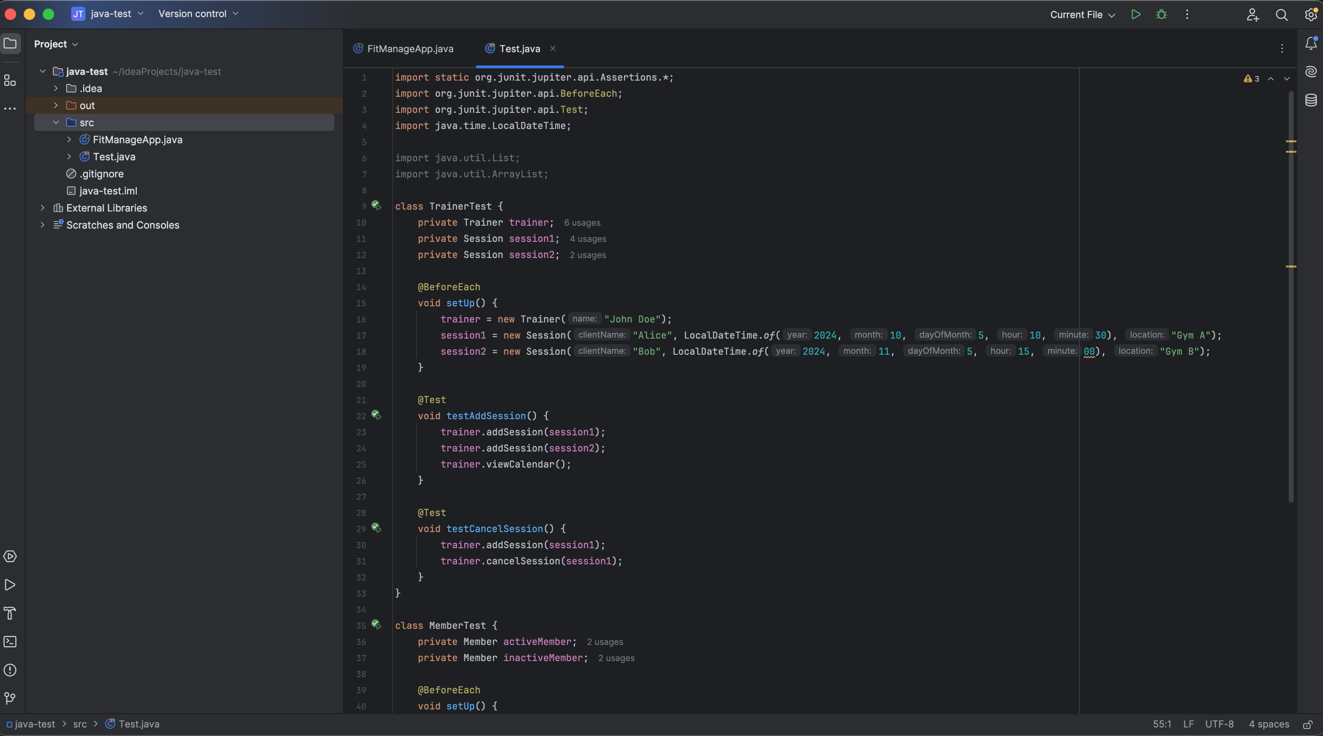
Scenarios Evaluated

Slide 5
JUnit Test Outcomes
Screenshots of test results showed that:
All test cases passed successfully.
Further, White-box testing confirmed logic correctness.

Slide 6
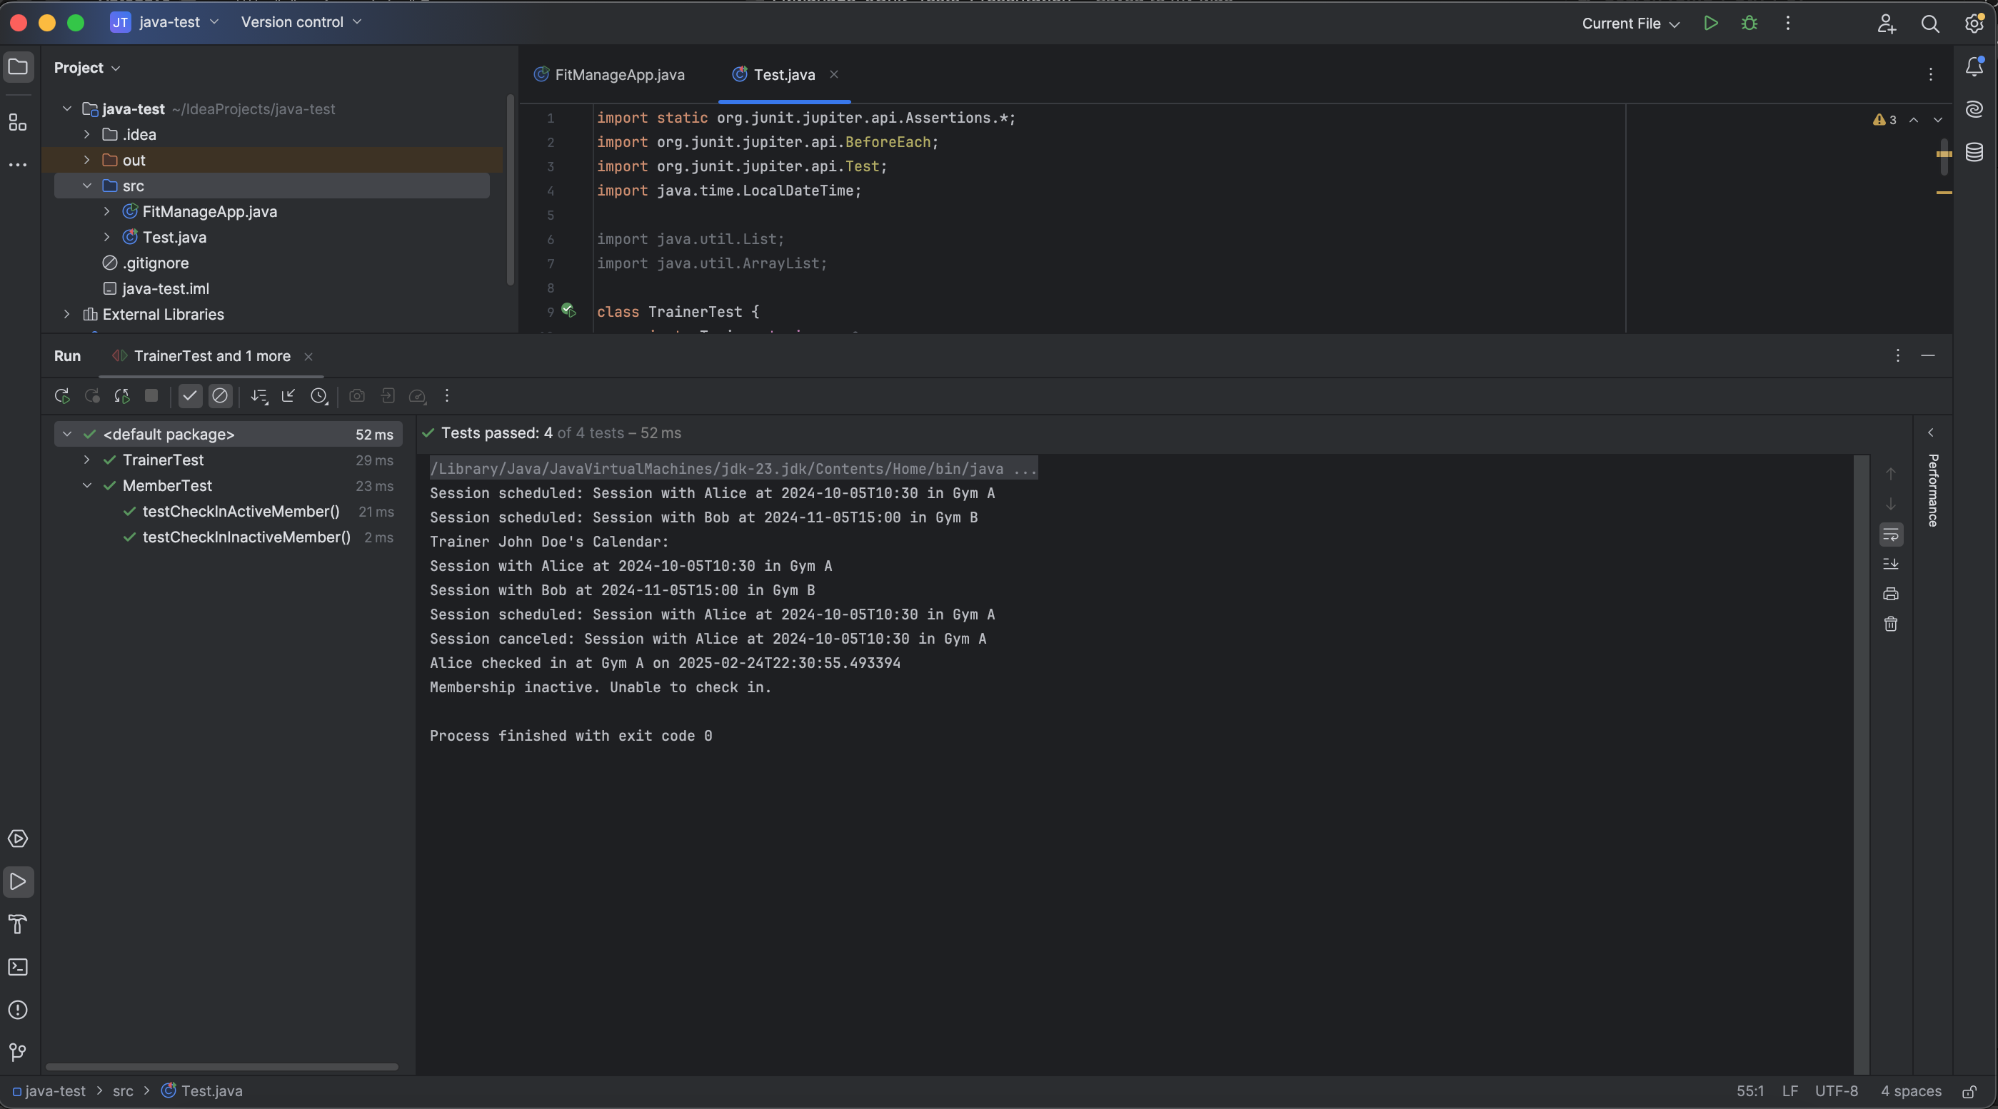
JUnit Test Outcomes

Slide 7
Code Coverage Analysis
JUnit coverage analysis:
- Trainer methods: 100% tested
- Member check-in: 100% tested
- Overall all FitManage code was successfully covered

Slide 8
Prompts Used to Generate JUnit Tests
Example of Prompt I used:
“Generate JUnit test cases for a Trainer class that manages sessions. Test adding, canceling, and checking upcoming sessions."
LLM outputs were then refined based on initial results.

