Slide 1
Static White-Box Testing Report
Identified Bugs in Java Code
Abdulla
16 Feb, 2024

Slide 2
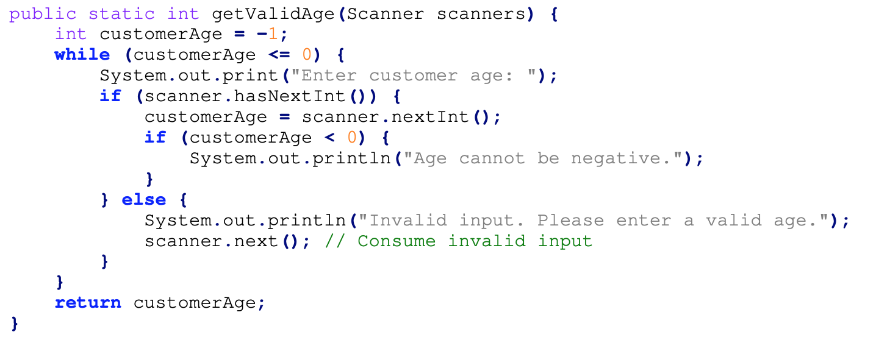
Invalid Age Validation
The condition `while (customerAge == 0)` allows negative values (-1) to be returned, which can cause incorrect behavior.

Slide 3
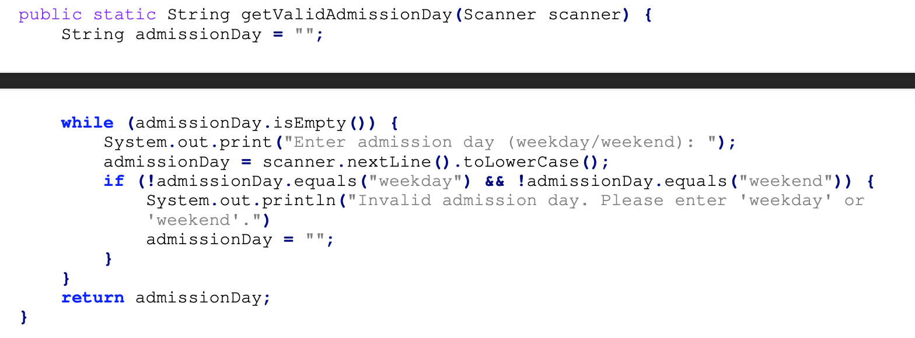
Infinite Loop Risk
If a user enters an valid admission day, the loop reset the input, leading to an infinite loop.

Slide 4
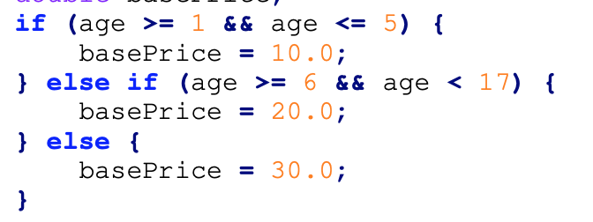
17 year olds not included
The condition `else if (age >= 6 && age < 17)` should be `else if (age >= 6 && age <= 17)` to correctly include 17 year olds.

Slide 5
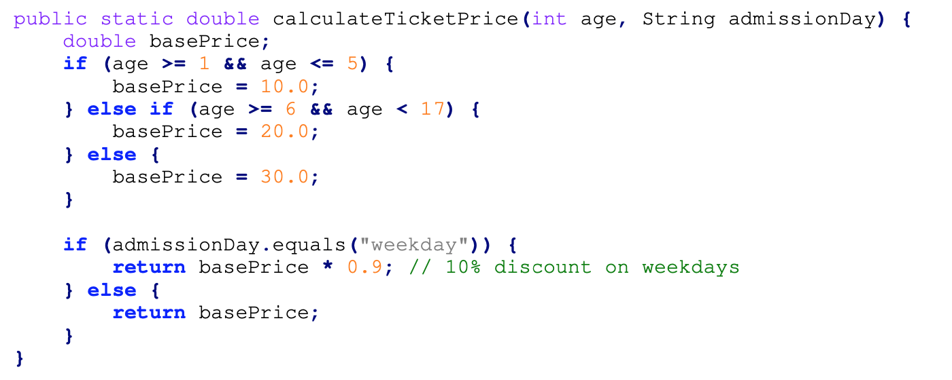
Incorrect Ticket Price Calculation for Invalid Ages
The function assumes age is always valid, but it does not handle unexpected cases like age == 0 or negative numbers.

Slide 6
Admission Day Input Can Be Blank
The program checks if admissionDay is empty (admissionDay.isEmpty()) before reading input, but does not verify if the input is actually blank after reading.

