Slide 1
Websocket
Protocol , html5 API and JEE implementation

Slide 2
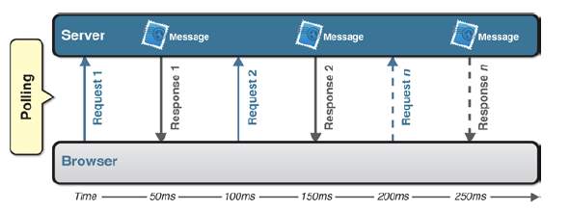
Polling
Polling is a regularly timed synchronous call
The client makes a request to the server to see if there’s any information available for it
The requests are made at regular intervals

Slide 3
Long Polling

