Slide 1
Websocket
Build Real Time Application With Html5 and Java EE

Slide 2

Contents
Little Introduction to websocket
Introduction for Previous Protocol
Websocket Protocol
Why websocket ?
Websocket API
Websocket In Glassfish 4.0 (JEE7)

Slide 3

What is Websocket ?
Protocol
Full-duplex communication between a client and server
API
JavaScript API for the WebSocket protocol within the browser

Slide 4
Before Websocket
Polling
Long polling
Streaming

Slide 5
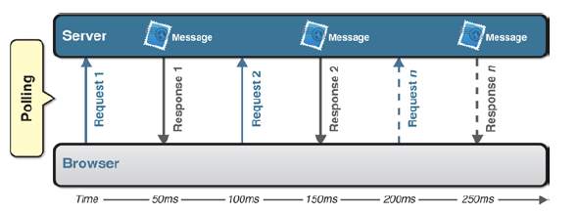
Polling
Polling is a regularly timed synchronous call
The client makes a request to the server to see if there’s any information available for it
The requests are made at regular intervals

Slide 6



Polling
Client needs to request data occasionally
Client needs to send data occasionally
Client needs to send data often
Server needs to initiate and send data without client request
High Message volume => Bad Performance

Slide 7
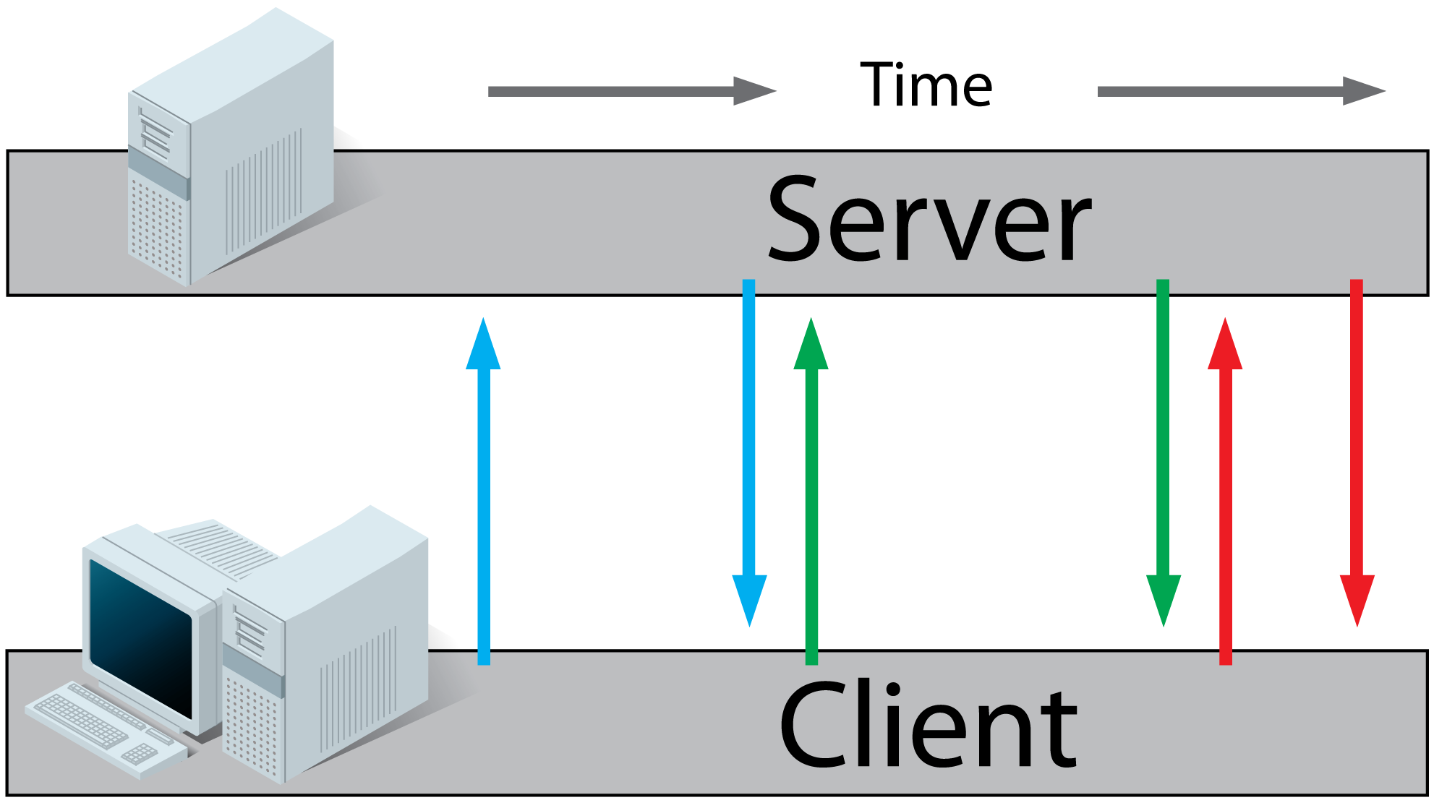
Long Polling
the client requests information from the server and opens a connection during a set time period
If the server does not have any information it holds the request open until
it has information for the client
it reaches the end of a designated timeout

Slide 8
Polling
Client needs to request one or a few pieces of data at a time
Client needs to send one or a few pieces of data occasionally
Client needs to send data often
Server needs to initiate and send data without client request
Client needs initiate and send data when available

Slide 9
Streaming
the client sends a request, and the server sends and maintains an open response that is continually updated and kept open
The server updates the response whenever a message is ready to be delivered
Involve HTTP request and response headers ( lot of header data )
the client must wait for requests to return

Slide 10
Why Websocket ?
Full-duplex ( not half-duplex like request -> response )
Bidirectional ( at any time the server or the client can send message )
Single-socket ( Low Resource )

Slide 11

Why Websocket ?
WebSocket is about Performance
WebSocket saves bandwidth, CPU power, and latency
WebSocket is about Simplicity
Before Websocket the communication is with AJAX and is complicated.
Websocket is about Standards
Underlying network protocol that enables you to build other standard protocols on top of it.
Websocket is about HTML5
a key component of the HTML5 platform and an incredibly powerful tool for developers.

Slide 12

We Need Websocket !
So ! You Need Websocket to build a world-class web applications.
For Online Gaming
For Chatting
For Collaborative document editing
For Stock Market
……..

Slide 13
Protocol And API
WebSocket is a protocol, but there is also a WebSocket API which enables your applications to control the WebSocket protocol and respond to events triggered by the server
API -> W3C
Protocol ->IETF (Internet Engineering Task Force)

Slide 14
How to create a websocket
To connect to a remote host, you simply create a new WebSocket object instance and provide the new object with a URL that represents the endpoint to which you wish to connect.

Slide 15
So ! Let’s begin implementation
var websoc= new WebSocket(‘ws://ammar:8080/chat/websocketChat ', ['soap', 'xmpp']);
Web socket protocol like http ; ther are also wss for secure websocket protocole like https
Server end point !
The second argument accepts optional subprotocols.
It can be a string or an array of strings.
Each string should represent a subprotocol name
server accepts only one of passed subprotocols in the array.

Slide 16
Event
A WebSocket object dispatches four different events:
Open
Message
Error
Close
As with all web APIs, you can listen for these events using on<eventname> handler properties, as well as using the addEventListener(); method.

Slide 17
Javascript Implementation
var socket = new WebSocket(ws://ammar:8080/chat/websocketChat);
// Define functions for events
socket.onopen = function(evt) {console.log(“Connection established”);};
socket.onmessage = function(evt) {console.log(“message has been received”;};
socket.onclose = function(evt) {console.log(“bye bye”)};
socket.onerror = function(evt) {console.log(“what is happened ? !!”))}

Slide 18

Methods
WebSocket objects have two methods:
Close
Close the Connection !
socket.close();
Send
This is the function who send the msg to the server!
Socket.send(msg);

Slide 19
Message Type binary(Blob)
// Set binaryType to blob (Blob is the default.)
ws.binaryType = "blob";
// Event handler for receiving Blob messages
ws.onmessage = function(e) {
if(e.data instanceof Blob){
console.log("Blob message received", e.data);
var blob = new Blob(e.data);}

Slide 20
Message Type Array buffer
// Set binaryType to ArrayBuffer messages
ws.binaryType = "arraybuffer";
// Event handler for receiving ArrayBuffer messages
ws.onmessage = function(e) {
if(e.data instanceof ArrayBuffer){
console.log("ArrayBuffer Message Received", + e.data);
// e.data is an ArrayBuffer. Create a byte view of that object.
var a = new Uint8Array(e.data);
}
};

Slide 21

Websocket in jee7
In Glassfish 4 , TYRUS Has Implemented the websocket API to the server side
TYRUS Project = JSR 356: Java API for WebSocket - Reference Implementation
So the client will connect to the server , and send him a message , when a server is listening to a endpoint ;
Let’s see the code to understand

Slide 22
Create Server EndPoint
@ServerEndpoint(value = "/websocketChat")
public class ChatEndpoint {
private static final Set<Session> peers = Collections.synchronizedSet(new HashSet<Session>());
@OnOpen
public void onOpen(Session peer) {peers.add(peer);}}
@OnClose
public void onClose(Session peer) {peers.remove(peer);}
@OnMessage
public void message(String message, Session client) {
for (Session peer : peers) {peer.getBasicRemote().sendObject(message);}
}

