Slide 1

COVID-19: Impact & Recovery Analytics
GLOBAL HEALTH ANALYTICS
From raw data to actionable insights
16.48M
Confirmed Cases
Python | Pandas | Power BI | DAX
Notes:
Welcome. When we look at a global crisis like COVID-19, numbers can easily become overwhelming. Today, we aren’t just looking at numbers; we are tracing a global story of impact, concentration, and recovery using Python, Pandas, and Power BI.

Slide 2
What does the data tell us about the global impact of COVID-19?
THE QUESTION
01
02
03
04
How large?
How severe?
How much recovered?
Where was the impact concentrated?
→ Confirmed / Active
→ Deaths
→ Recovered
→ Country + WHO Region
COVID-19 · Impact & Recovery Analytics
2
Notes:
Before writing a single line of code, we started with fundamental questions: How large was the outbreak? How severe was the toll? Where was the impact concentrated? This guided our entire analytical journey.

Slide 3
THE DATA
187 Countries
188 Days · 22 Jan – 27 Jul 2020
35,156 Records
10 Variables
country_wise_latest
full_grouped
clean_complete
Country Snapshot
Daily Analysis
Detailed Geographic Data
COVID-19 · Impact & Recovery Analytics
3
Notes:
Our foundation is built on three core datasets covering 187 countries over 188 days, resulting in over 35,000 granular records. We structured these into snapshots, daily trends, and geographic views.

Slide 4
Before → After: a validated dataset
DATA CLEANING
RAW DATA
Audit
Missing Values
Duplicates
Validation
Clean Analysis Dataset
187 × 15
0
0
35,156
187
188
raw shape
Missing
Duplicates
daily records
countries
days
Active = Confirmed − Deaths − Recovered
COVID-19 · Impact & Recovery Analytics
4
Notes:
Cleaning wasn’t just about dropping blanks. We audited raw records, verified duplicates, handled missing values, and programmatically recalculated Active cases using confirmed, death, and recovery figures to ensure absolute data integrity.

Slide 5
Overall Statistical Analysis
PART 1
ACTIVE
CONFIRMED
DEATHS
RECOVERED
6.36M
16.48M
654K
9.47M
Metric | Total | Average | Maximum
Active | 6,358,362 | 34,001.94 | 2,816,444 (US)
Confirmed | 16,480,485 | 88,130.94 | 4,290,259 (US)
Deaths | 654,036 | 3,497.52 | 148,011 (US)
Recovered | 9,468,087 | 50,631.48 | 1,846,641 (Brazil)
COVID-19 · Impact & Recovery Analytics
5
Notes:
Part 1 delivers our core statistical requirements. Across all observed records, we cross-referenced totals, averages, and maximums to establish a robust global baseline for active cases, confirmations, deaths, and recoveries.

Slide 6
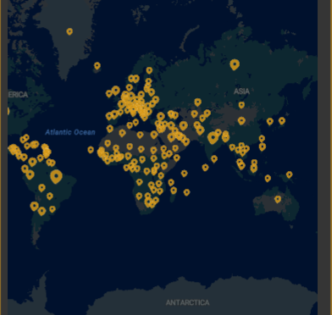
Where is the impact?
THE GEOGRAPHY
🇺🇸 United States
Highest Confirmed (4,290,259) & Highest Deaths (148,011)
🇧🇷 Brazil
Highest Recovered (1,846,641)
Top 10 countries hold 68.0% of confirmed cases: the impact was highly concentrated.
COVID-19 · Impact & Recovery Analytics
6
Notes:
Moving from tables to geography, the map reveals a stark reality. The impact wasn’t evenly distributed; it was heavily concentrated, with the United States and Brazil leading major metrics.

Slide 7
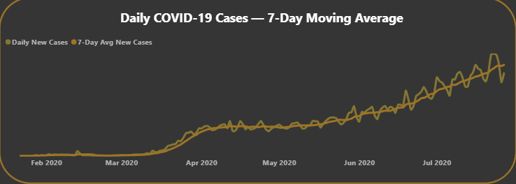
The pandemic over time
OVER TIME
282,756
Peak New Cases
23 July 2020
7-Day Moving Average trend line overlay
Same day: 9,966 deaths, the highest daily total
Daily cases continued to rise toward the end of the observed period.
COVID-19 · Impact & Recovery Analytics
7
Notes:
When we map the timeline, we don’t just see a fluctuating chart. We see a peak of over 282,000 new cases on July 23rd, 2020, with the 7-day moving average proving that the pandemic was still accelerating upward.

Slide 8
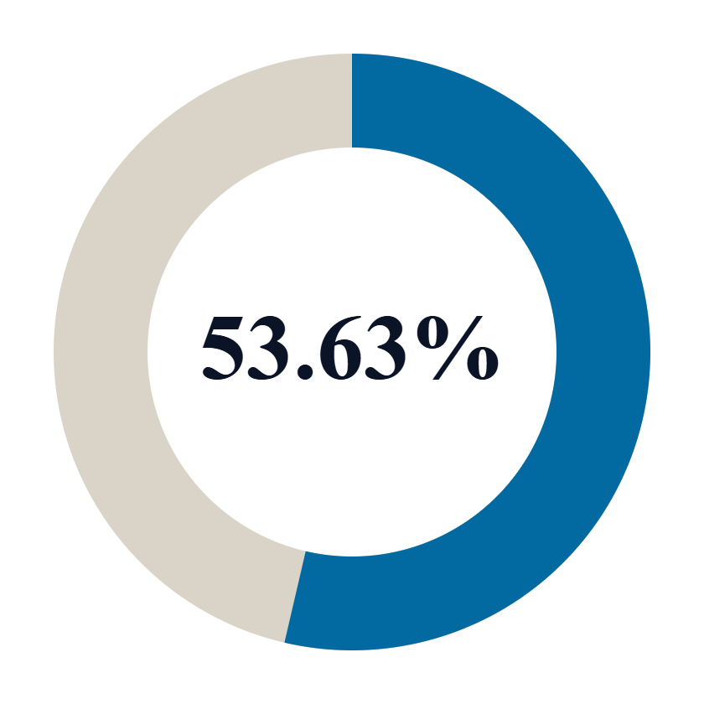
Which WHO regions carry the burden?
REGIONAL IMPACT
AMERICAS — 53.63%
Americas
53.63%
Europe
20.02%
South-East Asia
11.14%
Eastern Mediterranean
9.05%
Africa
4.39%
Western Pacific
1.77%
More than half of the confirmed cases were concentrated in the Americas (8,839,286).
COVID-19 · Impact & Recovery Analytics
8
Notes:
Breaking it down by WHO regions, the story sharpens further: over half of all global confirmed cases—53.6%—were concentrated entirely within the Americas.

Slide 9
Above-average benchmarking
PART 2
All 187 Countries
24
25
↓
Active · avg 34,002
Confirmed · avg 88,131
Calculate Overall Average
↓
Compare Each Country
26
28
↓
Deaths · avg 3,498
Recovered · avg 50,631
Identify Above-Average Countries
Full 187-country breakdown resides in the Appendix / Report.
COVID-19 · Impact & Recovery Analytics
9
Notes:
Instead of listing all 187 countries and cluttering our visual space, we built a comparative pipeline: calculating global averages and isolating the precise count of countries exceeding those thresholds per category.

Slide 10
What did we discover?
01
02
Cases were highly concentrated
Americas dominated the global burden
Top 10 countries = 68.0% of confirmed cases
53.63% of confirmed cases (8,839,286)
03
04
Daily cases were still increasing
A relatively small group of countries exceeded the global average
Peak of 282,756 new cases on 23 July 2020
24 to 28 of 187 countries, by metric
COVID-19 · Impact & Recovery Analytics
10
Notes:
This is our core discovery slide. The data tells four undeniable truths: concentration is high, the Americas dominate, trajectories were still rising at observation close, and only a minority of nations drove the global average.

Slide 11
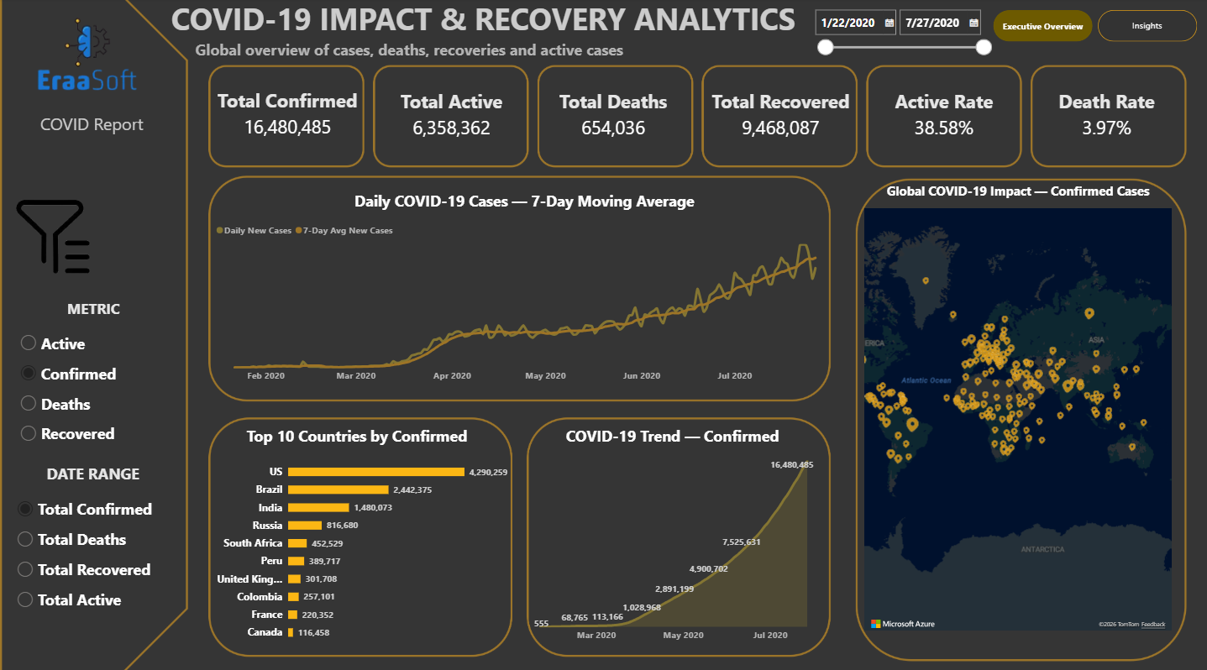
From Analysis → Interactive Decision Dashboard
POWER BI EXECUTIVE DASHBOARD
Dynamic KPIs
Date Slicer
Metric Selector
Top 10
Global Map
Trends
COVID-19 · Impact & Recovery Analytics
11
Notes:
See Slide 12 script.

Slide 12
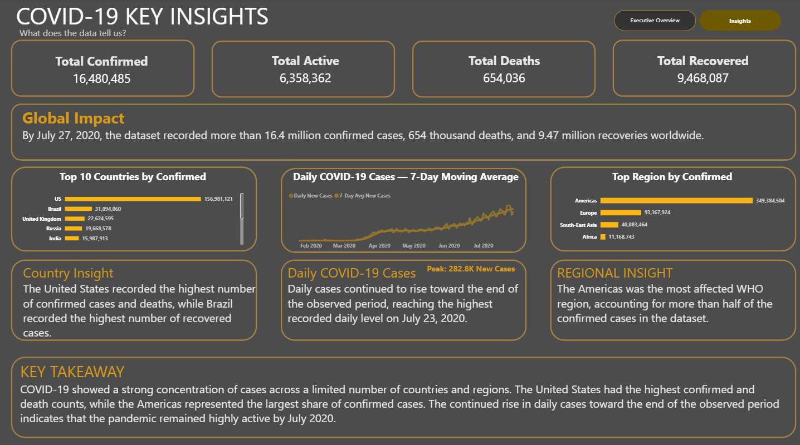
Insights Dashboard
← Global Impact
16.48M confirmed · 654K deaths · 9.47M recovered
← Regional Concentration
Americas: 53.63% of confirmed cases
← Time Trend
Peak 282.8K new cases on 23 Jul 2020
COVID-19 · Impact & Recovery Analytics
12
Notes:
To bring this to life, we transitioned our static analysis into an interactive Power BI suite. Stakeholders can slice by date, toggle metrics, explore regional drill-downs, and dynamically track trends without wading through static reports.

Slide 13
What should we do with this?
RECOMMENDATIONS
01
02
03
Prioritise high-burden areas
Pair daily cases with a 7-day average
Separate cumulative and daily logic
Plan monitoring and resources around countries and regions far above the average.
The moving average shows the true direction beneath daily noise.
Cumulative: latest snapshot in the period. Daily: sum the deltas.
04
05
06
Drill down by country and WHO region
Automate the refresh pipeline
Read it as historical
Data covers Jan–Jul 2020, so findings are analytical, not current.
Move from the global picture to the places driving the burden.
Python cleaning to Power BI refresh, repeatable on newer snapshots.
COVID-19 · Impact & Recovery Analytics
13
Notes:
Draft script: Every recommendation traces back to a finding. Prioritise the few countries and the Americas where the burden sits, read daily cases through a 7-day average, segment by country and region, and automate the refresh so the dashboard stays current.

Slide 14
From raw data to actionable insights
IN CLOSING
16.48M
53.6%
282,756
confirmed cases
of cases in the Americas
peak daily new cases
Thank you. Questions?
Notes:
Draft script: We started with a question and ended with a decision tool. Thank you, and I’m happy to take your questions.

