Slide 1
CITS4402 Computer Vision
HOLOGRAPHIC ACQUISITION RIG AUTOMATIC CALIBRATION
ERWIN BAUERNSCHMITT, ALIAN HAIDAR, LUKE KIRKBY
22964301, 22900426, 22885101

Slide 2
overview
Automatic calibration of a holographic acquisition Rig. The purpose of this project is to implement the automatic calibration procedure for a holographic acquisition Rig. The inputs in play are a series of images taken by specially located cameras inside a room taking images of the same subject from different angles.

Slide 3
How it is created
The program is written in Python 3.8.5 and uses the following libraries:
- OpenCV 4.5.1
- Numpy 1.19.5
- Matplotlib 3.3.4
- Pillow 8.1.0
- Scipy 1.6.0
- Scikit-Image 0.18.1
- PySimpleGUI 4.45.0
Main framework of the program's GUI is based on Qt6.

Slide 4
How to setup
A virtual environment is required to run the project.\
To create a virtual environment, run the following command:
```
python3 -m venv virtual_venv | python -m venv virtual_venv
```
To install the required packages, run the following command:
```
pip install -r requirements.txt
```
To exit the virtual environment, run the following command:
```
deactivate
```
For Windows:
Set powershell permissions to allow all bypass
```
Set-ExecutionPolicy -ExecutionPolicy Bypass -Scope Process -Force\
.\venv\bin\activate.ps1 | .\env\script\activate.ps1

Slide 5
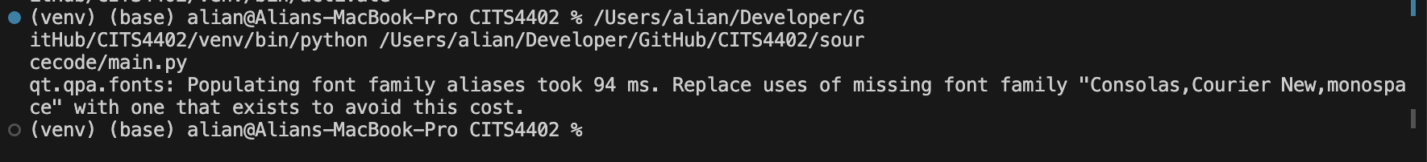
How to run
Assume that all dependencies are installed and terminal is on working virtual environment
To run the program, run the following command:
```
python3 main.py | python main.py
```

Slide 6


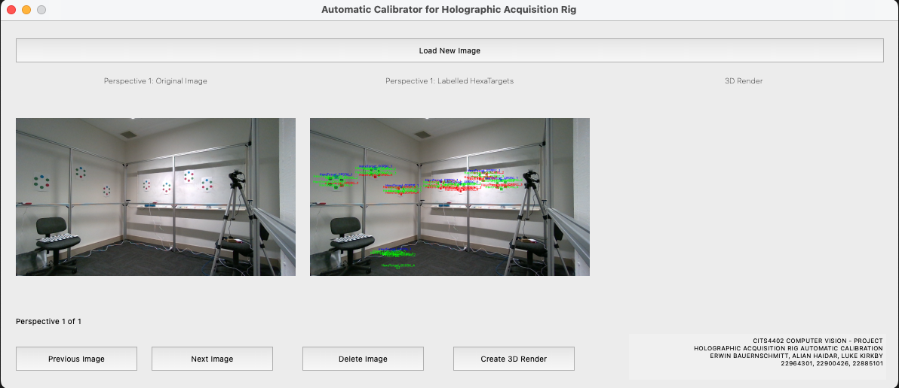
How to use: gui
When Ran successfully, a GUI window should open up

Slide 7
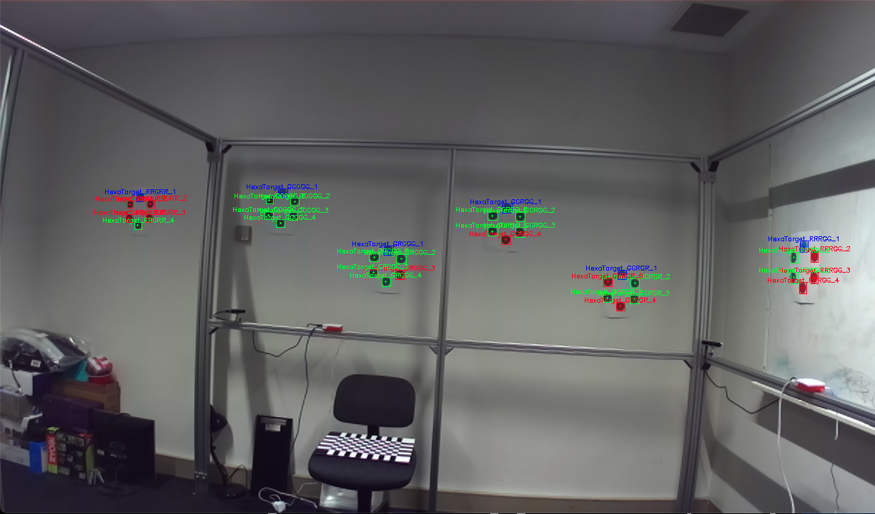
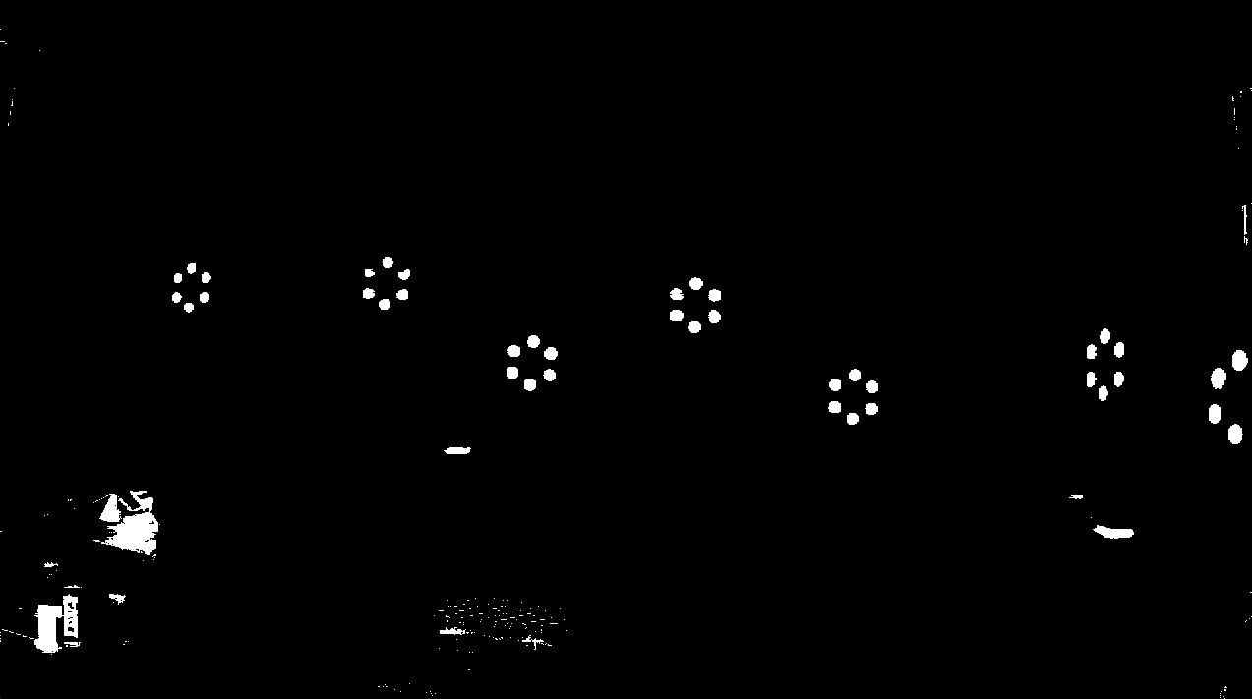
How to use: GUI
When image loaded successfully, the original image will be shown on the left-hand side, whilst a coordinated pixel selected HexaTargets will appear on the middle

Slide 8
How to use: gui
The three panels are:
**Perspective 0: Original Image** - Shows the original Image.
**Perspective 0: Labelled HexaTargets** - Shows the location of the RGB dots on the screen.
**3D Render** - This panel displays the 3D render of the selected images.
When all images are selected successfully, it will ask the user to import the selected JSON files specific to the camera image used. This will import all calibration data, such as the coordinates of the RGB dots, the camera matrix, the distortion coefficients, the rotation and translation vectors.
Once all the images are loaded and the JSON files are imported, the user can now select the image that they want to calibrate. The user can scroll through the images using the **Previous Image** and **Next Image** buttons. The user can also delete the selected image using the **Delete Image** button.

Slide 9
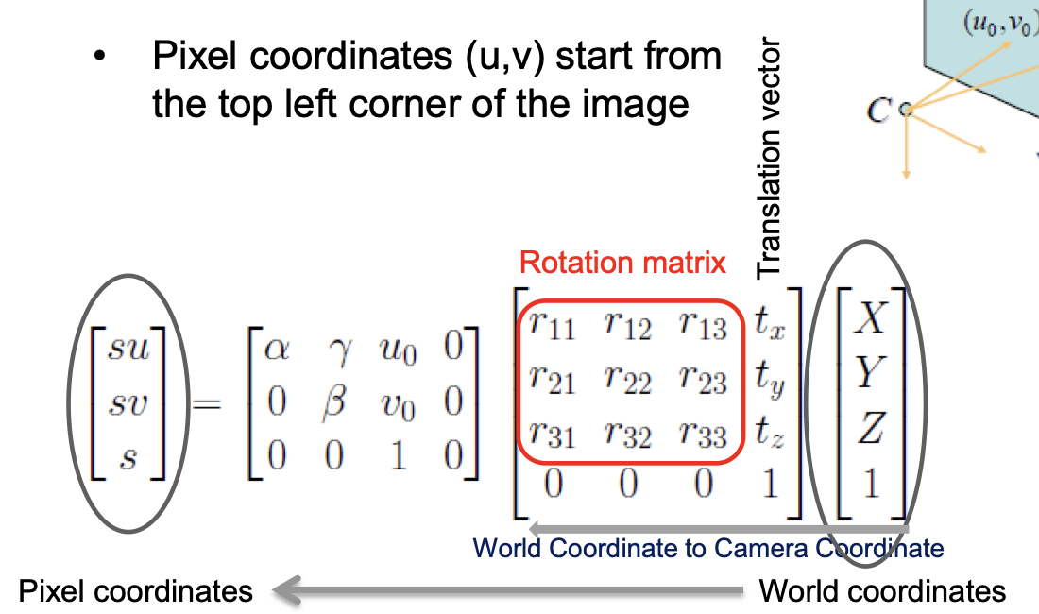
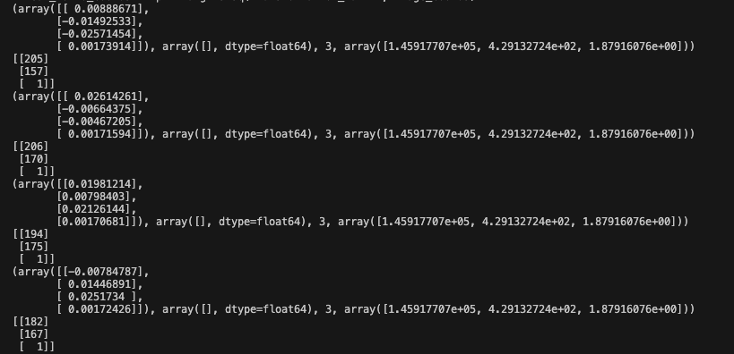
How to find camera properties
Using SolvePNP, we can discover R-vector and T-vector
Able to get camera matrix from JSON file
Able to solve the system of linear equations relating 2-D and 3-D points

Slide 10
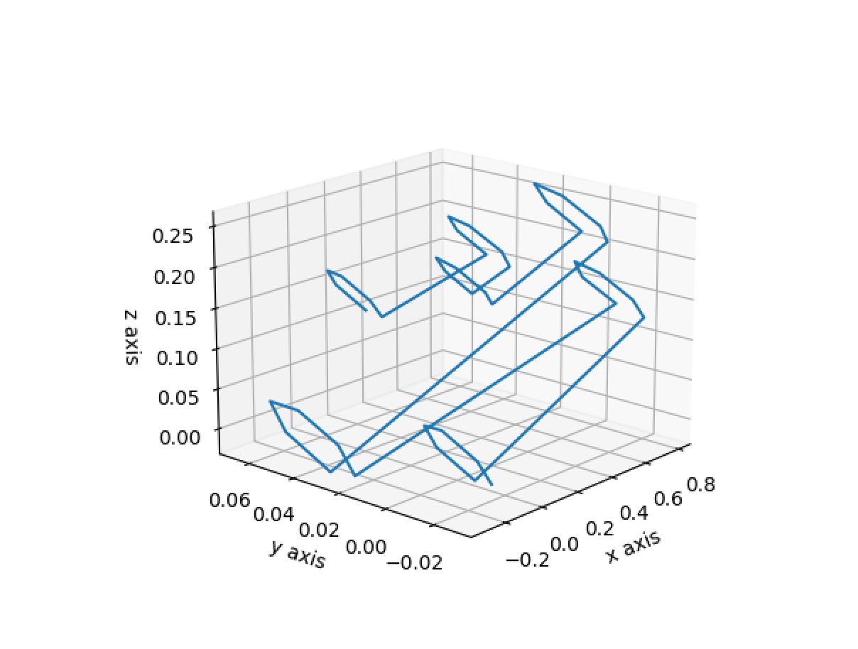
3D Plot
Once an image and respective JSON file was uploaded to the program, and the 3D render button was clicked, it will generate a new window of MatPlot3d that shows all points and camera in 3d space
The image on the left shows all 7 points with Camera 71 as the initial point

Slide 11
Color thresholding
What was done:​
Done in HSV colour space​
Used multiple thresholds for each color​
Tuned values to accurately detect all dots​
Issues:​
Had to use wide thresholds to get most of every dot​
Picked up lots of background objects​
Overlap between blue and green pixels​

Slide 12
Hexagon Detection (Post-Connected Components Analysis)​
What was done:​
Filtered connected components by size and aspect ratio​
Filtered green-blue error connected components​
Filtered by number of connected components around blue connected components ​
Filtered by size ratio to blue dot​
Filtered by hexagon shape (distribution around mean position)​

Slide 13
Sub-Pixel Alignment: Dilation​
Dilation:​
Applied a dilation mask (3x3 of one’s) to enlarge the segment​
​
Centroid Correction (all combinations of the following strategies):​
HSV and Normalised RGB colour spaces​
Double-calculating mean by excluding outliers​
Only using similar pixels (highly weighted) in the centroid mean calculation​
Weighting by proximity to initial centroid estimate​
​
Result: couldn’t improve centroid estimate on average​

