Slide 1
Encryption Algorithm for TCP Session Hijacking
Network and System Security Lecture
Paper presentation:
Presented By:
Ali Aqeel Zafar (AAFZDE)
Friedrich Ostertag (D7KQBF)

Slide 2
Content
Introduction & Background
Related work
Contribution
Model explanation
Experiment / Example
Conclusion
Remarks

Slide 3
1) Introduction & Background
TCP security issues
Plaintext transmission -> vulnerable data
No continuous authentication -> session can be hijacked

Slide 4
1) Introduction & Background
Attacks on TCP
Session hijacking e.g. Mitnick attack
(SYN-flooding)

Slide 5
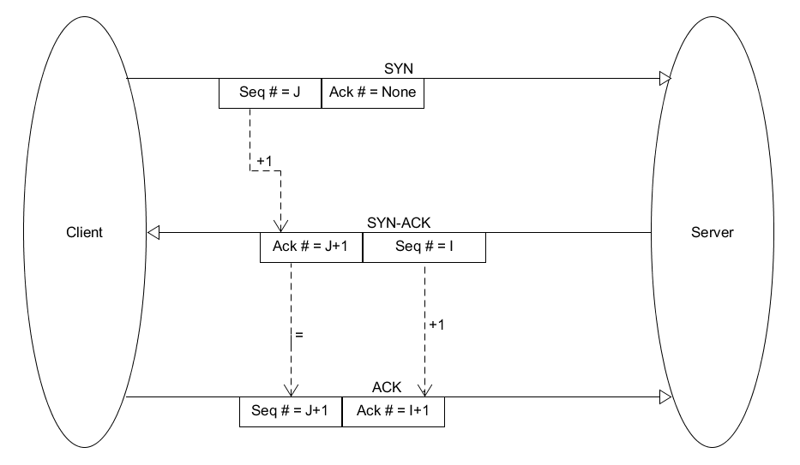
Session hijacking pt.1: TCP handshake

Slide 6
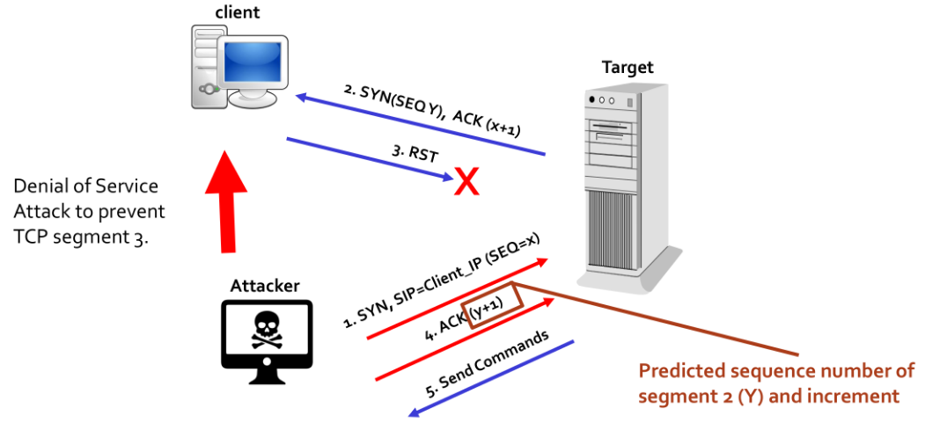
Session hijacking pt.2: Mitnick attack
Figure from Network & System Security Lecture 6, slide 42

Slide 7
2) Related work
Session authentication with cookies
Firewall to prevent eavesdropping
Two factor authentication
Server-side reverse proxy

Slide 8
3) Contribution
Prevent session hijacking …
… using RSA encryption & DH key exchange …
… providing double ended authentication.

Slide 9
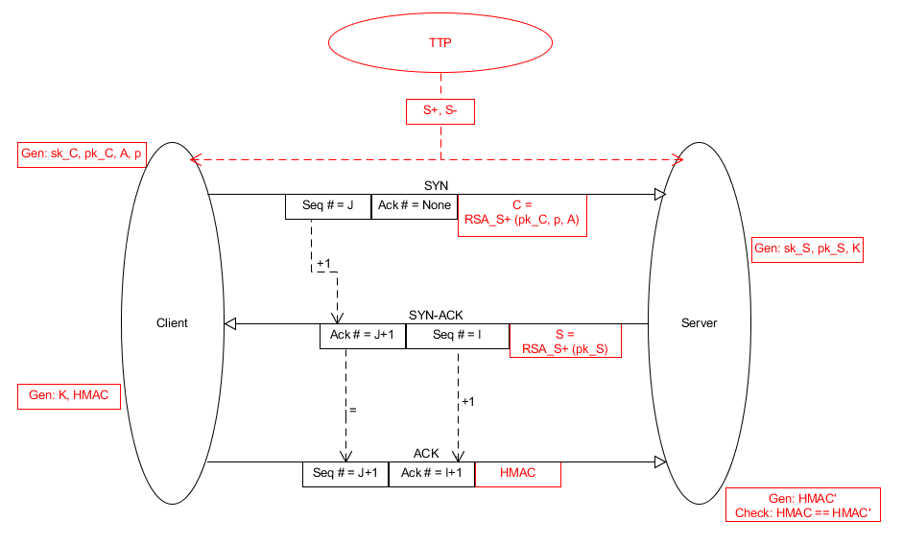
4) Proposed Model

Slide 10
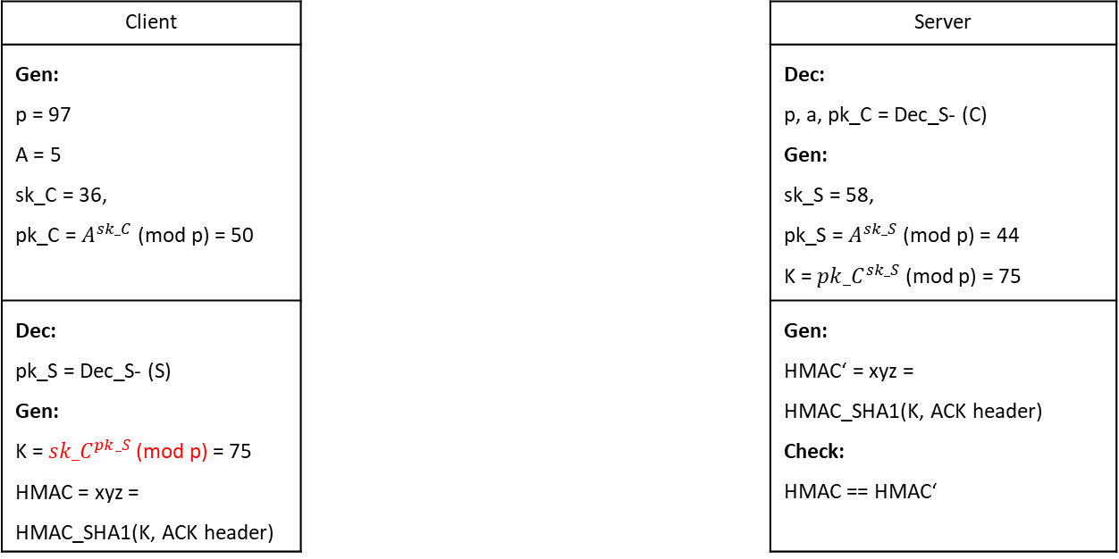
5) Experiment / Example
Client |  | Server
Gen: p = 97 A = 5 sk_C = 36, pk_C = $A^{sk_C}$ (mod p) = 50 |  | Dec: p, a, pk_C = Dec_S- (C) Gen: sk_S = 58, pk_S = $A^{sk_S}$(mod p) = 44 K = ${pk_C}^{sk_S}$ (mod p) = 75
Dec: pk_S = Dec_S- (S) Gen: K = ${sk_C}^{pk_S}$(mod p) = 75 HMAC = xyz = HMAC_SHA1(K, ACK header) |  | Gen: HMAC‘ = xyz = HMAC_SHA1(K, ACK header) Check: HMAC == HMAC‘
1st handshake packet
C = Enc_S+ (p, a, pk_C)
2nd handshake packet
S = Enc_S+ (pk_S)
3rd handshake packet
HMAC

Slide 11

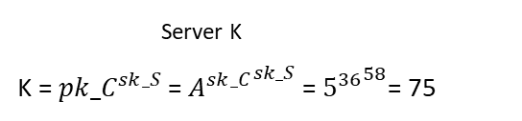
5) Experiment / Example
Client |  | Server
Gen: p = 97 A = 5 sk_C = 36, pk_C = $A^{sk_C}$ (mod p) = 50 |  | Dec: p, a, pk_C = Dec_S- (C) Gen: sk_S = 58, pk_S = $A^{sk_S}$(mod p) = 44 K = ${pk_C}^{sk_S}$ (mod p) = 75
Dec: pk_S = Dec_S- (S) Gen: K = ${sk_C}^{pk_S}$(mod p) = 75 HMAC = xyz = HMAC_SHA1(K, ACK header) |  | Gen: HMAC‘ = xyz = HMAC_SHA1(K, ACK header) Check: HMAC == HMAC‘
Client K
${WRONG: K=sk_C}^{pk_S}={sk_C}^{A^{sk_S}}$= ${{36}^{5}}^{58}$= 35
$WRONG:$ ? ? ? = ${5^{36}}^{58}$= 75
${CORRECT: K=pk_S}^{sk_C}=A^{{sk_S}^{sk_C}}$= ${5^{44}}^{36}$= 75
1st handshake
C = Enc_S+ (p, a, pk_C)
2nd handshake
S = Enc_S+ (pk_S)
Server K
K = ${pk_C}^{sk_S}$ = ${A^{sk_C}}^{sk_S}$ = ${5^{36}}^{58}$= 75
3rd handshake
HMAC

Slide 12
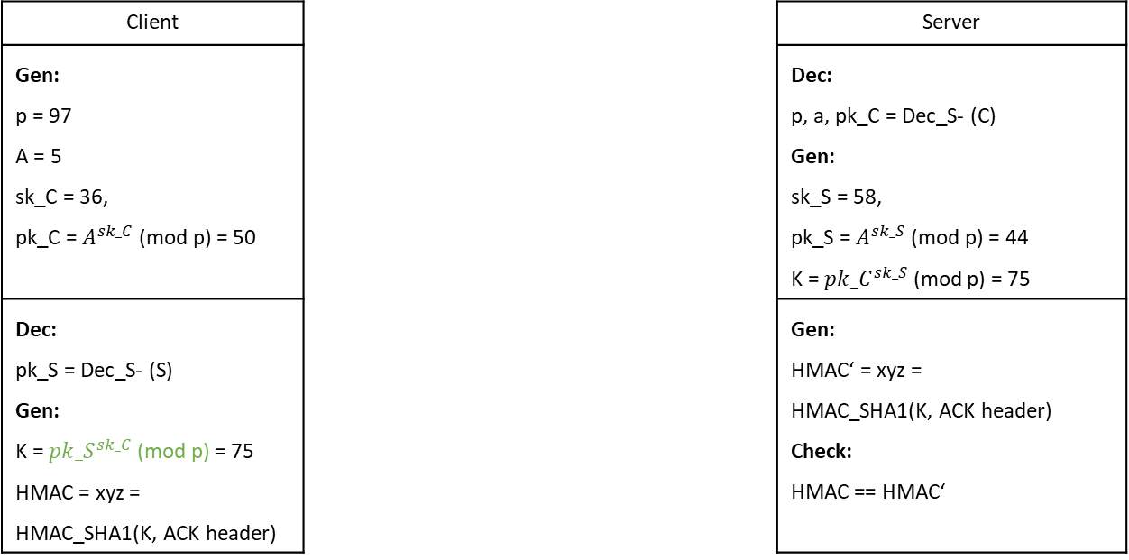
5) Experiment / Example
Client |  | Server
Gen: p = 97 A = 5 sk_C = 36, pk_C = $A^{sk_C}$ (mod p) = 50 |  | Dec: p, a, pk_C = Dec_S- (C) Gen: sk_S = 58, pk_S = $A^{sk_S}$(mod p) = 44 K = ${pk_C}^{sk_S}$ (mod p) = 75
Dec: pk_S = Dec_S- (S) Gen: K = ${pk_S}^{sk_C}$(mod p) = 75 HMAC = xyz = HMAC_SHA1(K, ACK header) |  | Gen: HMAC‘ = xyz = HMAC_SHA1(K, ACK header) Check: HMAC == HMAC‘
1st handshake packet
C = Enc_S+ (p, a, pk_C)
2nd handshake packet
S = Enc_S+ (pk_S)
3rd handshake packet
HMAC

Slide 13

6) Conclusion
Integrity verification
-> Prevent session hijacking
-> Identify malicious packets
Trade-off: runtime vs. security
Future work: optimize trade-off

Slide 14
7) Remarks
Good idea, BUT:
- No practical proof of concept
- No complete security
Requires TTP
Hijacking limited, not prevented
No double ended authentication
Paper contains many flaws
No justification for window value

Slide 15
Appendix
Paper:
Chen, M. et al.: Encryption Algorithm for TCP Session Hijacking. Computer Science ArXiv 2002.01391 (2020)
Related work:
TCP session authentication with cookies:
Dacosta, I. et al.: One-time cookies: Preventing session hijacking attacks with stateless authentication tokens. ACM Transactions onInternet Technology 12(1), 1 (2012)
Bortz, A. et al.: Origin Cookies: Session Integrity for Web Applications. Proceedings of the Web 2.0 Security and Privacy Workshop (W2SP) (2002)
TCP two factor authentication:
Bursztein, E. et al.: Sessionjuggler: secure web login from an untrusted terminal using session hijacking. Proceedings of the 21st international conference on World Wide Web, p.321-330. ACM (2012)
Server-side reverse proxy for TCP:
Burgers, W. et al.: Prevent session hijacking by binding the session to the cryptographic network credentials. 18th Nordic Conference on Secure IT Systems (NordSec 2013), volume 8208 p.33–50. Springer-Verlag (2013)

