Slide 1
Privacy Practice - Paper Presentation: Privacy-preserving Identity Management System (Lee et al. 2021)
by
Ali Aqeel Zafar (AAFZDE)
Friedrich Ostertag (D7KQBF)

Slide 2
Content
Motivation
Background & related work
Primitives
Approach
Implementation
Proof of Security
Experiment (Performance proof)
Conclusion

Slide 3
1. Motivation - What is the Problem?
Provide trusted authentication while …
… revealing as little as possible …
… holder is in control of data …
… using efficient computations …
… being able to apply any function …
… maintaining security.

Slide 4
2. Background & related work

Slide 5
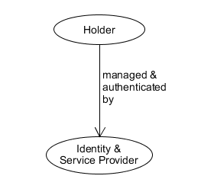
2.1 Centralized identity model
Problems:
Vulnerability
Low interoperability

Slide 6
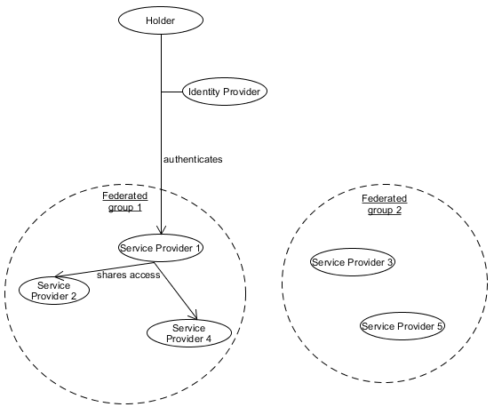
2.2 Federated identity model
New:
Identity provider != service provider
Federated groups
Identity reuse
Solves:
Improves interoperability
Problems:
Vulnerability
Trust required

Slide 7
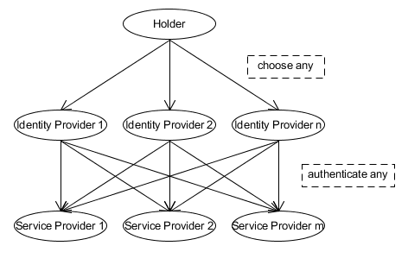
2.3 User centric model
New:
User can pick any identity provider to access any service
Solves:
Improves interoperability
Less trust required
Problems:
Control issues -> vulnerablility

Slide 8
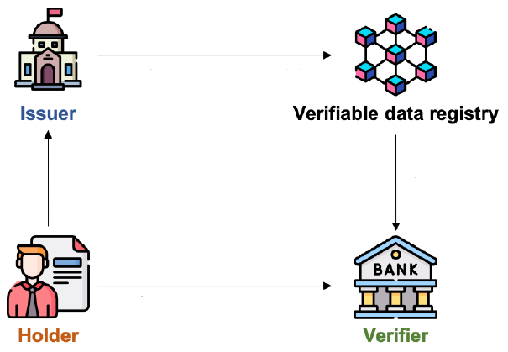
2.4 Self-sovereign model
New:
No identity provider
Solves:
Provides identity persistence
Gives user control over identity
Problem:
Privacy issues
authenticated data
Credentials / data
download for verification
Data presentation for authentification

Slide 9
2.5 Self-sovereign model: Improvements
New | ZKP | CL-Signature | Zk-SNARK
Solves | Privacy issues
Problem | No complex computations

Slide 10
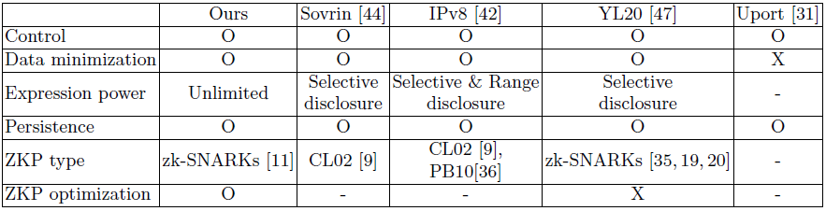
2.6 Self-sovereign model: Comparison

Slide 11
3. Primitives

Slide 12
3.1 Commitment
 | Input | Output
Setup (PPT algorithm) | λ | ck
Commit (PPT algorithm) | ck, u | c,o
Verify | ck,c,u,o | 0 / 1

Slide 13
3.2 (digital) Signature
 | Input | Output
Keygen | λ | sk,vk
Sign | m, sk | c,σ
Verify | m,vk,σ | 0 / 1

Slide 14
3.3 zk-SNARK
 | Input | Output
SetUp (PPT algorithm) | R ∈ R_{λ} | crs, τ
Prove (PPT algorithm) | crs, w, φ | π
Verify (Deterministic algorithm) | crs,w,φ | 0 / 1

Slide 15
3.4 Billinear Pair Function
A Generator Function
Input: λ (security parameter)
Output: (p,G₁,G₂,G_{T} , e, G,H)
non degenerative bilinear map e: G₁ x G₂-> G_{T}
G₁, G₂ , G_{T}= groups of prime number p with generator G ∈ G₁,generator H ∈ G₂

Slide 16
4. Approach
Use of CP-SNARK to:
Proof of knowledge (zk-SNARK) and proof of relation (CP-link)
Relation between proof of knowledge and commitment
Naive algorithm: include commitment checks in zk-SNARK
Actual algorithm: Check commitment outside of proof
-> improve computation efficiency

Slide 17
4.1 CP link
SetUp
Input = pp, crs_{k}*, element F
Select random u, v, w from ZP, calculate U= g₂^{u}, V=g₂^{v} and W=g₂^{w}
Generates randomly values r_{j,i} and calculate t_{j,i} = (g_{j,i}^{u} ) * (r_{j,i} ^{v} ) *(f_{j,i}^{w})
Output: crs_{link} _{k}
Prove
Input : crs_{link k} , c_{x} , u , o
Ouput : proofs T_{x} and R_{x} (π_{link}= T_{x} + R_{x})
Verify
Input: crs_{link k} , c_{x}, c
Output: checks whether the exponents of the proofs and commitments are equal using bilinear pairing function

Slide 18
4.2 CP-SNARK
 | Input | Output
Setup (PPT) | R_{cp} = (R,ck) | crs
Commit (PPT) | crs=(~c,φ), w_{cp}=((~u,~o),w) | proof π*
Verify (D) | crs, φ_{cp}, π* | 0 / 1

Slide 19
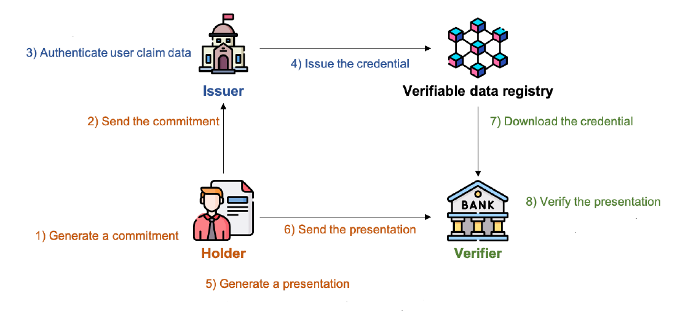
5. Implementation
2.Phase: zkVCP
1.Phase: zkCP
3.Phase: zkVPP

Slide 20
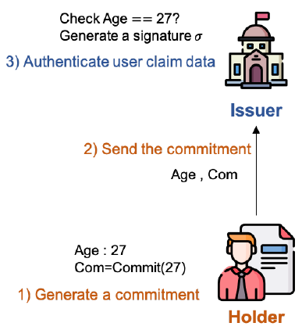
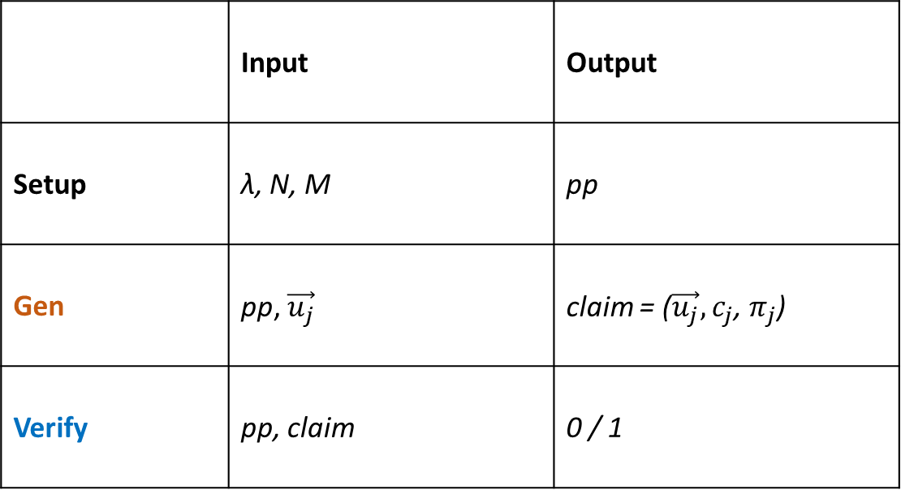
5.1 First Phase: zero-knowledge Claim Phase (zkCP)
 | Input | Output
Setup | λ, N, M | pp
Gen | pp, $\vec{u_{j}}$ | claim = ($\vec{u_{j}},$ $c_{j}$, $π_{j}$)
Verify | pp, claim | 0 / 1

Slide 21

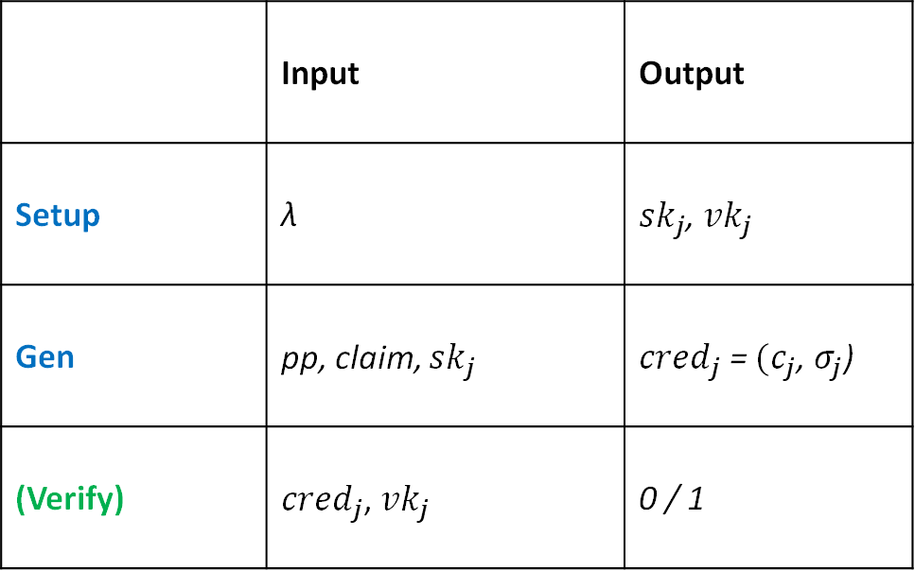
5.2 Second Phase: zero-knowledge Verifiable Credential Phase (zkVCP)
 | Input | Output
Setup | λ | ${sk}_{j}$, ${vk}_{j}$
Gen | pp, claim, ${sk}_{j}$ | ${cred}_{j}$ = $(c_{j}$, $σ_{j}$)
(Verify) | ${cred}_{j}$, ${vk}_{j}$ | 0 / 1

Slide 22
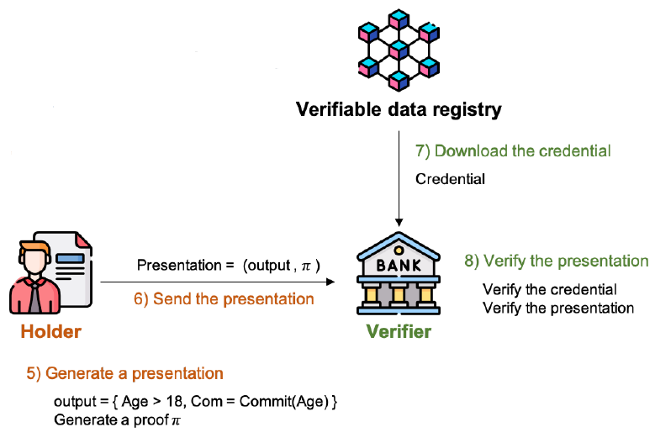
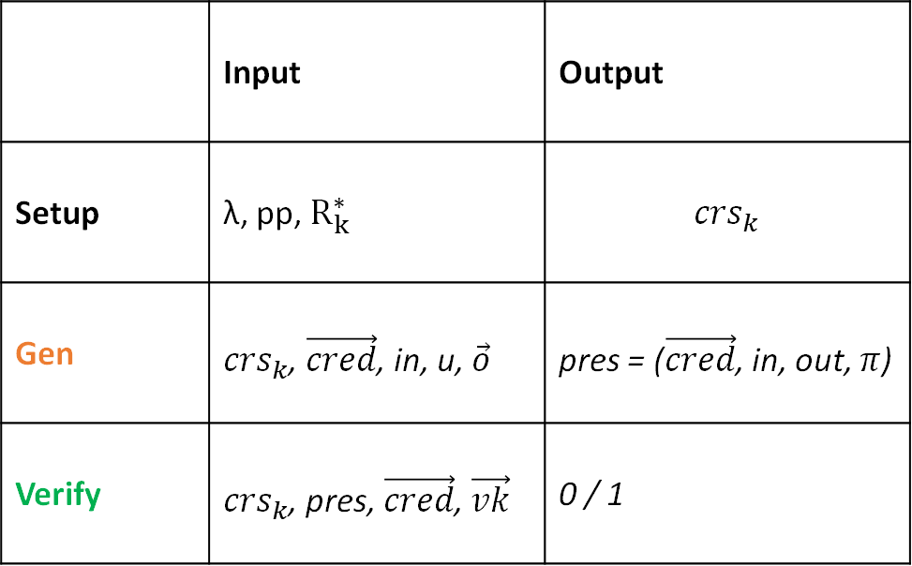
5.3 Third Phase: zero-knowledge Verifiable Presentation Phase (zkVPP)
 | Input | Output
Setup | λ, pp, $R_{k}^{∗}$ | $${crs}_{k}$$
Gen | ${crs}_{k}$, $\vec{cred}$, in, u, $\vec{o}$ | pres = ($\vec{cred}$, in, out, $π$)
Verify | ${crs}_{k}$, pres, $\vec{cred}$, $\vec{vk}$ | 0 / 1

Slide 23
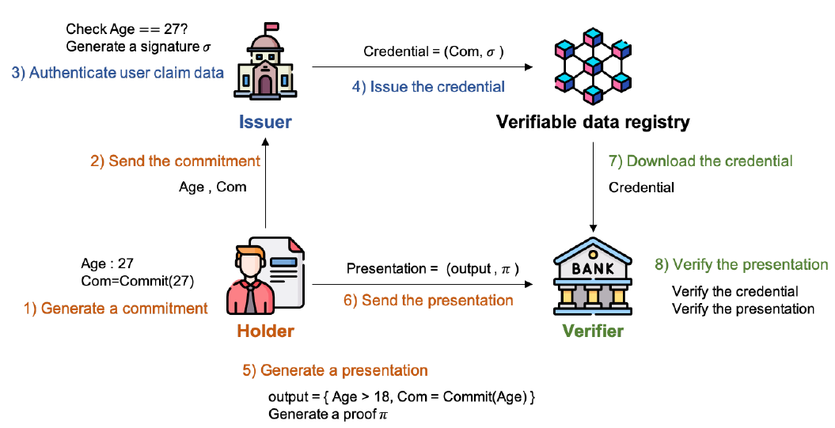
5.4 Implementation: Final Overview
2.Phase: zkVCP
1.Phase: zkCP
3.Phase: zkVPP

Slide 24
6. Proof of Security: Security model
Ideal world
cryptographic constructions are substituted to TP -> secure PIMS
Definition 11
A real functionality PIMS securely emulates the ideal world execution if there exists a simulator s.t.:
Pr[D(Ideal_{TP,S,Σ}(λ)) = 1] − Pr[D(Real_{PIMS,A,Σ}(λ))] ≈ 0
Theorem 1
The PIMS satisfies Definition 11 given the existence of CP-SNARK, Pedersen Commitment Scheme, Digital Signature Scheme and Verifiable Data Registry.

Slide 25
6.1 Proof of Theorem 1
Show that simulation is the same as real world execution (at least computationally indistinguishable) with games:
G0: real execution experiment
G1: replace proof with simulated proof
G2: replace CP-SNARK with knowledge extractor
G3: replace commitments with unique random values
G4: replace signatures by identifiers of issuer
=
=
=
=
=

Slide 26
6.2 Proof of G0 = G1
If proof system is computationally knowledge-sound then: G1 ≈ G2
Lemma 1
For all PPT adversaries A, if simulation sound CP-SNARK exists, then the advantage of distinguishing G0 and G1 is negligible for A.
-> Simulation fails with negligible probability
Proof of Lemma 1
Simulator operates in the same manner as in real execution and by definition, proof is CP-SNARK with an efficient simulator that fails only with negligible probability.

Slide 27
6.3 Proof of G1 = G2
If proof extractor fails with negligible probability then: G1 ≈ G2
Lemma 2
For all PPT adversaries A, if a knowledge extractable CP-SNARK exists, then the advantage of distinguishing G1 and G2 is negligible.
Proof of Lemma 2
Simulator operates in same manner as in real execution and by definition the proof for output is CP-SNARK with knowledge extractor.
-> proof extractor will fail with at most negligible probability

Slide 28
6.4 Proof of G2 = G3
If commitment scheme is secure then: G3 ≈ G2
Lemma 3
For all PPT adversaries A, the advantage of distinguishing G2 and G3 is negligible.
Proof of Lemma 3
Simulator operates in same manner as real execution and since commitment construction is a statistically hiding scheme, the probability that A can detect this substitution is negligible.

Slide 29
6.5 Proof of G3 = G4
If signature scheme satisfies unforgeability then: G4 ≈ G3
Lemma 4
For all PPT adversaries A, the advantage of distinguishing G3 and G4 is negligible.
Proof of Lemma 4
Simulator operates in same manner as real execution but signature is replaced with the issuer identifier value given from TP. Since by construction the signature satisfies unforgeability, the probability for A to forge signature is negligible.

Slide 30
6.6 Security proof conclusion
Proven that: G1 ≈ G4
-> Pr[D(IdealTP,S,Σ(λ)) = 1] − Pr[D(RealPIMS,A,Σ(λ))] ≈ 0
-> secure emulation of the ideal world execution
-> secure real world execution

Slide 31
6.7 Resistance against replay attacks
Two approaches:
1) Serial number | 2) Registration
Holder includes unique serial number in data presentation -> Verifier can check reuse | Holder produces unique proofs with randomness Verifiable presentation is stored -> Verifier can compare with existing entries

Slide 32
7. Experiment (Performance proof)

Slide 33
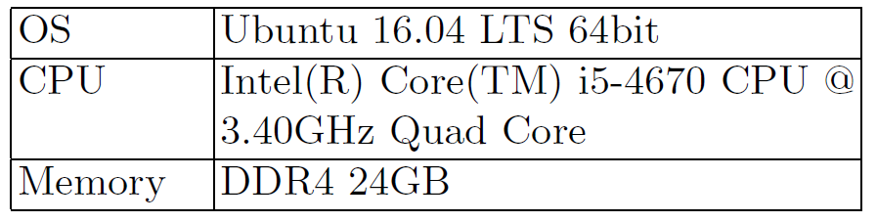
7.1 Experiment settings
Hardware:
Software:
use JSNARK (java library for zk-SNARK)

Slide 34
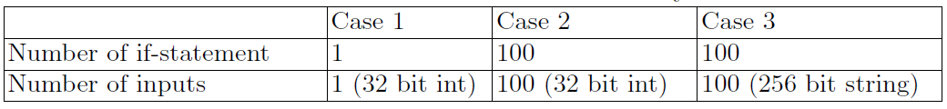
7.2 Experiment scenarios
3 proofs with different number of if-statements and input sizes:

Slide 35
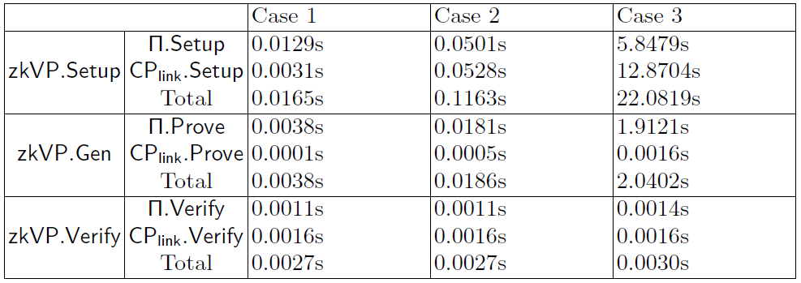
7.3 Experiment results - time
Input size and type are much more influencial than curcuit size

Slide 36
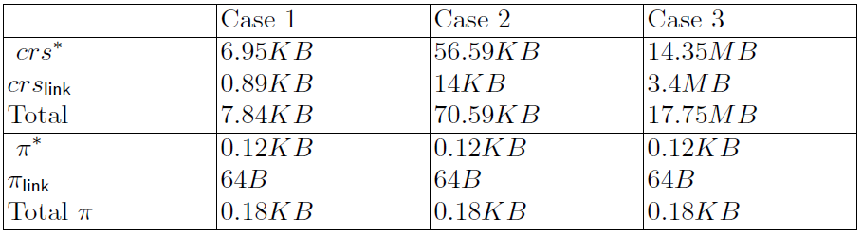
7.4 Experiment results - size
crs size correlates with input and curcuit size
Proof size remains the same

Slide 37
8. Conclusion
Using
zk-SNARKs as building blocks
Commit-and-Prove schemes (CP-SNARK)
It is possible to build a privacy-preserving self-sovereign identity model that
Supports data minimization for any relation
Runs with practical performance
Is formally secure
Future Work:
further improvement in performance of Cp-SNARK

Slide 38
Appendix
Paper: Lee, J. et al.: Privacy-preserving Identity Management System. IACR Cryptol. ePrint Arch. 2021 (2021)
Identity models:
Sovrin: Windley, P.: How sovrin works. Sovrin Foundation pp. 1-10 (2016)
Ipv8: Stokkink, Q. et al.: A truly self-sovereign identity system. arXiv preprint arXiv:2007.00415 (2020)
YL20: Yang, X., Li, W.: A zero-knowledge-proof-based digital identity management scheme in blockchain. Computers & Security 99, 102050 (2020)
Uport: Naik, N., Jenkings, P.: uport open-source identity management system: An assessment of self-sovereign identity and user-centric data platform built on blockchain. 2020 IEEE International Symposium on Systems Engineering pp. 1-7 (2020)
ZK-SNARK:
Groth, J., Maller, M.: Snarky signatures: Minimal signatures of knowledge from simulation-extractable snarks. Annual International Cryptology Conference. pp. 581 (2017)
Kim, J. et al.: Simulation-extractable zk-snark with a single verification. IEEE Access 8 (2020)
Lee, J. et al.: Forward-secure multi-user aggregate signatures based on zk-snarks. IEEE Access 9 (2021)
CP-link: Fiore, D. et al.: Hash first, argue later: Adaptive veri able computations on outsourced data. Proceedings of the 2016 ACM SIGSAC Conference on Computer and Communications Security. pp. 1304-1316 (2016)
CP-SNARK: Campanelli, M. et al.: Legosnark: Modular design and composition of succinct zero-knowledge proofs. In: Proceedings of the 2019 ACM SIGSAC Conference on Computer and Communications Security. pp. 2075-2092 (2019)

