Slide 1
CineWeb
by Ilyas, Ali

Slide 2
Introduction
CineWeb's Purpose: Simplifying Reservation Process
Touch-less & User-friendly Booking Service
Online Web Application that allows it’s users to book a ticket for their favorite movies.

Slide 3
Application Features
Log In Process:
Provide Email Address & Password
Checks in the database and gives Authorization
Sign In Process: Account Creation Steps
Provide your information such as name, email, phone, address, etc.…
Creates your account so that next time all you have to do is Log In.

Slide 4
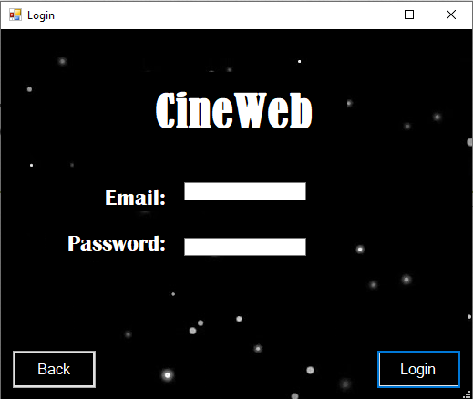
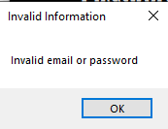
Log In Process
If the Information Provided is Authorized Then you move on to the next page. If The information is incorrect than the following pop up message appears

Slide 5
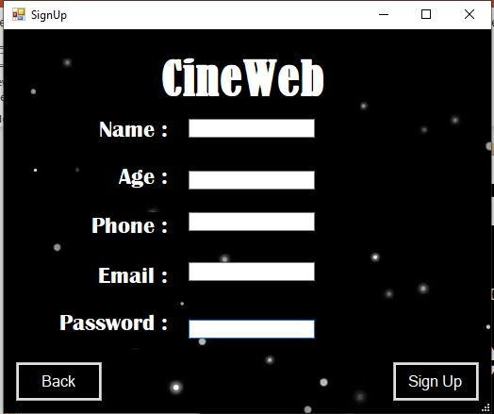
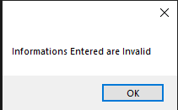
Sign Up Process
After Providing all of the information asked and clicking sign up your account will be successfully created.
1- Name should be String
2-Age should be an Integer
3-Phone should of the following pattern : XXX-XXX-XXXX
4- email should have an @ and also have a .(dot) with at least 2 letter after
5- Password should have minimum 1 Uppercase letter, 1 lowercase letter, 1 number, 1 special character and total of a minimum of 8 character
Else this message is displayed

Slide 6
Interactive Features
Personal Details Access
Reservation Details Access
All the reservations made by your account
Movie Selection by Genre
Movies are separated into fours categories : Action, Romance, Comedy, Drama
Showtime Selection
Select the exact date of your reservation
Seat Reservation
Select a specific seat out of the ones available
Secure Payment
provide your card details to finalize the payment
Confirmation Process
Receive a Receipt that has information such as your name, movie name, seat number, date , time , etc.

Slide 7
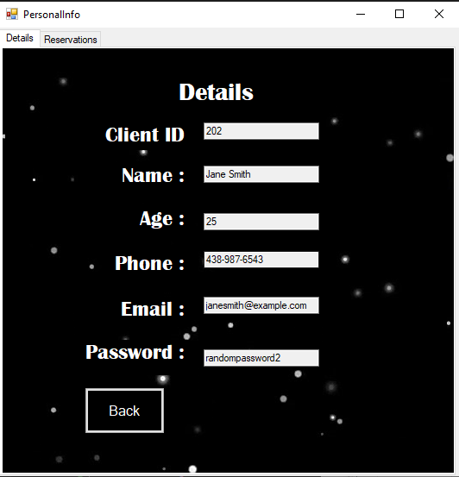
Personal Details Access
It give all of your personal information as displayed. You can switch tabs to have a look at all of your reservations

Slide 8
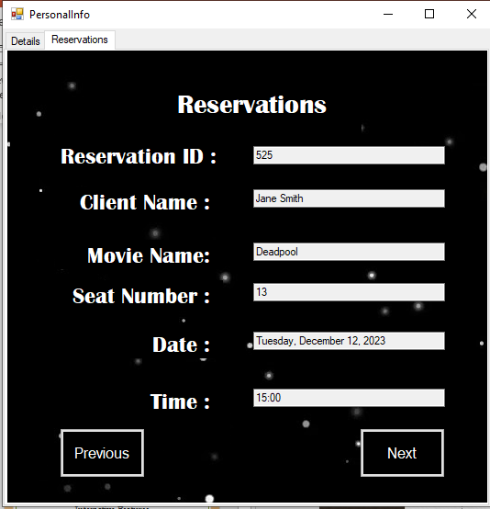
Reservation Details Access
You have all of your reservations saved here. You can iterate through the list by clicking Previous and Next. If you have gone through all of your reservations and you keep on clicking next it will come back to the first reservation. Basically it'll continue looping through your reservations.

Slide 9
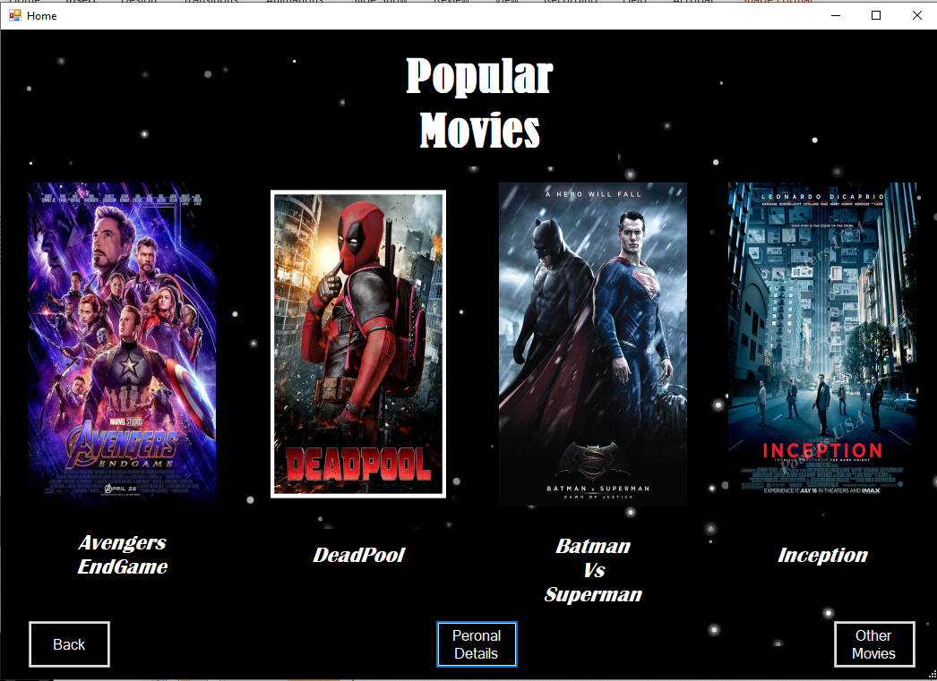
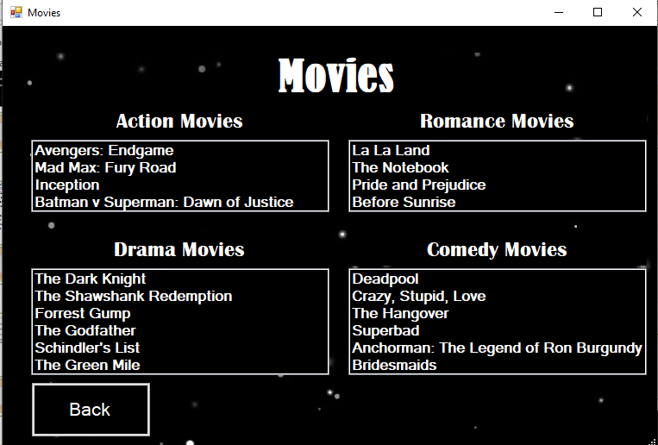
Movie Selection by Genre
Popular Movies
All other Movies Divided in genres

Slide 10
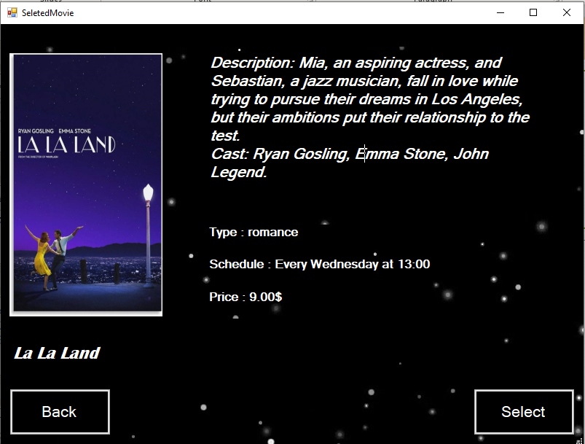
Finalize Movie Selection
Presented with :
Movie Poster
Description
Cast
Type of Movie
Schedule
Price

Slide 11
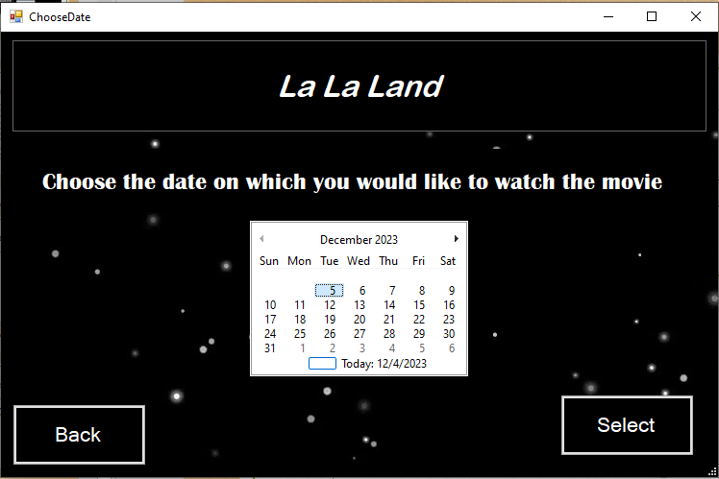
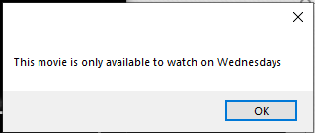
Showtime Selection
Chose by simple click on the desired date and finalize the choice by Clicking Select.
In this specific Example, since La La Land is only shown on Wednesdays at 13:00, if you click any other day of the week it’ll display the following message

Slide 12
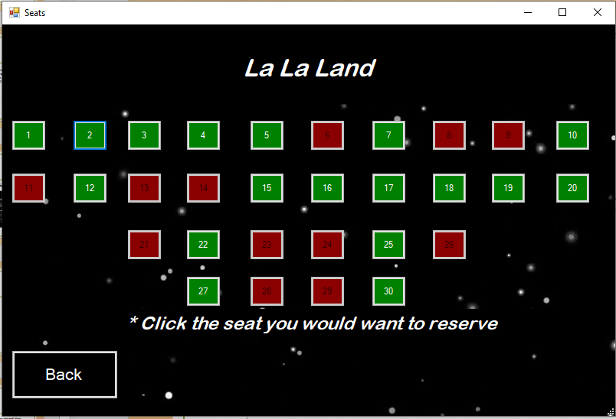
Seat Reservation
This shows the seats that are available(in green) for the selected movie on the selected date. All you have to do is click an available seat and it’ll take you to the next page

Slide 13
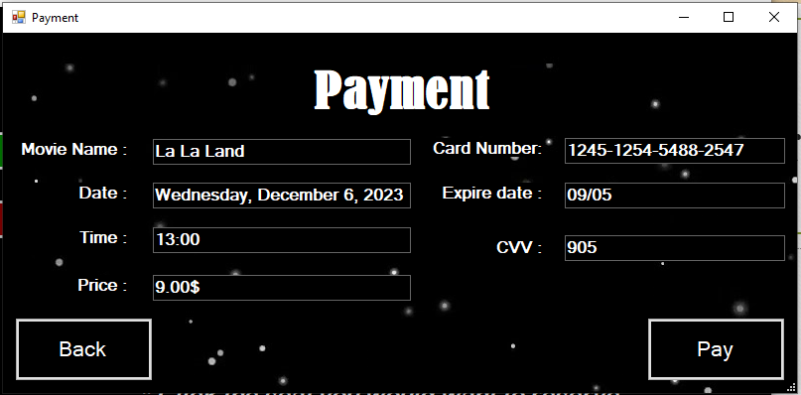
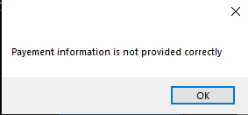
Secure Payment
This shows exactly what you chose
The card number should be in this Format: XXXX-XXXX-XXXX-XXXX
The expire date is supposed to be in this format : XX/XX
CVV should be a number composed of 3 digits
Else you'll be shown this message :

Slide 14
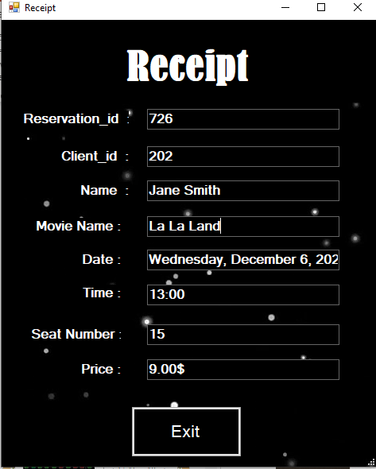
Confirmation Process
The reservation is completed here is your receipt. The next time you log in to your account you'll be able to see this reservation in your list of reservations.

Slide 15
Thanks For Listening
by Ilyas, Ali

