Slide 1
layout in question

Slide 2
layout in question

Slide 3
Float

Slide 4
index.html
<div class=‘todo’>
<div class=‘todo-text’>something idk</div>
<div class=‘action’>
<img src=‘delete.png’ />
</div>
</div>
main.css
.action {
float: right;
}
float

Slide 5

float

Slide 6

caveats

Slide 7
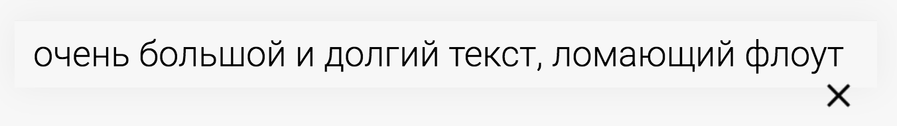
caveats

Slide 8
Position

Slide 9
main.css
.action {
position: absolute;
top: 10px;
right: 10px;
}
.todo { position: relative;
}
position: absolute

Slide 10

position: absolute

Slide 11

caveats

Slide 12
CSS FlexBox

Slide 13
main.css
.todo { display: flex;
}
flex

Slide 14

flex

Slide 15
main.css
.todo { display: flex;
}
.todo-text {
flex-grow: 1;
}
flex

Slide 16
flex

Slide 17
Flex QOL

Slide 18
index.html
<div class="blocks">
<div class="block one">1</div>
<div class="block two">2</div>
<div class="block three">3</div>
<div class="block four">4</div>
</div>
flex

Slide 19
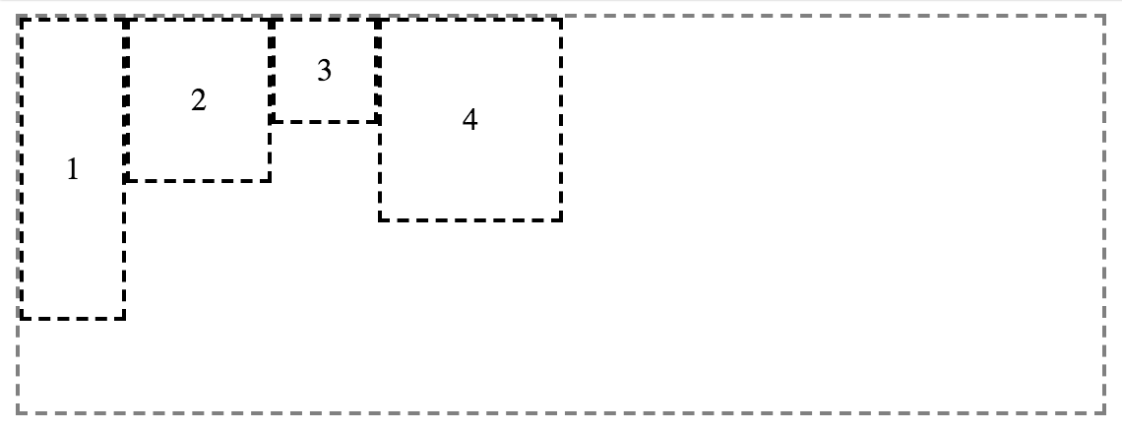
flex-direction: row;
flex

Slide 20
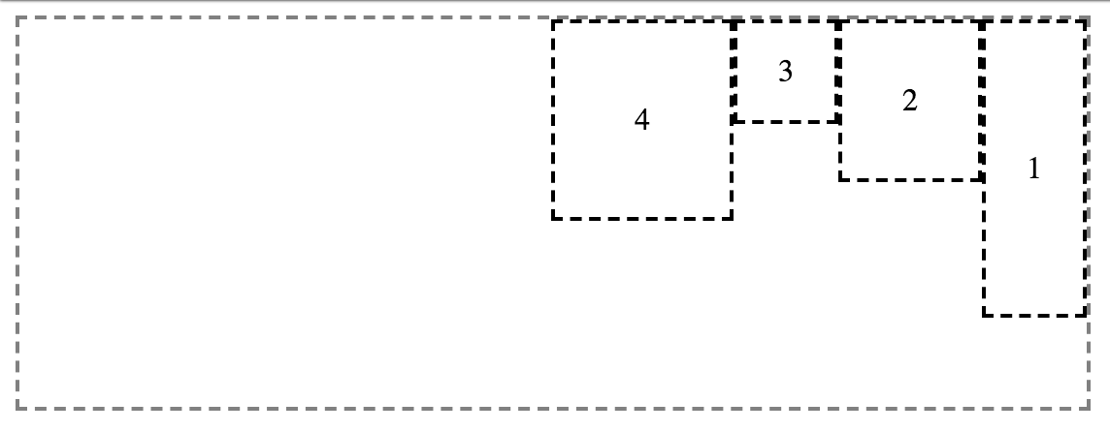
flex-direction: row-reverse;
flex

Slide 21
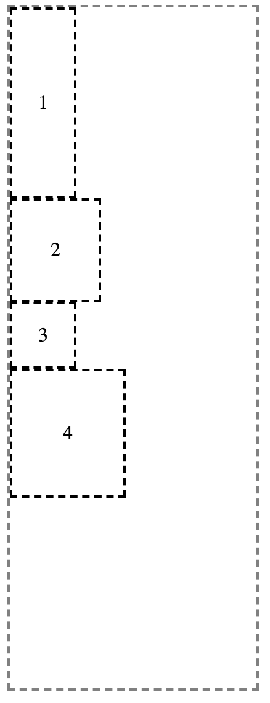
flex-direction: column;
flex

Slide 22
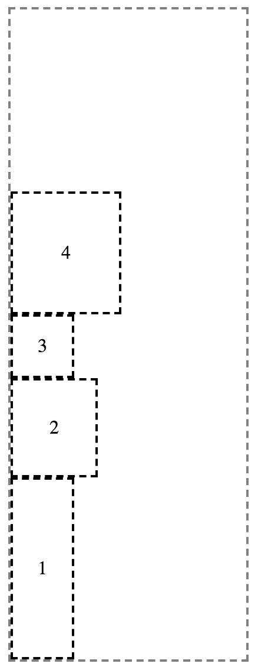
flex-direction: column-reverse;
flex

Slide 23

justify-content: flex-start;

Slide 24
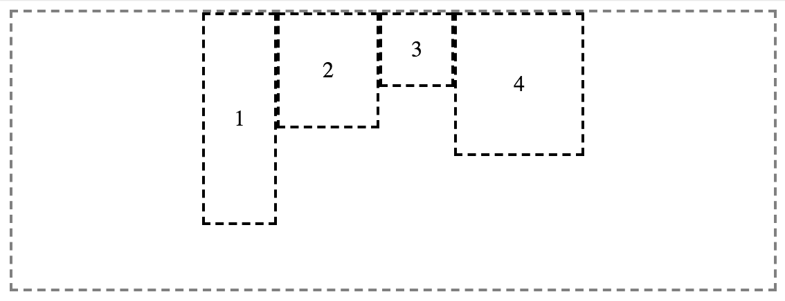
justify-content: center;
flex

Slide 25
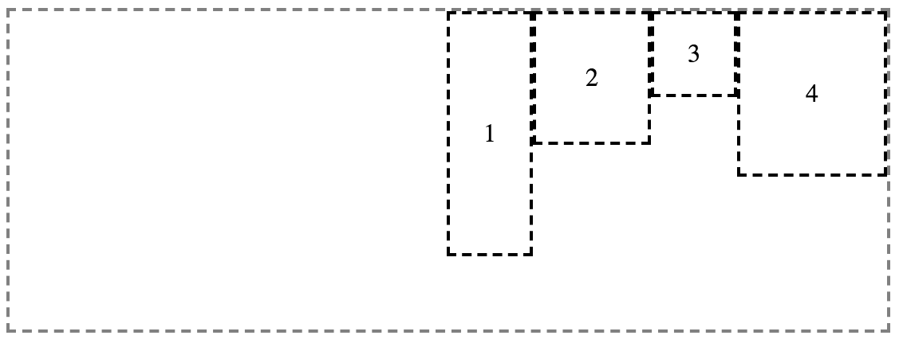
justify-content: flex-end;
flex

Slide 26
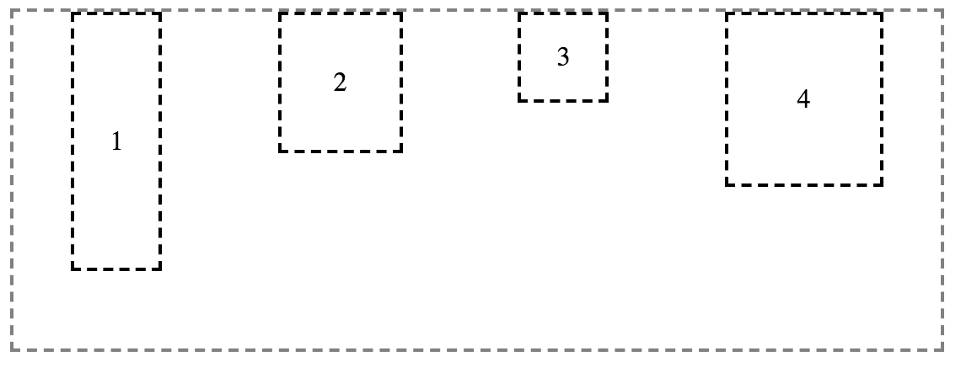
justify-content: space-around;
flex

Slide 27
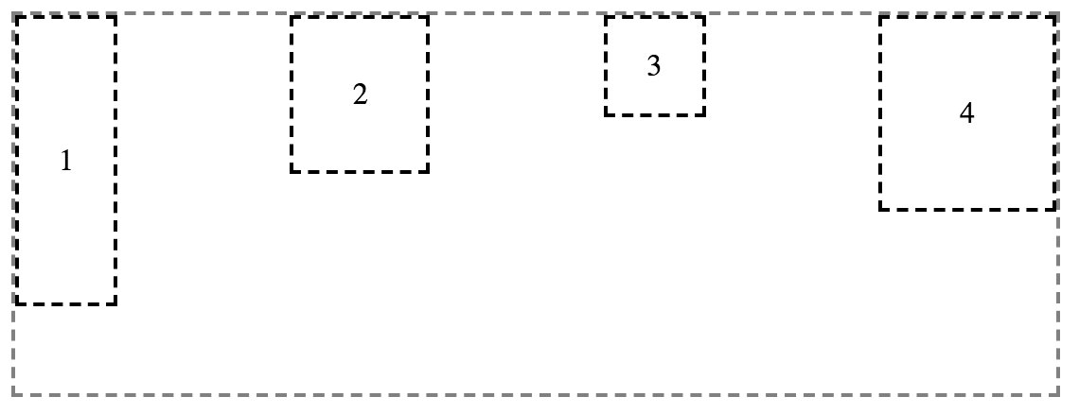
justify-content: space-between;
flex

Slide 28
align-items: flex-start;
flex

Slide 29
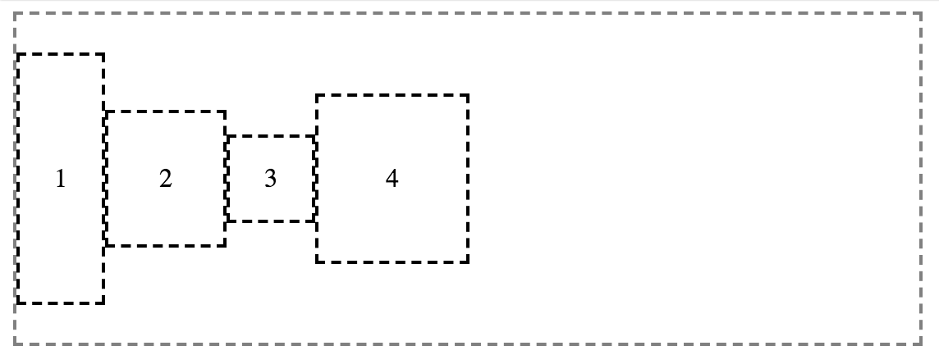
align-items: center;
flex

Slide 30
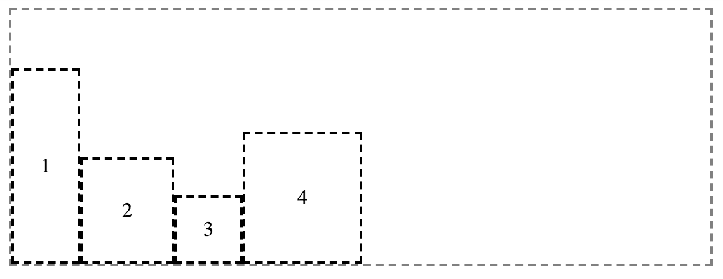
align-items: flex-end;
flex

Slide 31
justify-content
align-items
main axis
flex

Slide 32
align-items
justify-content
main axis
flex

Slide 33
@media

Slide 34
main.css
<meta name="viewport" content="width=device-width, initial-scale=1">
necessary meta

Slide 35
main.css
@media screen and (min-width: 512px) {
selector {
property: value;
}
}
@media

Slide 36
main.css
@media screen and (min-width: 512px) {
selector {
property: value;
}
}
media type
@media

Slide 37
main.css
@media screen and (min-width: 512px) {
selector {
property: value;
}
}
media query
@media

Slide 38
main.css
body {
background-color: red;
}
@media screen and (min-width: 512px) {
body {
background-color: green;
}
}
@media

Slide 39

@media

Slide 40
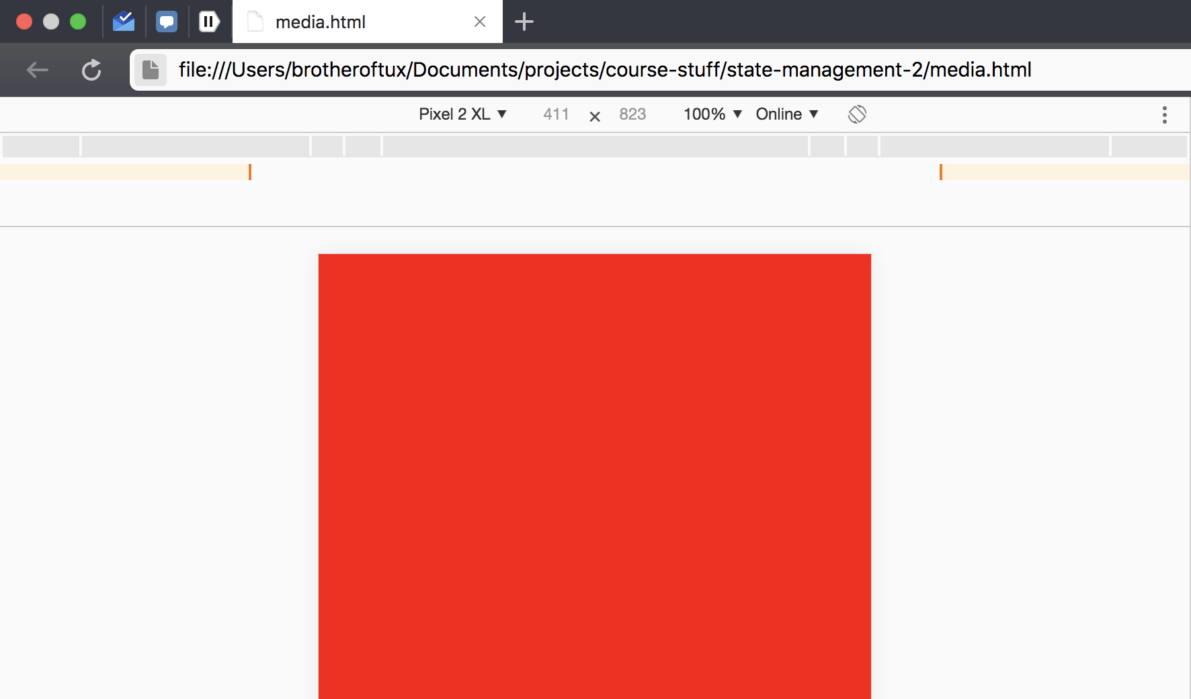
@media

