Slide 1
Network

Slide 2
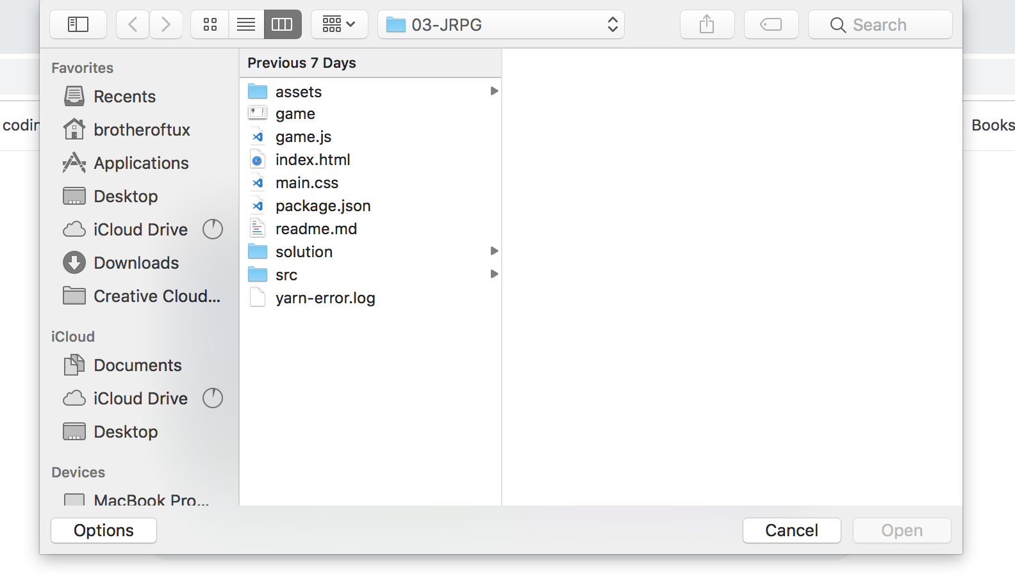
connection

Slide 3
connection

Slide 4
HTTP
connection

Slide 5
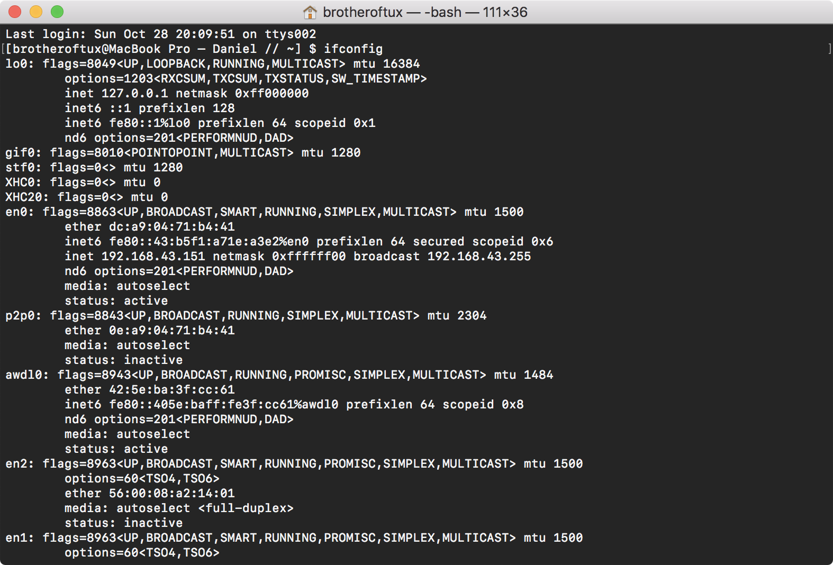
ip

Slide 6
ip

Slide 7
https://google.com
domain names

Slide 8
https://google.com
domain names

Slide 9
google.com -> ?.?.?.?
domain names

Slide 10
Client
DNS Server
google.com
dns

Slide 11
Client
DNS Server
173.194.122.152
dns

Slide 12
173.194.122.152:80
connecting to server

Slide 13
173.194.122.152:443
connecting to server

Slide 14
https://173.194.122.152:443
connecting to server

Slide 15
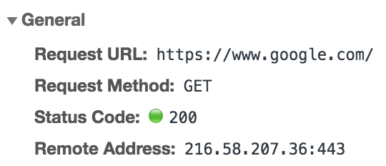
get request

Slide 16
get request

Slide 17
A Misconception

Slide 18
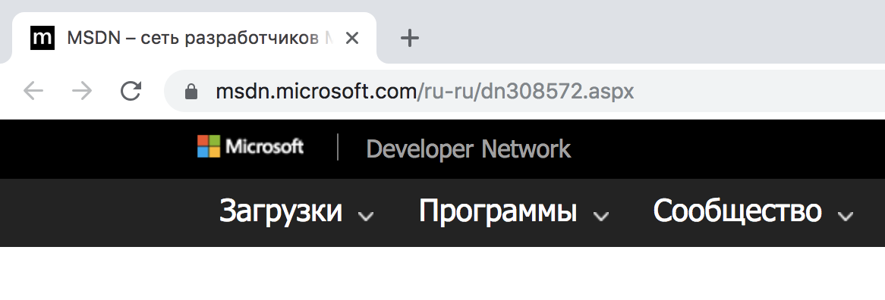
it’s all html

Slide 19
it’s all html

Slide 20
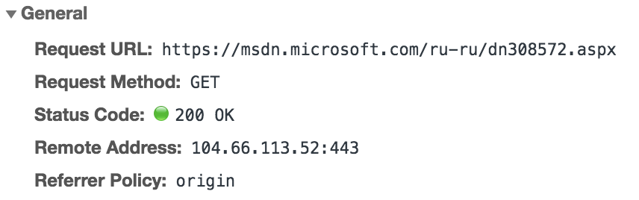
it’s all html

Slide 21
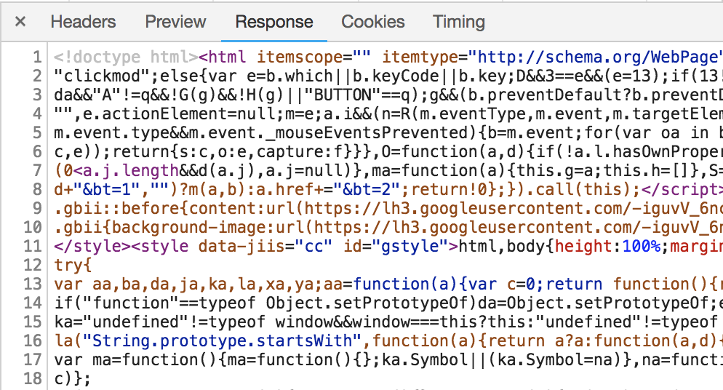
it’s all html

Slide 22
GET /path/to/somewhere
response.end(‘Hello world!’)
server decides how to handle response

Slide 23
GET /path/to/somewhere.php
php script.php
HTML
server decides how to handle response

Slide 24
Подходы к разработке

Slide 25
Server-Side Rendering

Slide 26
Client-Side Rendering

Slide 27
index.html
Клиент
app.js
main.css
client-side rendering

Slide 28
index.html
<!doctype html>
<html>
<head> <!-- ... --> </head>
<body>
<div id=‘app’></div>
<script src=‘app.js’></script>
</body>
</html>
client-side rendering

Slide 29
Isomorphic Rendering

Slide 30
XMLHttpRequest

Slide 31
xhr.js
const xhr = new XMLHttpRequest()
xhr.open(‘GET’, ‘url’)
xhr.onreadystatechange = () => {
if (xhr.readyState === XMLHttpRequest.DONE &&
xhr.status === 200)
console.log(xhr.responseText)
}
xhr

Slide 32
JSON

Slide 33
file.json
{
“key”: ”data”
“numericKey”: 42
}
json

Slide 34
json.js
const someObject = {
key: ‘ayyy’,
anotherKey: 45
}
const jsonString = JSON.stringify(someObject)
// {"key":"ayyy","anotherKey":45}
const parsedObject = JSON.parse(jsonString)
parsedObject.key
// ayyy
json

Slide 35
Практика

Slide 36
https://samples.openweathermap.org/data/2.5/weather?q=London,uk
&appid=b6907d289e10d714a6e88b30761fae22
const object = JSON.parse(response)
object.main.temp – 273 // ~= 7
практика

