Slide 1
Quick Recap

Slide 2
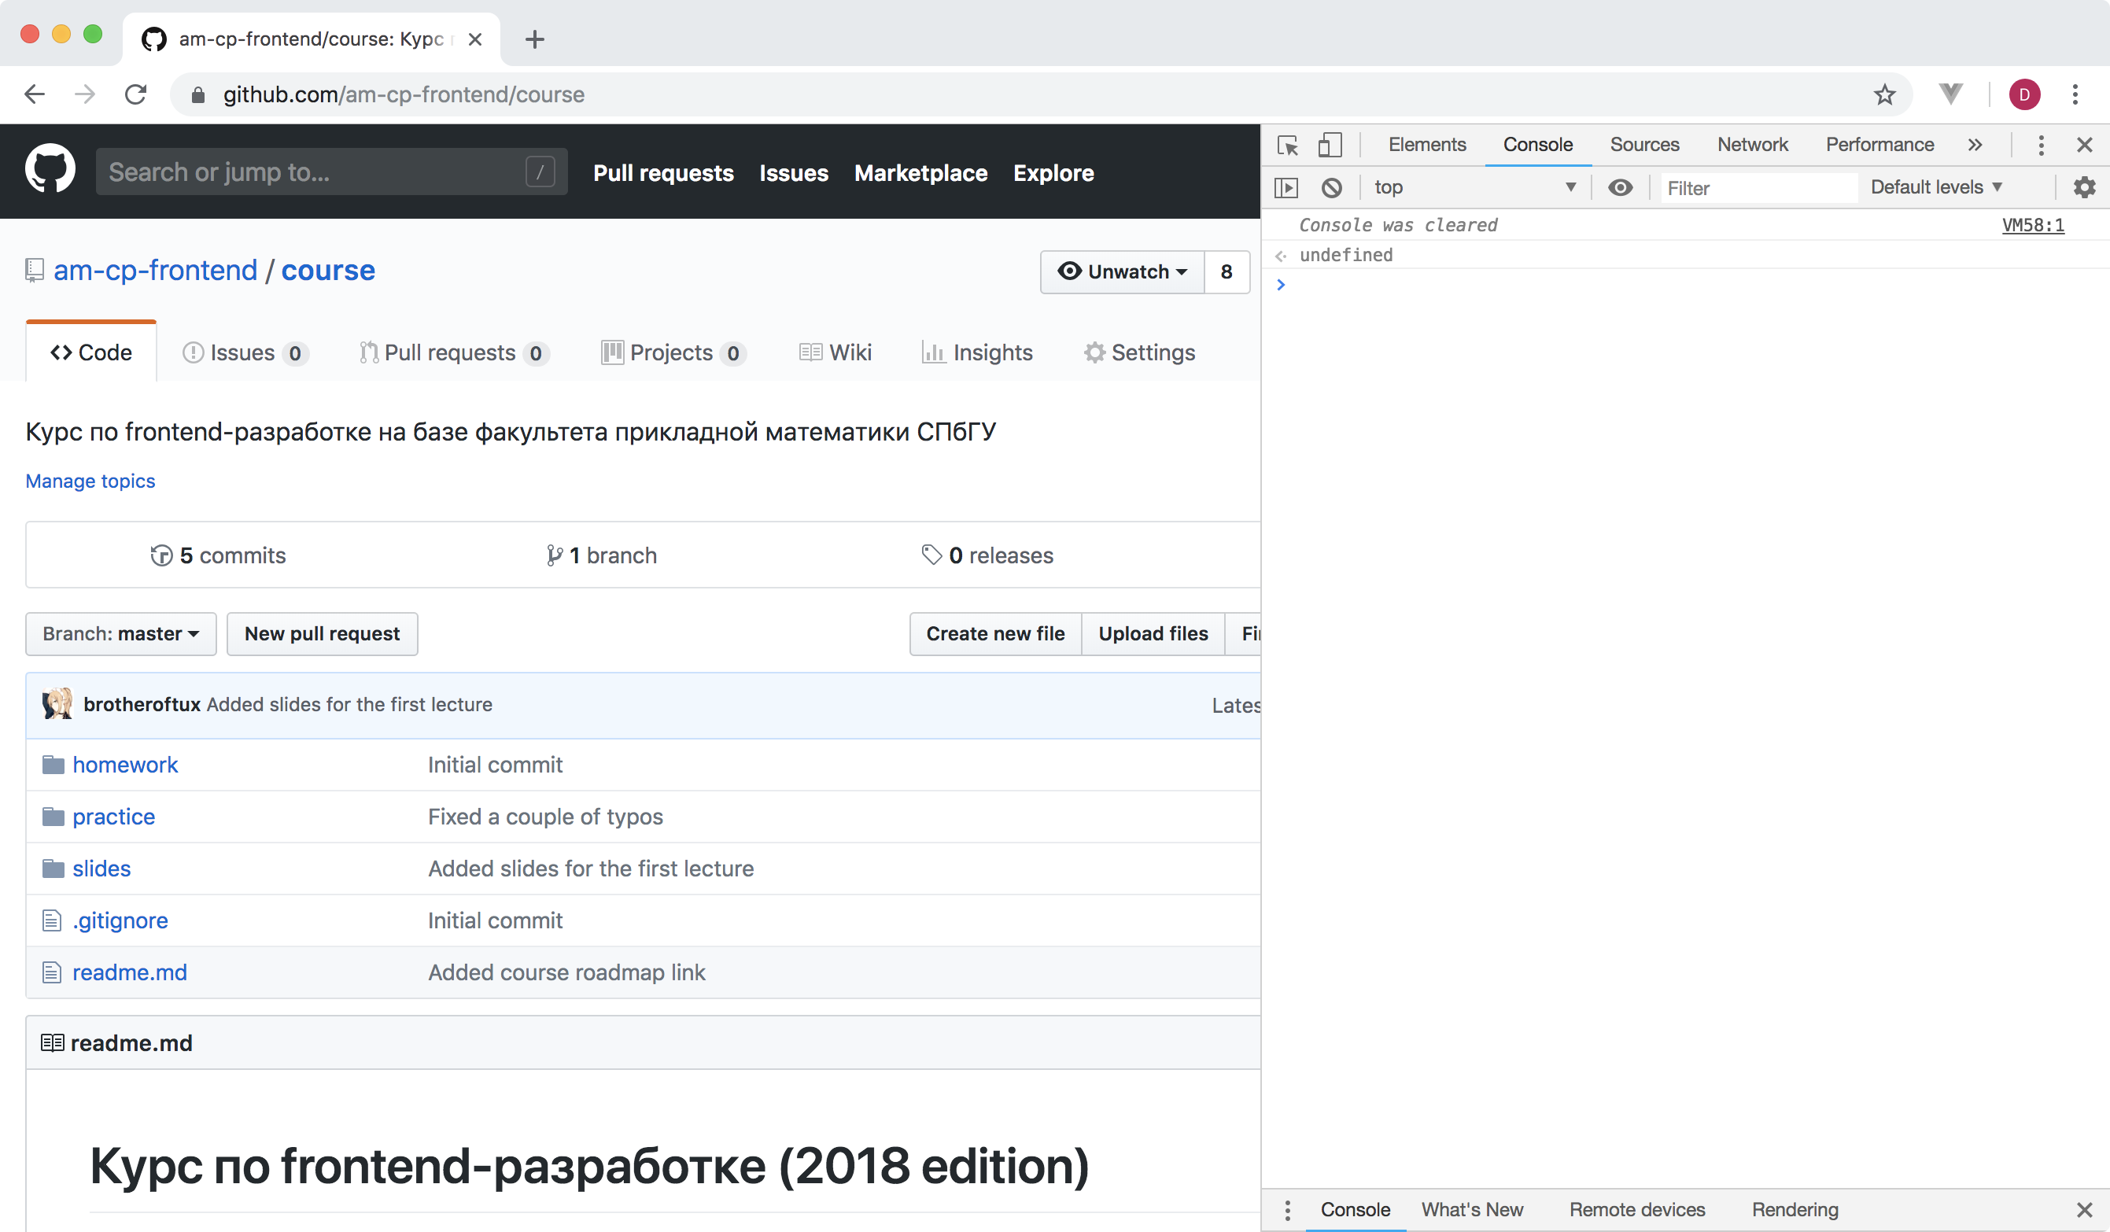
devtools encounter

Slide 3
variables.js
const number = 0.5
const string = ‘Hey guys, massive legend here!’
const array = [‘some’, 42, number]
// yikes
const greeter = name => `Hello, ${name}`
console.log(greeter(‘world’))
variables

Slide 4
0, null, undefined, ‘’,
false, NaN
falsy

Slide 5
if (‘0’)
console.log(‘yikes’)
truthy

Slide 6
for (el of iterable) {
statements
}
for-of

Slide 7
for-of.js
const numbers = [1, 2, 3, 7]
for (let number of numbers)
console.log(number)
/*
1
2
3
7
*/
for-of

Slide 8
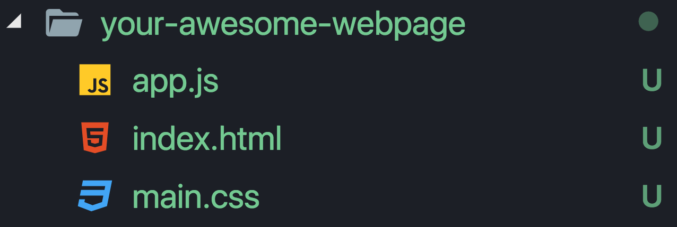
js include

Slide 9
<script src=‘app.js’>
</script>
include

Slide 10
<script>
your awesome code
</script>
or

Slide 11
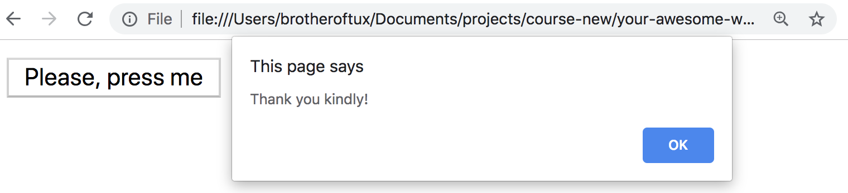
addEventListener.js
const button = document.querySelector(‘#button’)
button.addEventListener(‘click’, function () {
alert(‘Thank you kindly!’)
})
event listeners

Slide 12
Функции

Slide 13
function name (args) {
statements
[return expr]
}
functions

Slide 14
functions.js
function greeter (name) {
console.log(‘Hello there, ‘ + name)
}
greeter(‘Elon Musk’)
// Hello there, Elon Musk
functions

Slide 15
functions.js
function greeter (name) {
console.log(‘Hello there, ‘ + name)
}
greeter(‘Elon Musk’)
// Hello there, Elon Musk
greeter(‘Elon Musk’, ‘redundant’)
// Hello there, Elon Musk
functions

Slide 16
functions.js
function argumentsTest () {
console.log(arguments)
}
argumentsTest(1, 2, 3, 4, 5, 6, 7)
// [1, 2, 3, 4, 5, 6, 7]
arguments

Slide 17
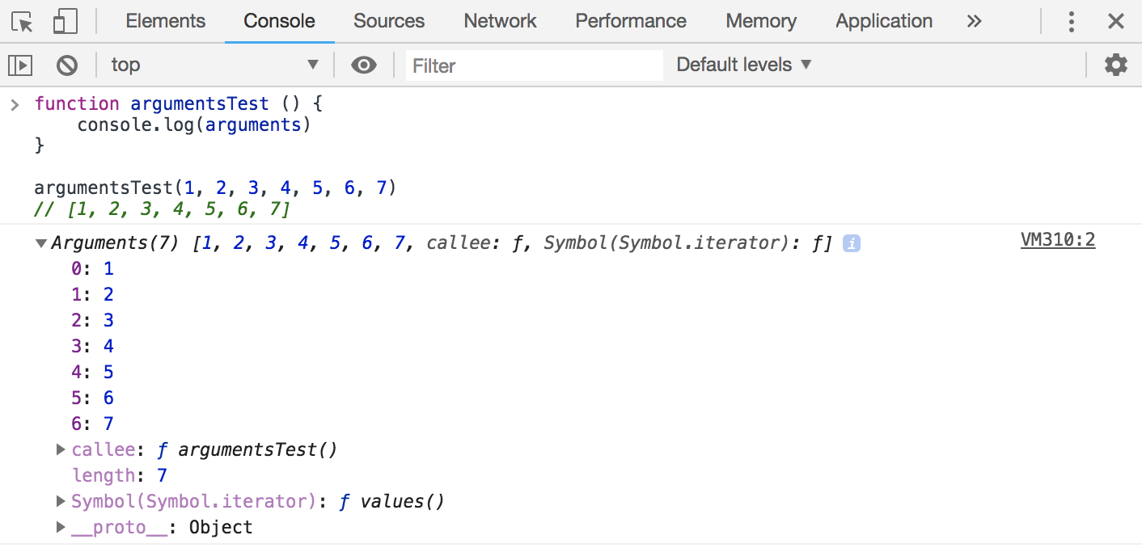
arguments

Slide 18
Hoisting

Slide 19
functions.js
willHoist()
function willHoist () { }
// vs
wontHoist()
const wontHoist = function () { }
// Uncaught ReferenceError: wontHoist is not defined
hoisting

Slide 20
Higher Order Functions

Slide 21
hof.js
function evaluate (lhs, rhs, binaryOpImpl) {
return binaryOpImpl(lhs, rhs)
}
const addition = function (a, b) {
return a + b
}
evaluate(49, 41, addition)
// 90
hof

Slide 22
hof.js
function helloGenerator () {
return function () {
console.log(‘Hello’)
}
}
const greeter = helloGenerator()
greeter()
// Hello
hof

Slide 23
Scoping

Slide 24
scoping.js
let counter = 0
function makeIncrementer () {
return function () {
return ++counter
}
}
const incrementer = makeIncrementer()
incrementer()
// 1
scoping

Slide 25
scoping.js
let counter = 0
function makeIncrementer () {
return function () {
return ++counter
}
}
const incrementer = makeIncrementer()
incrementer()
// 1
scoping

Slide 26
Closures

Slide 27
closures.js
function makeIncrementer () {
let counter = 0
return function () {
return ++counter
}
}
const incrementer = makeIncrementer()
const anotherIncrementer = makeIncrementer()
closures

Slide 28
closures.js
const incrementer = makeIncrementer()
const anotherIncrementer = makeIncrementer()
incrementer()
// 1
incrementer()
// 2
anotherIncrementer()
// 1
incrementer()
// 3
closures

Slide 29
Block Variables

Slide 30
block-variables.js
// pre es6-style
if (true) {
var some = ‘a’
}
some
// a
var vs let/const

Slide 31
block-variables.js
// pre es6-style
if (true) {
let some = ‘a’
}
some
// Uncaught ReferenceError: some is not defined
var vs let/const

Slide 32
block-variables.js
// pre es6-style
if (true) {
const some = ‘a’
}
some
// Uncaught ReferenceError: some is not defined
var vs let/const

Slide 33
Контекст выполнения

Slide 34
this

Slide 35
this
this

Slide 36
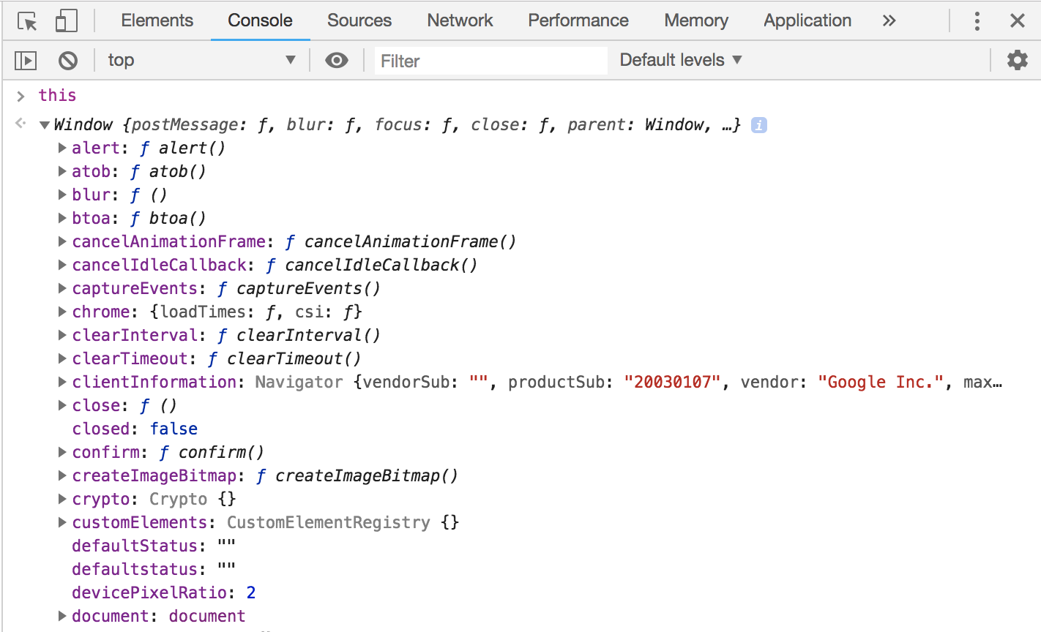
this

Slide 37
this.js
const someObject = {
someFunction: function () {
console.log(this)
},
someData: 'u s e l e s s d a t a'
}
someObject.someFunction()
this

Slide 38
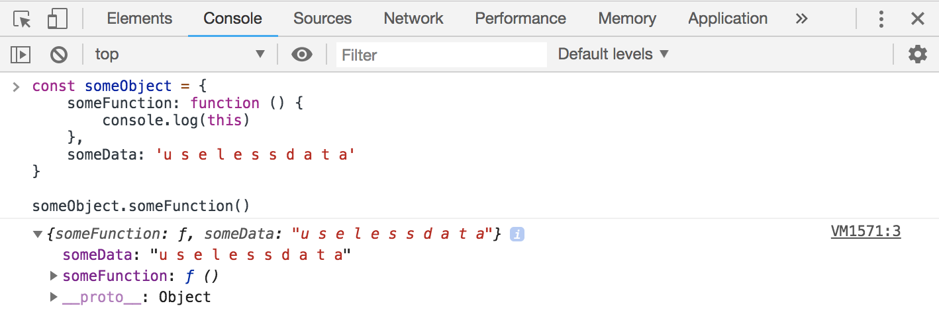
this

Slide 39
this.js
const someObject = {
someFunction: function () {
console.log(this)
},
someData: 'u s e l e s s d a t a'
}
const reference = someObject.someFunction
reference()
this

Slide 40
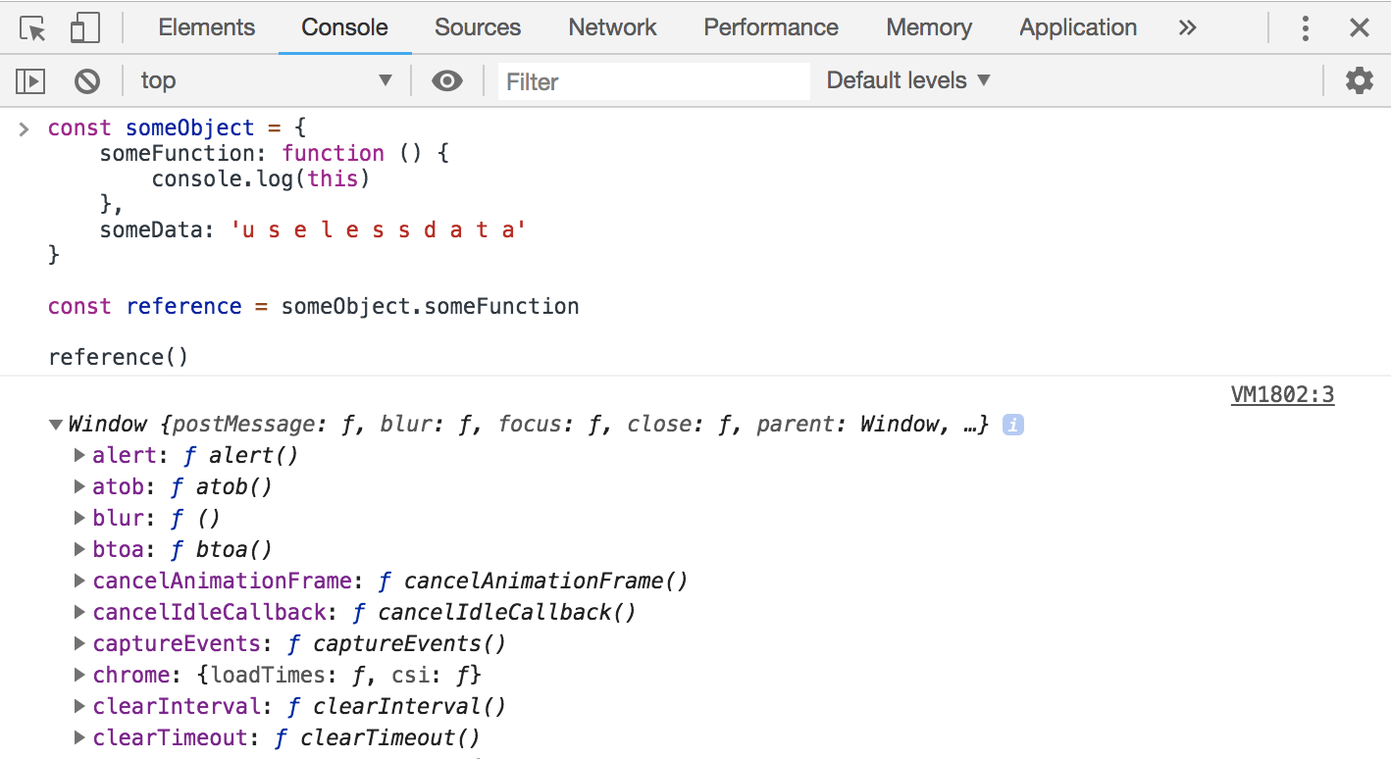
this

Slide 41
this.js
const someObject = {
someFunction: function () {
console.log(‘Why, hello there!’)
},
anotherFunction: function () {
someFunction()
}
}
someObject.anotherFunction()
// Uncaught ReferenceError: someFunction is not defined
this

Slide 42
this.js
const someObject = {
someFunction: function () {
console.log('Why, hello there!')
},
anotherFunction: function () {
this.someFunction()
}
}
someObject.anotherFunction()
// Why, hello there!
this

Slide 43
Меняем контекст выполнения

Slide 44
this.js
const a = {k: 7}
const b = {
k: 5,
modifyK: function () {
this.k = ‘ok buddy, it’s modified’
}
}
b.modifyK.call(a)
b.k // 5
a.k // ok buddy, it’s modified
call

Slide 45
Arrow functions

Slide 46
const arrow = (arguments) => {
statements
[return expr]
}
basic syntax

Slide 47
const arrow = (arguments) =>
return-expr
one-liner

Slide 48
const arrow = argument =>
return-expr
with one arguments

Slide 49
this.js
const normalOne = function (a, b) {
return a + b
}
// vs
const arrow = (a, b) => a + b
normalOne(2 + 2) // 4
arrow(4 - 1) // 3
arrow functions

Slide 50
this.js
const normalOne = function (name) {
return `Hey, ${name}`
}
// vs
const arrow = name => `Hey, ${name}`
normalOne(‘Ben Shapiro’) // Hey, Ben Shapiro
arrow(‘Vsauce, Michael here’)
// Hey, Vsauce, Michael here
arrow functions

Slide 51
Big differences

Slide 52
this.js
const a = {k: 7}
const b = {
k: 5,
modifyK: () => {
this.k = 'ok buddy, it’s modified'
}
}
b.modifyK()
a.k // 7
b.k // 5
// ??
не перепривязывают this

Slide 53
this.js
const a = {k: 7}
const b = {
k: 5,
modifyK: () => {
this.k = 'ok buddy, it’s modified'
}
}
b.modifyK()
window.k
// 'ok buddy, it’s modified'
не перепривязывают this

Slide 54
this.js
const a = {k: 7}
const b = {
k: 5,
modifyK: () => {
this.k = 'ok buddy, it’s modified'
}
}
b.modifyK.call(a)
a.k // 7
b.k // 5
не перепривязывают this

Slide 55
functions.js
const argumentsTest = () => console.log(arguments)
argumentsTest(1, 2, 3, 4, 5, 6, 7)
// Uncaught ReferenceError: arguments is not defined
нет arguments

