Slide 1
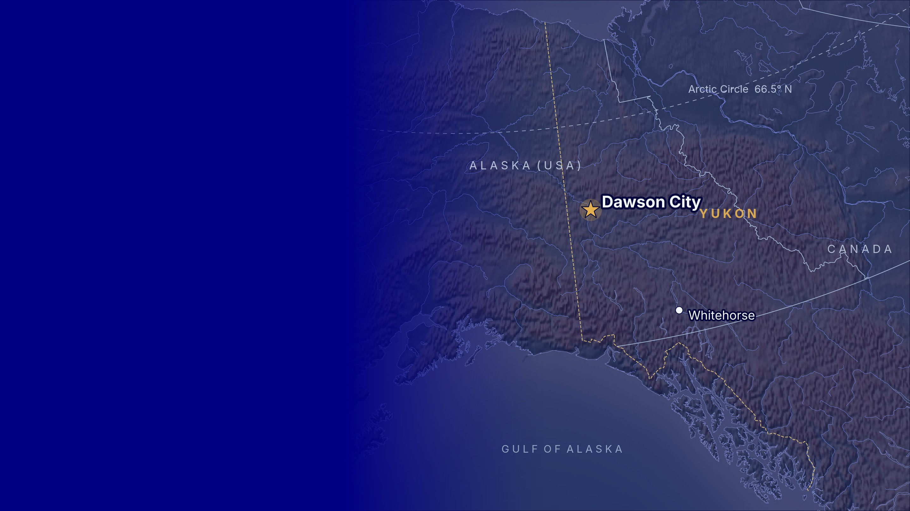
The Klondike
Gold Rush
YUKON, CANADA · 1896–1899
The last great gold rush, and a 5-day trip to Dawson City, the town where it all began.
Notes:
ALI: Good morning, everyone. We are Ali, Tuana and Irmak, and today we are taking you to the far north of Canada. Our topic is the Klondike Gold Rush, one of the biggest adventures of the 19th century. In the first part, I will tell you what happened, where and when. Then Tuana will present our five-day trip to Dawson City, and Irmak will explain the practical details and the budget. Let’s begin.

Slide 2
What We Will Cover
CONTENTS
01
02
03
04
05
The Gold Rush
Three Facts
5-Day Tour Plan
Practical Info
Budget
What it was, where it happened and when
Interesting things most people do not know
Weather, transport, where to sleep, what to pack
What the trip costs with 2,000 USD per person
Places, activities and a plan for every day
DESTINATION
DATES
TRAVELLERS
BUDGET
Dawson City, Yukon, Canada
12 to 16 August 2027
3 friends, one shared room
2,000 USD per person
The Klondike Gold Rush · Pertevniyal High School 159/E
2
Notes:
ALI: Here is our plan for the next fifteen minutes. First, the Gold Rush itself: what it was, where it happened and when. Second, three interesting facts that surprised us. Third, our five-day tour plan, with places and activities for every day. Fourth, practical information: weather, transport, accommodation and what to pack. And finally, the budget. Our trip is for three friends, from 12 to 16 August 2027, with 2,000 US dollars per person.

Slide 3
What Was the Klondike Gold Rush?
THE GOLD RUSH · OVERVIEW
In August 1896, gold was found in Bonanza Creek, a small stream near today’s Dawson City in Yukon, north-western Canada. When the news reached the United States one year later, about 100,000 people left their homes and headed north, hoping to get rich.
100,000
30,000
reached Dawson City
The “stampede” lasted from 1897 to 1899. It turned a quiet river valley into Dawson City, a boomtown of 30,000 people, and it was one of the last great gold rushes in history.
people set out for the Klondike
4,000
3 years
THREE WORDS TO KNOW
Stampeder – a person who rushed to the Klondike · Claim – a piece of land a miner registers to dig for gold · Panning – washing river gravel in a pan to find gold
actually found gold
from discovery to the end, 1896 to 1899
The Klondike Gold Rush · Pertevniyal High School 159/E
3
Notes:
ALI: So, what was the Klondike Gold Rush? In August 1896, gold was found in a small stream called Bonanza Creek, in Yukon, in the north-west of Canada. One year later the news reached the United States, and about 100,000 people left their jobs and families to go north. We call them “stampeders”. Only 30,000 of them reached Dawson City, and only about 4,000 found gold. Three useful words for today: a stampeder is a person who rushed to the Klondike; a claim is a piece of land that a miner registers; and panning means washing river gravel in a pan to find gold.

Slide 4
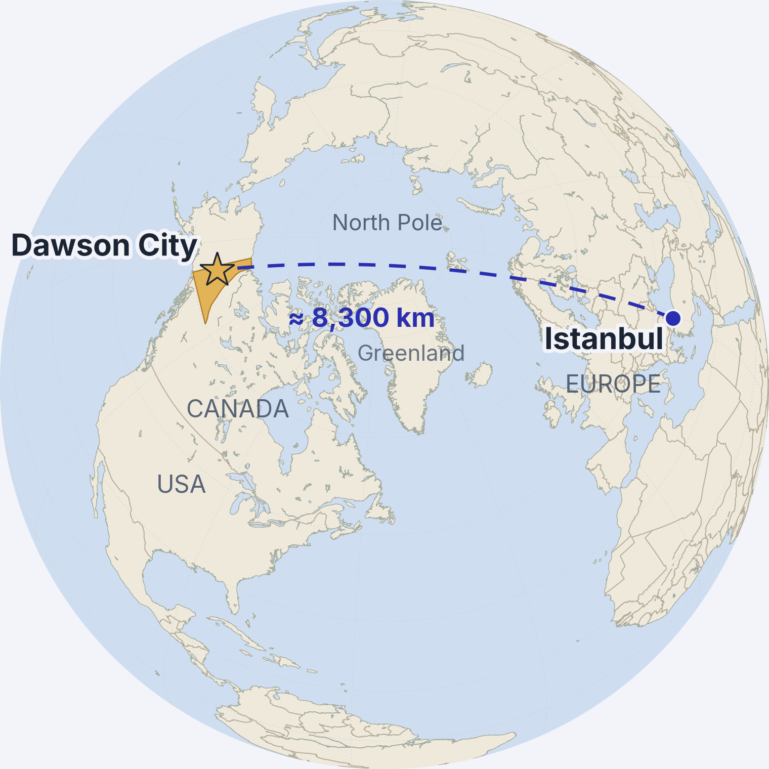

Where: Dawson City, Yukon, Canada
THE GOLD RUSH · WHERE
Yukon Territory, in the far north-west of Canada, next to Alaska (USA)
64° North, only 300 km south of the Arctic Circle
Where the Klondike River flows into the Yukon River
530 km north of Whitehorse, the capital of Yukon
About 8,300 km from Istanbul in a straight line, over the North Pole
Traditional land of the Tr’ondëk Hwëch’in First Nation; the name “Klondike” comes from their word Tr’ondëk
Population today: about 1,600 people (40,000 in 1898!)
The Klondike Gold Rush · Pertevniyal High School 159/E
4
Notes:
ALI: Where is this place? Dawson City is in Yukon Territory, in the far north-west of Canada, right next to Alaska. It is at 64 degrees north, only 300 kilometres south of the Arctic Circle. The town stands where the Klondike River meets the Yukon River. On the globe you can see Istanbul on the right and Dawson City on the left. In a straight line over the North Pole, it is about 8,300 kilometres away. This is the traditional land of the Tr’ondëk Hwëch’in First Nation, and the name “Klondike” comes from their word “Tr’ondëk”. Today only about 1,600 people live there.

Slide 5


When: From Discovery to the End, 1896 to 1899
THE GOLD RUSH · WHEN
16 Aug 1896
July 1897
1897–1898
Summer 1898
1899
Gold!
The news spreads
The stampede
Boomtown
The end
Skookum Jim Mason, Dawson Charlie and George and Kate Carmack find gold in Rabbit Creek, soon renamed Bonanza Creek.
Ships reach San Francisco and Seattle with miners carrying “a ton of gold”. Newspapers start the gold fever.
About 100,000 people set out. Most cross the Chilkoot or White Pass in winter and build boats at Lake Bennett.
30,000 people reach Dawson City. For one year it is the largest Canadian city west of Winnipeg.
Gold is found in Nome, Alaska. Thousands leave Dawson, and the Klondike Gold Rush is over.
Discovery Day: Yukon still celebrates the 1896 discovery every year on the third Monday of August. Our trip ends on Discovery Day, 16 August 2027, exactly 131 years after the first gold was found.
The Klondike Gold Rush · Pertevniyal High School 159/E
5
Notes:
ALI: Let’s look at the timeline. On 16 August 1896, Skookum Jim, Dawson Charlie and George and Kate Carmack found gold in Rabbit Creek, which was quickly renamed Bonanza Creek. In July 1897, two ships arrived in San Francisco and Seattle with miners and, as the newspapers wrote, “a ton of gold”. That started the gold fever. In the winter of 1897 to 1898, about 100,000 people set out. In the summer of 1898, 30,000 of them reached Dawson City, which became the largest Canadian city west of Winnipeg. And in 1899 gold was found in Nome, Alaska, so thousands of people left, and the Klondike Gold Rush was over. Yukon still celebrates Discovery Day every August, and our trip ends exactly on that day.

Slide 6
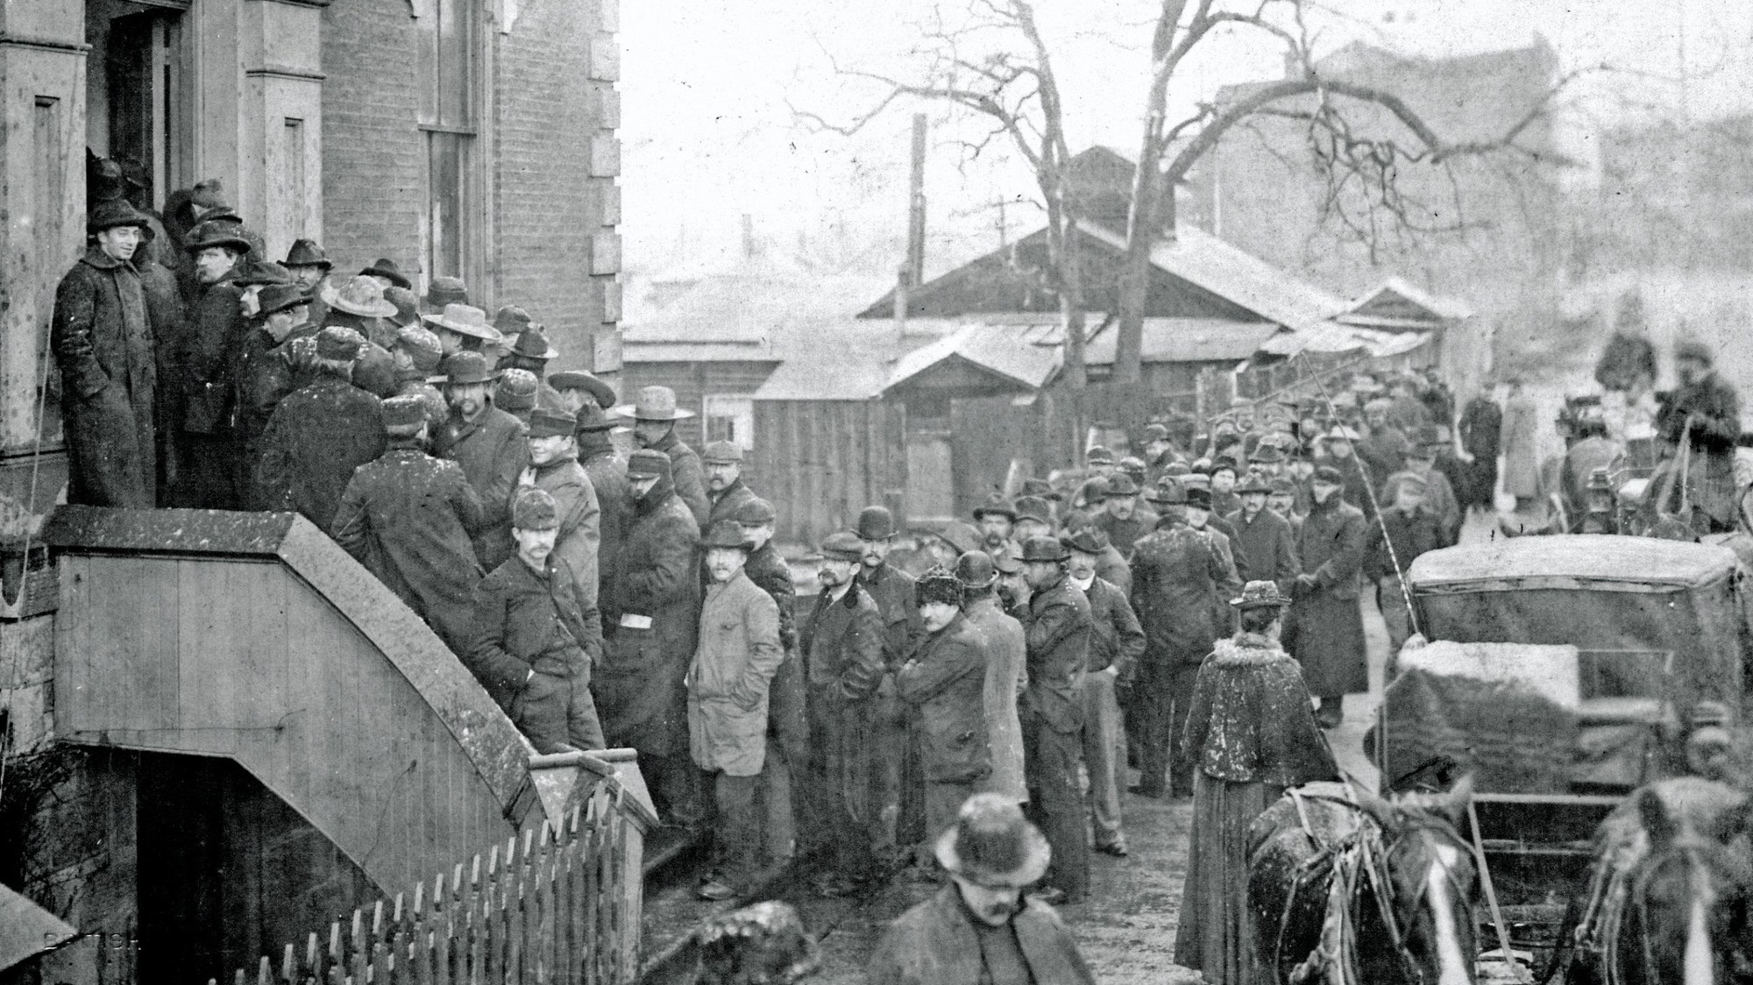
Gold Fever: Waiting in Line for a Miner’s Licence
THE STAMPEDE · FEBRUARY 1898
Klondikers buying miner’s licences at the Custom House in Victoria, British Columbia, on 12 February 1898. Photo: Jones, Victoria B.C. (public domain)
Notes:
ALI: This photo was taken on 12 February 1898 in Victoria, British Columbia, on the Pacific coast of Canada. These men are waiting in line to buy a miner’s licence before they travel north to the Klondike. Look at their faces and their clothes: they are not professional miners. They were clerks, farmers, teachers, even policemen. Most of them had never held a gold pan. Photos like this one appeared in newspapers all over the world, and they made even more people want to go.

Slide 7
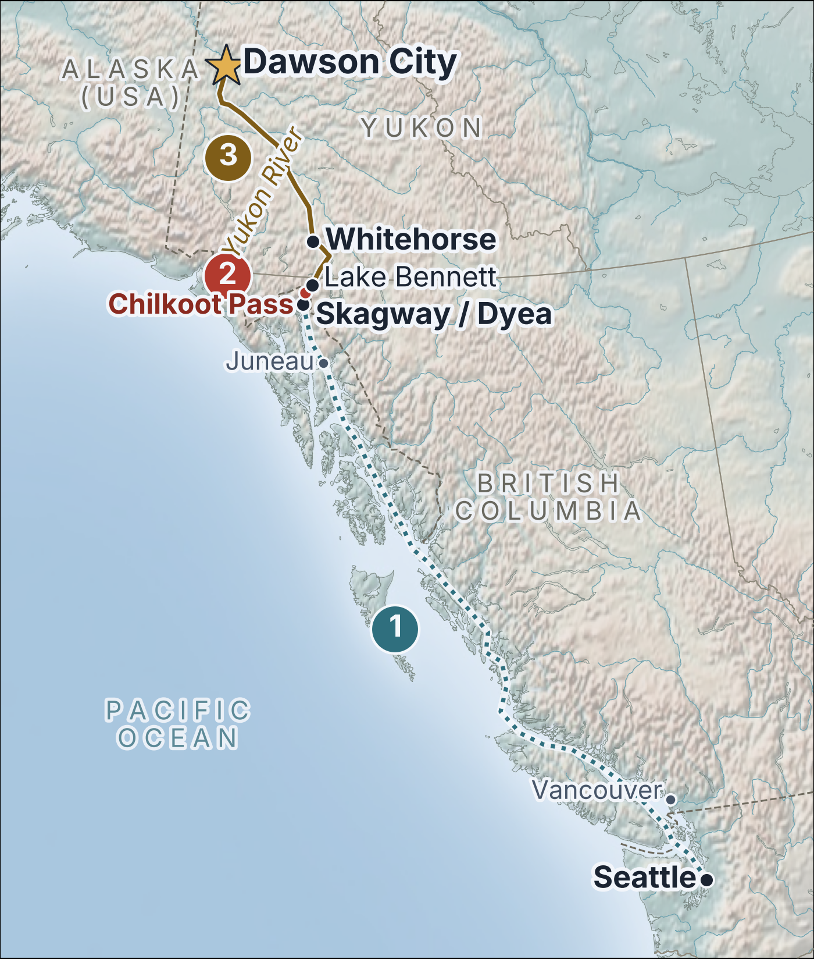
The Stampeders’ Route to the Klondike
THE GOLD RUSH · THE JOURNEY
By ship: Seattle to Skagway
1
About 1,600 km north along the Inside Passage on crowded steamships, 7 to 10 days.
On foot: the Chilkoot Trail
2
53 km from Dyea to Lake Bennett over the 1,067 m pass. The last climb, the “Golden Stairs”, was 1,500 steps cut into the ice.
By boat: 800 km down the Yukon River
3
Stampeders built 7,000 boats at Lake Bennett and left together when the ice broke on 29 May 1898.
Other routes: the White Pass (“Dead Horse Trail”, where about 3,000 horses died), the all-water route around Alaska (4,700 km), and long overland trails from Edmonton.
Notes:
ALI: How did the stampeders get there? This map shows the most popular route. First, by ship from Seattle to Skagway in Alaska: about 1,600 kilometres along the coast, which took seven to ten days. Second, on foot over the Chilkoot Pass: 53 kilometres from Dyea to Lake Bennett. The last part was the famous “Golden Stairs”, 1,500 steps cut into the ice. Third, by boat. At Lake Bennett the stampeders built about 7,000 boats, and when the ice broke on 29 May 1898, they all sailed 800 kilometres down the Yukon River to Dawson City. There were other routes too, like the White Pass, where about 3,000 horses died.

Slide 8

Three Things Most People Do Not Know
THREE INTERESTING FACTS
FACT 1
FACT 2
FACT 3
1,000 kg
40,000
in 1899
A ton of goods per person
The “Paris of the North”
The rush ended because:
The Canadian Mounted Police let nobody into Yukon without a year of supplies, about one ton. Stampeders carried it over the Chilkoot Pass in 20 to 40 trips.
In 1898 Dawson City had up to 40,000 people, electric lights, telephones and theatres. Today only about 1,600 people live there.
In the Nome region in Alaska people found a new gold deposit and it was easier to mine this deposit. So people gave up on Klondike and went there.
Bonus: Dawson City and the Klondike goldfields became a UNESCO World Heritage Site (“Tr’ondëk-Klondike”) in 2023.
The Klondike Gold Rush · Pertevniyal High School 159/E
8
Notes:
ALI: Now three facts that surprised us. Fact one: a ton of goods. The Canadian Mounted Police did not let anyone enter Yukon without one year of supplies, about 1,000 kilograms per person. Imagine carrying that over the Chilkoot Pass: people made the climb 20 to 40 times. Fact two: in 1898 Dawson City had up to 40,000 people, electric lights, telephones and theatres. People called it the “Paris of the North”. Today only about 1,600 people live there. Fact three: the writer Jack London was there. He was 21 years old, he found almost no gold, but his winter in the Klondike gave us “The Call of the Wild” and “White Fang”. And a bonus: since 2023, Dawson City and the goldfields are a UNESCO World Heritage Site. Now Tuana will take you on our trip.

Slide 9
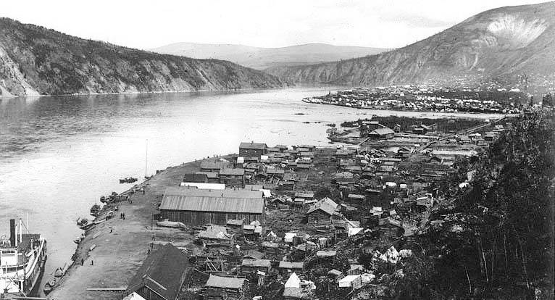
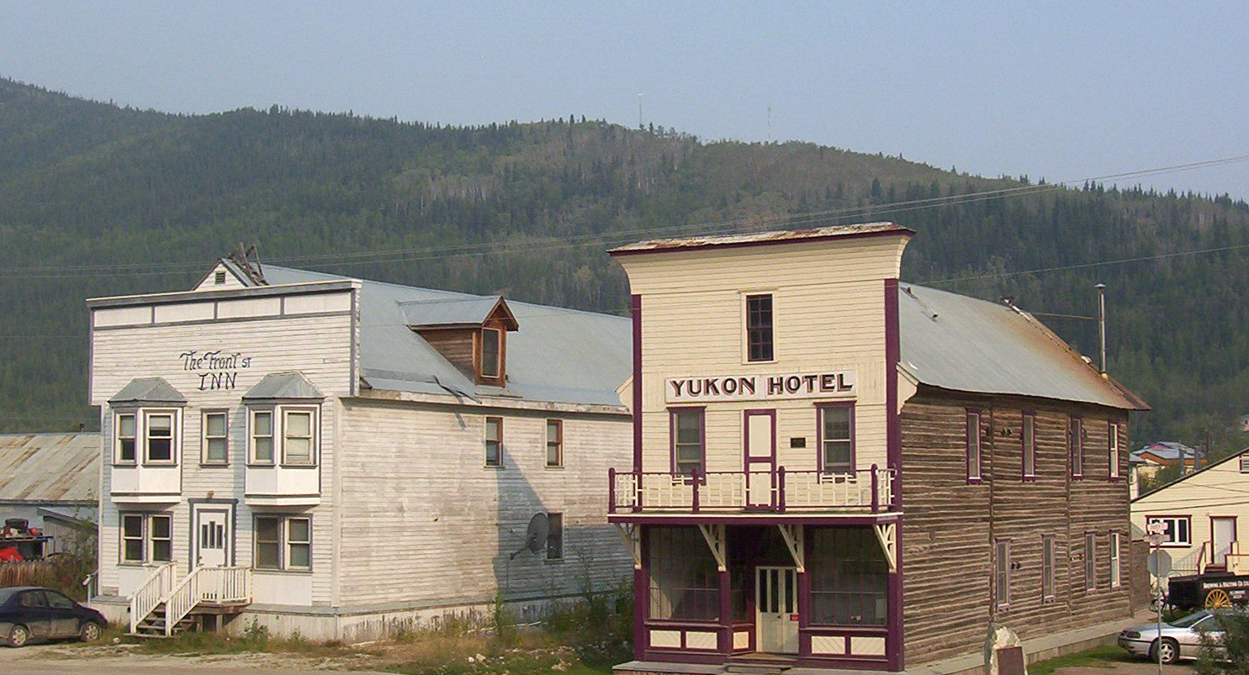
Dawson City in 1899 and Today
DAWSON CITY · THEN AND NOW
1899: the boomtown on the Yukon River
2005: the Yukon Hotel on Front Street
Klondike City in front and Dawson City across the river; a sternwheeler waits at the bank. Photo: Asahel Curtis
Gold-rush buildings restored by Parks Canada; about 1,600 people live here today. Photo: Wikimedia Commons
The Klondike Gold Rush · Pertevniyal High School 159/E
9
Notes:
TUANA: Thank you, Ali. Before I show you our plan, look at these two pictures. On the left is Dawson City in 1899, at the peak of the gold rush: log cabins, tents, a sternwheeler at the river bank, and thousands of people who arrived only a few months earlier. On the right is the Yukon Hotel on Front Street in 2005. Many gold-rush buildings are still standing, and Parks Canada has restored them, so the town looks a little like a film set. This is where we are going. Let me show you our plan.

Slide 10
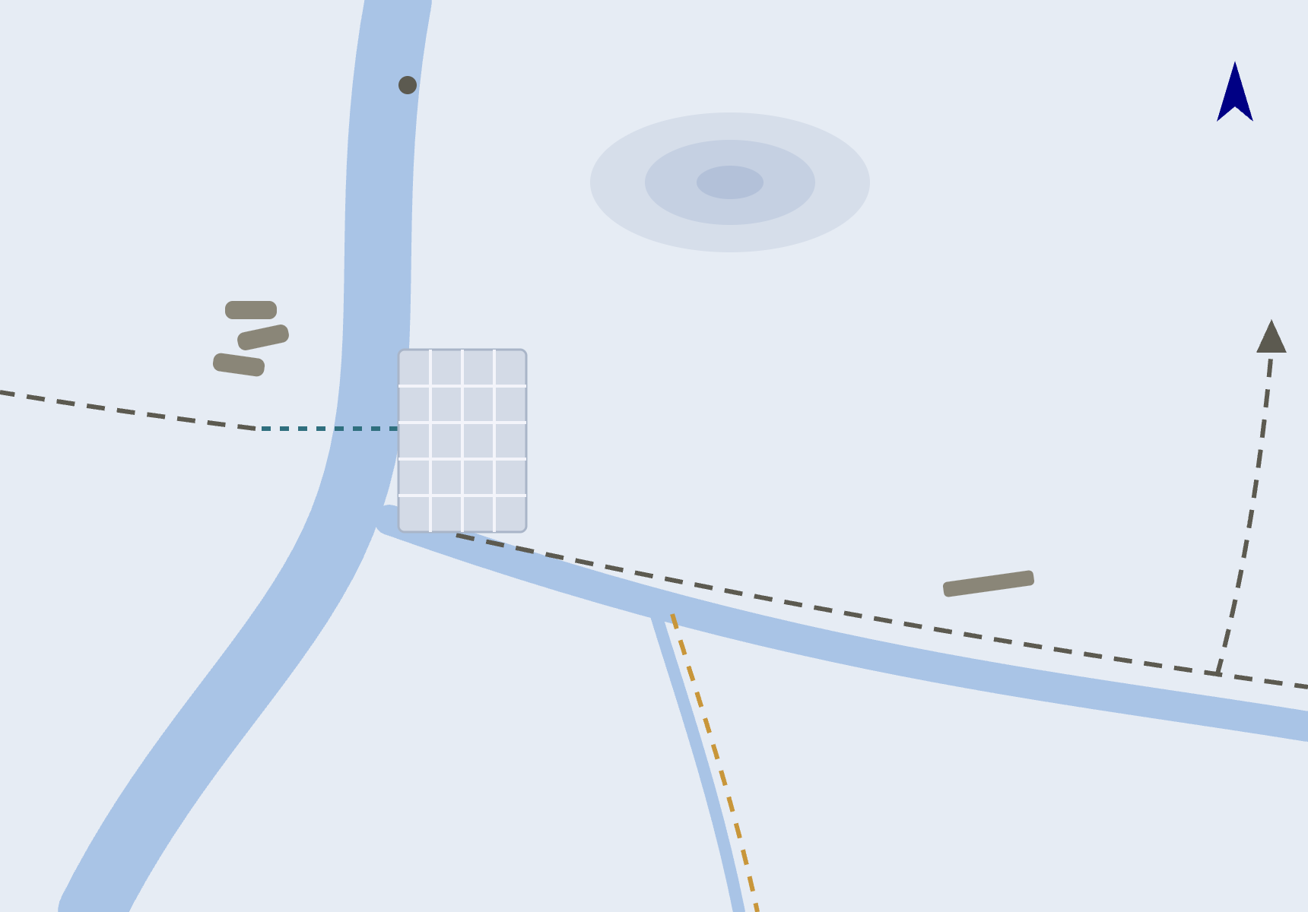
Our Five Days in Dawson City at a Glance
5-DAY TOUR PLAN · 12 TO 16 AUGUST 2027
DAY 1
THU 12 AUG
Arrival and the Historic Town
Flight from Whitehorse, walking tour, Dänojà Zho, riverfront (pin 1)
Not to scale
N
Moosehide
The Goldfields
Sternwheeler Graveyard
5
Midnight Dome
880 m
DAY 2
FRI 13 AUG
Discovery Claim, Dredge No. 4, gold panning, river cruise (pins 2, 3, 4)
6
1
Dawson City
to Alaska
Tombstone Park
110 km
8
DAY 3
SAT 14 AUG
Discovery Days
Museum, Jack London’s cabin, the parade, sunset on the Midnight Dome (pin 5)
George Black
Ferry (free)
Airport · 15 km
7
DAY 4
SUN 15 AUG
Tombstone Territorial Park
Full-day tour up the Dempster Highway with a guided hike (pin 8)
Yukon River
2
Claim 33 · gold panning
Bonanza Creek
3
Dredge No. 4
Klondike River
DAY 5
MON 16 AUG
River Stories and Departure
4
Discovery Claim
S.S. Keno, free ferry, Sternwheeler Graveyard, flight home (pins 6, 7)
The Klondike Gold Rush · Pertevniyal High School 159/E
10
Notes:
TUANA: Now let’s travel there ourselves! This is our five-day plan, from Thursday 12 August to Monday 16 August 2027. We chose these dates because of the Discovery Days festival. On the map on the right you can see Dawson City on the Yukon River, the goldfields along Bonanza Creek with pins 2, 3 and 4, the Midnight Dome above the town, the free ferry to West Dawson, the airport, and the road north to Tombstone Park. Day one is arrival and the historic town, day two the goldfields, day three Discovery Days, day four Tombstone Territorial Park, and day five the river and our flight home. Let me show you each day.

Slide 11

Day 1: Arrival and the Historic Town
DAY 1 OF 5 · THURSDAY 12 AUGUST 2027
MORNING
Fly Whitehorse to Dawson City
08:00
Air North flight, about 1 hour. Shuttle from the airport (15 km) and check-in at The Bunkhouse hostel.
AFTERNOON
Historic Town Walking Tour
PLACES
Palace Grand Theatre · Dänojà Zho Cultural Centre · Front Street and the Yukon riverfront
A Parks Canada guide in 1898 costume shows us Front Street, the Palace Grand Theatre and the wooden boardwalks.
13:00
ACTIVITY
Guided walking tour with a costumed guide (90 minutes)
EVENING
Dänojà Zho and the riverfront
17:00
The Tr’ondëk Hwëch’in cultural centre, then a walk along the Yukon River. The sun sets after 10 pm!
COST
About CA$30 per person for the tour and the centre
The Klondike Gold Rush · Pertevniyal High School 159/E
11
Notes:
TUANA: Day one, Thursday 12 August. In the morning we fly from Whitehorse to Dawson City with Air North; the flight takes about one hour. A shuttle takes us the 15 kilometres into town, and we check in at The Bunkhouse hostel. In the afternoon we join the Historic Town Walking Tour: a Parks Canada guide in an 1898 costume shows us Front Street, the Palace Grand Theatre and the wooden boardwalks. In the evening we visit the Dänojà Zho Cultural Centre of the Tr’ondëk Hwëch’in people and walk along the Yukon River. There is no hurry, because the sun sets after 10 pm! Today costs about 30 Canadian dollars per person.

Slide 12

Day 2: The Goldfields of Bonanza Creek
DAY 2 OF 5 · FRIDAY 13 AUGUST 2027
MORNING
Discovery Claim and Dredge No. 4
09:00
Shuttle along Bonanza Creek Road to the spot where gold was found in 1896, then a guided tour inside the giant dredge.
AFTERNOON
Gold panning at Claim 33
PLACES
Discovery Claim National Historic Site · Dredge No. 4 · Claim 33 on Bonanza Creek
We learn to pan for gold in Bonanza Creek. Gold is guaranteed, and we keep every flake we find.
14:00
ACTIVITIES
Gold panning · Paddlewheeler cruise on the Yukon River
EVENING
Klondike Spirit river cruise
18:00
Paddlewheeler trip on the Yukon River past the old Moosehide village, about 1.5 hours with stories from the crew.
COST
About CA$125 per person plus the goldfields shuttle
The Klondike Gold Rush · Pertevniyal High School 159/E
12
Notes:
TUANA: Day two is the goldfields day. In the morning a shuttle takes us along Bonanza Creek Road to Discovery Claim, the exact spot where gold was found in 1896, and then to Dredge No. 4, a giant wooden gold machine, eight storeys high, where Parks Canada gives guided tours. In the afternoon we try gold panning at Claim 33. They teach us the technique, gold is guaranteed, and we keep every flake we find! In the evening we take the Klondike Spirit, a paddlewheeler boat, for a cruise on the Yukon River past the old Moosehide village. This day costs about 125 Canadian dollars per person, plus the shuttle.

Slide 13

Day 3: Discovery Days Weekend
DAY 3 OF 5 · SATURDAY 14 AUGUST 2027
MORNING
Dawson City Museum and the writers’ cabins
09:30
Gold rush objects and old locomotives at the museum, then the cabins of the writers Jack London and Robert Service.
NOON
Discovery Days parade
PLACES
Dawson City Museum · Jack London Museum · Robert Service Cabin · Midnight Dome
12:00
Front Street fills with floats, music and Mounties in red uniforms. Afterwards: street festival, games and live music.
ACTIVITIES
Discovery Days parade and festival (free) · Hike up the Dome
EVENING
Sunset on the Midnight Dome
19:30
Hike (about 2 hours) or taxi to the 880 m viewpoint over the town, the Yukon River and the goldfields.
COST
About CA$25 per person for the museums
The Klondike Gold Rush · Pertevniyal High School 159/E
13
Notes:
TUANA: Day three is Saturday, the big Discovery Days weekend. In the morning we visit the Dawson City Museum, with gold rush objects and old locomotives, and the cabins of two famous writers, Jack London and Robert Service. At noon the parade starts on Front Street: floats, music, and Mounties in their red uniforms. After that there is a street festival with games and live music, all for free. In the evening we hike up the Midnight Dome, about two hours, or we take a taxi. From 880 metres we can see the whole town, the Yukon River and the goldfields, and we watch the sunset at about ten o’clock. The museums cost about 25 Canadian dollars.

Slide 14
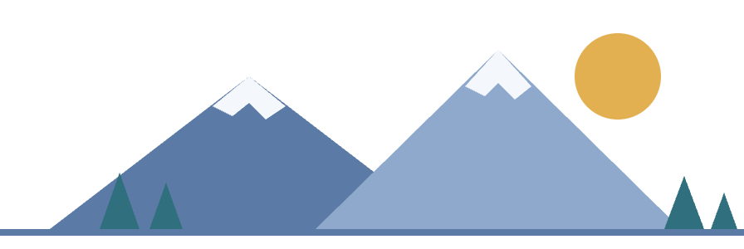
Day 4: Tombstone Territorial Park
DAY 4 OF 5 · SUNDAY 15 AUGUST 2027
MORNING
Up the Dempster Highway
08:30
Guided van tour north on Canada’s only road to the Arctic, 1.5 hours each way. Photo stops and wildlife watching.
PLACES
Dempster Highway · Tombstone Interpretive Centre · North Klondike River or Goldensides trail
MIDDAY
Tombstone Interpretive Centre
11:00
Exhibits about the “Patagonia of the North”, a cup of wild mountain tea with the rangers, and a picnic lunch.
ACTIVITIES
Full-day guided tour · Hiking · Wildlife watching (moose, caribou, bears from a safe distance)
AFTERNOON
Guided hike in the mountains
Easy North Klondike River trail (1 hour) or the Goldensides viewpoint trail (2 hours). Back in Dawson around 6 pm.
13:00
COST
About CA$230 per person, lunch included
The Klondike Gold Rush · Pertevniyal High School 159/E
14
Notes:
TUANA: Day four is our nature day: Tombstone Territorial Park, which people call the “Patagonia of the North”. We take a guided van tour up the Dempster Highway, Canada’s only road to the Arctic. It takes about one and a half hours each way, with photo stops and, if we are lucky, moose, caribou or bears, from a safe distance of course. At the Tombstone Interpretive Centre we see the exhibits, drink wild mountain tea with the rangers and have a picnic lunch. In the afternoon we hike: the easy North Klondike River trail for one hour, or the Goldensides trail for two hours with a great viewpoint. We are back in Dawson at about 6 pm. This is our most expensive day, about 230 Canadian dollars, lunch included.

Slide 15
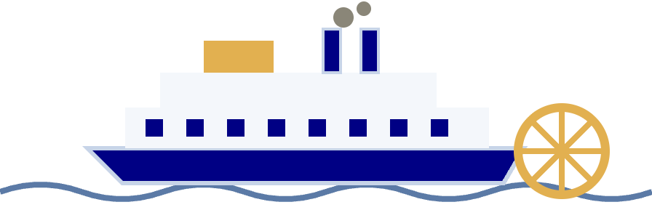
Day 5: River Stories and Departure
DAY 5 OF 5 · MONDAY 16 AUGUST 2027 · DISCOVERY DAY
MORNING
S.S. Keno sternwheeler
09:00
Tour of the historic river boat on Front Street: how the sternwheelers connected the Klondike to the world.
MIDDAY
Across the river by ferry
PLACES
S.S. Keno National Historic Site · George Black ferry · Sternwheeler Graveyard in West Dawson
11:00
Free George Black ferry to West Dawson and a short walk to the Sternwheeler Graveyard. Last souvenirs on Front Street.
AFTERNOON
Fly home
ACTIVITIES
Ferry ride across the Yukon River (free) · Souvenir shopping
Shuttle to the airport, Air North to Whitehorse (1 hour), then the flights to Vancouver and on to Istanbul.
15:00
COST
About CA$18 per person for the S.S. Keno tour
The Klondike Gold Rush · Pertevniyal High School 159/E
15
Notes:
TUANA: Day five is Monday 16 August, Discovery Day itself, a public holiday in Yukon. In the morning we tour the S.S. Keno, a historic sternwheeler boat on Front Street, and learn how these boats connected the Klondike to the world. Then we take the George Black ferry across the Yukon River. It is free! On the other side a short walk takes us to the Sternwheeler Graveyard, where old river boats are slowly falling apart in the forest. We buy our last souvenirs on Front Street, and in the afternoon the shuttle takes us to the airport: Air North to Whitehorse, then Vancouver, then home to Istanbul. Now Irmak will explain the practical side of the trip.

Slide 16




August Weather in Dawson City
PRACTICAL INFORMATION · WEATHER
19 °C
6 °C
WHAT THIS MEANS FOR US
Dress in layers: T-shirt at noon, fleece and jacket in the evening
average daytime high
average night low
Warm sun at noon, like a spring day in Istanbul
Late August nights can get close to 0 °C
A rain jacket is a must; umbrellas are useless on windy trails
Long bright evenings: we can hike the Dome after dinner
43 mm
16 h
Fewer mosquitoes than in July, but still bring repellent
rain, on about 13 days
of daylight, sunset about 10 pm
The first autumn colours appear in Tombstone Park in late August
Usually short showers, rarely a whole wet day
In June the sun hardly sets at all
Source: Environment Canada climate normals for Dawson (1981–2010) · Klondike Gold Rush · Pertevniyal High School 159/E
16
Notes:
IRMAK: Thank you, Tuana. Before we pack, let’s check the weather. August in Dawson City is like a nice spring day in Istanbul: about 19 degrees in the daytime. But at night it drops to around 6 degrees, and at the end of August it can get close to zero. It rains on about 13 days in August, in total about 43 millimetres, but usually in short showers. The best part: about 16 hours of daylight, and the sun sets at about 10 pm, so we can hike the Dome after dinner. For us this means layers: T-shirt at noon, fleece and rain jacket in the evening. Also, there are fewer mosquitoes than in July, but we still bring repellent.

Slide 17
Getting There and Getting Around
PRACTICAL INFORMATION · TRANSPORT
START
LEG 1 · 12.5 H
LEG 2 · 2.5 H
LEG 3 · 1 H
Istanbul
Vancouver
Whitehorse
Dawson City
Direct flight to Vancouver with Turkish Airlines, about 12.5 hours
Change planes; Air North or Air Canada fly north to Whitehorse
Capital of Yukon; Air North to Dawson (1 h) or 530 km by road (6 h)
The airport is 15 km from town; a hotel or tour shuttle takes us in
GETTING AROUND IN DAWSON CITY
On foot
Shuttle or taxi
George Black ferry
Bicycle
The town is only 1.5 km across: wooden boardwalks, dirt streets, no traffic lights.
No public bus. Tour vans or a taxi take us to the goldfields (13 km) and the airport.
Free ferry across the Yukon River to West Dawson, running 24 hours a day in summer.
Rent a bike in town for the Dome Road and the riverside trails on a sunny day.
The Klondike Gold Rush · Pertevniyal High School 159/E
17
Notes:
IRMAK: How do we get there? Istanbul to Vancouver is a direct flight with Turkish Airlines, about twelve and a half hours. In Vancouver we change planes and fly two and a half hours north to Whitehorse, the capital of Yukon. From Whitehorse, Air North takes us to Dawson City in one hour; by road it would be 530 kilometres and six hours. The airport is 15 kilometres from town, and a shuttle takes us in. In Dawson City we mostly walk: the town is only one and a half kilometres across, with wooden boardwalks, dirt streets and no traffic lights. There is no public bus, so for the goldfields we use a tour van or a taxi. The George Black ferry across the river is free and runs 24 hours a day. And on a sunny day we can rent bikes.

Slide 18

Where to Stay in Dawson City
PRACTICAL INFORMATION · ACCOMMODATION
OUR CHOICE · BUDGET
CHEAPEST · OUTDOORS
COMFORT · HISTORIC
The Bunkhouse
Campgrounds
Hotels
from CA$130
CA$20
CA$180–280
per room per night, about US$95
per tent site per night
per room per night
Hostel-style rooms with shared bathrooms, two minutes from Front Street. A family room for three keeps the price per person low.
Yukon River Campground across the free ferry, or Gold Rush Campground in town. Bring a tent and warm sleeping bags for 5 °C nights.
The Downtown Hotel, the Eldorado or the Triple J: gold-rush style buildings with private bathrooms. Too expensive for five nights.
Book early! Dawson City has only about 8 hotels, and Discovery Days weekend sells out weeks in advance. We book in March, 5 months before the trip.
Prices: Booking.com, Kayak and Yukon Parks, autumn 2026 · Pertevniyal High School 159/E
18
Notes:
IRMAK: Where do we sleep? We compared three options. Our choice is The Bunkhouse: hostel-style rooms with shared bathrooms, two minutes from Front Street, from about 130 Canadian dollars per room per night, that is about 95 US dollars. A family room for three people keeps the price per person low. The cheapest option is camping: the Yukon River Campground across the free ferry costs 20 dollars per tent site, but the nights are cold and we need a tent and sleeping bags. The comfortable option is a historic hotel like the Downtown Hotel or the Eldorado, 180 to 280 dollars per night, which is too expensive for our budget. One important rule: book early! Dawson City has only about eight hotels, and the Discovery Days weekend sells out weeks in advance. We would book in March.

Slide 19


What Goes in the Backpack
PRACTICAL INFORMATION · PACKING LIST
Waterproof rain jacket
Warm layers: fleece, hat, gloves
Hiking boots
Rain on about 13 days in August
Dome trail, Tombstone, muddy creek banks
Evenings are 5–8 °C, colder on the Dome
Mosquito repellent
Sunscreen and sunglasses
Sleep mask
Yukon mosquitoes are famous for a reason
16 hours of sunlight a day
It is still light at 10:30 pm
Water bottle and daypack
Power bank and camera
Passport, Canadian visa, insurance
Tap water is safe; no shops on the trails
Long days, many photos, few plugs on tours
The visa takes 2–3 months; bring some Canadian cash too
The Klondike Gold Rush · Pertevniyal High School 159/E
19
Notes:
IRMAK: What goes in the backpack? Nine things. A waterproof rain jacket, because it rains on 13 days in August. Warm layers: a fleece, a hat and gloves for the cold evenings. Hiking boots for the Dome trail, Tombstone Park and the muddy creek banks. Mosquito repellent, because Yukon mosquitoes are famous. Sunscreen and sunglasses, because the sun is up for 16 hours. A sleep mask, because it is still light at half past ten at night. A water bottle and a daypack; the tap water is safe, and there are no shops on the trails. A power bank and a camera for all the photos. And the most important: passport, Canadian visa, travel insurance and some Canadian cash. The visa takes two to three months, so we apply early.

Slide 20
Trip Budget: About 1,700 USD per Person
BUDGET · PER PERSON · AUGUST 2027 · 1 CAD ≈ 0.73 USD
Flights Vancouver – Whitehorse
300 USD
Flights Whitehorse – Dawson City
370 USD
Hostel, 4 nights (room for 3)
220 USD
Food and drinks, 5 days
275 USD
Tours and entrance fees
300 USD
Local transport (shuttle, taxi)
80 USD
Souvenirs, snacks, SIM card
100 USD
Travel insurance
50 USD
Planned total: 1,695 USD
Budget: 2,000 USD
85% of the budget is planned
Reserve for surprises: 305 USD (15%)
Estimates based on 2026 prices (Expedia, Kayak, Parks Canada, Klondike Experience, Booking.com). The international flight Istanbul – Vancouver (about 1,200 to 1,600 USD return) is not part of the 2,000 USD trip budget.
The Klondike Gold Rush · Pertevniyal High School 159/E
20
Notes:
IRMAK: Now the question everyone asks: how much does it cost? Here is our budget per person, in US dollars, with one Canadian dollar at about 73 cents. The return flights from Vancouver to Whitehorse are about 300 dollars, and from Whitehorse to Dawson City about 370; flights in the north are expensive. Four nights at the hostel, sharing a room for three, cost about 220. Food for five days, 275. Tours and entrance fees, including Tombstone, the dredge, the cruise and the museums, about 300. Local transport 80, souvenirs and snacks 100, travel insurance 50. The total is 1,695 dollars, which is 85 per cent of our 2,000-dollar budget, so we have 305 dollars for surprises. One honest note: the international flight from Istanbul to Vancouver is not included; that would be another 1,200 to 1,600 dollars.

Slide 21
BUDGET CHECK
1,695 USD
per person for five days in the Klondike
That is 305 USD under our 2,000 USD budget, with money left for a real gold nugget souvenir.
Book early
Share and cook
Enjoy the free things
Flights and the hostel 4 to 5 months ahead. Discovery Days weekend sells out and prices rise.
One room for three and breakfast from the grocery store keep the daily cost low.
The parade, the ferry, Discovery Claim, Free Claim No. 6 and the view from the Dome cost nothing.
Notes:
IRMAK: So, 1,695 dollars per person for five days in the Klondike, 305 dollars under budget. How do we keep it that low? First, we book early: flights and the hostel four to five months ahead, because the Discovery Days weekend sells out and prices go up. Second, we share one room for three and buy breakfast at the grocery store. Third, we enjoy the free things: the parade, the ferry, Discovery Claim, Free Claim No. 6 where anyone can pan for gold, and the view from the Midnight Dome. They cost nothing, and they are the best memories.

Slide 22
Where Our Information Comes From
SOURCES
HISTORY
TRIP PLANNING
HISTORY.com, “Klondike Gold Rush” (history.com)
Travel Yukon, Dawson City and Discovery Days pages (travelyukon.com)
Parks Canada, Klondike National Historic Sites: Dredge No. 4, Discovery Claim, S.S. Keno, fees and tours (parks.canada.ca)
The Klondike Experience, tours and transport (klondikeexperience.com); Yukon News, Discovery Days reports
UNESCO World Heritage List, “Tr’ondëk-Klondike” (whc.unesco.org)
Air North, Expedia and Kayak flight prices; Booking.com and Kayak hotel prices (searched October 2026)
Ruby Range Adventure, “Gold Rush History” (rubyrange.com)
Wikipedia, “Klondike Gold Rush” and “Dawson City” (en.wikipedia.org)
Environment Canada climate normals for Dawson, 1981–2010 (via currentresults.com)
Maps: drawn for this presentation with Basemap, GSHHG coastlines and Natural Earth shaded relief
The Klondike Gold Rush · Pertevniyal High School 159/E
22
Notes:
IRMAK: These are our sources. For the history we used HISTORY.com, Parks Canada, UNESCO and Wikipedia. For the trip we used Travel Yukon, the Klondike Experience tour company, flight and hotel websites, and Environment Canada’s climate data. All prices were checked in October 2026, so they can change a little. The maps you saw were made by us from real geographic data.

Slide 23
Thank you!
THE KLONDIKE GOLD RUSH · DAWSON CITY, YUKON
Any questions?
Mähsį’ – “thank you” in the Hän language of the Tr’ondëk Hwëch’in, the first people of Dawson City.
Notes:
ALL THREE: Thank you for listening! The stampeders went to the Klondike for gold; we would go for the mountains, the river and the history. Do you have any questions? (Possible questions and short answers. Why August? Because of the weather and the Discovery Days festival. Is it dangerous? No, but we respect the bears and stay on the trails. Did anyone get rich? Only a few hundred of the 100,000 people; most of the money was made by shopkeepers and transport companies. Why is the budget without the Istanbul flight? Because 2,000 dollars cannot cover an intercontinental flight; we show that separately.) Together: Mähsį’, thank you!

