Slide 1
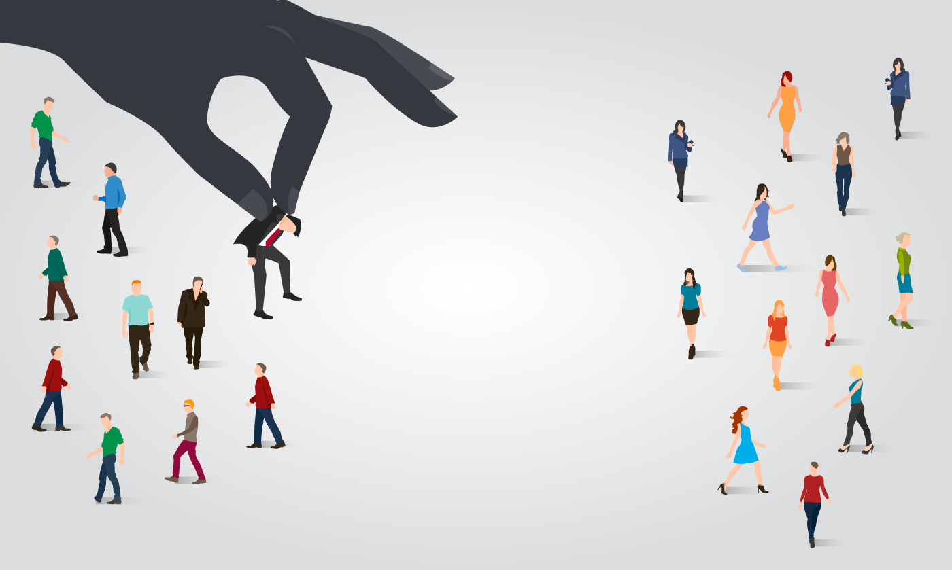
Image Classification
Made by
Ali Asgar

Slide 2
Problem Statement
We must create an Image Classification model.
We must use deep learning and machine learning to create the model which can differentiate between Saree, Jeans(men) and Trousers(men).

Slide 3
Image Classification
Image classification is a technique in deep learning where a system is trained to classify images for various categories.
Several images are used to train the model so that it can differentiate between them.
Image classification is where a computer can analyze an image and identify the ‘class’ the image falls under. (Or a probability of the image being part of a ‘class’.).

Slide 4
Benefits of Image Classification!!
Image classification can be used in various sectors and fields for the betterment.
It makes the task easy and more efficient
Helps in security field as identification system.
Can be used in medical field to detect several disease and also their type and degree.

Slide 5
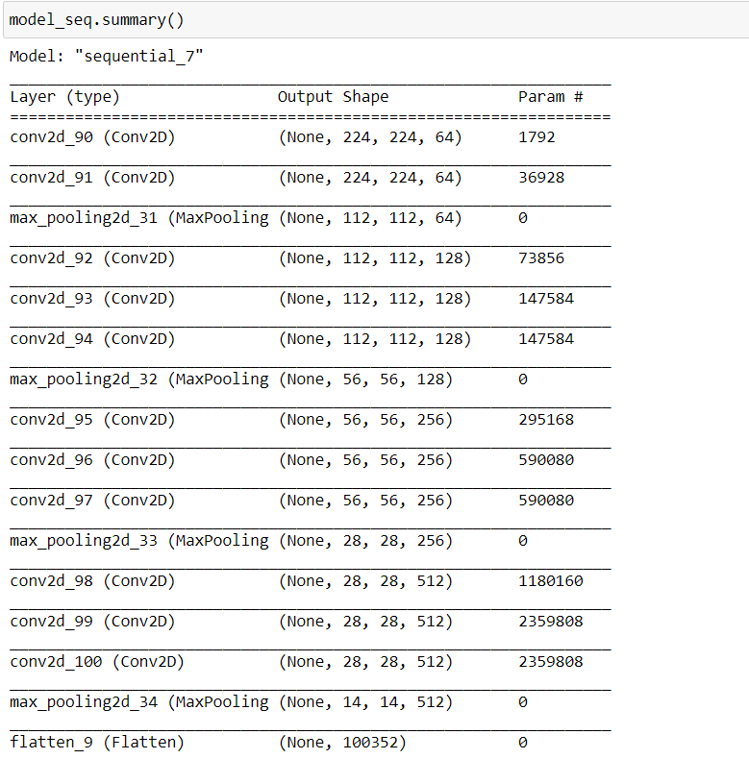
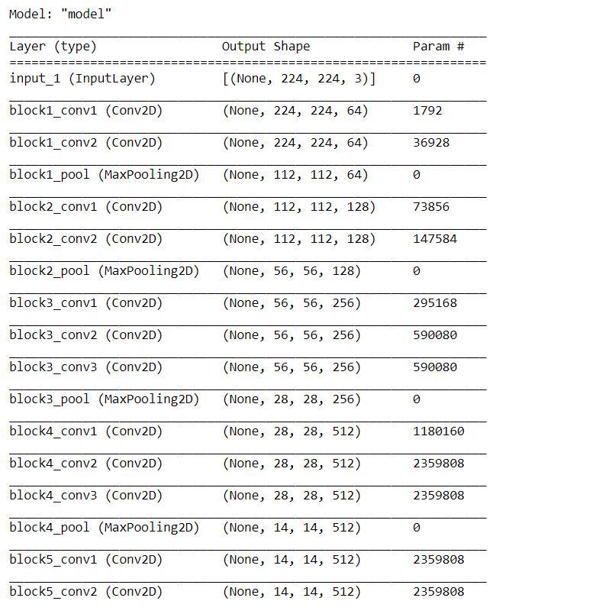
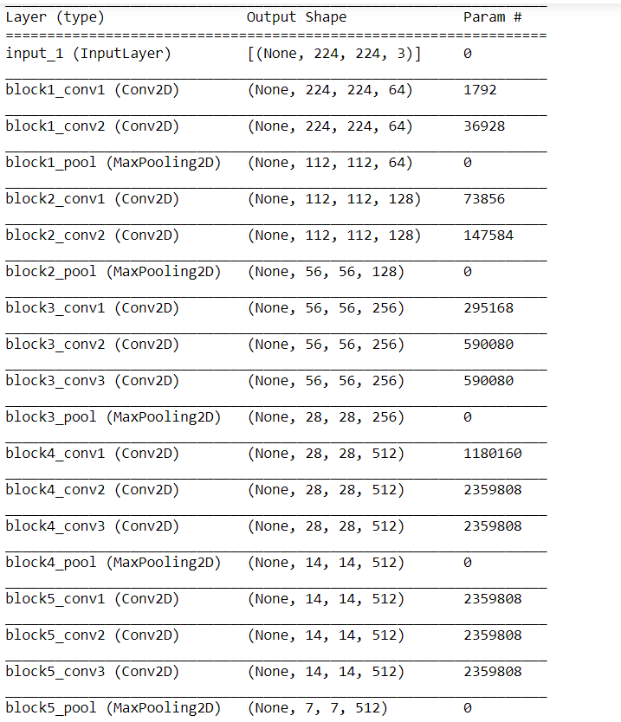
Visualization
We created a model summary for each model which gives us a glimpse of the model’s working cycle.

Slide 6
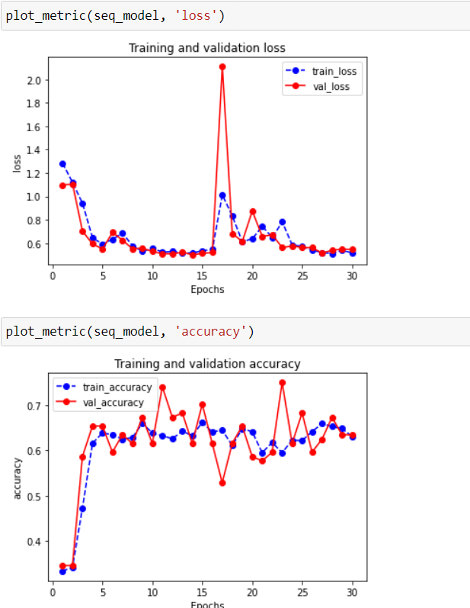
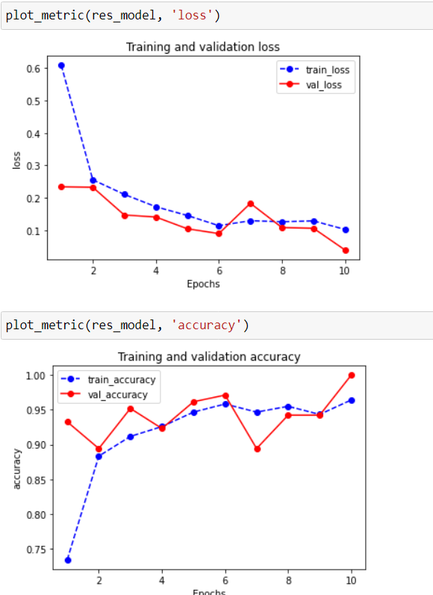
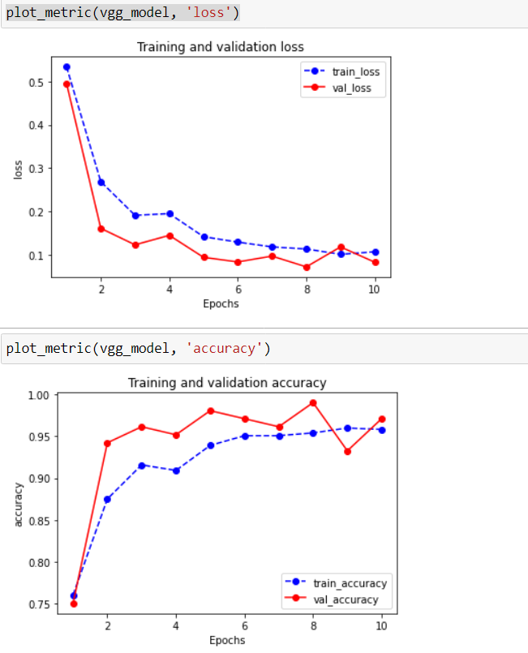
We also visualized the flow of model during the fit to analyze the loss and accuracy which the model attains at various epochs.

Slide 7

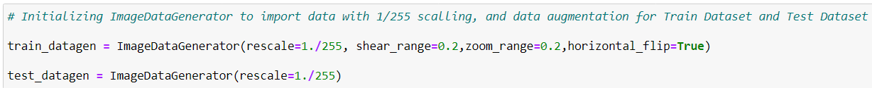
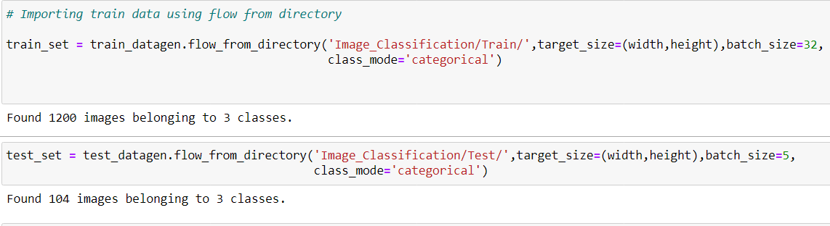
Preprocessing
We corrected the images with their size and used data augmentation techniques before passing the image through the constructed model.

Slide 8
Model Training
We started with self defined model using Sequential API.
We created a network of Convolution layers and Pooling layers to extract features from images.
We then flatten the outcome from CNN network and passed it through a full connected network.
We used categorical cross-entropy loss function and accuracy to test the performance of our model.
We used ADAM optimizer with learning rate of 0.001

Slide 9
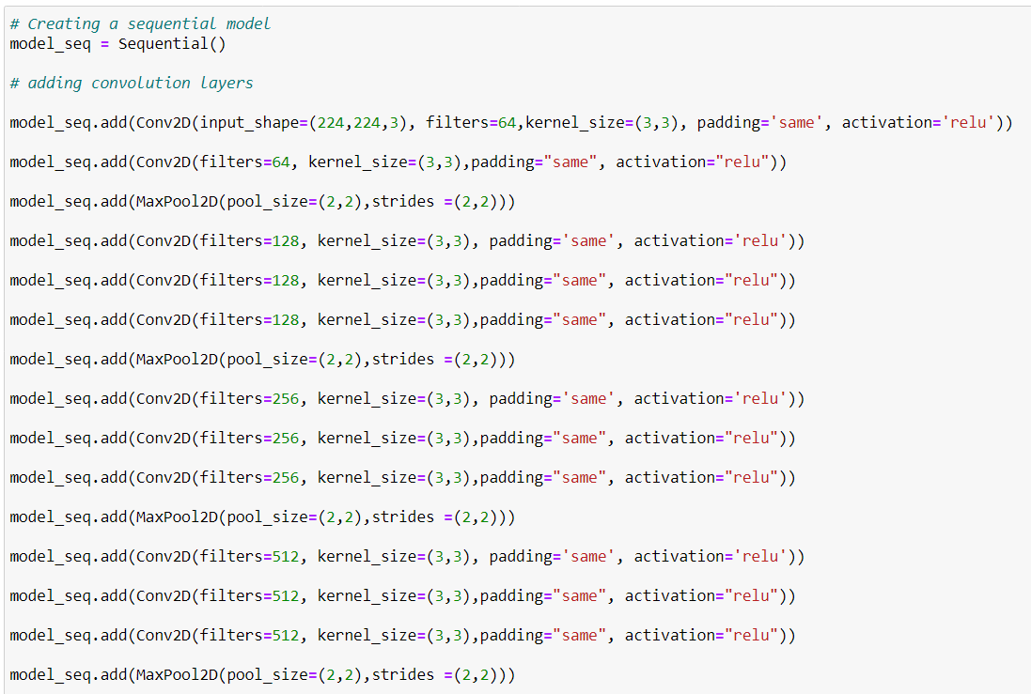
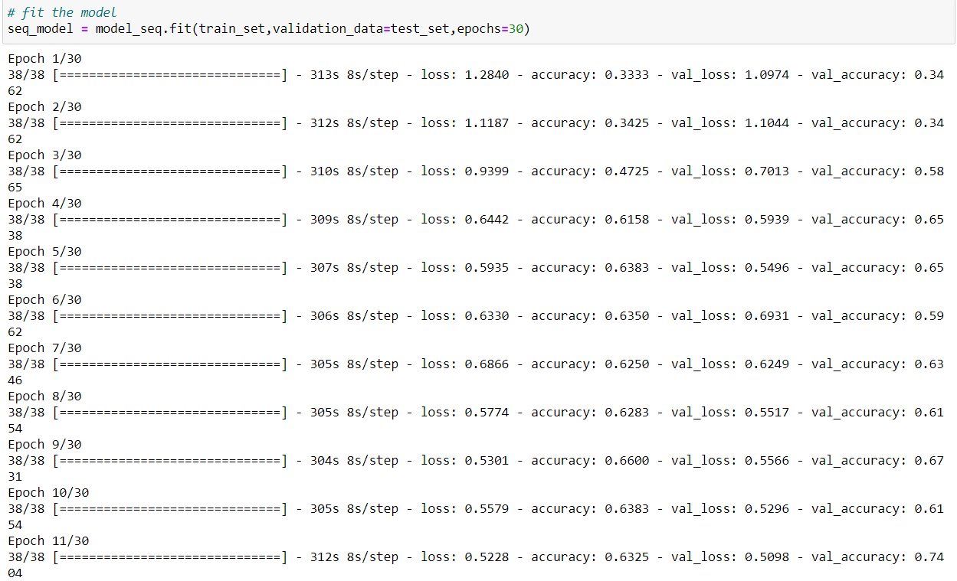
Sequential Model

Slide 10
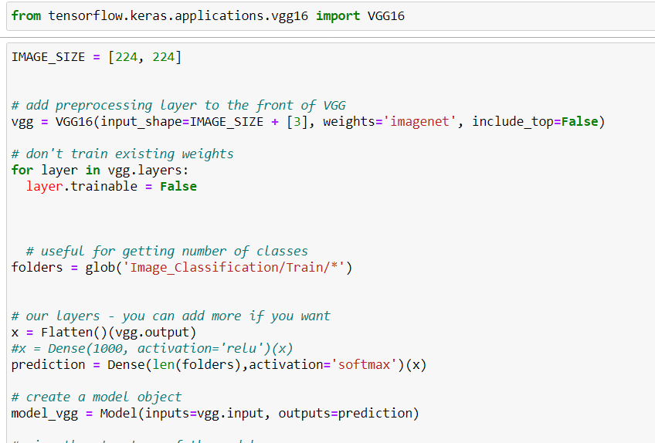
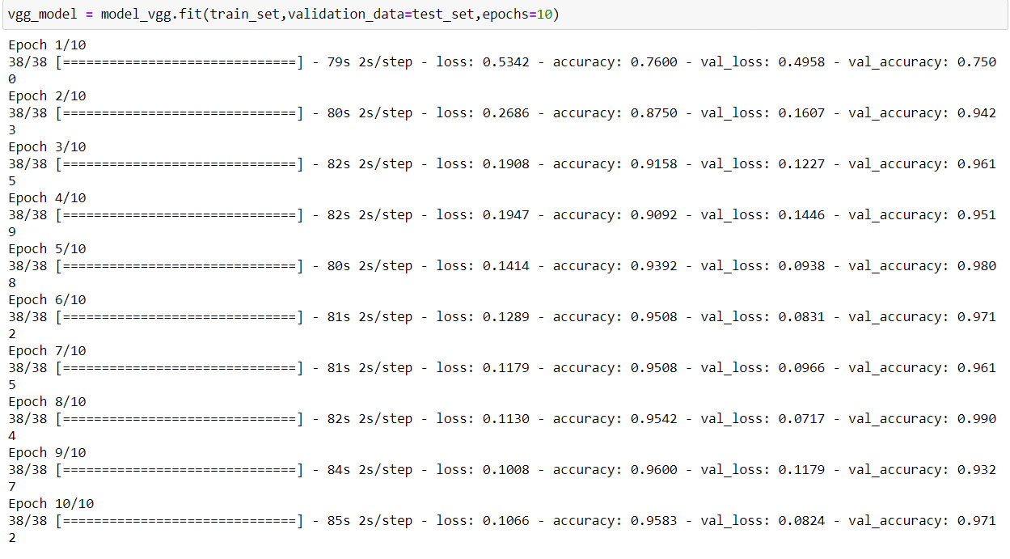
With VGG16

Slide 11
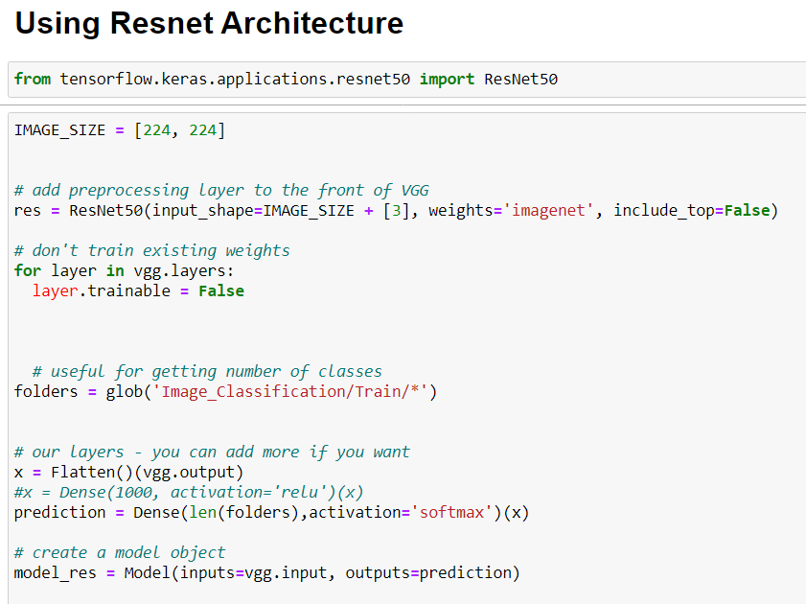
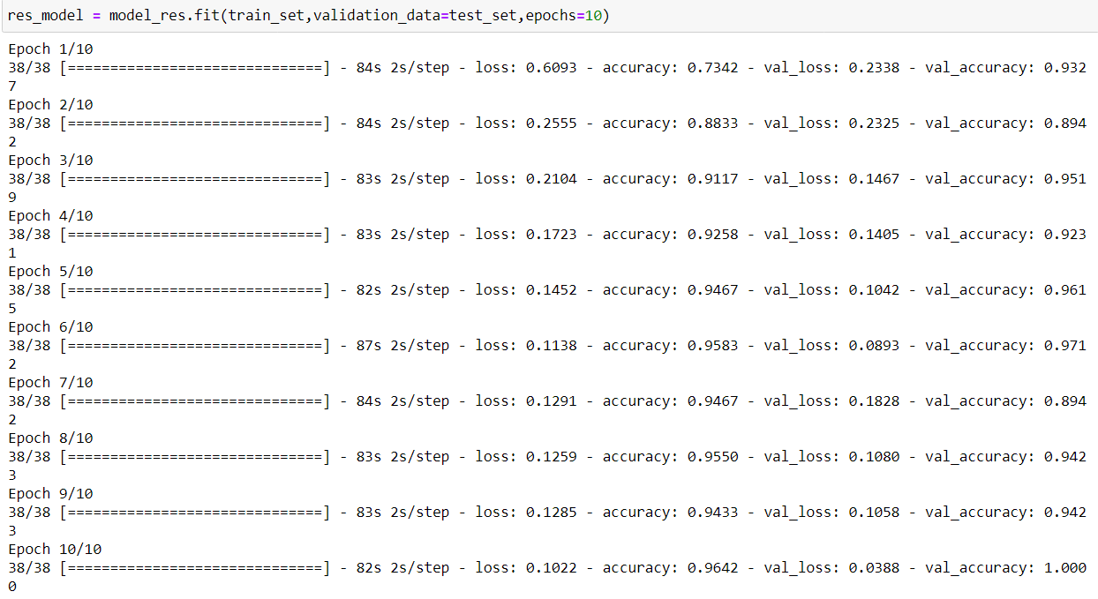
With Resnet50

Slide 12
Finalizing Model
Based on training and validation loss and accuracy we found the VGG16 model to be more accurate and efficient for our current scenario.
We can also train our model for more epochs to further increase the accuracy.

Slide 13
Conclusion
Given dataset provides us with images of apparels.
We use deep learning branch of AI to extract features from images.
Extracted features are used to train the model to identify and classify images.
Model trained can distinguish between apparels like saree, jeans and trousers.

