Slide 1
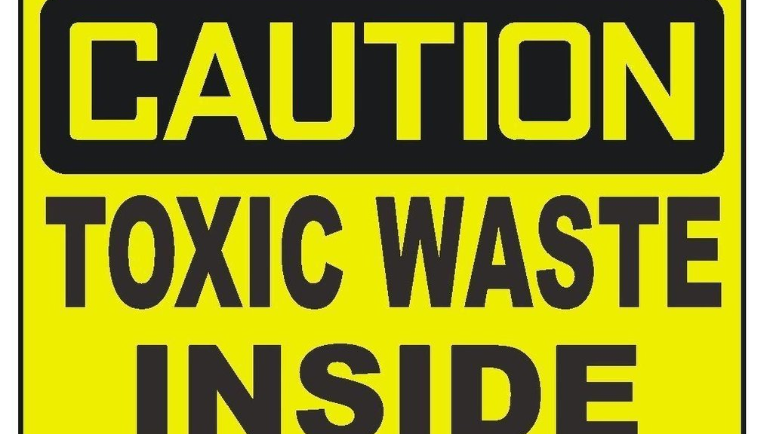
Malignant Comment Classification
Made by
Ali Asgar

Slide 2
Problem Statement
The proliferation of social media enables people to express their opinions widely online. However, at the same time, this has resulted in the emergence of conflict and hate, making online environments uninviting for users.
Many celebrities and influences are facing backlashes from people and have to come across hateful and offensive comments.
This can take a toll on anyone and affect them mentally leading to depression, mental illness, self-hatred, and suicidal thoughts.
A machine learning model is required to predict the possible rating for a review.

Slide 3
Malignant Comments!!
Platforms that aggregate user content are the foundation of knowledge sharing on the Internet. Blogs, forums, discussion boards, and, of course, Wikipedia.
But the catch is that not all people on the Internet are interested in participating nicely, and some see it as an avenue to vent their rage, insecurity, and prejudices.
Online hate, described as abusive language, aggression, cyberbullying, hatefulness, and many others has been identified as a major threat on online social media platforms.
Social media platforms are the most prominent grounds for such toxic behavior.

Slide 4
Effects of Toxic Comments!!
If they come across any kind of a malignant or toxic type of a reply which can also be a threat or an insult or any kind of harassment which makes them uncomfortable, they might defer using the social media platform in the future.
Leads to depression, mental illness, self-hatred, and suicidal thoughts.

Slide 5
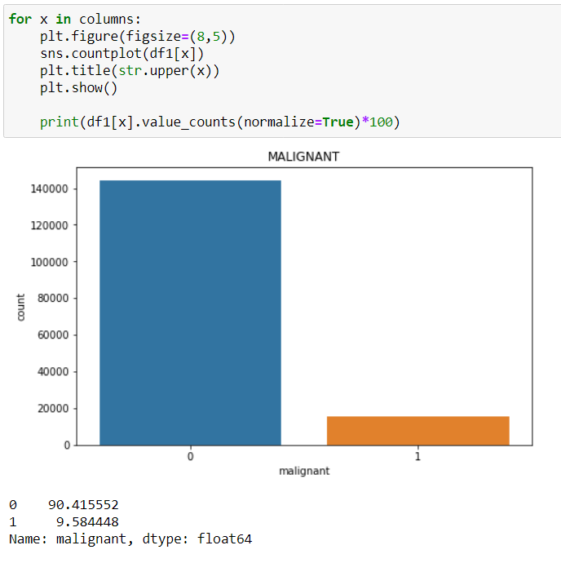
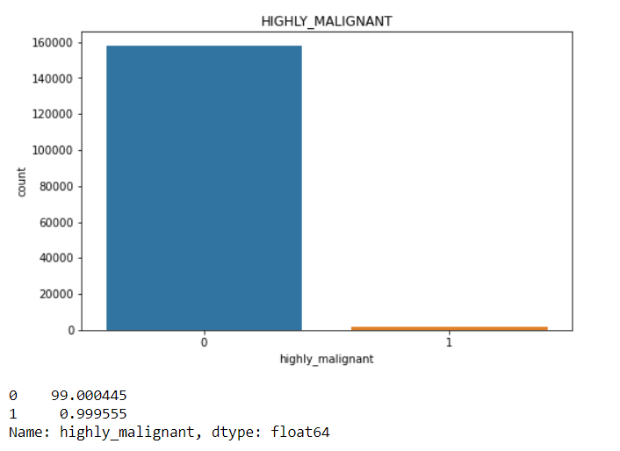
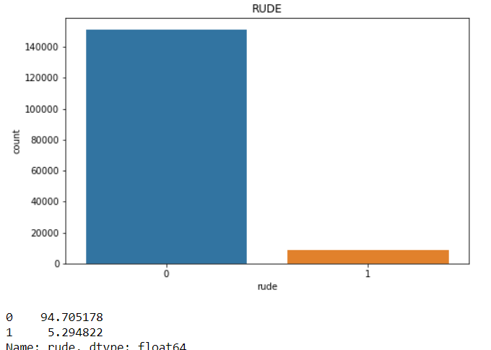
Exploratory Analysis
Count of each category

Slide 6
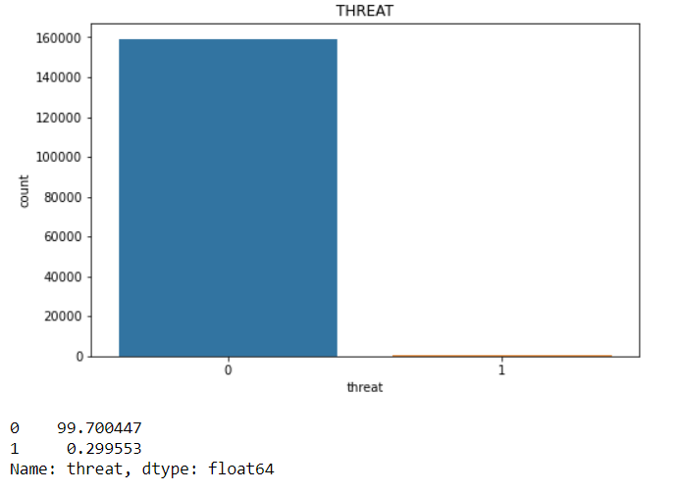
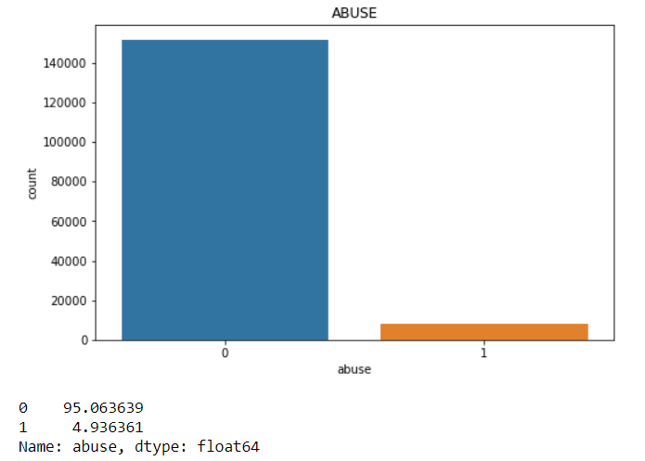
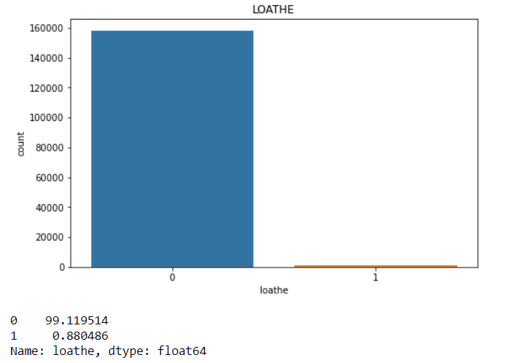

Slide 7
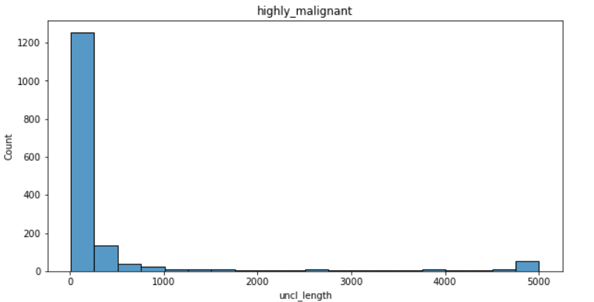
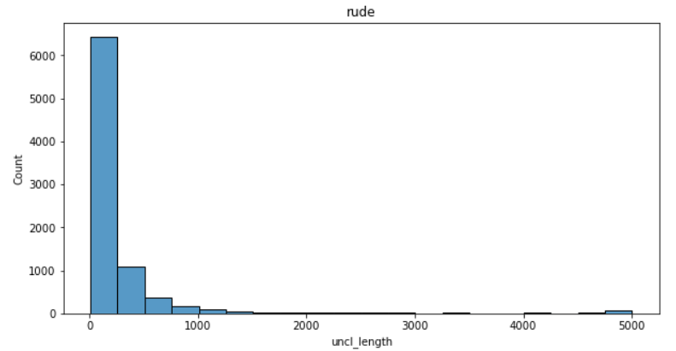
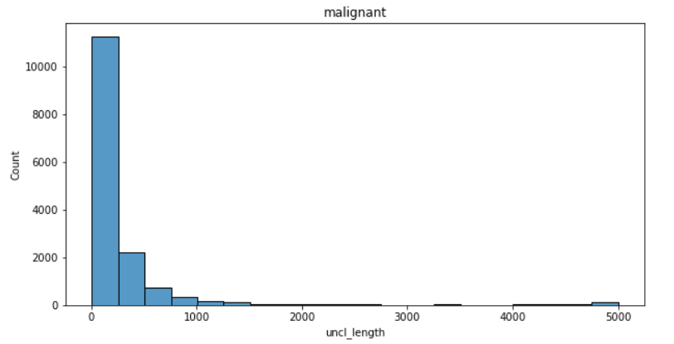
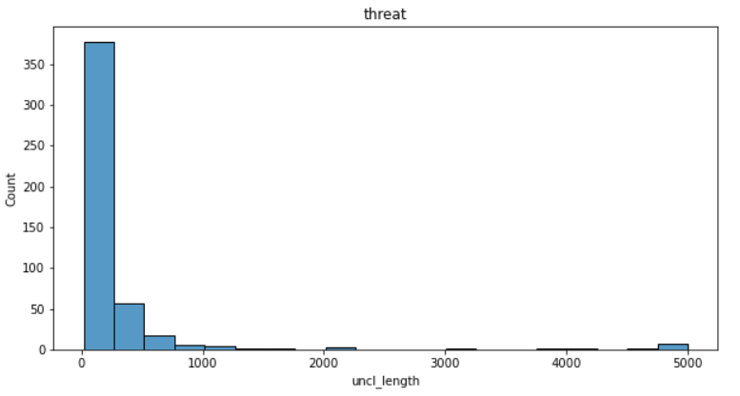
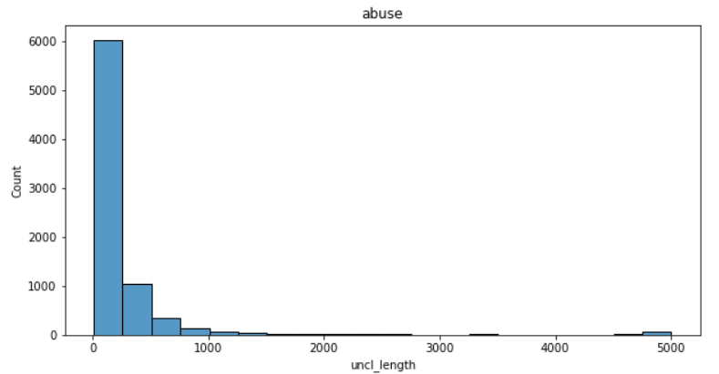
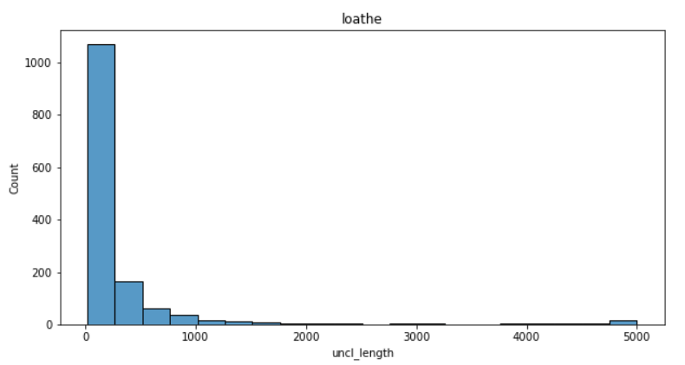
Checking length of toxic comment

Slide 8
We observe that comments majorly range to 200 characters and extend to 1000 characters.
Some comments have 5000 characters in them.
We see that comments which have 5000 characters are more in the Highly malignant category.

Slide 9
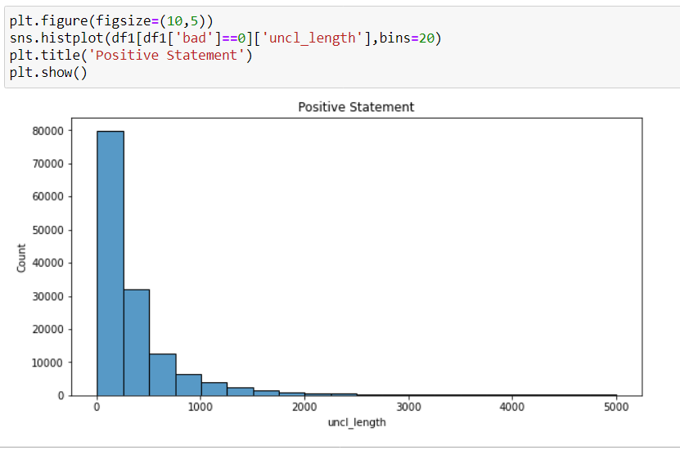
String length for normal comments
We observe that the string count for normal comments is major up to 200 characters and also has a significant number for up to 500 characters.
Although we see a spread to 2000 characters it doesn’t go any further much.

Slide 10
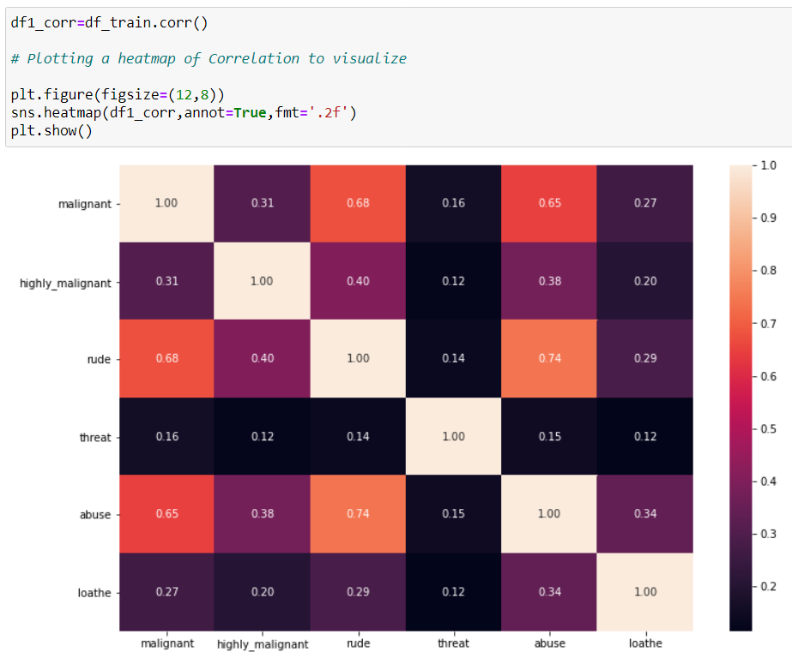
Correlation Matrix
We see a high correlation between rude and abusive comments. There is also a good correlation between rude-malignant and malignant-abuse pair.

Slide 11
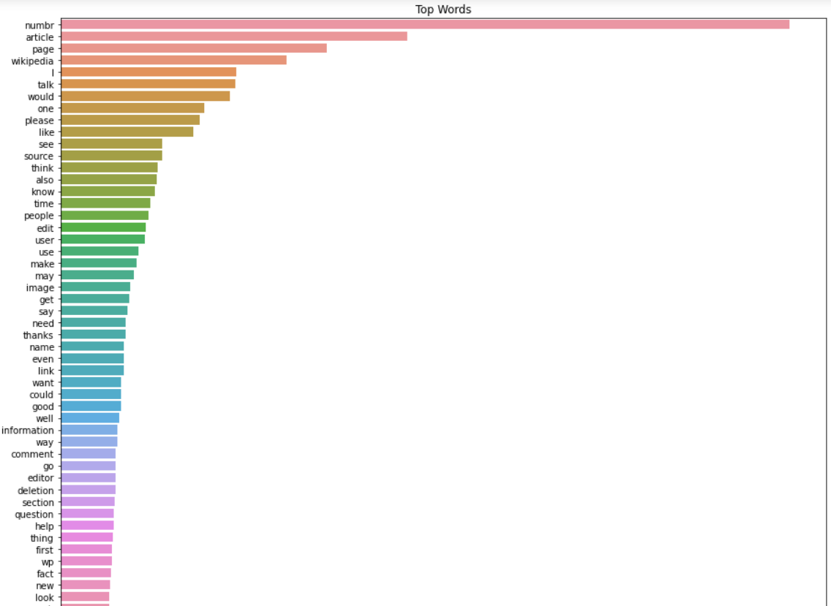
Checking top words
We replaced digits with ‘numbr’. We see a high count of digits in the text. Article, page, Wikipedia also has a high count. This refers to a conversation related to articles on Wikipedia or related to Wikipedia article pages.

Slide 12
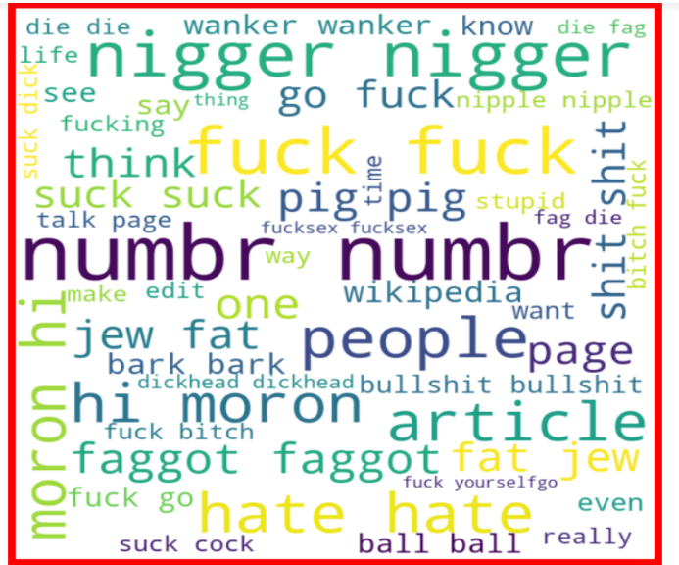
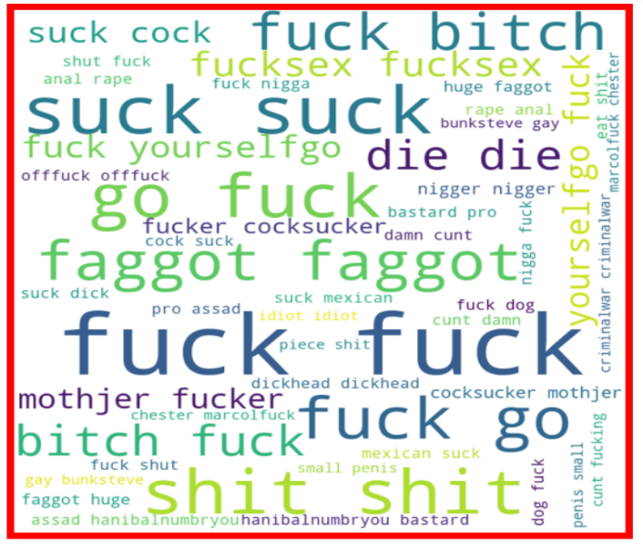
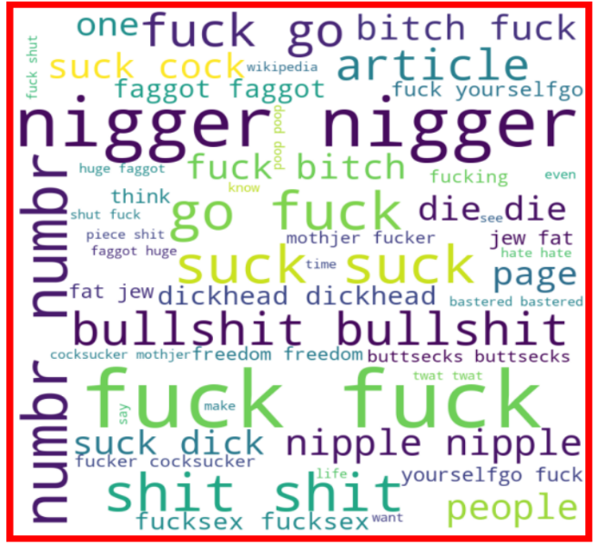
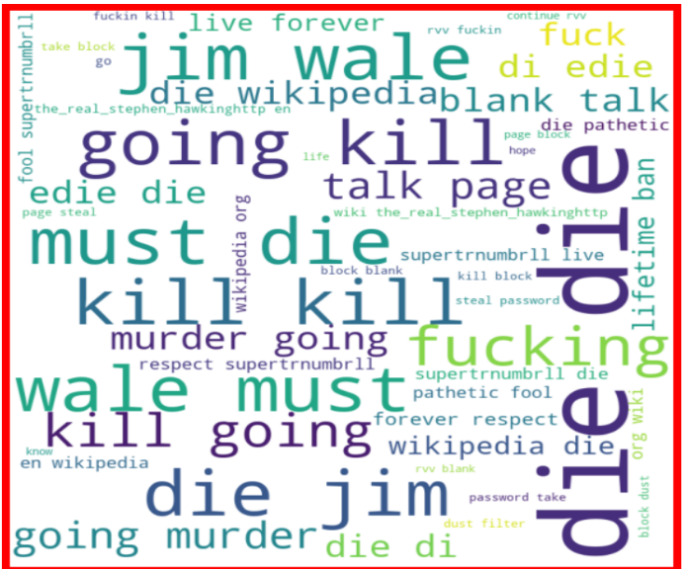
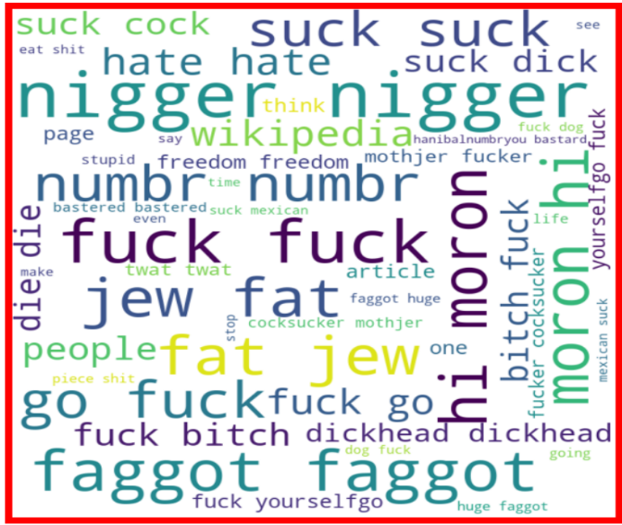
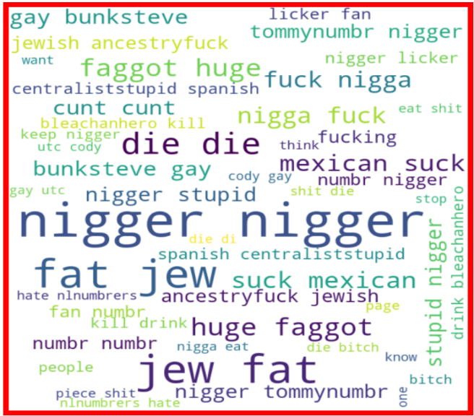
Word Cloud
Malignant
Highly Malignant
Rude
Threat
Abuse
Loathe

Slide 13
All the comments falling under any of the categories usually have abusive, racist, or discriminating, provoking words.
Malignant comments have nigger, fuck, faggot, pig as most used words. There we see a high number of ‘numbr’ which denotes digits.
Highly malignant comment again has fuck, faggot as common with malignant. There are words like shit, bitch, mother fucker, cocksucker usually seen in this category.
Rude comments have extensive use of words like nigger, bullshit, fuck, suck, nipple, bitch, faggot. As we see a correlation between malignant and rude category we also see common words in them. Numbr again appears several times.
Threat column has die, kill as most common words. Must die, going kill, murder is the most common word. We also see lifetime ban, fucking, Jim wale as most used.
The abuse column has abusive words. Nigger, fuck, bitch dickhead, faggot are most common. These are similar to rude and malignant comments. We see the use of words moron, fat, jew to be used as abusive words.
Loathe comments have common words like nigger, die, faggot, etc. Similar to abuse it also contains fat, jew. We see bunksteve, gay, Mexican, Jewish, licker as different words denoting a loathe comment.

Slide 14

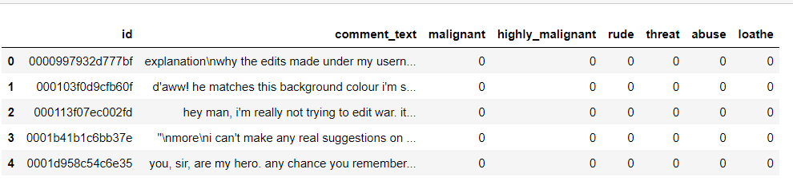
Preprocessing
Converting the text to lower case
We converted all the text to lower case

Slide 15
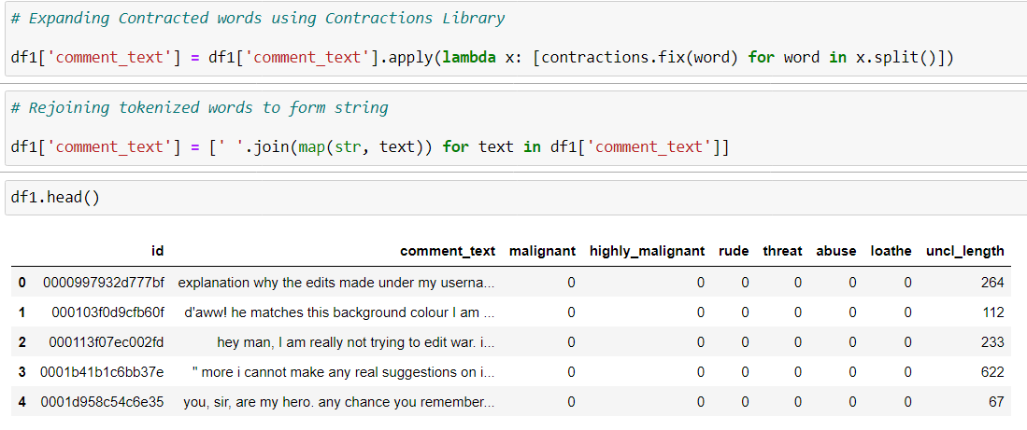
Expanding Contracted Words
We used contractions library to expand contracted words.

Slide 16
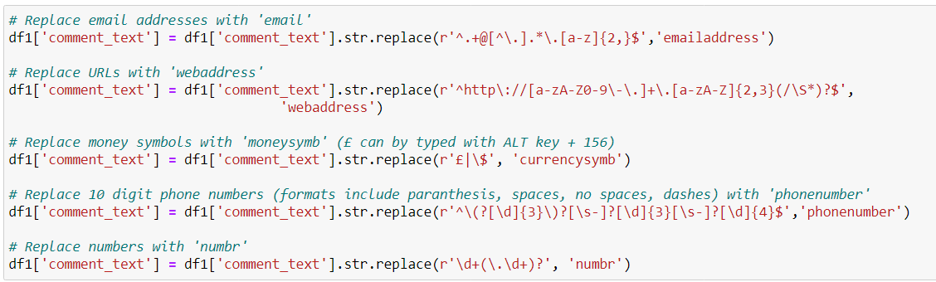
Replacing emails,web addresses, phone numbers, digits, dollar signs

Slide 17
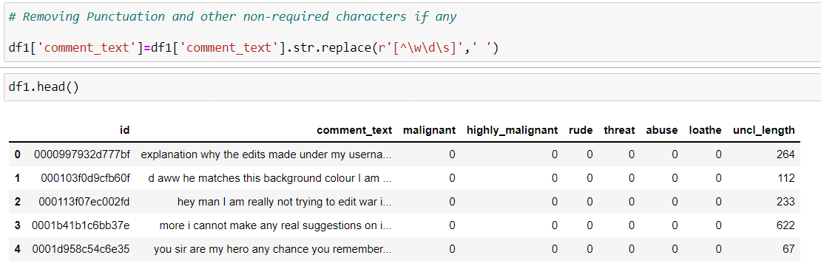
Removing Punctuations and Extra Characters
We removed punctuation from the text.
As punctuation doesn’t add meaning to the test in terms
of machine learning.

Slide 18
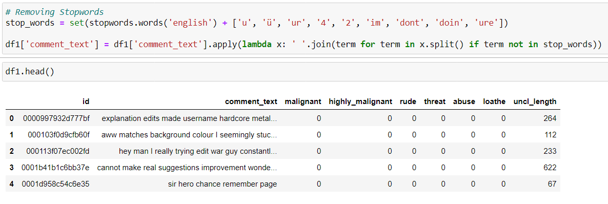
Removing Stopwords
Stopwords are common words which occur frequently.

Slide 19
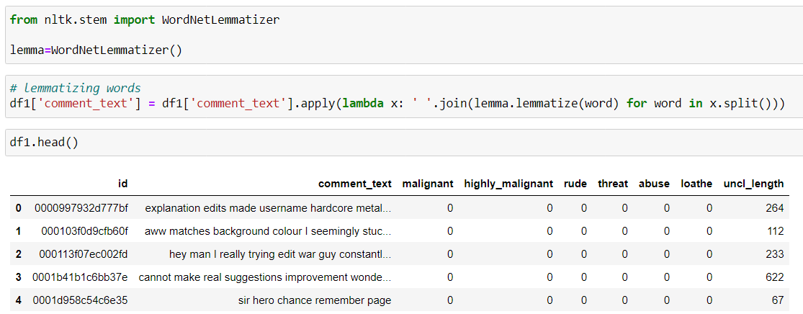
Lemmatization
We applied lemmatization on the words in the review column.
Lemmatization chops off extra part from the word while keeping the meaning of the word intact.

Slide 20
Vectorization
Text data can not be directly inputted into machine learning models.
To make the text suitable to be passed into machine learning model, text is converted to vectors.
We use TF-IDF method to convert text into vectors

Slide 21
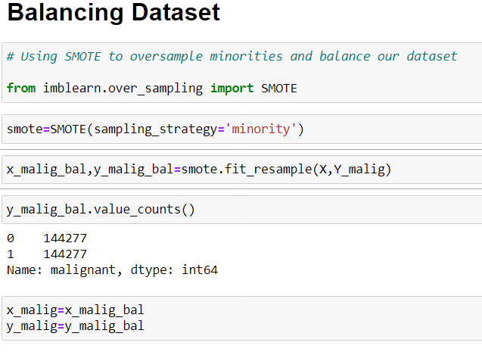
Class Balancing
Class balancing is the procedure of creating samples of a class to make it equal to another class.
One way the imbalance may affect our Machine Learning algorithm is when our algorithm completely ignores the minority class. The reason this is an issue is that the minority class is often the class that we are most interested in.
We created synthetic samples using SMOTE.

Slide 22
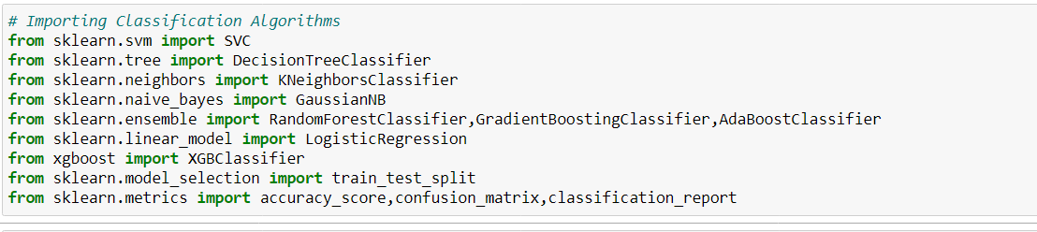
Model Training
We started our job by finding the best random state with 66.66% data as training data and 33.33% data as test data.
We used ‘For loop’ for this purpose, identifying highest accuracy score at a certain random state.
Using the random state we created Train Test Split.
We imported all the classification algorithms and evaluation metrics.

Slide 23
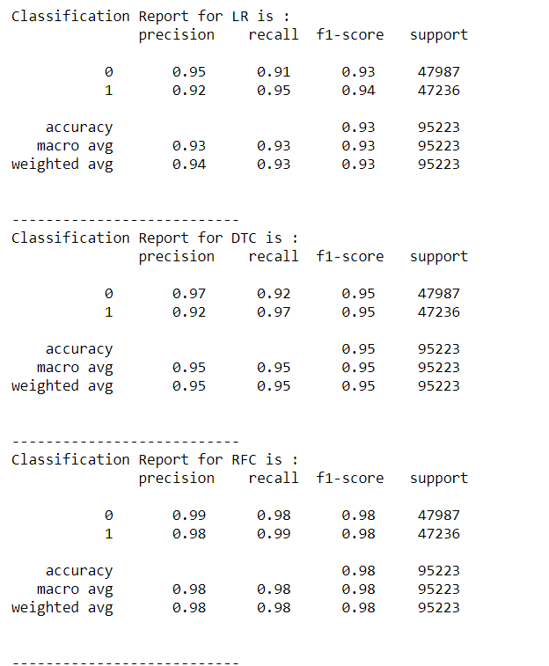
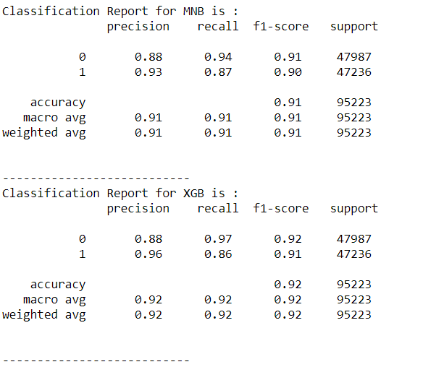
Training and checking accuracy of the models
We created a list of algorithms to be tested and checked for training and testing accuracy of various classification algorithms.
We get the best scores with Random Forest classifier with 98% to 99% accuracy.
We cross validated the scores using Cross Validation method. Random Forest has the best performance with least overfitting.
We also checked the classification report for various models.

Slide 24
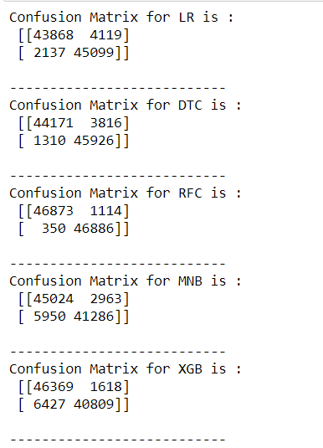
Confusion Matrix
We checked the confusion matrix for various models for each category.
We find the best performance by Random Forest with least False Positive and False Negative.

Slide 25
Finalizing Model
On the basis of Accuracy score , Precision, Recall, F1 score we select Random Forest classifier algorithm for final model building for each category.
Our final model is created using Random Forest algorithm with 98% to 99.99% accuracy.

Slide 26
Conclusion
Given dataset provides us with information about a user’s commenting pattern.
We observe that with increasing positive sentiment rating increases.
Toxic or malignant comment has more words than normal.
Rude and Abusive category is correlated.
Word cloud give us an idea about the words used in each classes.
Malignant, Rude, Abusive had correlation.

