Slide 1

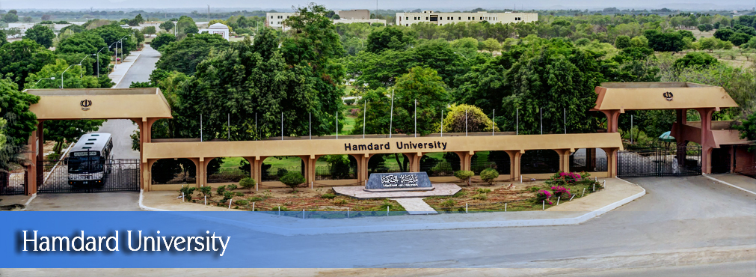
FYP
Proposal
CMS Made Easy…Automated Chatbot for Students
Group Members:
Balaj Yousuf
Saad Nasir
Usama Amjad
Supervisor:
Asst. Prof Imran Uddin Khan
Hamdard University

Slide 2
Summary
Group Introduction
Problem Statement
Motivation
FYP Scope
FYP Objectives
Process Flow Diagram
Functional Requirement
Methodology
Project Plan
Project tools
Budget / Costing
Limitations
FYP Deliverables
References

Slide 3
1– Group Introduction
Group Members:
Balaj Yousuf (BSCS/F15/0144)
Saad Nasir (BSCS/F15/0151)
Usama Amjad (BSCS/F15/0104)
Supervisor: Sir Imran Khan
Knowledge and researches:
Artificial Intelligence.
Software Engineering.

Slide 4
2 – Problem Statement
In this technologically advanced world, navigating between pages or to perform queries in every other pages wastes a lot of time.
People now a days prefer those applications where they can see everything in just one place.
Stereotype websites are being replaced by Single Page Applications and Progressive Web Apps.

Slide 5
3 – Motivation
Navigating between CMS takes a lot of time.
For e.g. just to see my current schedule or transport or tuition fee we have to navigate back and forth on average 4 times.
In the age where 5G is evolving the world, this is a no brainer.
Chatbots are one of many solutions that can solve this problem. You just ask chatbot the question, it will provide with you the relevant answers.

Slide 6
4 – Scope
Chatbot will provide a unique way of seeing data and visualizing with CMS. It will make user fun to open CMS.
We will train our machine learning models until they are fitting enough to be used on application.
Our project will mainly hub on developing a machine learning model and training it to accomplish high level of accuracy
Our basic endeavor is to train model using Generative approach and generative models on the seq2seq neural network.
If we think that Generative approach is not working according to our need we will switch to Retrieval Based bots. The bot is trained to rank the best response from a finite set of predefined responses.

Slide 7
5 – Objectives
The objective is to develop a generalized algorithm that is able to detect what user wants to know with the help of Artificial Intelligence and provide appropriate answer.
The Aim is to develop a model that can be integrated with our own university CMS and help students serve better way

Slide 8
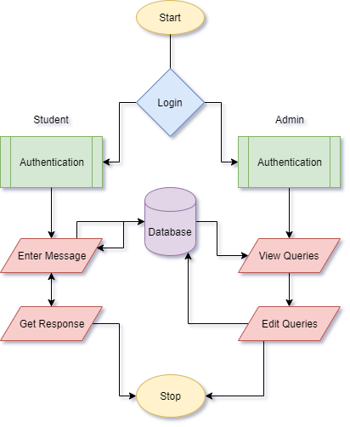
7 – Process Flow Diagram

Slide 9
8 – Functional Requirement
Login Module:
User
Admin
Server Module:
Send information to server and receive response
Admin Module:
Admin will be able to add additional info

Slide 10
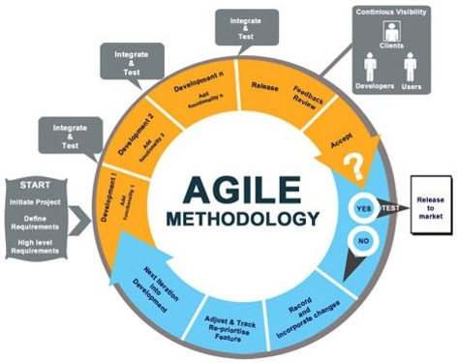
9 – Methodology

Slide 11
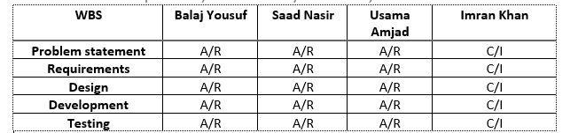
10 – Project Plan
Team Role & responsibilities (RACI Matrix)
R = Responsible, A = Accountable, C = Consulted, I = Informed

Slide 12
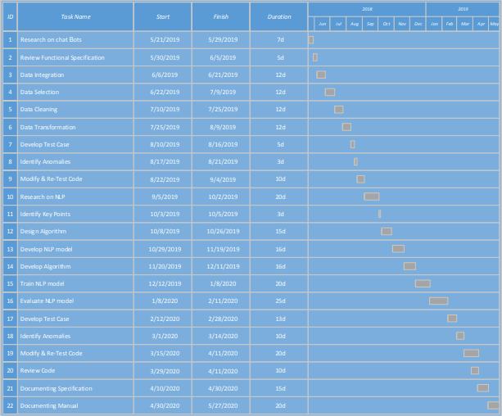
10 – Project Plan (cont.)
Gantt Chart:

Slide 13
11 – Project tools
Software Requirement:
Python – Programming language.
HTML, CSS3, Angular 6– For web application
Anaconda – For large scale data processing and scientific computing.
Scikit- For training our model using machine learning.
Telegram – Python library for chatbot implementation

Slide 14
12 – Budget / Costing
Budget:- 50000
GPU`s are required for high-end processing which are pretty expensive hence we have decided to use Amazon’s micro services or AWS which are estimated to be $250.
4 Udemy Courses for Chatbot Implementation which will cost $12/course.

Slide 15
13 – Limitations
The main limitations will be that it able to solve high level of complex queries as you would want but still would be able to solve our daily queries for which we use CMS like attendance and fee ledger.

Slide 16
14 – FYP Deliverables
Following are the project deliverables:
Requirements documentation
Design documents
Trained Machine Learning model
First Evaluation:
By the end of first evaluation, we will have decided which approach will be used to train the model and model will be trained sufficient enough to perform simple queries. Database part will also be completed and integrated with chatbot.

Slide 17
14 - FYP Deliverables
Final evaluation
At the end of final evaluation, the model will be trained with high accuracy and high efficiency and will be able to perform complex queries as well.
An interactive messenger application will also be developed in which chatbot would be integrated.

Slide 18
15 – References
Kerlyl, Alice, Phil Hall, and Susan Bull. "Bringing chatbots into education: Towards natural language negotiation of open learner models." In International Conference on Innovative Techniques and Applications of Artificial Intelligence, pp. 179-192. Springer, London, 2006.
Georgescu, Alin-Andrei. "Chatbots for Education–Trends, Benefits and Challenges." In Conference proceedings of» eLearning and Software for Education «(eLSE), vol. 2, no. 14, pp. 195-200. ” Carol I” National Defence University Publishing House, 2018..
Benotti, Luciana, María Cecilia Martínez, and Fernando Schapachnik. "Engaging high school students using chatbots." In Proceedings of the 2014 conference on Innovation & technology in computer science education, pp. 63-68. ACM, 2014.
Georgescu, Alin-Andrei. "Chatbots for Education–Trends, Benefits and Challenges." In Conference proceedings of» eLearning and Software for Education «(eLSE), vol. 2, no. 14, pp. 195-200. ” Carol I” National Defence University Publishing House, 2018.
Leonhardt, Michelle Denise, Liane Tarouco, Rosa Maria Vicari, Elder Rizzon Santos, and Michele dos Santos da Silva. "Using chatbots for network management training through problem-based oriented education." In Seventh IEEE International Conference on Advanced Learning Technologies (ICALT 2007), pp. 845-847. IEEE, 2007.

Slide 19
15 – References
Golbeck, Roos, Sofie. "Chatbots in education: A passing trend or a valuable pedagogical tool?." (2018).
Roos, Sofie. "Chatbots in education: A passing trend or a valuable pedagogical tool?." (2018).
Shawar, Bayan Abu, and Eric Atwell. "Chatbots: are they really useful?." In Ldv forum, vol. 22, no. 1, pp. 29-49. 2007.
Kowalski, Stewart, Katarina Pavlovska, and Mikael Goldstein. "Two case studies in using chatbots for security training." In IFIP World Conference on Information Security Education, pp. 265-272. Springer, Berlin, Heidelberg, 2009..
Molnár, György, and Zoltán Szüts. "The Role of Chatbots in Formal Education." In 2018 IEEE 16th International Symposium on Intelligent Systems and Informatics (SISY), pp. 000197-000202. IEEE, 2018.

