Slide 1

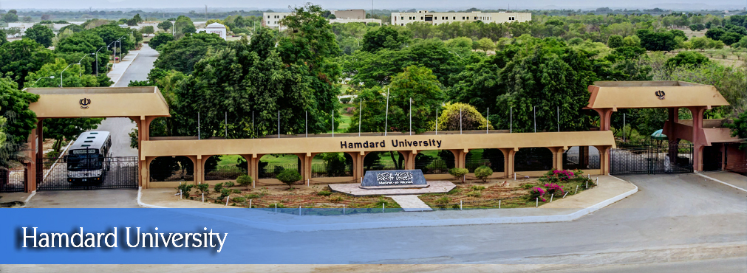
FYP
Proposal
Traffic Violation Detection Using Smart Systems
Group Members:
Abdul Sami Khan
M. Ehtisham Siddiqui
M. Faraz Khalid
Supervisor:
Asst. Prof Imran Uddin Khan
Co-Supervisor:
Hamdard University

Slide 2
Summary
Group Introduction
Problem Statement
Motivation
FYP Scope
FYP Objectives
Process Flow Diagram
Functional Requirement
Methodology
Project Plan
Project tools
Budget / Costing
Limitations
FYP Deliverables
References

Slide 3
1– Group Introduction
Group Members:
Abdul Sami Khan (BSCS/F15/0144)
M. Ehtisham Siddiqui (BSCS/F15/0151)
M. Faraz Khalid (BSCS/F15/0104)
Supervisor: Sir Imran Khan Co-Supervisor:
Knowledge and researches:
Artificial Intelligence.
Software Engineering.

Slide 4
2 – Problem Statement
In the past few years, almost all the big and smart cities have been suffering from this severe issue called traffic violations.
This problem is continuously increasing because of industrialization.
It is observed that people are not the following the traffic rules which results in high ratio of accidents and loss of precious lives.

Slide 5
3 – Motivation
Karachi is a metropolitan city. Mostly in metropolitan cities, life routine is really tight, due to which people are not following rules be it traffic or some other.
There must be some kind of strictness embossed which should bind people to follow the rules.
The loss of live due to road accidents is very high in Karachi.

Slide 6
4 – Scope
Create our own number plates dataset
Train the dataset so it can be used with our application to recognize number plates from a vehicle
Integrate the trained model with OpenCV which would map different types of vehicles
Use both things to simultaneously map and detect the number plates from vehicles which have violated rules.
A web application to keep record of number of challans and view or edit challans.

Slide 7
5 – Objectives
Objective is to develop a generalized algorithm that is able to detect different types of traffic violations.
The objective is to make people follow rules and regulations and to end bribery and corruption in traffic police department.
To research, it can provide extension of Machine Learning and image recognition to in web-applications.

Slide 8
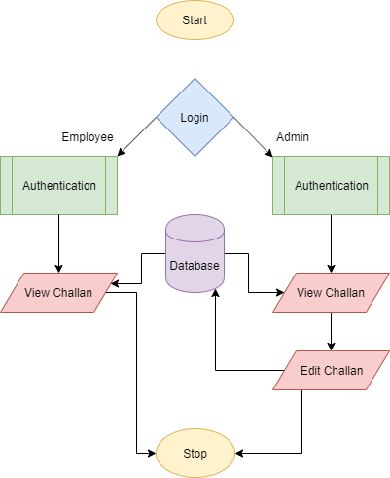
7 – Process Flow Diagram

Slide 9
8 – Functional Requirement
Login Module:
User
Admin
Server Module:
Send information to server.
Report Module:
View/Update generated challan.

Slide 10
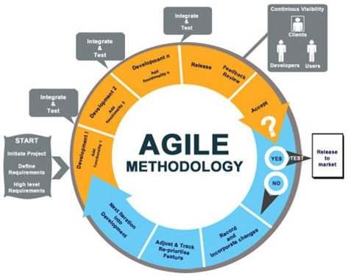
9 – Methodology

Slide 11
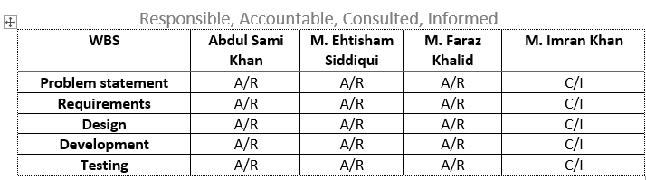
10 – Project Plan
Team Role & responsibilities (RACI Matrix)
R = Responsible, A = Accountable, C = Consulted, I = Informed

Slide 12
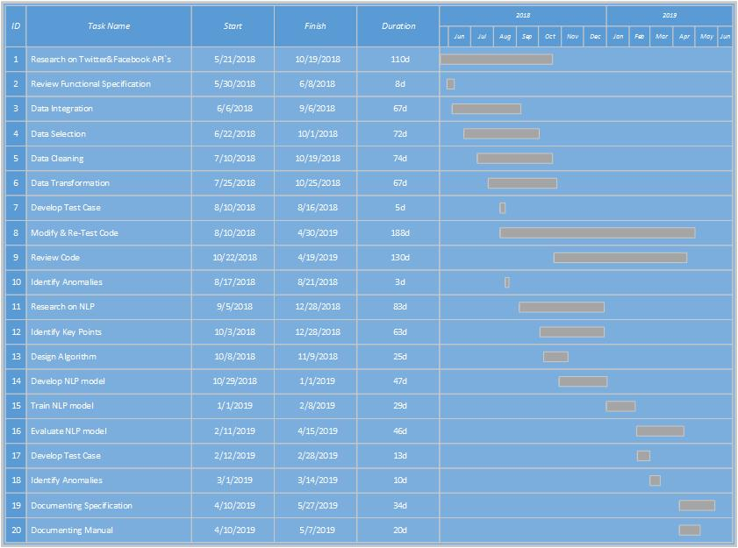
10 – Project Plan (cont.)
Gantt Chart:

Slide 13
11 – Project tools
Software Requirement:
Python – Programming language.
HTML, CSS3, Angular 6– For web application
Anaconda – For large scale data processing and scientific computing.
Scikit- For training our model using machine learning.
OpenCV – For image recognition and number plate recognition.

Slide 14
12 – Budget / Costing
Budget:- 50000
GPU`s are required for high-end processing which are pretty expensive hence we have decided to use Amazon Web Services (AWS) for our backend and model training which will cost us around 300$.

Slide 15
13 – Limitations
The main limitations will be that it won’t be able to detect all kind of traffic violations and it might not be able to map all traffic because of blockages.

Slide 16
14 – FYP Deliverables
Following are the project deliverables:
Requirements documentation
Design documents
Trained Machine Learning model
First Evaluation:
By the end of first evaluation, we will have trained our model and that model will be able to differentiate between different types of vehicles. We will also be able to detect the first kind of violation i.e. when the signal is red and someone breaks the signal. The system will generate an alert

Slide 17
14 - FYP Deliverables
Final evaluation
At the time of final evaluation, our model will be trained enough to detect few kinds of traffic violations and detect their number plates also.

Slide 18
15 – References
Ciolli, Robert. "Traffic violation detection, recording and evidence processing system." U.S. Patent 8,134,693, issued March 13, 2012.
Ciolli, Robert. "Traffic violation detection, recording and evidence processing system." U.S. Patent Application 10/555,634, filed November 30, 2006.
Vijverberg, Julien A., Nick AHM de Koning, Jungong Han, Peter HN de With, and Dion Cornelissen. "High-level traffic-violation detection for embedded traffic analysis." In 2007 IEEE International Conference on Acoustics, Speech and Signal Processing-ICASSP'07, vol. 2, pp. II-793. IEEE, 2007.
Ni, Sze-Yao, Yuang-Tzong Lan, Tom CI Lin, and Yi-Wei Chen. "Automatic traffic violation detection system and method of the same." U.S. Patent Application 12/963,861, filed June 14, 2012.
Uy, Aaron Christian P., Rhen Anjerome Bedruz, Ana Riza Quiros, Argel Bandala, and Elmer P. Dadios. "Machine vision for traffic violation detection system through genetic algorithm." In 2015 International Conference on Humanoid, Nanotechnology, Information Technology, Communication and Control, Environment and Management (HNICEM), pp. 1-7. IEEE, 2015.

Slide 19
15 – References
Danis, Robert. "Traffic Violation Photo Enforcement System." U.S. Patent Application 13/107,933, filed November 15, 2012.
A Lotufo, R. A., A. D. Morgan, and A. S. Johnson. "Automatic number-plate recognition." In IEE Colloquium on Image Analysis for Transport Applications, pp. 6-1. IET, 1990.
Fahmy, Maged MM. "Automatic number-plate recognition: neural network approach." In Proceedings of VNIS'94-1994 Vehicle Navigation and Information Systems Conference, pp. 99-101. IEEE, 1994.
Martinsky, Ondrej. "Algorithmic and mathematical principles of automatic number plate recognition systems." Brno University of technology (2007): 20-23.
Dhage, Manisha R., Gaurav V. Patil, Shrayank J. Mistry, Prathamesh N. Tambe, and Parag H. Nankar. "Automatic Traffic E-challan Generation Using Computer Vision." In International Conference on Sustainable Communication Networks and Application, pp. 203-213. Springer, Cham, 2019.

