Slide 1
GENERAL ASSEMBLY · DATA SCIENCE BOOTCAMP · BAHRAIN 2026
Motor Fault Detection
Using Motor Current Signature Analysis (MCSA)
Ali Ashoor
Lightning Talk 2 · July 2026
Capstone Part 2 · EDA & Modeling Plan

Slide 2
THE PROBLEM
Why Motor Faults Matter
70%
36–38%
10%
of industrial electricity
consumed by motors
of failures from
stator winding faults
of failures from
broken rotor bars
Motors are the single largest electricity consumer in industry — any failure cascades into major energy waste and production losses.
Stator winding faults are the most common electrical failure mode — caused by insulation breakdown, overheating, or voltage spikes.
BRB faults develop gradually from mechanical stress and thermal fatigue — often undetected until the motor fails completely.
IEA, 2020
Maraaba et al., 2018
Maraaba et al., 2018

Slide 3
CONDITION MONITORING
Why MCSA?
MCSA works by analysing the stator current waveform drawn by the motor. A healthy motor produces a clean sinusoidal current at the supply frequency. When a fault develops — a broken rotor bar or a damaged winding — it introduces small disturbances that appear as sidebands and harmonics around the fundamental frequency. These signatures are invisible to the eye but detectable through frequency analysis.
Method
Hardware needed?
Online monitoring?
Our choice?
Vibration Analysis
Yes — accelerometers
Difficult
✗
Thermal Imaging
Yes — IR camera
No
✗
MCSA
No — uses existing current sensors
Yes
✓
MCSA is fully non-invasive — no extra hardware, no production interruption. It reads fault signatures from the same current sensors already installed on every industrial motor.

Slide 4
RESEARCH QUESTION
What Are We Trying to Solve?
Can a machine learning classifier trained on engineered features from three-phase motor current signals match or outperform the existing rule-based MCSA fault detection system developed in a prior senior thesis (Bahrain Polytechnic, 2025) — and which feature extraction approach (time-domain, FFT, wavelet, or hybrid) provides the strongest classification performance?
Target Variable
condition — three-class label:
healthy
BRB
SWF
Normal motor operation
Broken Rotor Bar
Stator Winding Fault
Success Metrics
Weighted F1-score ≥ 0.90 on held-out test set
Per-class precision and recall ≥ 0.85 for both BRB and SWF fault types

Slide 5
POTENTIAL AUDIENCE
Who Benefits From This Work?
Maintenance Engineers
Plant Managers
Real-time fault alerts without additional hardware — enabling earlier intervention and less unplanned downtime. The system flags BRB and SWF conditions before they escalate to full motor failure.
Predictive maintenance scheduling based on ML model outputs, reducing costly production losses and enabling smarter resource planning across facilities.
OEM Manufacturers
Research Community
Embed intelligent fault detection directly into motor control systems and drives as a value-added software feature — no extra sensors required.
A reproducible, open-dataset ML baseline for MCSA fault classification — extending the Bruinsma et al. (2024) dataset with a data-driven approach.

Slide 6
ABOUT THE DATA
Dataset Overview
Source
900K
300K
Bruinsma et al. (2024) — 4TU.ResearchData
Motor 2 only · 3 conditions · 3 speeds · 3 phases · 5 independent measurement replicates per group
rows per condition
(perfectly balanced)
rows per condition
× speed group (9 groups)
Structure
2,7 M rows × 18 columns
16 signal columns (float32): A_m1 … C_m5
Naming: {phase}_{replicate} — e.g. A_m1 = Phase A, run 1
0
±34A
Each replicate is an independent experimental run
speed column (int): 50 · 75 · 100 (% of rated load)
missing values or
corrupted signals detected
amplitude range
all columns within bounds
condition column (str): healthy · brb · swf ← target

Slide 7
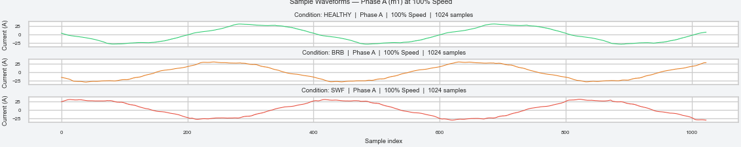
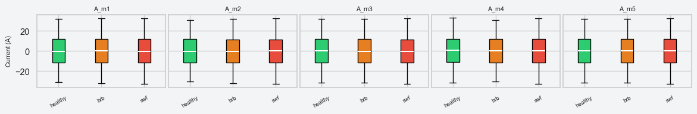
EXPLORATORY DATA ANALYSIS
Do Fault Conditions Look Different?
Waveform — Phase A, m1, 3 conditions, 100% speed, 1,024 samples:
[Insert waveform plot here — export from notebook cell: Sample Waveforms]
Amplitude distributions — Phase A, all 5 measurements, by condition:
All three conditions produce identical waveforms and overlapping distributions — fault signatures are not visible in raw time-domain amplitude.

Slide 8
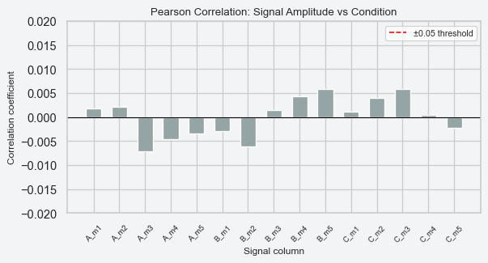
EDA — KEY FINDING
Fault Signatures Live in the Frequency Domain
Pearson correlation: signal amplitude vs condition label:
What this means:
Max correlation across all 15 columns is only 0.007 — effectively zero
Raw amplitude carries no linear information about fault type
BRB sidebands (f ± 2sf) and SWF harmonics (3f, 5f) only appear in the frequency spectrum
Any ML model trained on raw amplitude will perform at chance level (~33%)
This is the expected result in MCSA — it validates the entire project strategy
FFT-based feature extraction is not optional — it is the prerequisite for any successful classifier.

Slide 9
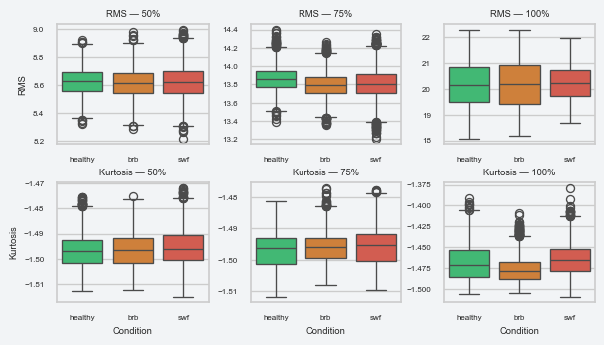
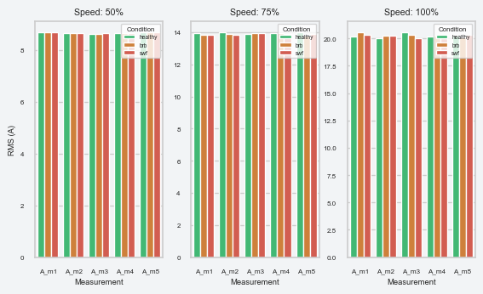
EDA — SUPPORTING STATISTICS
RMS, Kurtosis & Measurement Consistency
RMS & Kurtosis by condition, separated by speed:
Inter-measurement RMS consistency (m1–m5):
RMS responds to speed, not fault condition. Kurtosis shows a weak signal at 100% speed only.
All five replicates are highly consistent — reliable as independent training samples.
Time-domain statistics respond to speed but cannot distinguish fault condition. Frequency-domain feature extraction is required before modeling.

Slide 10
MODELING PLAN
Preprocessing & Modeling Approach
Preprocessing Steps
12 Models
1. Recording-level train/test split (80/20) — performed before windowing to prevent data leakage
Pipeline
Dummy
Random Forest
SVM
TD — Time-Domain
✓
✓
✓
2. Sliding window segmentation — 1,024 samples per window, 50% overlap → ~26 k labeled samples
FFT — Frequency
✓
✓
✓
3. Four parallel feature pipelines: Time-Domain · FFT · Wavelet · Hybrid (all three combined)
WT — Wavelet
✓
✓
✓
4. StandardScaler fit on train set only · speed included as an additional input feature
HYB — Hybrid
✓
✓
✓
All models benchmarked against the rule-based MCSA system from the senior thesis (Bahrain Polytechnic, 2024)
Evaluation: Weighted F1-score (primary) · Precision · Recall · Confusion Matrix · ROC-AUC

Slide 11
PROGRESS REPORT
Work Done & Next Steps
✓ Completed
→ Next Steps
Master dataset built from Bruinsma et al. (2024) raw CSVs
Implement sliding window segmentation and feature extraction
All 4 signal integrity checks passed — zero issues found
Build and evaluate all 4 feature pipelines (TD, FFT, WT, Hybrid)
Full EDA completed — waveforms, amplitude distributions, RMS, kurtosis, and correlation analysis
Train Dummy · Random Forest · SVM on each pipeline (12 models total)
Frequency-domain justification confirmed (max correlation ≈ 0.007)
Benchmark all models against the rule-based MCSA thesis system
Preprocessing pipeline and modeling plan fully defined
Final capstone report, presentation, and potential deployment

Slide 12
Thank You
Questions & Discussion
Ali Ashoor
General Assembly Data Science Bootcamp · Bahrain 2026

