Slide 1
Group Members Shaik Ali Ashraf Suraj Dhamdhere Apoorv Sarvesh
LEAD SCORE CASE STUDY

Slide 2
Problem Statement
X Education sells online courses to industry professionals.
X Education gets a lot of leads, its lead conversion rate is very poor. For example, if, say, they acquire 100 leads in a day, only about 30 of them are converted.
To make this process more efficient, the company wishes to identify the most potential leads, also known as ‘Hot Leads’.
If they successfully identify this set of leads, the lead conversion rate should go up as the sales team will now be focusing more on communicating with the potential leads rather than making calls to everyone.

Slide 3
Business Objective:
The company requires a model to be built for selecting most promising leads.
Lead score to be given to each leads such that it indicates how promising the lead could be. The higher the lead score the more promising the lead to get converted, the lower it is the lesser the chances of conversion
The model to be built in lead conversion rate around 80% or more.

Slide 4
STRATEGY
Import data
Clean and prepare the acquired data for further analysis
Exploratory data analysis for figuring out most helpful attributes for conversion
Scaling features
Prepare the data for model building
﻿Build a logistic regression model
﻿﻿Assign a lead score for each leads
Test the model on train set
﻿﻿Evaluate model by different measures and metrics Test the model on test set
﻿﻿Measure the accuracy of the model and other metrics for evaluation

Slide 5
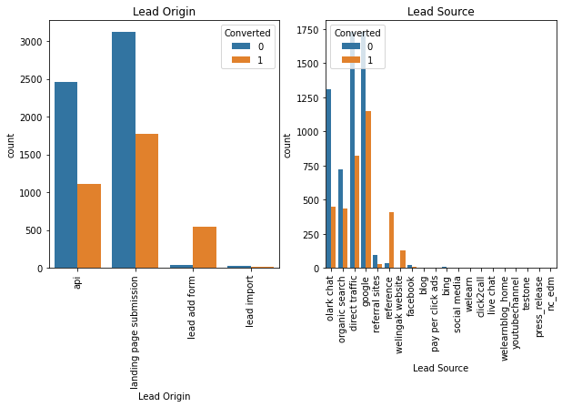
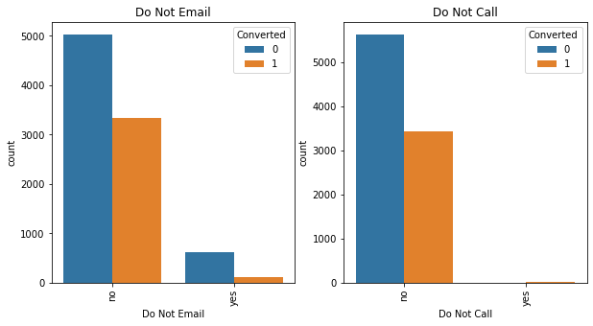
EXPLORATORY DATA ANALYSIS

Slide 6
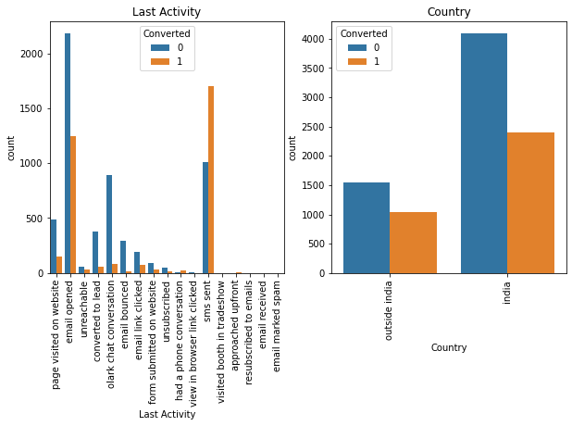
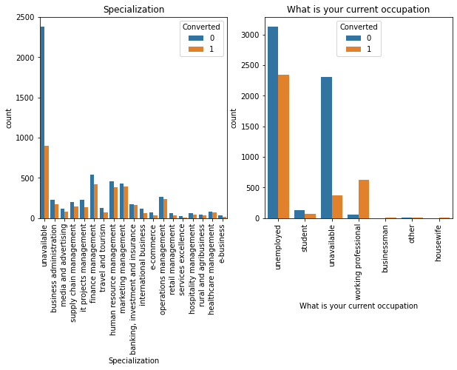

Slide 7
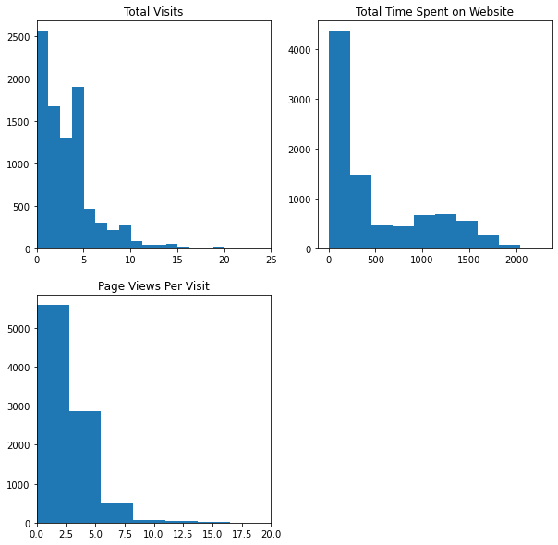
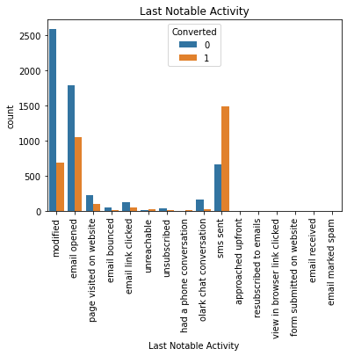

Slide 8
MODEL BUILDING
Splitting the Data into Training and Testing Sets
The first basic step for regression is performing a train-test split, we have chosen 70:30 ratio.
Use RFE for Feature Selection
Then RFE was done to attain the top 15 relevant variables.
Later the rest of the variables were removed manually depending on the VIF values and p-value.
A confusion matrix was created, and overall accuracy was checked which came out to be 81%.

Slide 9
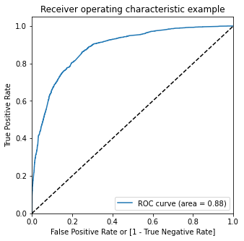
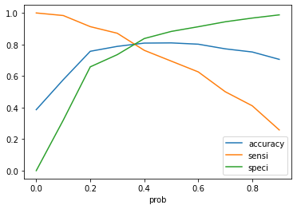
ROC CURVE
Finding Optimal Cut off Point
Optimal cut off probability is that
probability where we get balanced sensitivity and specificity
From the second graph it is visible that the optimal cut off is at 0.35

Slide 10
CONCLUSION
The variables that mattered the most in the potential buyers are :
The total time spend on the Website.
Total number of visits
When the lead source was:
Google
Direct traffic
Organic search
Welingak website
When the last activity was:
SMS
Olark chat conversation
When the lead origin is Lead add format.
When their current occupation is as a working professional. Keeping these in mind the X Education can flourish as they have a very high chance to get almost all the potential buyers to change their mind and buy their courses.

