Slide 1





Management System for
FOOD DELIVERY

Slide 2
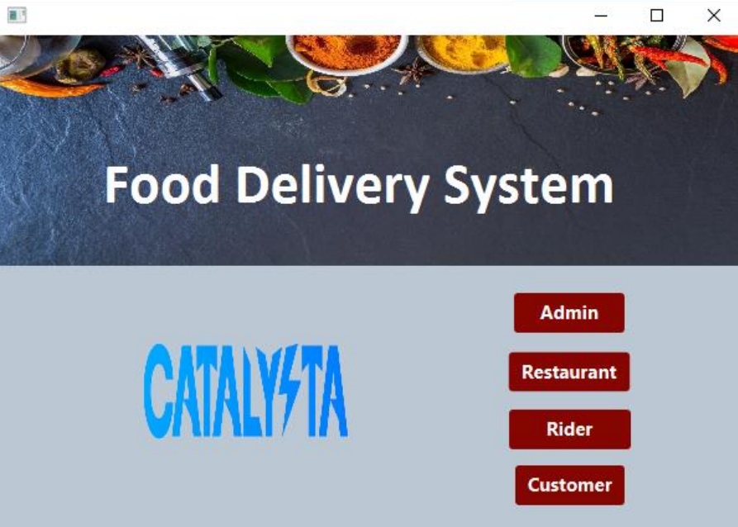

Slide 3
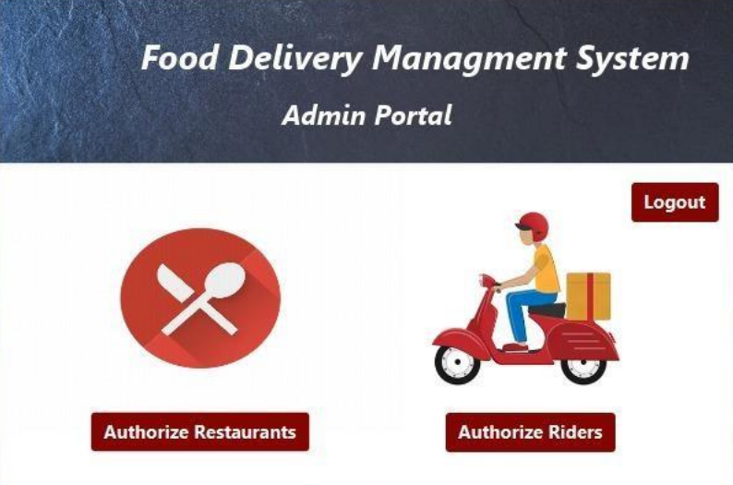

Slide 4
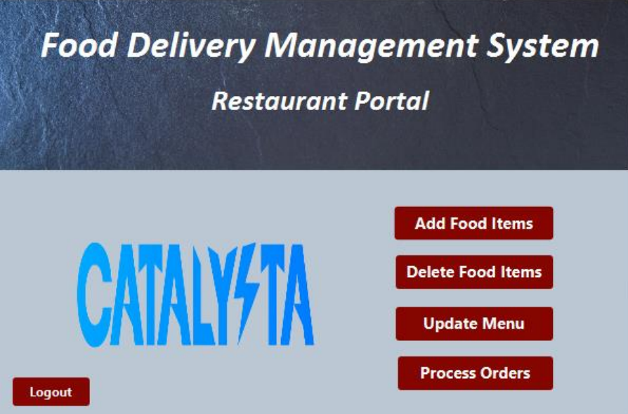

Slide 5
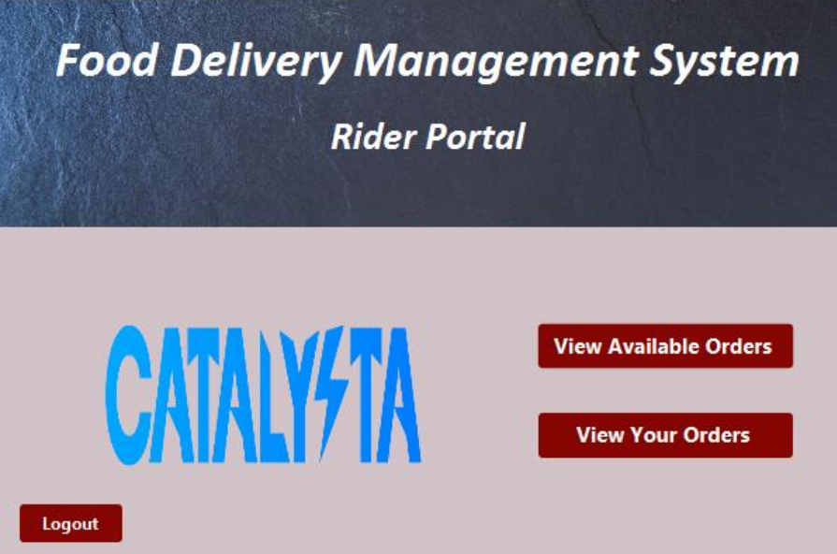

Slide 6
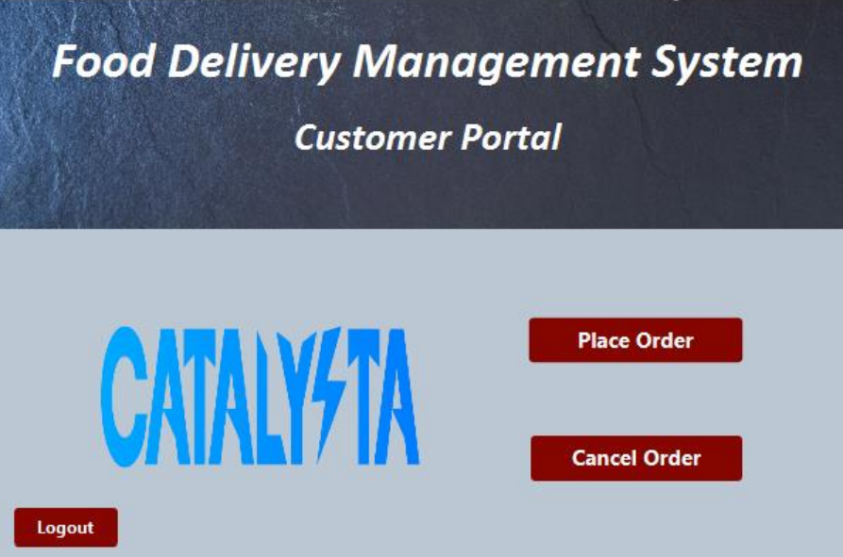

Slide 7
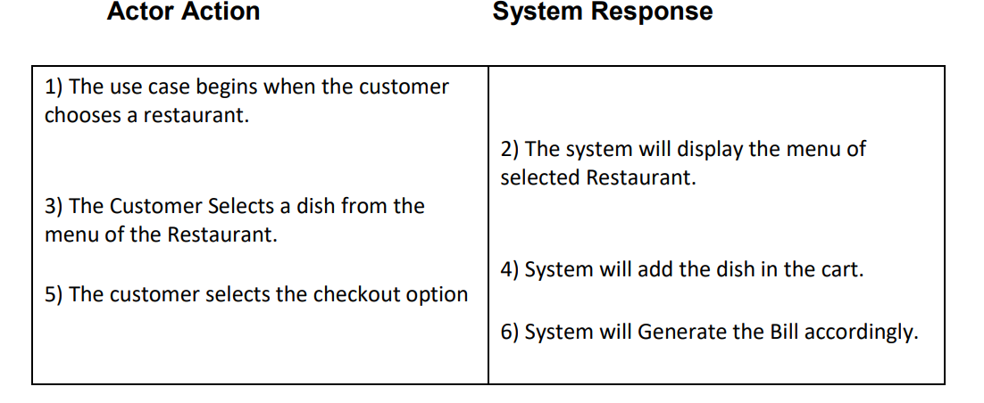
Use case name: Place Order
Scope: Food Delivery Management System
Level: User Goal
Primary Actor: Customer

Slide 8
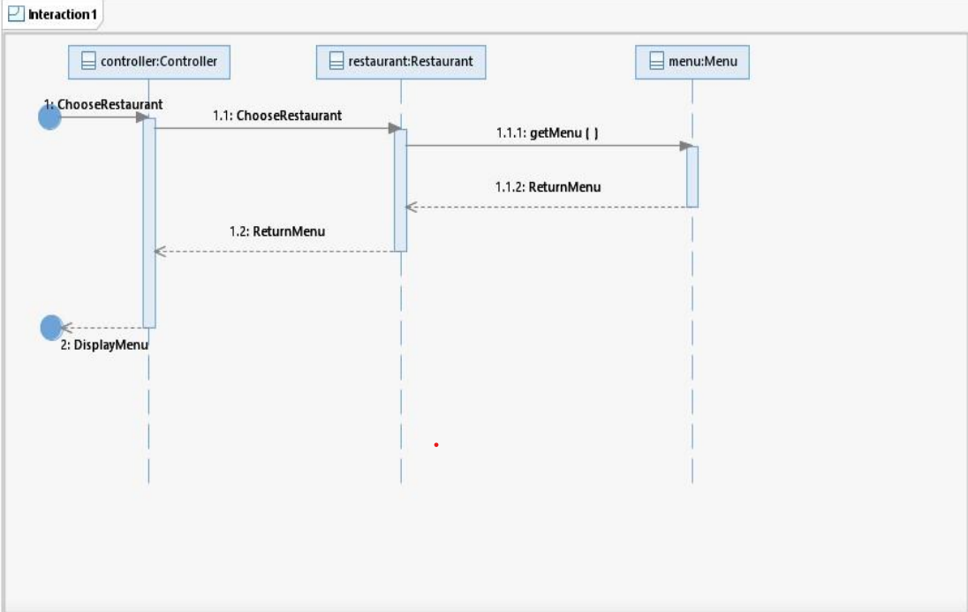

Slide 9
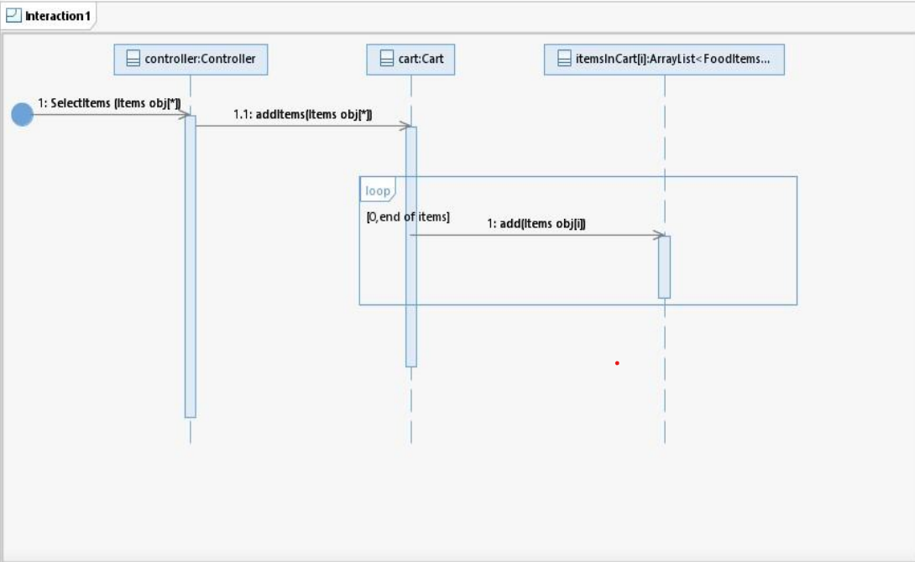

Slide 10
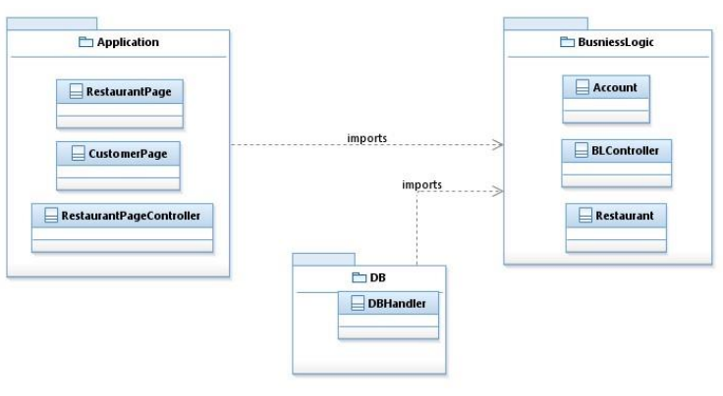
Package Diagram

Slide 11
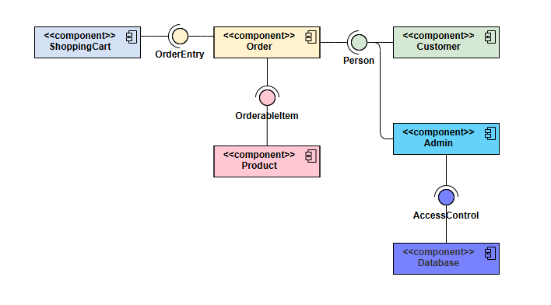
Component Diagram

Slide 12
Design Patterns
High Cohesion
Low Coupling
Pure Fabrication
Controller

Slide 13
THANK YOU!

