Slide 1
Lab 9: OSM and Interactive Web Maps
Xiaofan Liang
Urban Informatics
Fall 2026
Led by Maina Wachira

Slide 2
Reminder: Final Project Groups
Follow this link
to rank your preferred topics / groups for the final assignment.

Slide 3
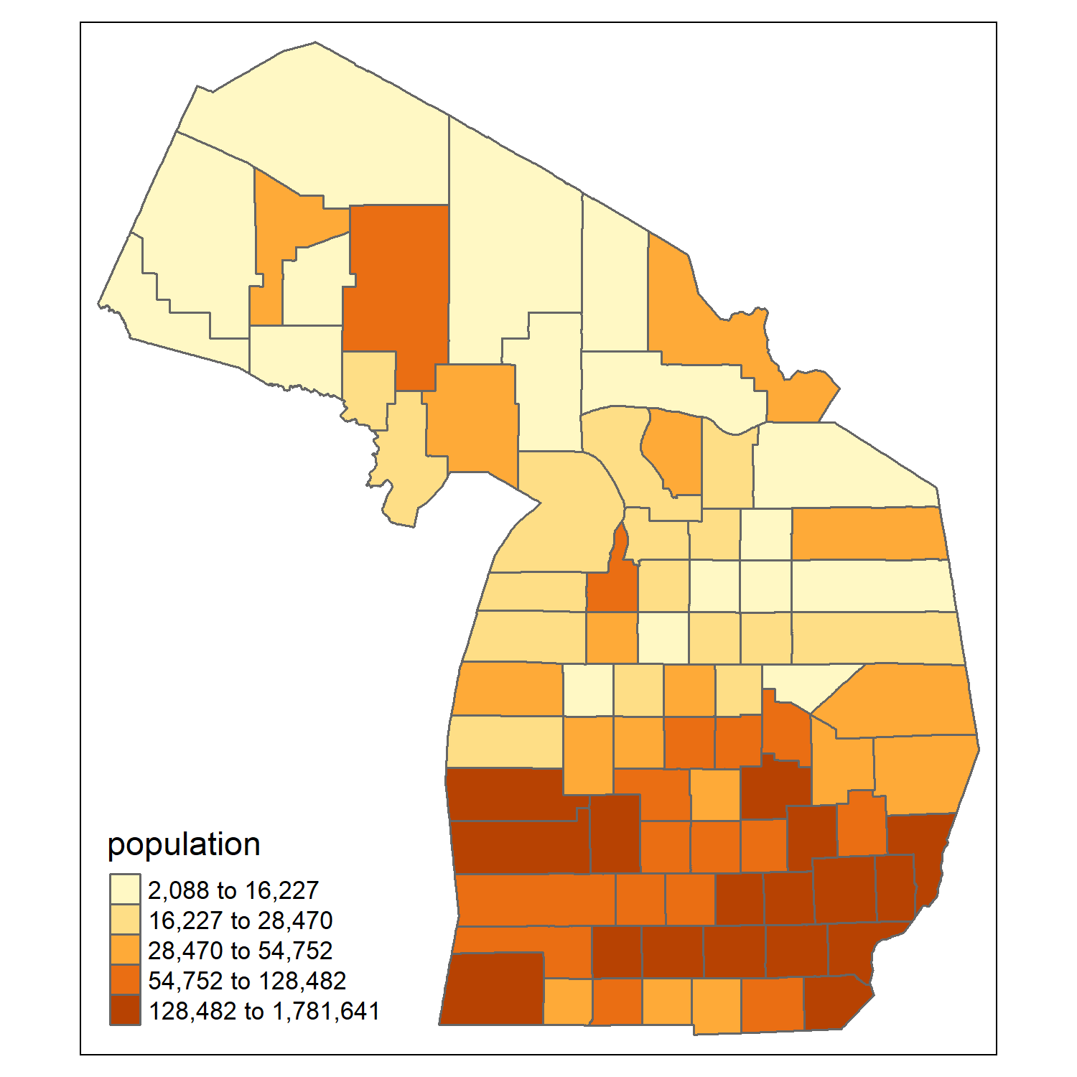
Static Map vs. Interactive Web Map
So far we have mostly used static maps:
  A fixed image of a map (e.g., PNG, JPEG, PDF)
  Created with geopandas / matplotlib (Python), tmap (R), or GIS software
  Not interactive, i.e., users cannot pan, zoom, or click figures.

Slide 4
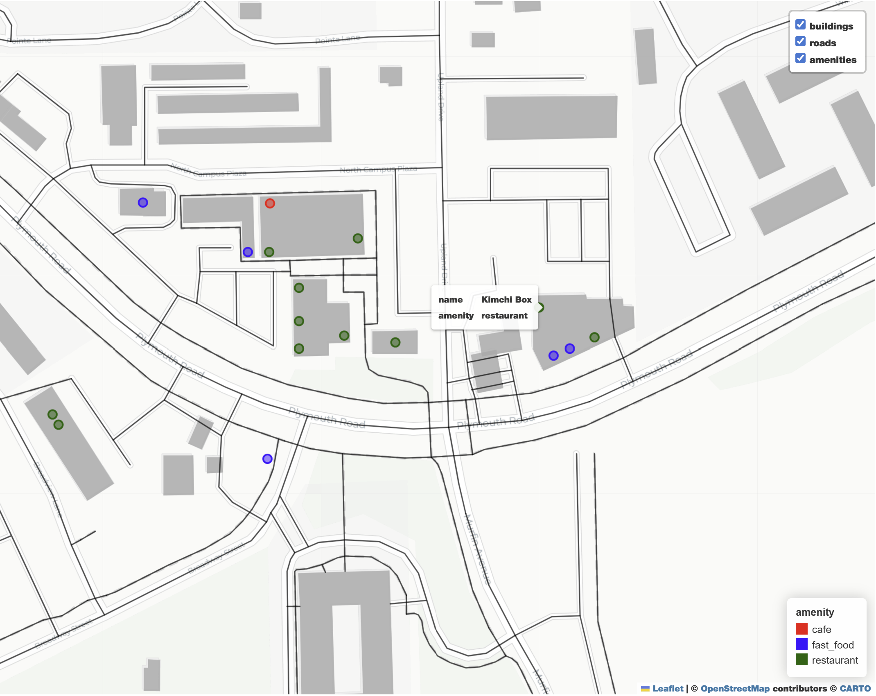
Static Map vs. Interactive Web Map
However, this lab focuses on interactive web maps
  Can change based on input (e.g., filtering POIs by type, turning layers on or off, showing popups)
  Requires HTML, CSS, and Javascript (folium + leaflet)
  Can be hosted online to share with other users.

Slide 5
Interactive Maps with OSM
Open Street Map
OSMnx / Osmdata
GeoDataFrames / SF
bbox = (west, south,
east, north)
ox.features_from_bbox(
bbox,
tags={'building': True}
)
feature
geometry
building
road
amenity
polygon
line
point
OSM is an online database of mapped urban features (e.g., roads, POIs)
We use OSMnx (Python) or Osmdata (R) packages to access it
And store its input in datasets with geographic attributes

Slide 6
Interactive Maps with OSM
Browser window
Geopandas and folium work to translate code (e.g., see below) into HTML, CSS, and JavaScript
feature
geometry
building
road
amenity
polygon
line
point
# Building layer
m = building.explore(...)
# Add road layer
roads.explore(m=m, ...)
# Add amenity layer
amenity_point.explore(m=m, ...)
# Save interactive file
m.save("lab9_map.html")

Slide 7
Web Hosting: Shareable Map Links
Local Rendering:
For a simple application, you can write HTML, CSS, JavaScript in one .html file and open it locally in your browser. This is the same type of file you get if you export a HTML file from Python/R.
Web Hosting:
If you want a sharable, public link on the web, you need to host your .html file on a server. In this lab we use GitHub Pages but there are other options (e.g., RPub for R).

Slide 8
What is GitHub and GitHub Pages
GitHub is an online platform for storing projects, tracking changes over time, and collaborating with others.
GitHub Pages is a free GitHub service that takes files stored on GitHub and publishes them as a public website. Most other hosting service costs money (e.g., you have to buy a domain name).
Example: Professor Liang uses GitHub pages to host her personal website and all interactive maps. Feel free to explore her repository here: https://github.com/xiaofanliang?tab=repositories

Slide 9
Publish a HTML Map on GitHub
You create a map in Python or R.
You save/name it as a html file.
You upload it to GitHub.
You click “Enable Pages.”
GitHub gives you a public web address, e.g.: https://<your_username>.github.io/REPO/<map_name>.html

Slide 10
How to write HTML, CSS, JS in Python/R for Maps? → Leaflet.js
Leaflet.js is an open-source JavaScript library for interactive webmaps.
You don’t need to know how to write HTML, CSS, JS.
  The folium package in Python and leaflet package in R translate R/Python commands into instructions that can execute in your browser.
  They take in Python or R code and create an interactive map you can export a HTML file you can host somewhere (e.g., GitHub Pages)
Still: knowing basic HTML, CSS, and Javascript can help with customization, understanding your exported HTML, debugging, etc.

Slide 11
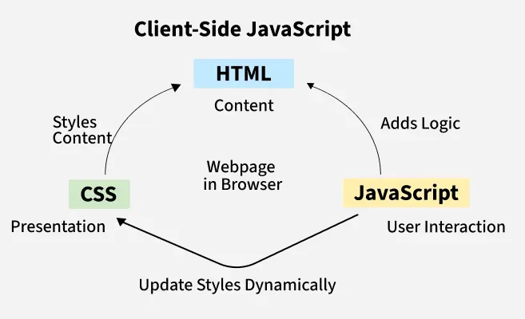
Basic Web Concepts
HTML (HyperText Markup Language) defines the structure of a webpage (e.g., headings, paragraphs, maps)
CSS (Cascading Style Sheets) controls the styling of a webpage (e.g., colors, fonts, layout)
JavaScript adds interactivity to a webpage (e.g., buttons, dynamic maps, animations)
https://www.geeksforgeeks.org/javascript/javascript-tutorial/

Slide 12
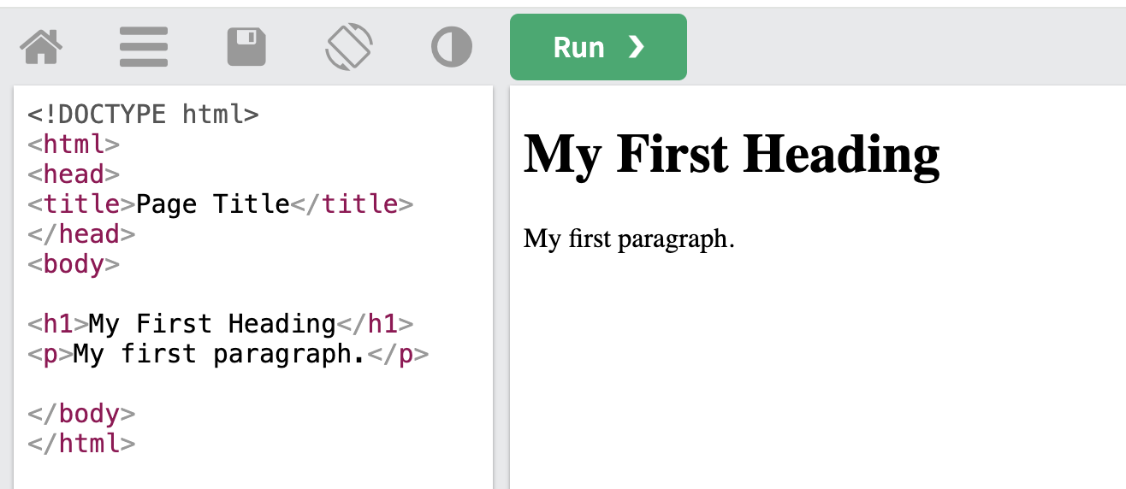
HTML Raw Code (L) & Web Rendering (R)
https://www.w3schools.com/html/tryit.asp?filename=tryhtml_intro

Slide 13
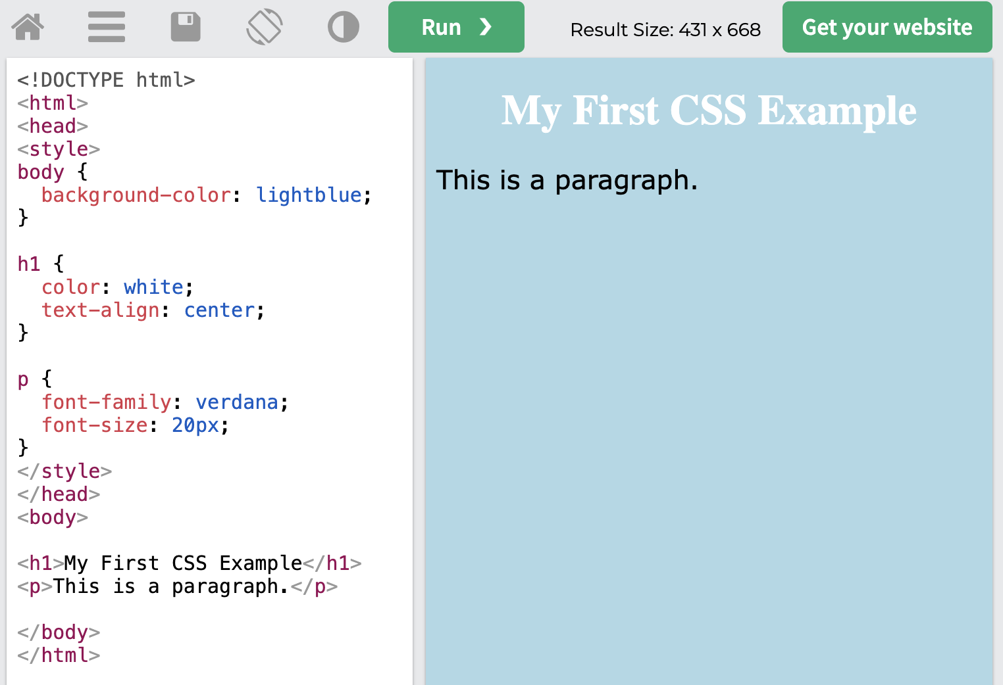
CSS Raw Code (L) & Web Rendering (R)
CSS rules are wrapped in <style> tags nested in a HTML file
Define color and text alignment in <h1> section
Define font type and size in <p> section
HTML content
https://www.w3schools.com/css/tryit.asp?filename=trycss_intro

Slide 14
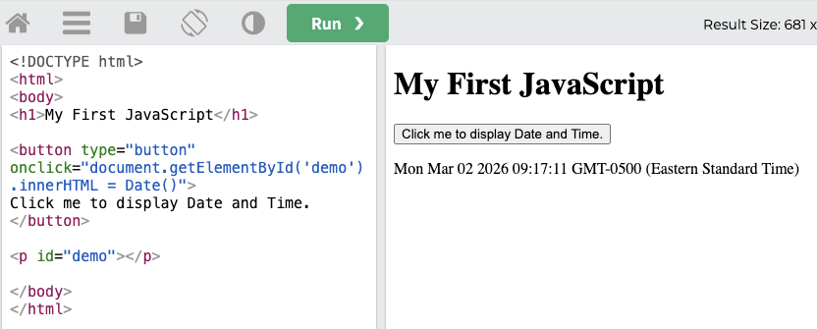
JavaScript Code (L) & Web Rendering (R)
Result of Date()
When clicked, the button runs JavaScript code that finds the element wih id = ‘demo’ and inserts the current date and time (from Date()) inside.
id = ‘demo’

Slide 15
Resources for Learning More
OSMnx docs: essential urban mapping package/API for OSM
MDN Web Docs: web development documentation
Leaflet : Official Leaflet JS tutorials and API
Python Folium : Python package documentation
R Leaflet : R package documentation
W3Schools: Interactive tutorials for HTML/CSS/JavaScript

Slide 16
Next
Review explanations and practice examples -> do practice questions -> complete the quiz
Canvas -> Assignment -> Lab 9 quiz (this is different from others)
  Submit by next lab
  If R, submit your R code (if any) in .R format for the Quiz questions ONLY
Feel free to leave when you are done with lab

