Slide 1

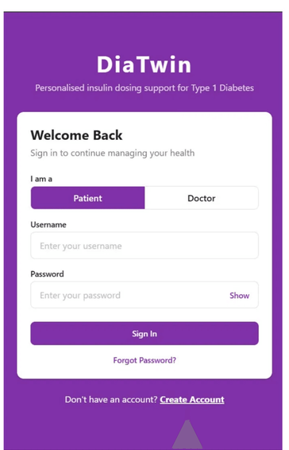



DiaTwin
Personalised insulin dosing support for Type 1 Diabetes
Meet DiaTwin a clinically supervised digital twin for Type 1 diabetes, built for patients who use insulin pens, not just expensive pumps.
Helping People with Type 1 Diabetes Live Safer Lives
Smart App
CGM + Pen
Clinically Proven
Notes:
Managing Type 1 Diabetes with an insulin pen is one of the hardest things a person can do every single day. DiaTwin is the app we built to make it safer, and smarter.

Slide 2

Living With Type 1 Diabetes Is a Full-Time Job
365
Every meal, every snack, every activity demands a decision: How many carbs? How much insulin? How will my body respond? One wrong estimate can cause dangerous hypoglycaemia — or years of silent damage.
DAYS / YEAR
•
365 days a year — no breaks, no holidays, no rest.
Never-Ending Decisions
•
One wrong estimate: hypoglycaemia, hospital visits, or long-term complications.
•
Patients become their own pancreas — every single day, for life.
Notes:
People with Type 1 Diabetes have to manually decide how much insulin to inject , for every meal, every snack, every day, for the rest of their lives. Too much insulin and they can collapse. Too little, and they silently damage their body over years. There's no day off. No autopilot. And most people are doing this completely alone.

Slide 3
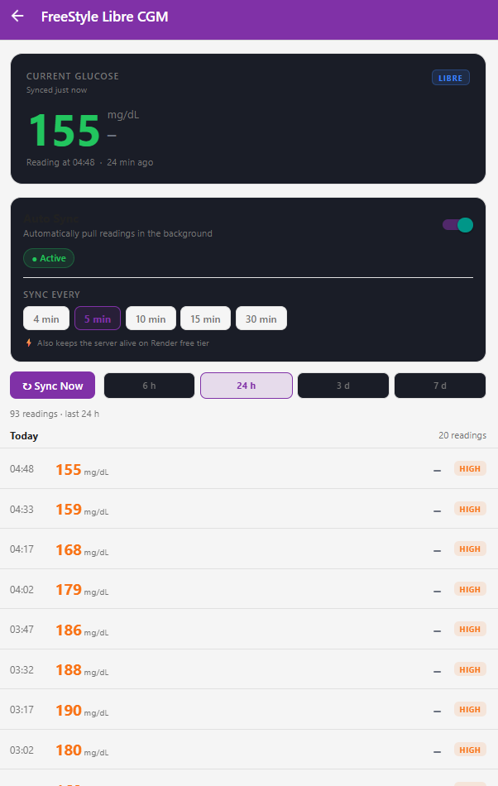
Always Connected. Always Informed.
DiaTwin connects directly to the FreeStyle Libre CGM sensor, pulling live glucose readings automatically — no manual logging, no guesswork.
•
Zero manual entry — data flows in automatically
•
Continuous connection to FreeStyle Libre, around the clock
•
A seamless link between clinical data and everyday decisions
Notes:
DiaTwin starts by connecting to a small sensor the patient already wears on their arm. It reads their glucose levels automatically, around the clock , no manual input, no extra effort. The data just comes in on its own.

Slide 4
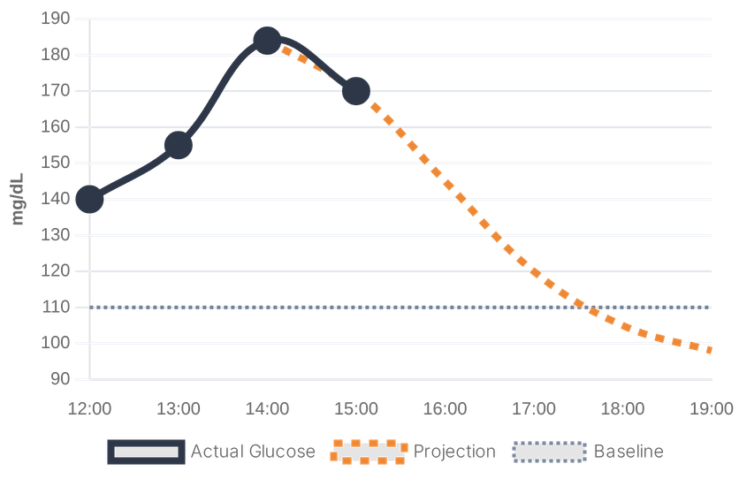
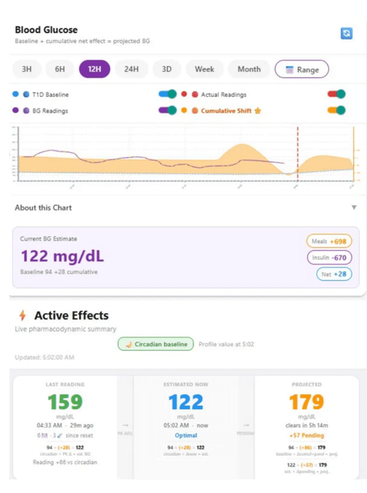
GLUCOSE DASHBOARD
&
FORECAST
The dashboard shows live glucose levels alongside a personalised baseline — revealing not just where blood sugar is right now, but exactly where it is heading.
Live Glucose Monitoring
Continuous CGM sync keeps every reading current and accurate.
4-Hour Glucose Forecast
Personalised predictions help patients act before problems arise — not after.
Notes:
Instead of just showing a number, DiaTwin shows the patient where their glucose is heading , up to four hours ahead. Think of it like a weather forecast for your body. You can prepare before the storm hits, not after.

Slide 5
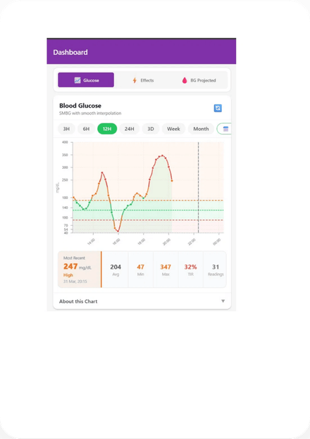

SMART INSULIN & MEAL TRACKING
DiaTwin continuously monitors how much insulin and food are still active in the body — calculating their combined effect on glucose levels, hour by hour. No other pen-based system does this.
ALERT: Insulin activity is outpacing food absorption —
hypoglycaemia risk detected early.
Notes:
After eating or injecting, both the food and the insulin are still active in the body for hours. DiaTwin tracks both at the same time and warns the patient if something is going out of balance , early enough to actually do something about it. No other pen-based app on the market does this.

Slide 6
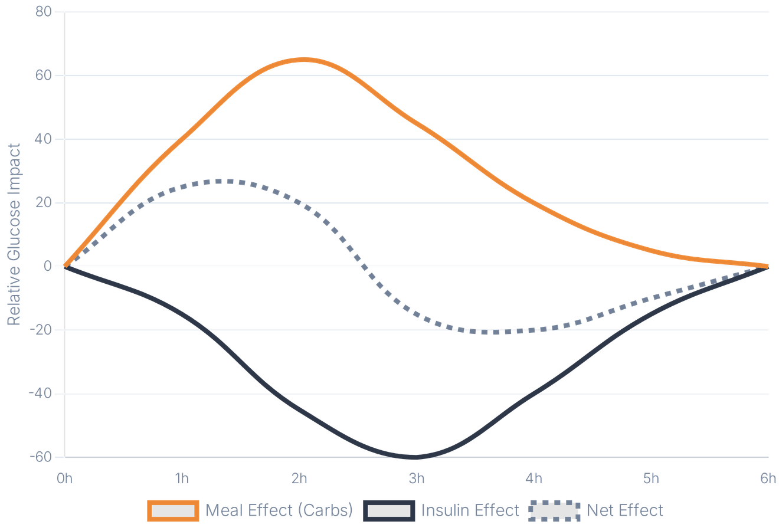


See the Full Picture
Meal effect, insulin effect, and combined net impact — all visible in a single, intuitive chart.
Patients and clinicians see the same data — building shared understanding and trust.
Effects resolve in real time, giving complete transparency into why glucose moves the way it does.
A shared visual language for patients and care teams to improve therapy together.
Notes:
For the first time, the patient and their doctor are looking at exactly the same information. That shared picture makes doctor appointments more productive , and gives patients real confidence in understanding their own body.

Slide 7

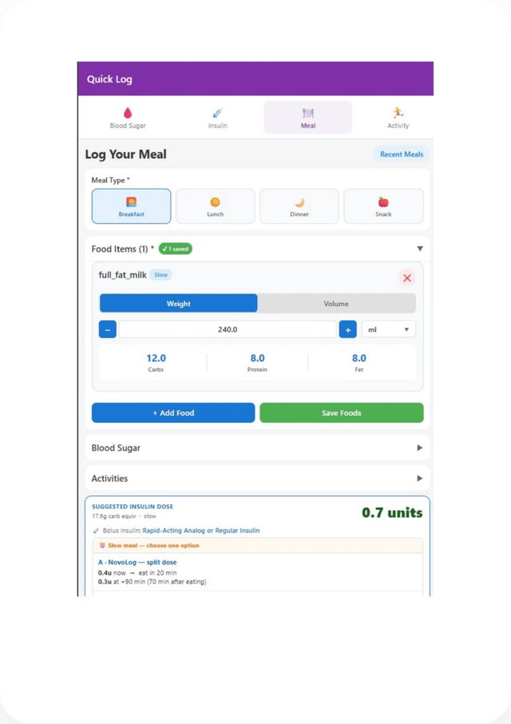




Smart Meal
Logging
Logging a meal takes seconds. Search a verified food database, choose a portion size, and all nutritional values are calculated instantly — no manual entry, no guesswork.
Verified Food Database
Natural Portion Sizes
Thousands of verified food items with accurate nutritional values — including German foods.
Log by palm size, grams, or plate size — however feels natural in daily life.
Instant Nutrition Calculation
AI-Assisted Recognition
Carbs, protein, and fat calculated the moment a meal is logged.
Photo-based food recognition to identify items and estimate portions automatically.
Notes:
Logging a meal is as simple as searching for a food, picking a portion size, and tapping confirm , it takes about ten seconds. The app even lets patients take a photo of their plate and identifies the food automatically.

Slide 8





A Safe, Personalised Dose — Every Time
DiaTwin calculates the right insulin dose by combining live data with physician-defined safety limits. Every factor is shown clearly — so patients always understand why a dose is suggested.
10
STEP PERSONALISED
CALCULATION
Base Needs
Active Insulin & Meal Adj.
6.8 Units
+
Correction
±
=
Carbohydrates
Blood Sugar
Protein & Fat
Active Insulin
Doctor Parameters
Active Carbs
Notes:
When it's time to inject, DiaTwin suggests a dose calculated from everything it knows about that specific patient at that specific moment. The patient sees exactly how the number was reached. And every suggestion stays within limits their own doctor has already approved.

Slide 9

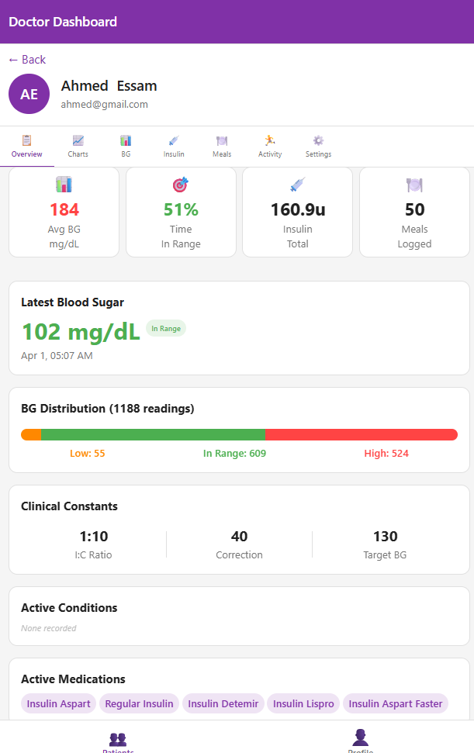


Full Control
for the
Doctor
Physician-Led Safety
Physicians maintain a clear, real-time view of patient glucose trends and insulin history — from anywhere.
Doctor-Defined Safety Limits
All medical parameters are set and locked by the physician. Patients follow guided recommendations — safely within prescribed boundaries.
Built for the German Market
Fully aligned with German S3 clinical guidelines and designed from the ground up for DiGA insurance reimbursement.
DIGA READY
GDPR
Notes:
The doctor stays in full control. They set the safety boundaries, and the app never goes outside them. DiaTwin is also built to qualify for German health insurance coverage , meaning patients could access it at no cost out of pocket.

Slide 10

VALIDATED. AFFORDABLE. READY TO SCALE.
Precision diabetes management for the millions using insulin pens — not just expensive pumps.
1.6
TRL 6-7
€20
PATIENT TRIAL RESULT
CLINICAL VALIDATION
MONTHLY COST
Rated Excellent in real-world testing — patients reported feeling safer and more in control.
Reviewed and endorsed by certified diabetologists for clinical utility and S3 guideline compliance.
A fraction of pump system costs. DiGA-ready for full insurance reimbursement — no out-of-pocket burden.
Currently advancing to real-world clinical validation in Germany — TRL 6–7, on track for DiGA submission.
Notes:
We've had DiaTwin reviewed by diabetes specialists, tested with real patients , who rated it excellent , and we're already preparing to clinical validation in Germany. The monthly cost is just twenty euros, with a clear path to full insurance reimbursement.

Slide 11




DiaTwin
Making every day safer for people living with Type 1 Diabetes.
Germany
ali.attia@gmx.de
dia-twin.vercel.app
LET’S BUILD THE FUTURE OF DIABETES CARE TOGETHER
Notes:
We're a small team building something that genuinely changes daily life for hundreds of thousands of people , starting in Germany. The Exist grant would give us the runway to complete our clinical validation and bring DiaTwin to the patients who need it most. Thank you.

