Slide 1

Anka Inc. Hardware Presentation
Ali Aydin
Enes Ayaz
Huzeyfe Hintoglu

Slide 2
Outline
Design procedures & Component selection
Future plan

Slide 3
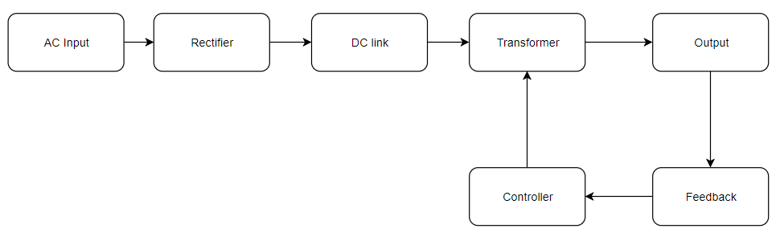
Design Procedure

Slide 4
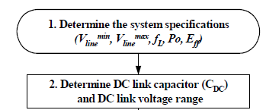

Rectifier and DC link Capacitor Design
%% Flyback Parameters
V_line_minimum= 210; % V rms
V_line_max=230 ; % Vrms
V_dc_min= 280; % 5 percentage ripple
V_dc_max=sqrt(2)*V_line_max;
Output_power= 15; % Watt
Efficiency= 0.8 ; % between 0-1
Input_power= Output_power/Efficiency;
%% DC Link Capacitor Calculation
D_ch=0.2; % for capacitor charging duty
F_line= 50; % Line frequency
C_DC = (Input_power*(1-D_ch))/ ...
(F_line*((2*V_line_minimum^2)-V_dc_min^2));
fprintf(' %f microFarad \n',C_DC*1e6);
Single Phase Rectifier:
KBP210-KT 1000V/2A
$C_{dc}=30.6 µF≈$ 33µF

Slide 5


Mode selection: CCM or DCM
%% Determination of Maximum Duty Cycle
D_max= 0.45 ; % for CCM mode, it is bigger than 0.5
V_Ro= (D_max/(1-D_max))*V_dc_min;
V_ds= V_dc_max+V_Ro;
DCM mode of operation is chosen
Low power application
Higher efficiency
In the case of 650V rated MOSFET, it is typical to set Dmax to be 0.45~0.5 for an universal input range application.
$D_{operation}=$0.35

Slide 6



Magnetizing Inductance (Lm)
%% Lm Determination
f_s= 40000; % Switching Frequecny Hertz
K_f= 1; % for ccm 0.25-0.50
L_m= (( V_dc_min*D_max)^2)/(2*Input_power*f_s*K_f)...
*1e3; % mili Henry
fprintf('% f mH \n', L_m);
L_m=L_m*1e-3;
$$F_{s}=40kHz$$
$$L_{m}=10.6mH$$

Slide 7
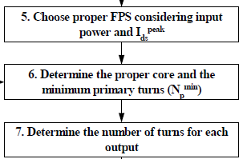



Turns Ratio and Core Selection
Core = 0P45530EC (Ferrite E core)
Core loss = 1.4 W
$N_{p}=$ 45
%% Calculation of peak current of FSP( mosfet, IGBT)
I_edc= Input_power/(V_dc_min*D_max); % average ...
... switching amplifier
Delta_Ids= (V_dc_min*D_max)/(L_m*f_s);
Ids_Peak=I_edc+(Delta_Ids/2);
Ids_rms=sqrt((3*I_edc^2) + ((Delta_Ids/2)^2*D_max/2));
fprintf('%f %f \n',Ids_Peak,Ids_rms);
%% Primary Side Turns Determination
Ae=233*1e-6; % m^2
B_sat=0.3 ; %Tesla
N_p= ((L_m*Ids_Peak)/(B_sat*Ae));
fprintf('%f \n', N_p);
%% Secondary Side Turn Ratio
N_s= N_p/((V_Ro)/(15+0.7));
fprintf('%f \n', N_s);
$N_{s}=$ 3
$$N=15$$

Slide 8

Cable selection
Skin depth = 0.326mm
AWG 25-26

Slide 9
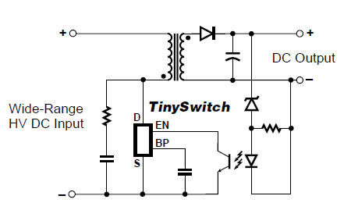
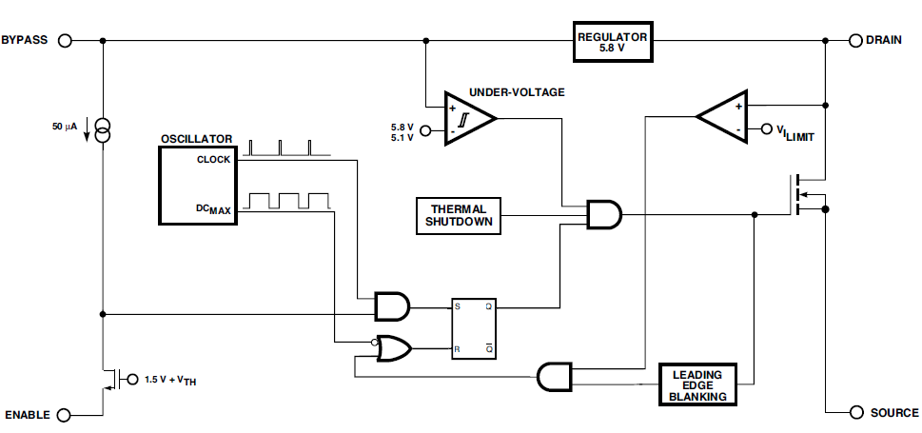
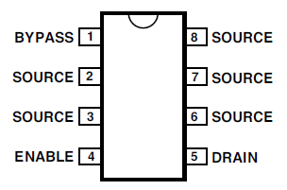

Controller
TNY254
$$F_{s}=44kHz$$

Slide 10
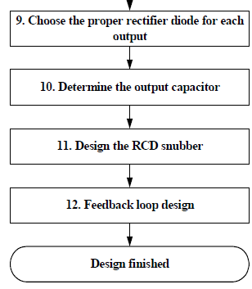
Future work
Implementation and tests

