Slide 1

RaLaZaBa Electonics Oral Representation
Ali Aydın
Anıl Aydın
Enes Ayaz
Nail Tosun
Selman Dinç
Notes:
Hi i am Nail, Today we as ralazaba electronics are gonna present our companies new product AMR which called… Let me introduce our team.

Slide 2





Team
Ali Aydın
Anıl Aydın
Nail Tosun
Selman Dinç
Enes Ayaz
Notes:
Our team members are …

Slide 3
Outline
Team Definition
Objectives, Functional Requirement and Problem Statement
Overall Solution
Decision and Control Unit
Environment Sensing Unit, Motion of the Sensing Unit
Motion, Mapping and Self localization Units
Solution Approach and Test Results
Deliverables, Time Plan and Cost Analysis
Notes:
Through out the presention i will explain out team definition, objectives FE and PS. Enes will mention overall solution and decision and control unit. Ali will explain all other sub units. Selman and Anıl will explain our test results. Anıl will summarize deliverables time plan and cost analysis.

Slide 4
Team
EE Options Majors
EE Options Including Minors
Notes:
Our company has an interdiciplinary team which you can see from pie charts. Even though our majors consist of power electronics and electronics area when we include our minör we covered 5 of 8 EE options. The organization chart is following.

Slide 5
Team
Selman Dinç
Project Manager
Enes Ayaz
Software Engineer
Ali Aydın
Hardware Engineer
Nail Tosun
System Engineer
Anıl Aydın
Software Engineer
Notes:
Selman is our PM. Enes and Anıl are our software engineer. Ali is our hardware engineer and I am a system engineer.

Slide 6
Objective Tree
Objectives
Performance
Accuracy
Operation Time
Marketable
Cost
Ease of Use
Power Consumption
0.2
0.2
0.16
0.16
0.1
Robustness
0.18
Order of Importance
Notes:
We divide our objectives two main part namely Performance and Market related objectives. The performance related objectives are accuracy, operation time and robustness. The market related objectives are Cost Easy of Use and Power consumption.

Slide 7
 | Short Operation Time | Accuracy | Low Cost | Ease of use | Robust operation with changing environment | Low power consumption
3 | <5 min | Understand how many objects are in field, their shapes properly and determine their positions correctly | <100 $ | User friendly GUI and live mapping | Works properly in laboratory and fair field for both dark and sunlight conditions | <10 W
2 | 5-10 min | Understand how many objects are in field and their shapes properly, but cannot determine their positions correctly | 100-150 $ | User friendly GUI but long update duration of data | Works in laboratory everywhere but sometimes cannot operate properly on fair field ground | 10-20 W
1 | 10-15 min | Understand how many objects are in field but cannot determine their position and shapes correctly | 150-200 $ | User friendly GUI presenting data transmission at the end of operation | Works only at specific conditions in laboratory | 20-50 W
0 | >15 min | Number of objects, their shapes and their position cannot be determined correctly | >200 $ | No user-friendly GUI and no real time data processing | Sometimes works, but sometime does not work in any condition | >50 W
Notes:
The measurements of our objective can found at this table. To summarize this table, in the best case;
*Our robot should finish mapping process under 5 minutes
*Understand how mant objects are in field with their shapes and positions correctly
Has a total cost below 50$
It should work properly at Design studio, KKM hole under both light and heavy sunlight illumination
It consume less than 10 W of power
And it has user friendly GUI and live mapping feature.

Slide 8
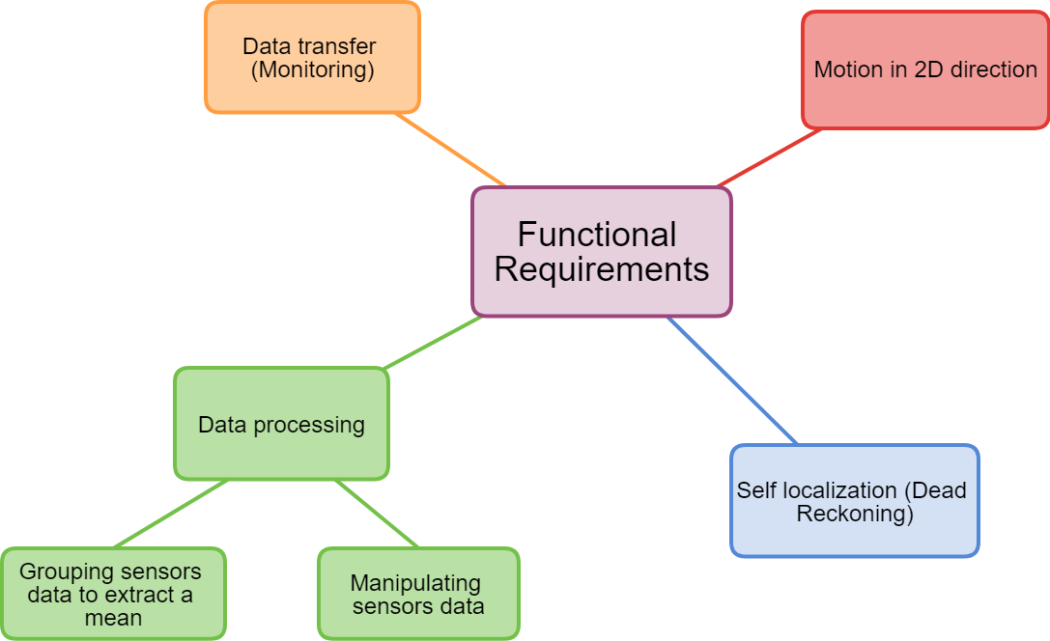
Functional Requirements
Notes:
Let me explain our function requirement
The robot should move at 2D directions
It some how know its location which we call self localization or dead reckoning.
It should deliver the mapping data to monitör for users.
It somehow process the sensors data like manipulating and grouping them in order to extract a useful information.

Slide 9
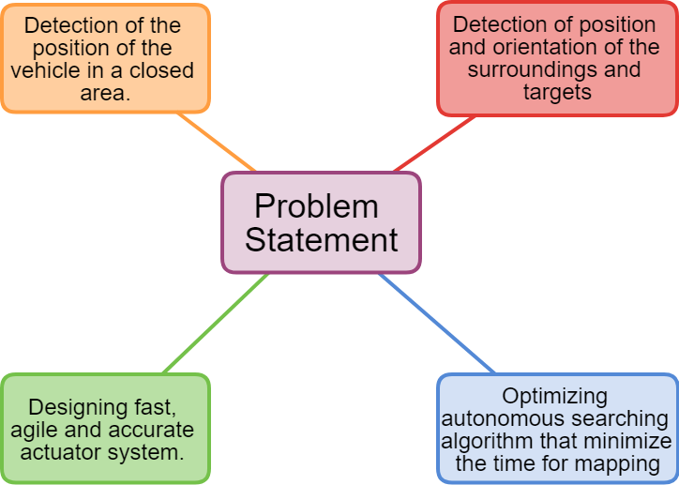
Problem Statement
Notes:
Then the our problems are
detection of the position of vehicle in a closed area
Detection of position an orientation of the surrounding and targets
Designing fast,agile an accurate actuator system
Optimizing autonomous searching algorithm that minimize time for mapping.

Slide 10
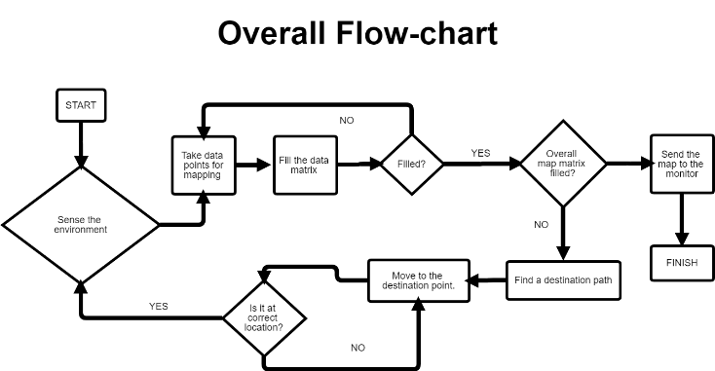
How do we need a way to improve solutions?

Slide 11
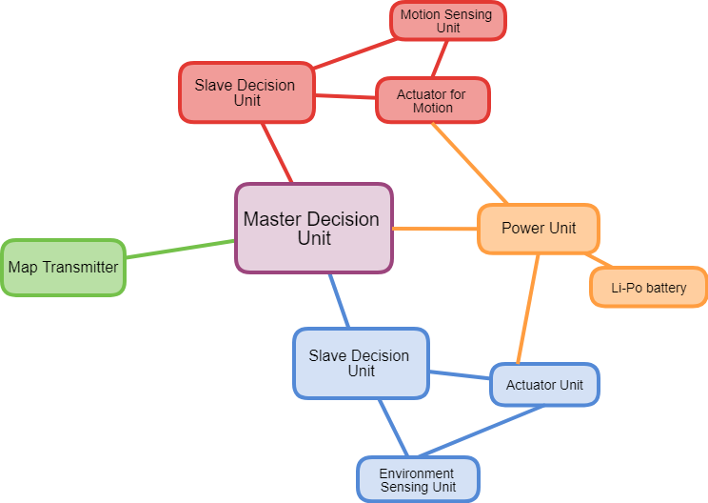
How do we make a distribution of duties?
We seperate the device into 7 subsytems.
Decision and Control Unit
Environment Sensing Unit
Motion of sensor
Motion Unit
Mapping
Sensing Unit for Self Localization
Power Unit

Slide 12
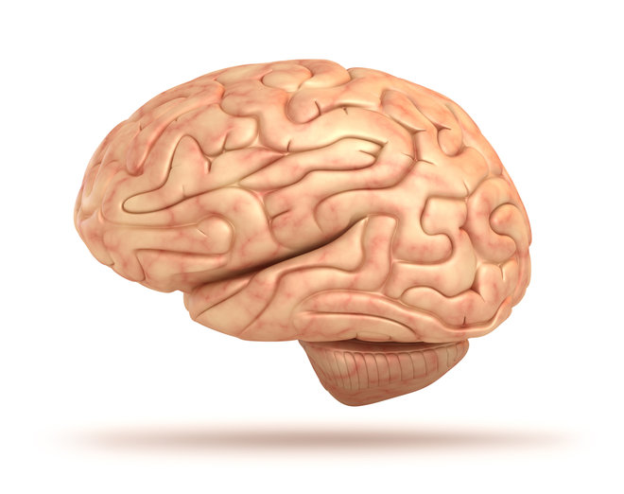
Decision and Control Unit
The unit is like brain of the devices.
It governs all of other subsytems.
The unit is divided in two basic operation.
1) Control systems
2) Decision systems

Slide 13
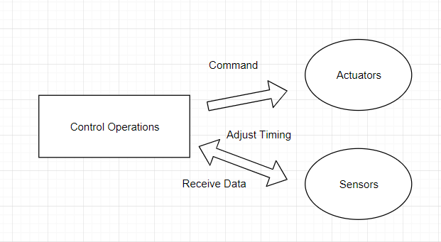
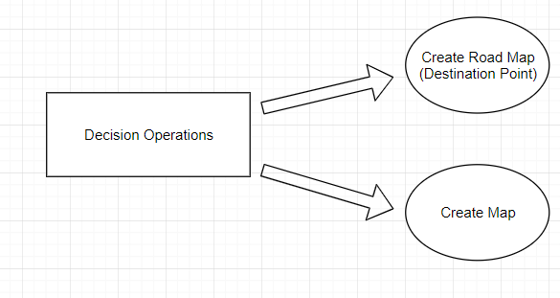
Operations
Trigger

Slide 14
Algorithms in Decision and Control Unit
Mapping Algorithm:
Shape Finder Algorithm:
Road Map Algorithm:

Slide 15
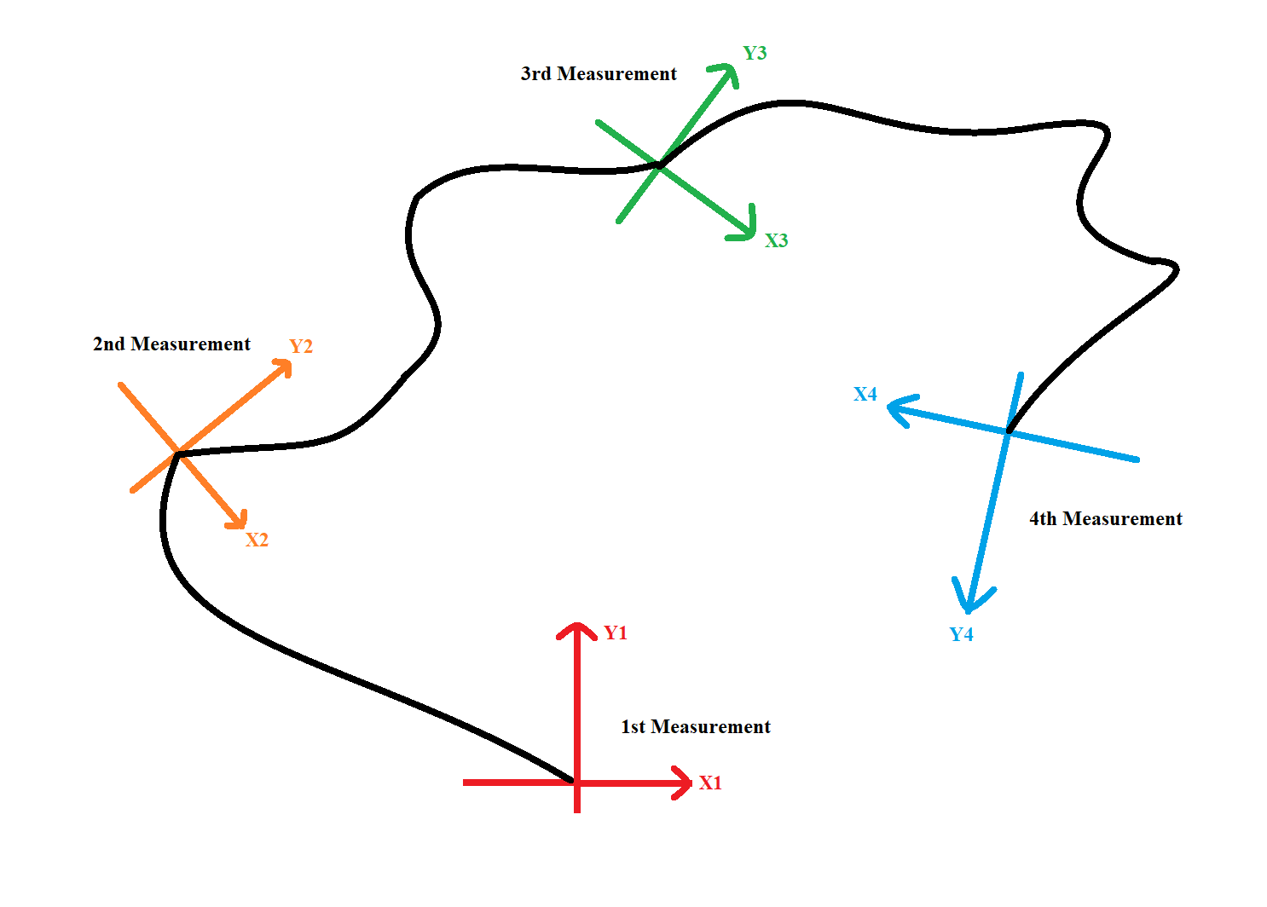
Mapping Algorithm
As seen , there are some points that the device makes the measurement.
Direction of the device changes.
Position of the device changes.
Two data group are received.
The data are merged by algorithm to create map.

Slide 16
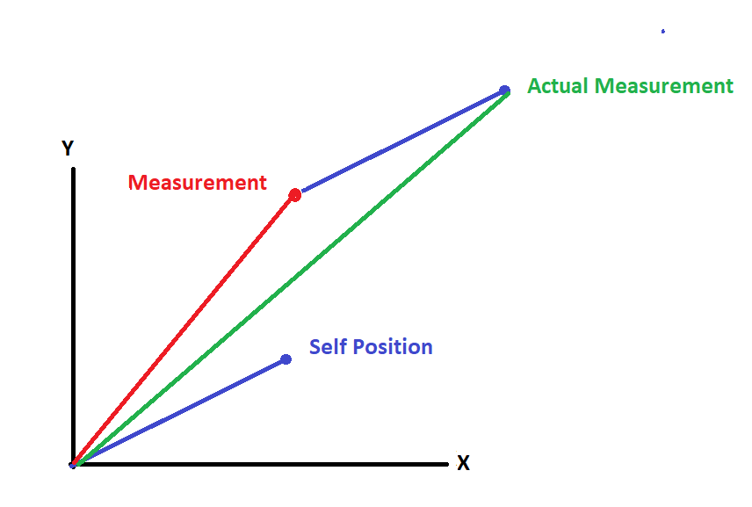
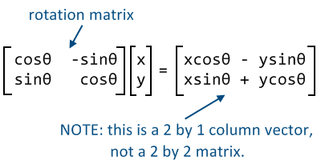
Solution
Rotation Matrix
Vector Addition
Direction of the devices are converted to stationary cooradinates.
Vector addition is made.
Self position and measurement are merged.

Slide 17

Road Map Algorithm
There is a uncompleted map and
create a roadmap.
A destination point are created
to control the actuator.
SLAM
A map is required for localization
A localization is required for map
Like chicken-egg problem.
Actually, it is a probabilistic model.

Slide 18
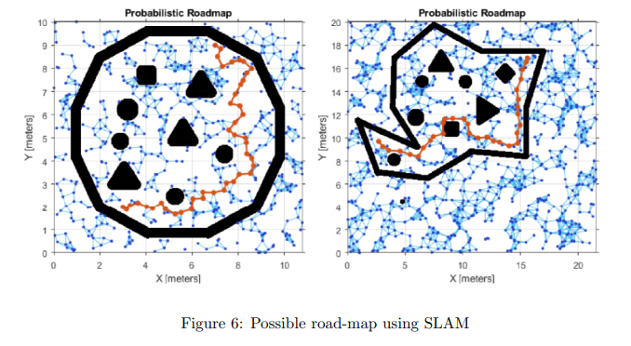

Slide 19
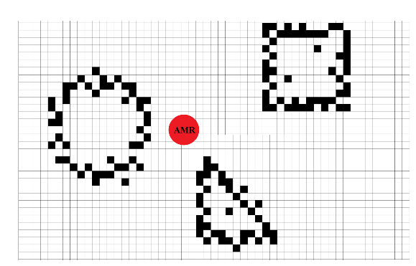
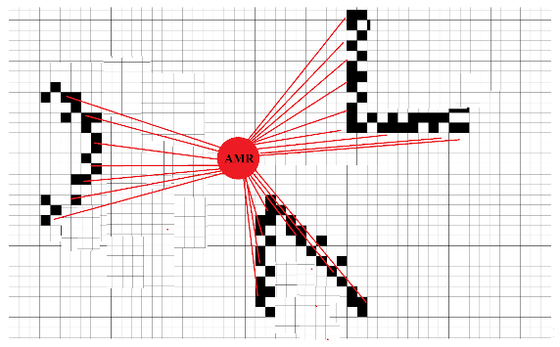
Environment Sensing Unit

Slide 20
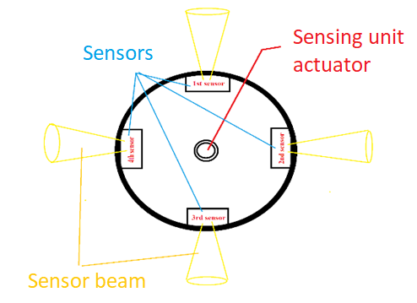
Motion Of Sensing Unit
Rotate 90 degree clockwise or counter-clock wise

Slide 21
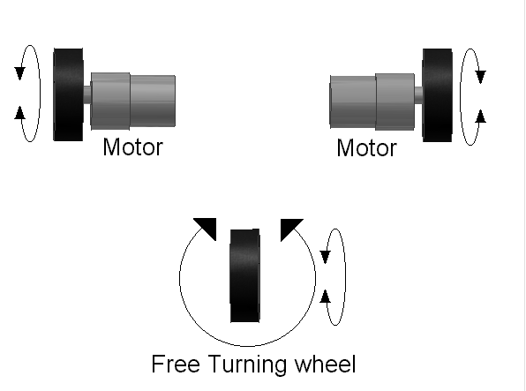
Motion Unit
Differential drive technique with freewheel.

Slide 22
Mapping Unit
Object types
Position of object center
How many objects there are in the field
Map of field

Slide 23
Sensing Unit For Self-localization
We need to determine the position of the device to refer the mesurements.
We could not rely on encoders on the motors only.

Slide 24
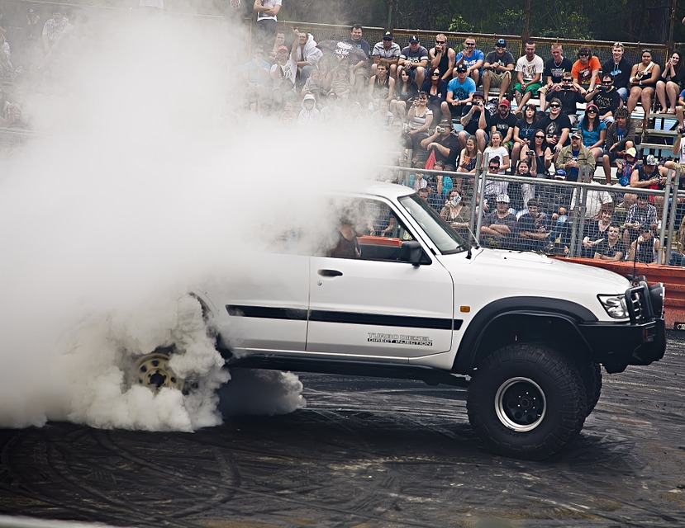
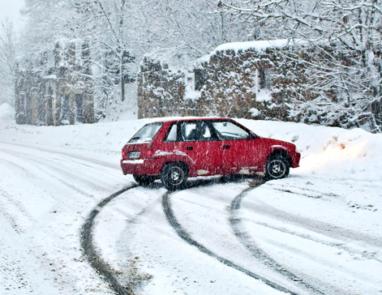
Spinning.
Skidding.

Slide 25
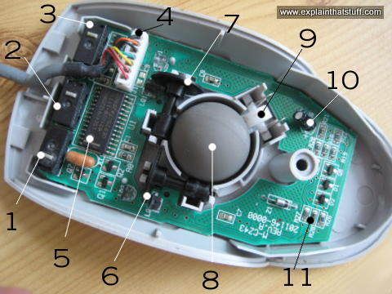
Our Solution: A Trackball Mouse
Key features of a typical mouse:
400 step per inch resolution
It can detect without error up to 12 inches per second
What is inside a trackball mouse?

Slide 26
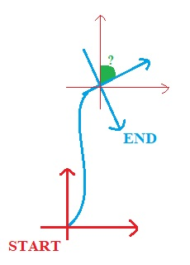
How Are We Going To Use Them?
Using one mouse gives us linear motion on a plane, not angular motion.
If we use two of them, we can determine our heading.

Slide 27
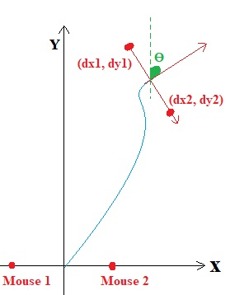
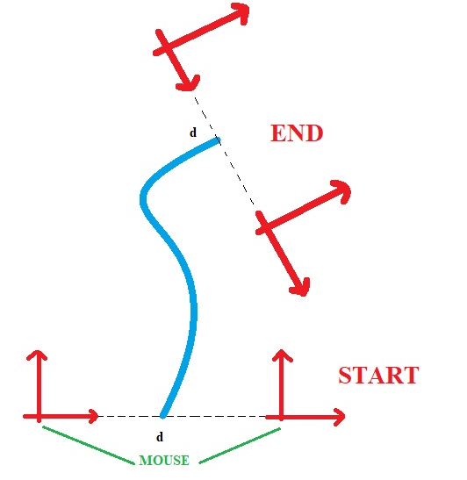

Slide 28
With two mouse we coud determine our position via the followings:
dX = (dX1 + dX2)/2
dY = (dY1 + dY2)/2
ϴ = arctan((dY1-dY2)/(dX1-dX2))

Slide 29

Power Unit
Without constant supply of energy our device is a garbage!
The power mainly consumed for actuation.
With rough estimation, we need
1A for 2 actuators in motion unit,
1A for actuator of sensing unit,
1A for computation and sensing

Slide 30
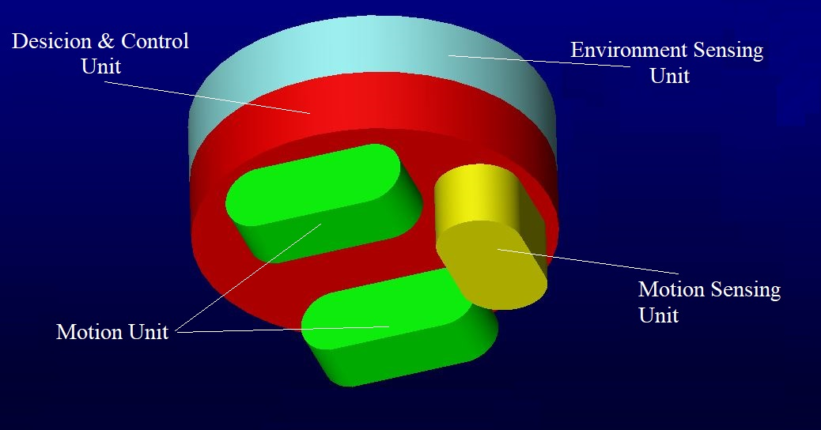
Mechanical Structure

Slide 31
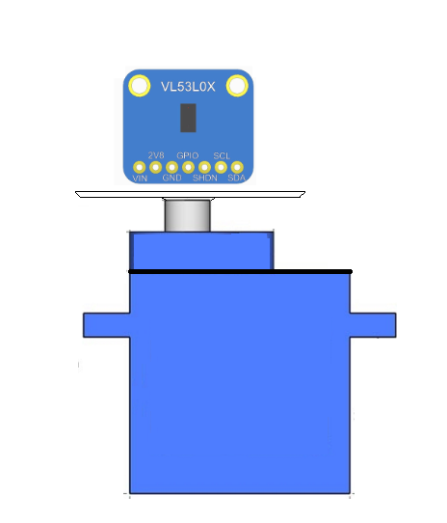
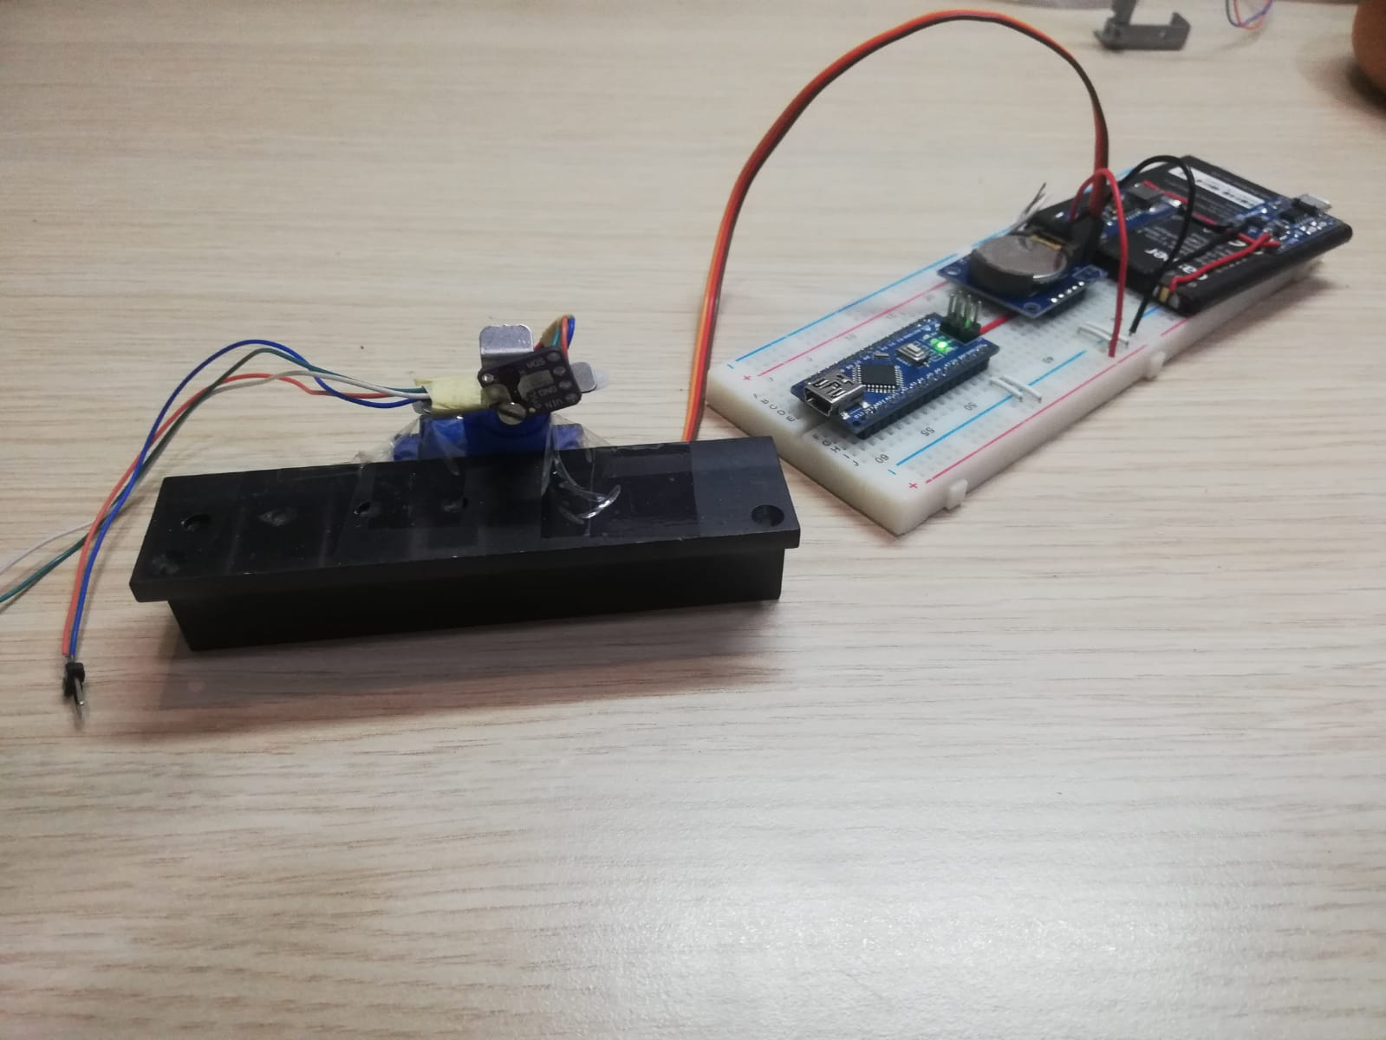
Testing Our Conceptual Idea
We took some meauremetns with real data of objects.

Slide 32
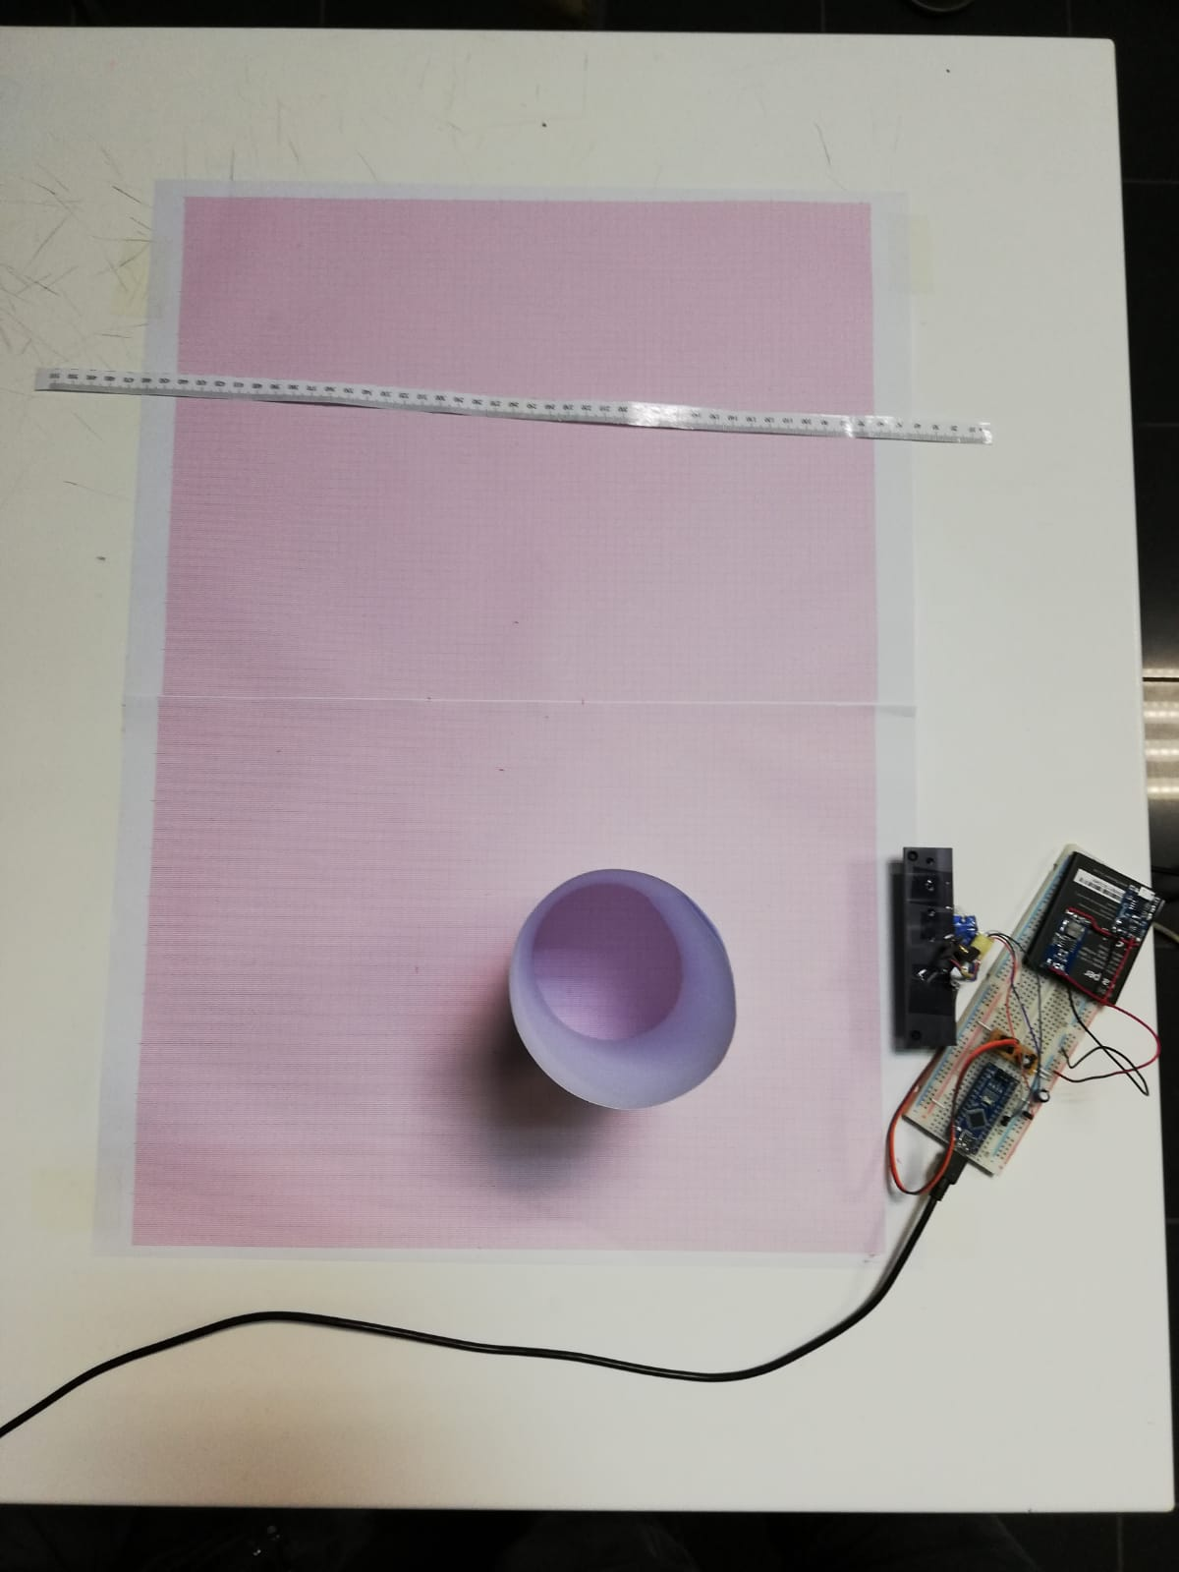
How did we take data?
We took three different measurements of a cylinder with radius of 10 cm.
Then, we gathered the data via MATLAB.
The test setup using VL53L0X and servo.

Slide 33
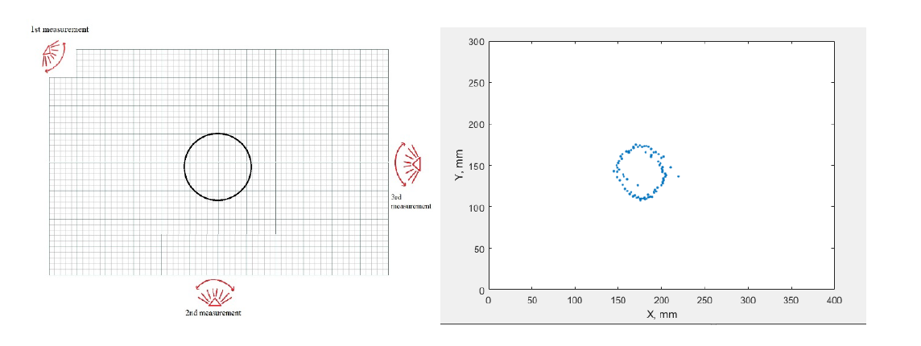
Test Setup for Sensing Unit and Results
Test Map and its output for cylinderical object

Slide 34
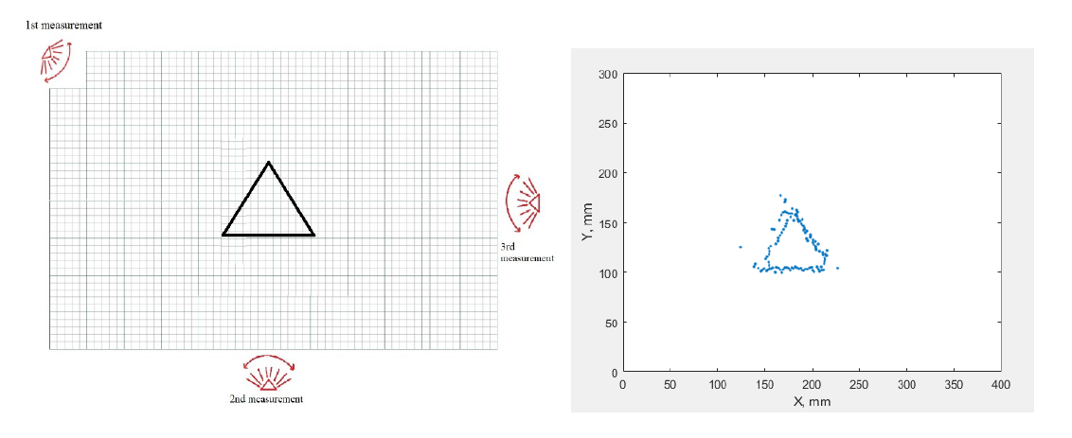
Additional Tests For Sensing Unit
Test Map and its output for triangular object.

Slide 35
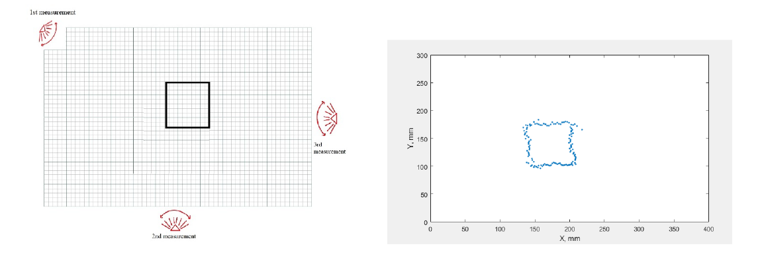
Additional Tests For Sensing Unit
Test Map and its output for rectangular objects

Slide 36
Shape Finder Algorithm and Tests
Make preprocessing
Convert to gray scale
Blur the gray image
Find edges using Canny Edge Detector
Dilate and erode the edged image
Get (x,y) Coordinate Information
Convert coordinates to 2D array
Specify area range considering objects in the environment
Find number of sides of each contour
Find all contours on the image
#of sides = 3
#of sides = 4
#of sides > 4
Output: triangle
Find center
Output: Rectangle
Find center
Output: Cylinder
Find center

Slide 37
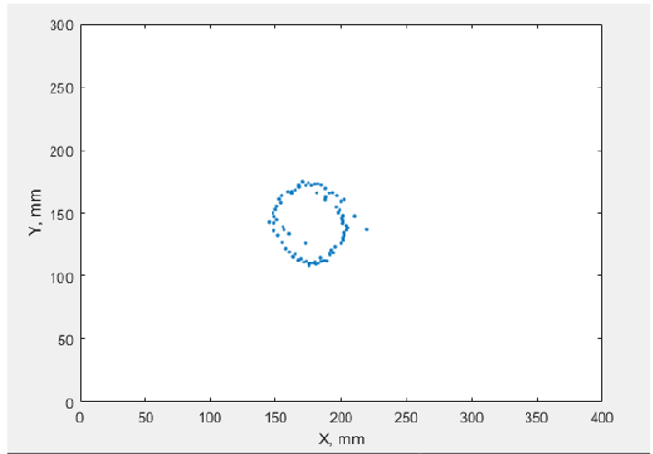

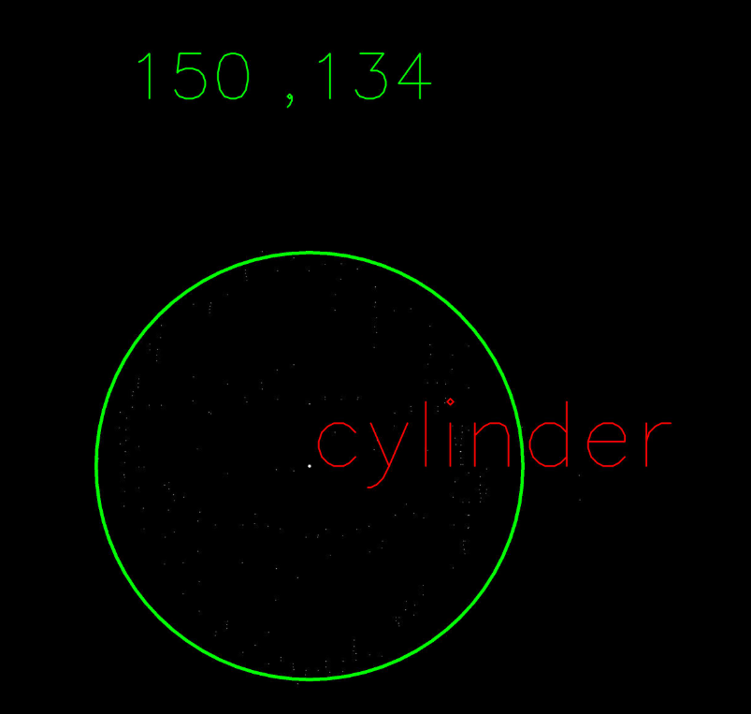


Slide 38
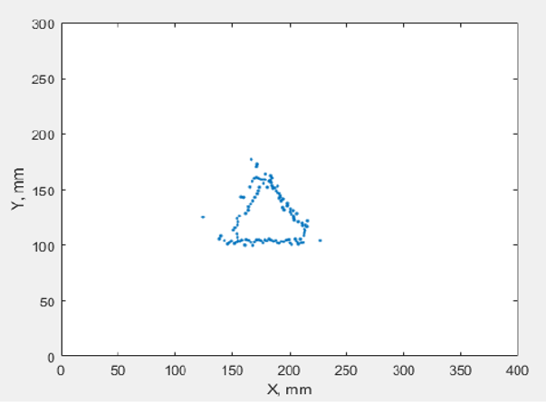
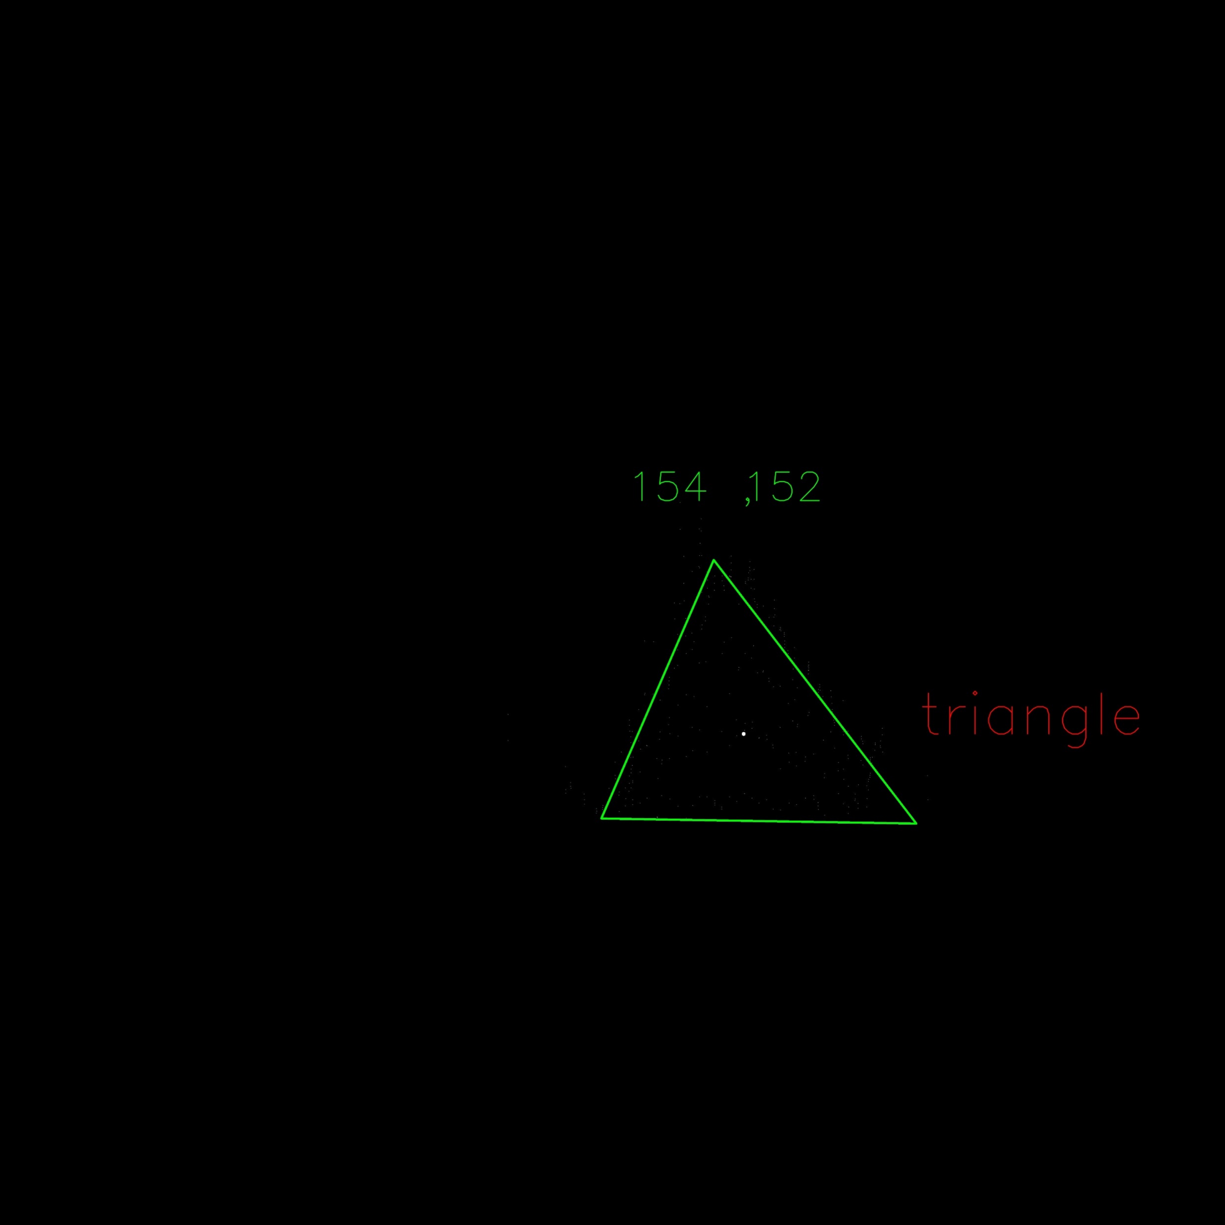
Additional Tests For Shape-finder Unit

Slide 39
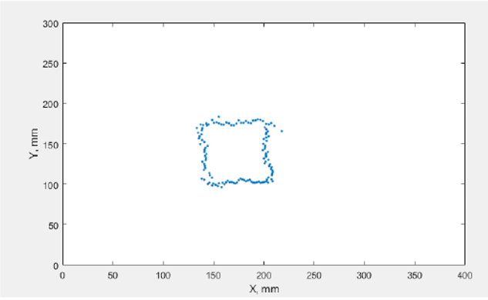
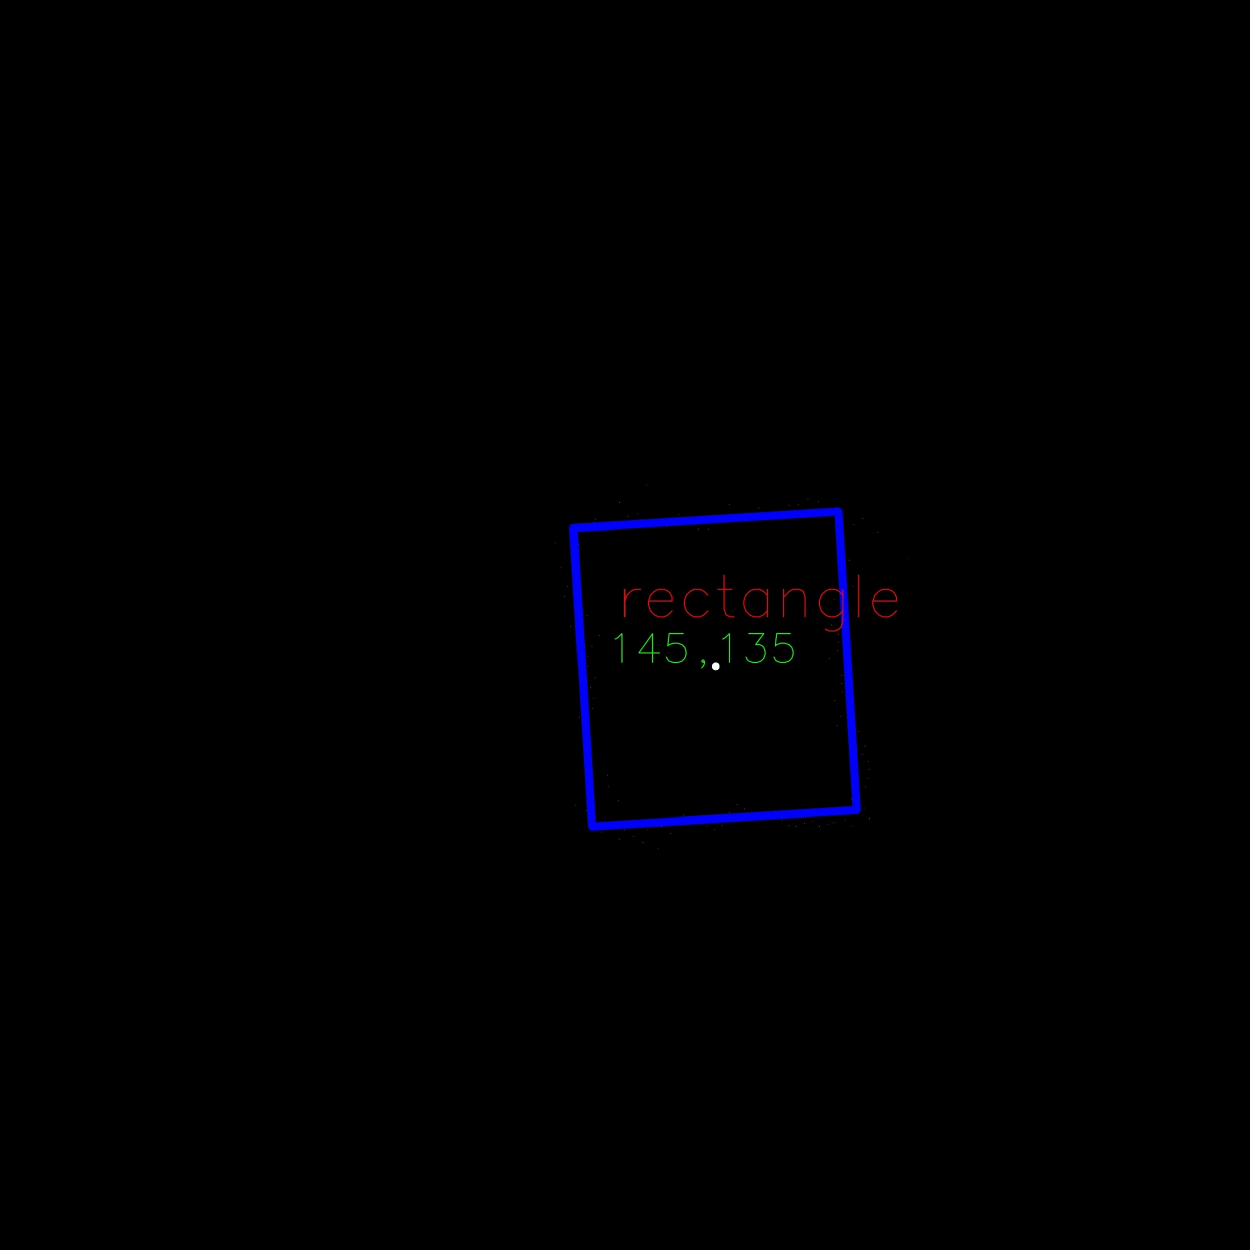
Additional Tests For Shape-finder Unit

Slide 40
Deliverables
Equipment
The mapping device
Platform
Battery and charging unit
Software
User Interface
Documents
User Manual
Technical Support

Slide 41
Time Plan
Tests for overall system and improvements of the system
Improvements of Subsystems and Detailed Design
May
February
April
January
March
Delivery of the Product
Tests for Subsystems
Integration of Subsystems And Prototype Production

Slide 42
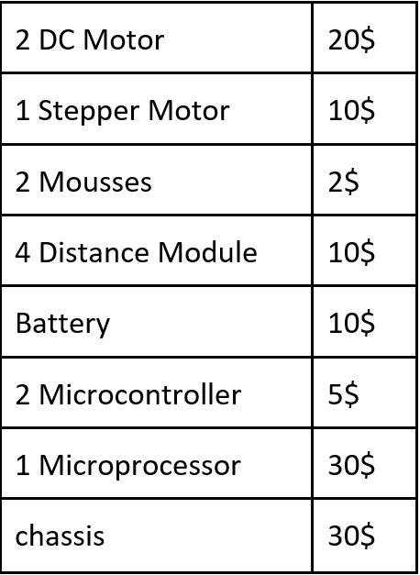
Cost Analysis
117 $

Slide 43
Thank You For Listening

