Slide 1
BİL 473-673 VERİ AĞ GÜVENLİĞİ DERSİ
ALİ AYDOĞAN
DATA PROTECTION

Slide 2
İÇERİK
Tabular Data Protection
TRAP-Array
Mariner
Mobil phone methods
RAID
Results

Slide 3
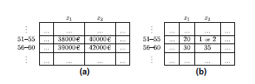
TABULAR DATA PROTECTION
Tablo Representaion
Disclosing
Different tables

Slide 4
TRAP-ARRAY
CDP support
Reducing the space consumption of the CDP history data
Achieve good compression of the version history of each block in the repository
The system does not support preforming revert

Slide 5
MARİNER
Support comprehensive data protection
Supports block-level CDP
Three storage server
Allows roll-back to any point in time.

Slide 6
MOBILE PHONE METHODS
LAC systems
- Prevent an application
- Dangerous set of permissions
Paranoid Android
- Malwares detect

Slide 7
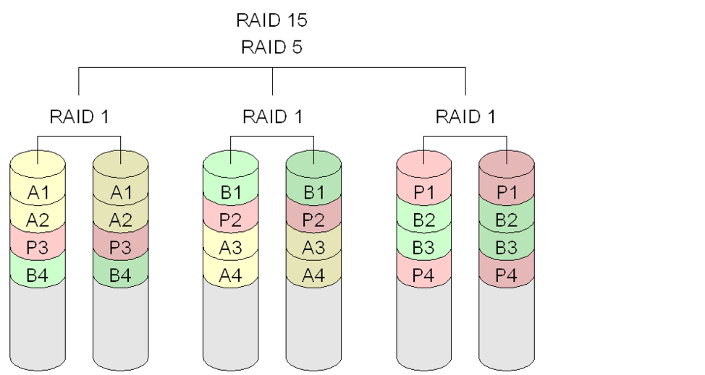
RAID
Prevent data loss
Performance and security

Slide 8
RESULTS
Census Decision 1983, Germany
Secure and long password
Activate firewall
Update systems
Be attention e-mail
Trojan,Keylogger,Rootkit

