Slide 1
Meeting with collaborators
8/21/17

Slide 2
Overall goals
Determine how the following influence age at death for animals that died of lethal cancer (gamma irradiated only):
Total dose
Dose rate
Fractionation

Slide 3
Method
Use Janus data archive for large pool of comparable animals with different irradiation conditions
Check controls for comparable animals
Stratify by:
Fractions
Experiment
Species (N/A)
Investigate lethal cancers

Slide 4
Part 1 – controls analysis

Slide 5
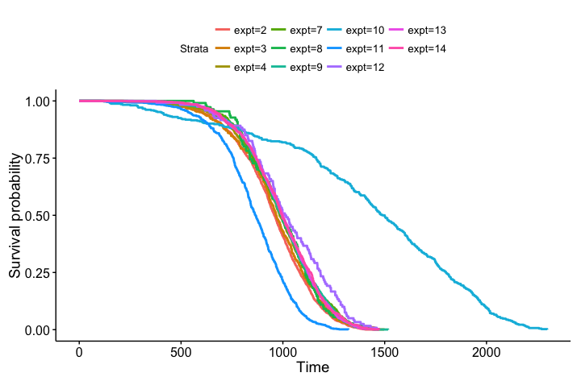
All control animals from Janus
Notes:
JM10 – peromyscus leucopus
JM11 – not even listed??? Not listed as control, but under treatments tab, it shows the total dose is equal to 0Gy for gamma and neutrons, there aren’t any mice treated with a total dose over 0Gy. Ignore
JM12 – 1 ctrl, 3 treatments of neutrons, all male, small sample size, 120 mice per group - exclude

Slide 6
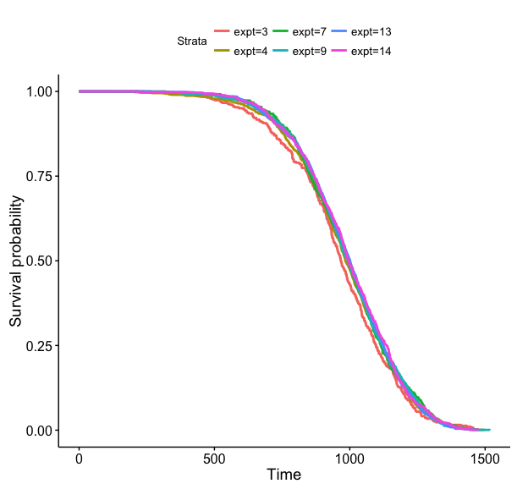
Controls from experiments without significant differences in mortality
N Observed Expected (O-E)^2/E (O-E)^2/V
expt=3 385 385 354 2.7762 3.0069
expt=4 1021 1021 1007 0.1818 0.2268
expt=7 485 485 491 0.0795 0.0883
expt=9 1338 1338 1350 0.1129 0.1536
expt=13 1176 1176 1182 0.0257 0.0335
expt=14 792 792 813 0.5301 0.6324
Chisq= 3.7 on 5 degrees of freedom, p= 0.588
Notes:
Excluded JM8 because of strange experimental set up… needs to be separate.
Issues with JM2 may be that this was the FIRST janus test and the JANUS facility could not be used… facility differences could explain life expectancy differences.

Slide 7
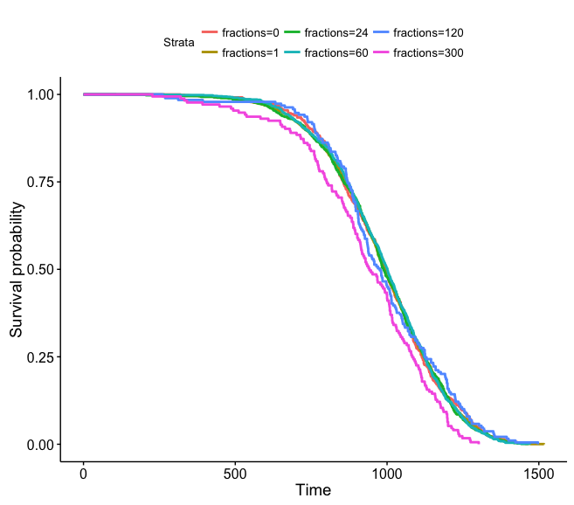
Stratify by fractions
fractions expt tot_n
<int> <int> <int>
1 0 7 485
2 1 3 385
3 1 9 1138
4 1 14 792
5 24 4 659
6 24 9 200
7 60 13 1176
8 120 4 189
9 300 4 173
N Observed Expected (O-E)^2/E (O-E)^2/V
fractions=0 485 485 491 0.07950 0.08835
fractions=1 2315 2315 2336 0.19041 0.34815
fractions=24 859 859 857 0.00488 0.00588
fractions=60 1176 1176 1182 0.02571 0.03348
fractions=120 189 189 200 0.60961 0.64032
fractions=300 173 173 131 13.35337 13.78945
Chisq= 14.4 on 5 degrees of freedom, p= 0.0134
Notes:
300 and 120 both look the worst… both come from JM 4 and have the lowest n. Remove and try again!

Slide 8
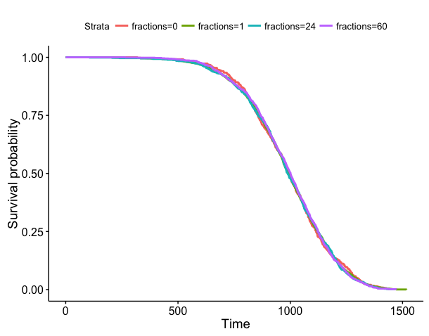
Remove 120 and 300 fractions
N Observed Expected (O-E)^2/E (O-E)^2/V
fractions=0 485 485 488 0.01783 0.01996
fractions=1 2315 2315 2322 0.01825 0.03535
fractions=24 859 859 851 0.06756 0.08250
fractions=60 1176 1176 1174 0.00299 0.00398
Chisq= 0.1 on 3 degrees of freedom, p= 0.991
Notes:
This works with or without JM 8 included

Slide 9
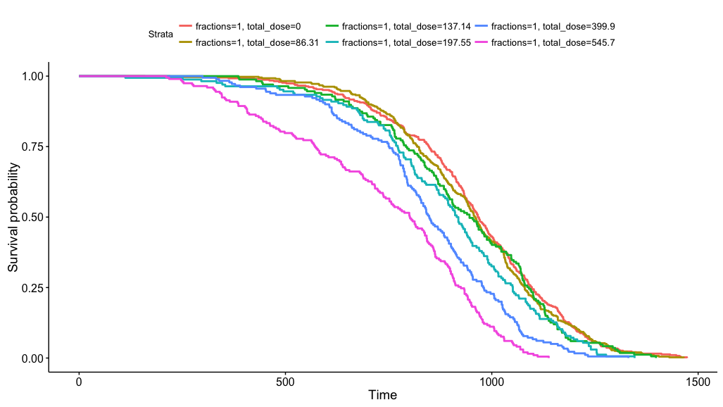
JM3
Notes:
Examples of how data looks

Slide 10
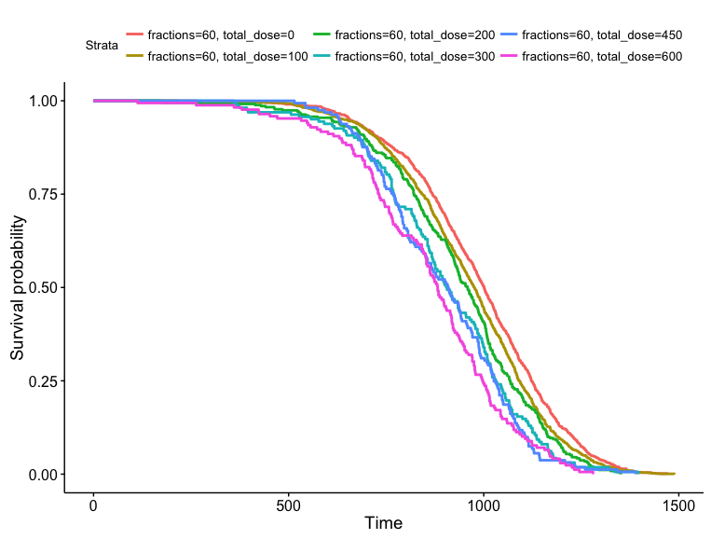
JM 13
Notes:
Example of how data looks

Slide 11
Part 2 – descriptive analysis

Slide 12
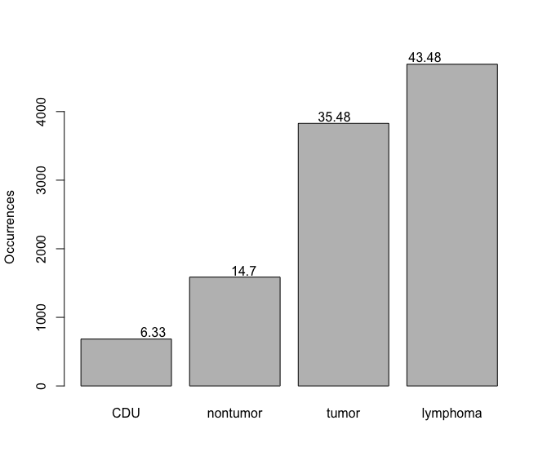
Number of mice: 10788. Cause of death:

Slide 13
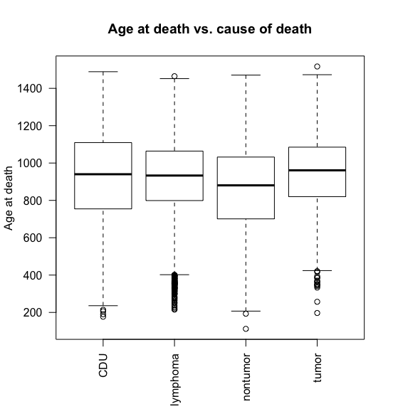
Determine if certain causes of death result in changes in total lifespan
Notes:
Figure 9: Age at death vs cause of death as a box plot. One-way anova to check for significant differences – nontumor and tumor are different from CDU, lymphoma is not different. One way anova shows class is a significant factor for determining age at death (p <2.2e-16).

Slide 14
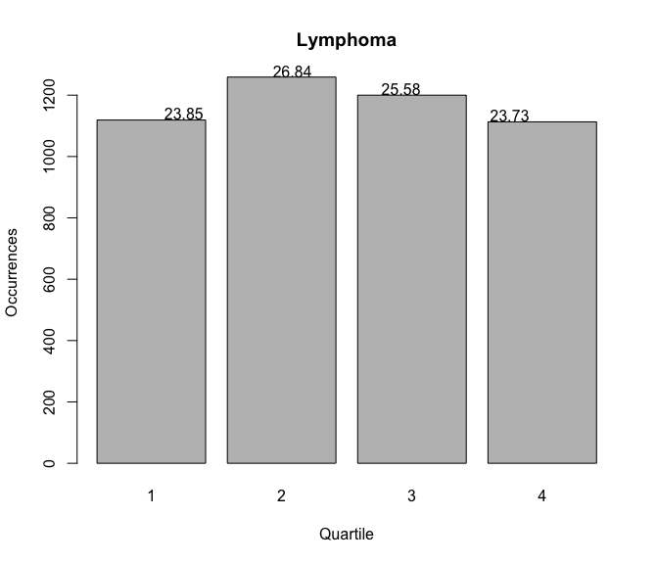
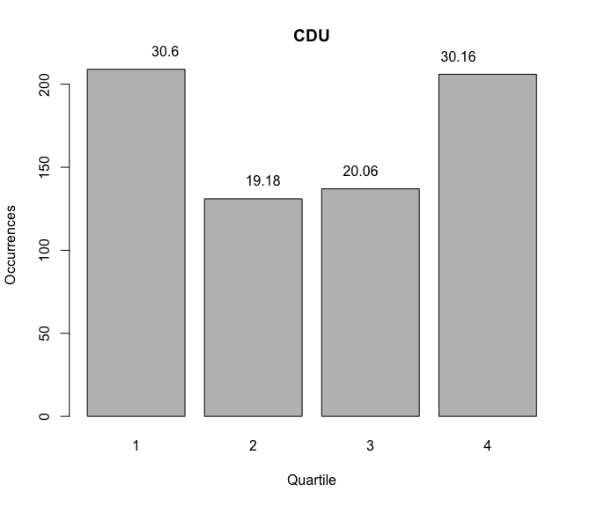
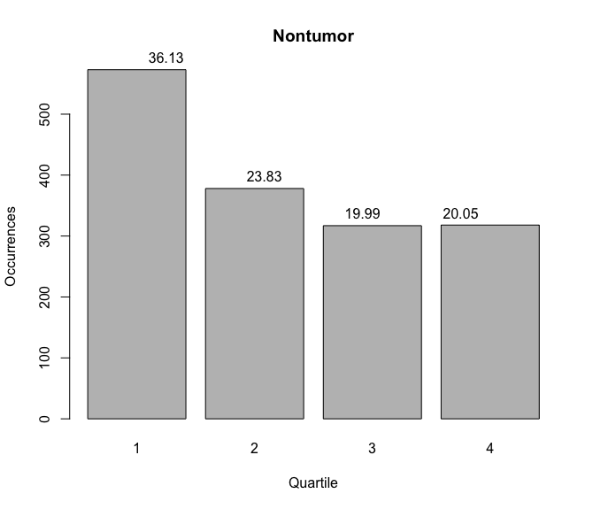
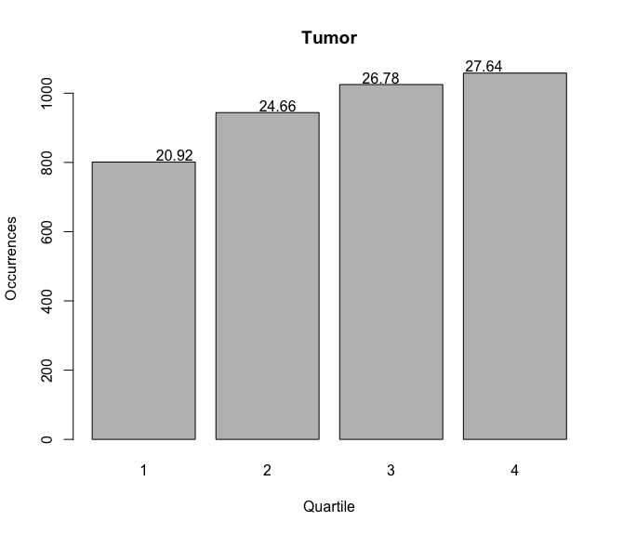
For each cause of death, a break down of how many deaths per quarter.
Notes:
Tumors and non-tumors seem to have opposite trends. Tumors take the longest to develop and/or become deadly?

Slide 15
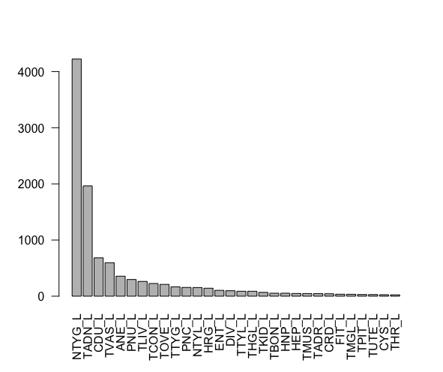
Top 30 causes of death

Slide 16
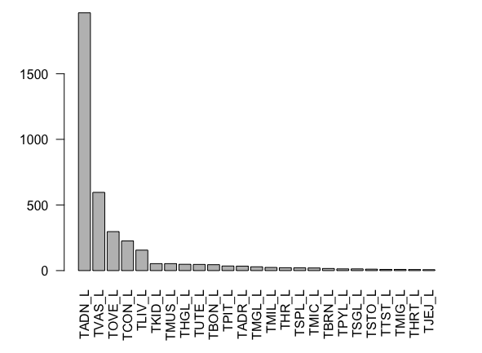
Top 25 tumors that caused death
Notes:
TADN – lung, TVAS – vascular, TOVE – ovarian ,TCON – connective tissue tumors other than lymphoreticular and vascular tumors, TLIV – liver and gallbladder tumors

Slide 17
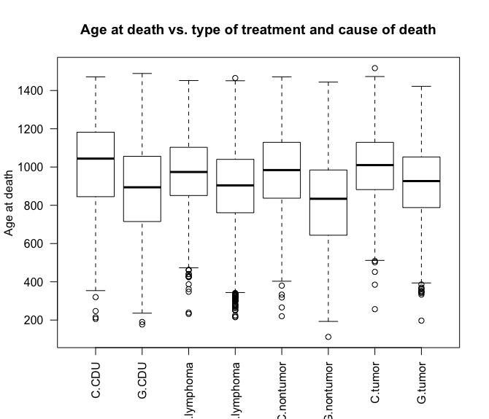
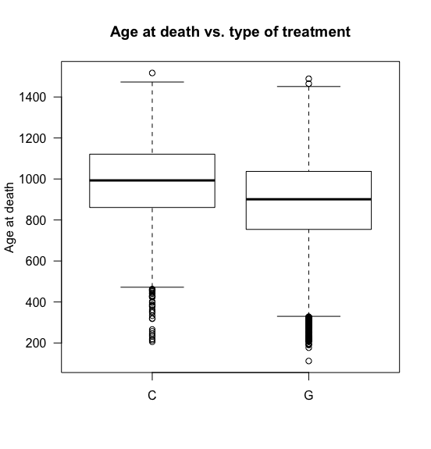
Irradiated mice die younger for all causes of death

Slide 18
Part 3 – fractionation/dose analysis

Slide 19
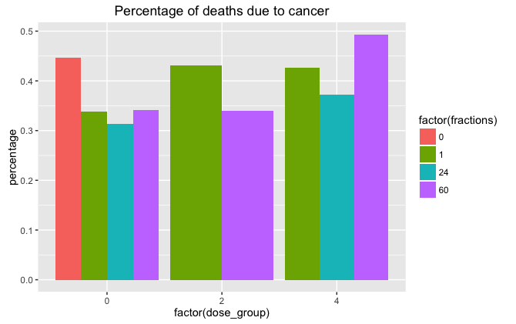
Percentage of mice that died of cancer under different conditions

Slide 20
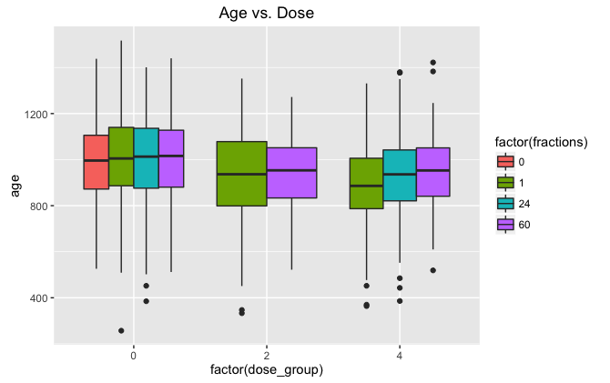
For specific doses, determine how dose and fractionation impact age at death

Slide 21
Statistical analysis of age at death due to dose group and fractions, dose > 0 Gy
Dose - all
Response: age
Sum Sq Df F value Pr(>F)
factor(fractions) 36995 3 0.3660 0.7776
factor(dose_group2) 2356363 1 69.9395 <2e-16 ***
factor(fractions):factor(dose_group2) 50593 2 0.7508 0.4721
Residuals 68191483 2024
Dose > 0Gy
Response: age
Sum Sq Df F value Pr(>F)
factor(fractions) 138818 2 2.0939 0.12396
factor(dose_group) 120329 1 3.6301 0.05715 .
factor(fractions):factor(dose_group) 91144 1 2.7496 0.09772 .
Residuals 23601350 712

Slide 22
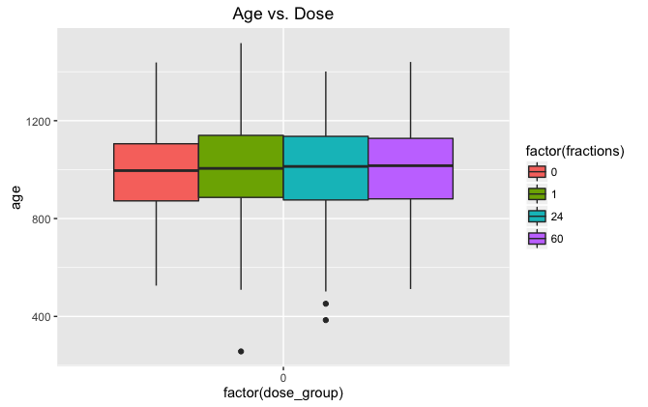
For 0 Gy doses, determine how fractionation impacts age at death

Slide 23
Statistical Analysis - for 0Gy doses, determine how fractionation impacts age at death
Response: age
Sum Sq Df F value Pr(>F)
factor(fractions) 22107 3 0.2175 0.8843
Residuals 44378660 1310

Slide 24
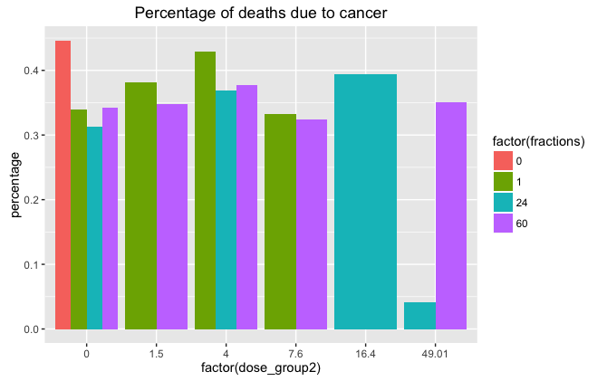
Percentage of mice that died of cancer under different conditions

Slide 25
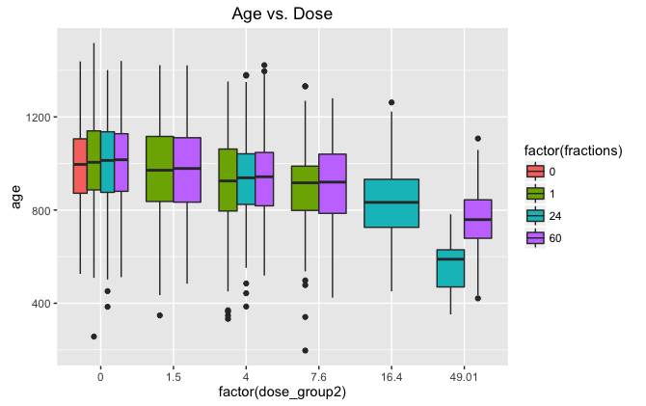
For specific doses, determine how dose and fractionation impact age at death

Slide 26
Statistical Analysis of Age at death due to dose group and fractions
Dose - all
Response: age
Sum Sq Df F value Pr(>F)
factor(fractions) 42948 3 0.4258 0.7345
factor(dose_group) 2403626 2 35.7468 5.54e-16 ***
factor(fractions):factor(dose_group) 219497 4 1.6322 0.1634
Residuals 67980010 2022
Dose > 0Gy
Anova Table (Type II tests)
Response: age
Sum Sq Df F value Pr(>F)
factor(fractions) 81582 3 0.8006 0.493397
factor(dose_group2) 11287255 5 66.4587 < 2.2e-16 ***
factor(fractions):factor(dose_group2) 555320 5 3.2697 0.005993 **
Residuals 120721269 3554

Slide 27
For 0 Gy doses, determine how fractionation impacts age at death

Slide 28
Statistical Analysis - for 0Gy doses, determine how fractionation impacts age at death
Dose = 0Gy
Response: age
Sum Sq Df F value Pr(>F)
factor(fractions) 22107 3 0.2175 0.8843
Residuals 44378660 1310

Slide 29
Conclusions:
We are able to use a large set of data compiled from multiple Janus experiments
Dose an significantly decrease age at death due to lethal cancer incidences
Fractions can significantly increase age at death due to lethal cancer in response to radiation

Slide 30
Figure 1 for paper
A.
B.
C.
Notes:
A. Breakdown of causes of death in our data set.
B. Tumor incidence by quarter. Increase in lethal tumors over time.
C. Top 25 lethal tumors – maybe create a table instead?

Slide 31
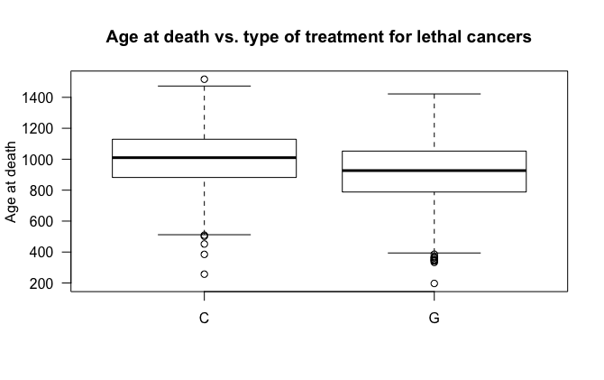
Figure 2 for paper
A.
B.
Notes:
Age at death vs. type of treatment for all animals, p-value < 2.2e-16
Age at death vs. type of treatment for animals that died of cancer, p-value < 2.2e-16

Slide 32
Figure 3 for paper
Notes:
Interesting – 24 fractions and 49.01 Gy shows that most mice do not die of lung cancer – strong dose so maybe died right away from radiation?

Slide 33
Figure 4 for paper
Notes:
Show stats too… as dose increases, age decreases. With the interaction of dose and fractions, fractions increase age at higher doses.

Slide 34
Figure 5 for paper
Potentially show more survival curves with select data stratifying by dose and fractions

Slide 35
Figure 6 for paper
Do we want to make a general cancer DREF?

