Slide 1
Calculating cancer associated dose and dose rate effectiveness factor to
Alia Zander
December 15, 2016
Committee Meeting

Slide 2
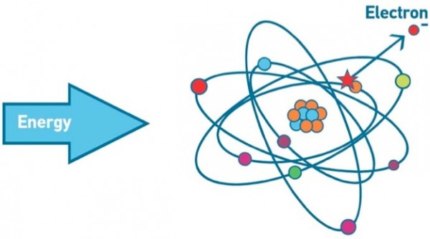
Ionizing radiation
Excitation of electrons
Photon energy > 124eV
Wavelength < 10⁻⁶ cm
Linear energy transfer (LET) – energy transferred per unit length
High LET – alpha particles, beta particles, neutrons
Low LET – x-rays, gamma rays
Notes:
Radiation is the emission or transmission of energy in the form of waves or particles through space or through a material medium.
A unit of energy commonly used in nuclear physics is the electron volt (eV).
It is the kinetic energy possessed by an electron when accelerated through a potential difference of 1 volt.
High LET is more damaging to biological material because DNA repair is more difficult for mutations within close proximity to one another

Slide 3
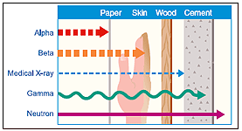
Types of ionizing radiation
Particulate – protons, neutrons, electrons, alpha and beta particles
Electromagnetic – gamma rays and x-rays

Slide 4
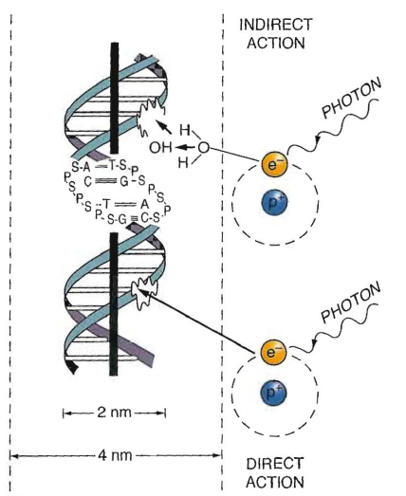
Ionizing Radiation
Indirect action – photon comes into contact with water molecule and creates hydroxyl intermediate that then damages DNA (neutrons, gamma-rays, x-rays)
Direct action – photon directly damages DNA (alpha and beta particles, protons, electrons)
Notes:
Fig 1.8
Indirect:
Free radicals are produced which diffuse and cause damage (Free radical: unpaired e- in outer shell)
Direct: Interaction directly with critical targets in the cell (DNA)

Slide 5
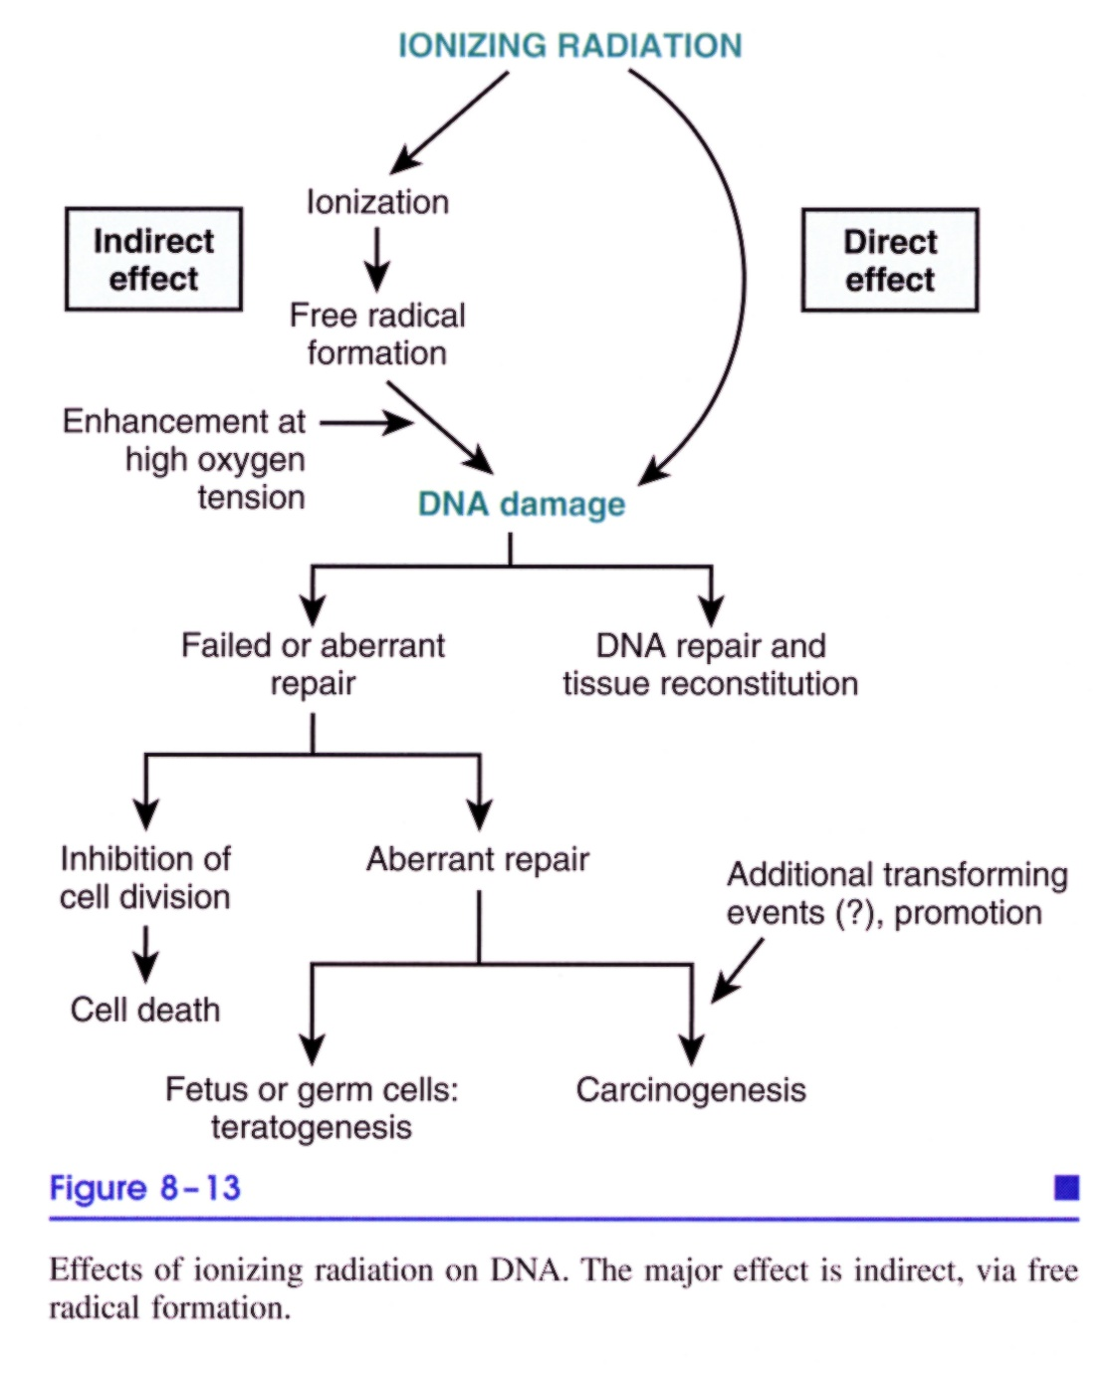
Radiation Injury

Slide 6
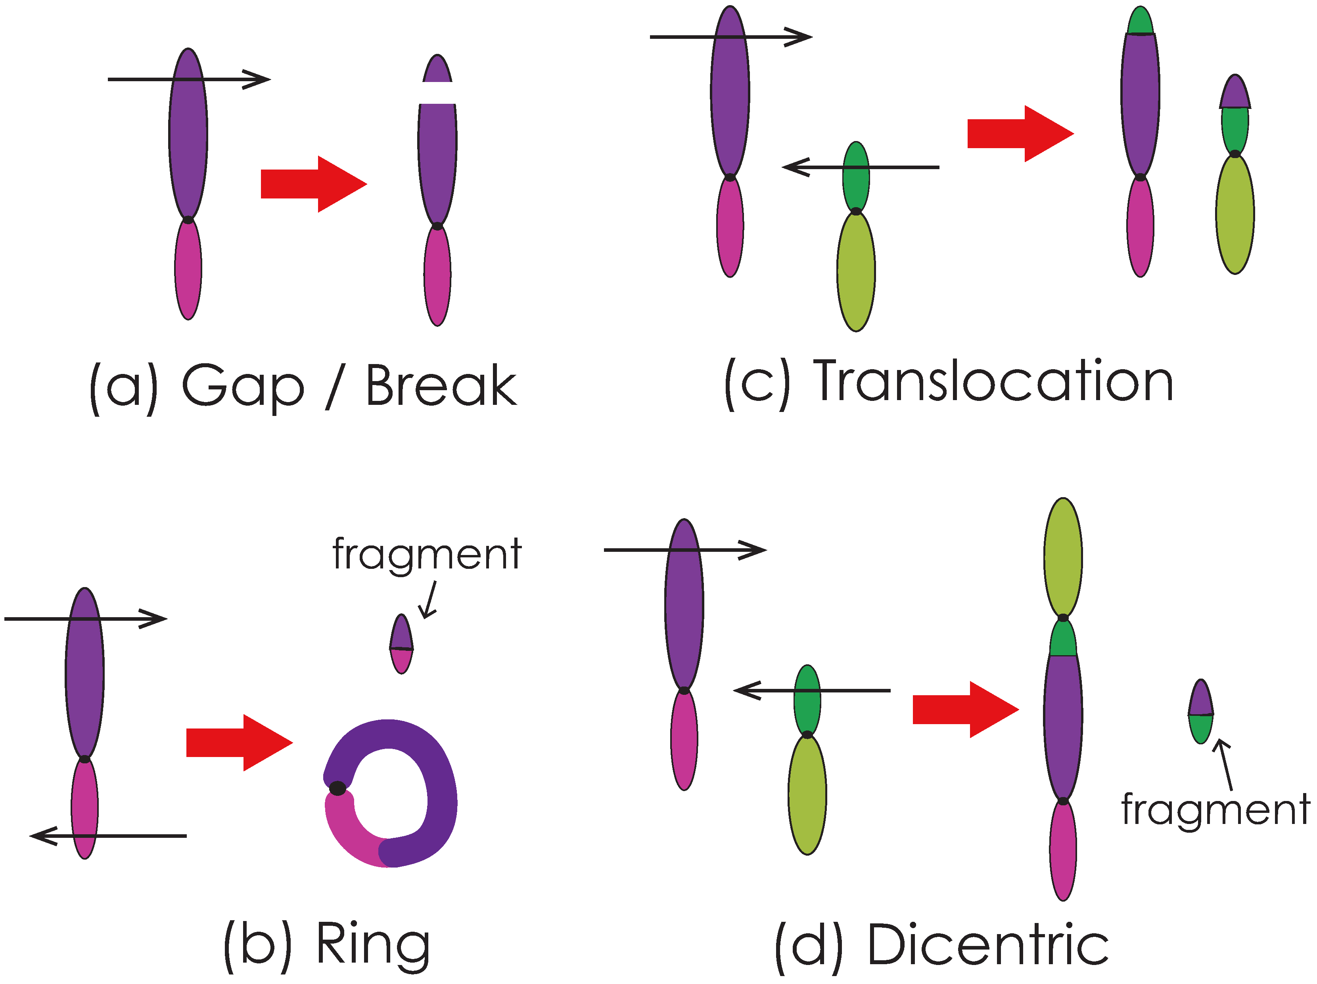
Radiation induced chromosomal aberrations
Base damage
ssb
dsb
mds

Slide 7
Radiation measurements
Quantity | Unit | SI Unit | Relationship between units
Absorbed dose | Rad | Gray (Gy) | 1 Gy = 100 rad 1 Gy = 1 Sv
Equivalent dose | Rem | Sievert (Sv) | 1 Sv = 100 rem 1 rem = 1 rad * RBE (relative biological effectiveness)
Gray equals 1 joule of radiation energy per kg of material
Equivalent dose is modified from absorbed dose based on radiation types, dose rate, tissue weighting factors, etc.

Slide 8
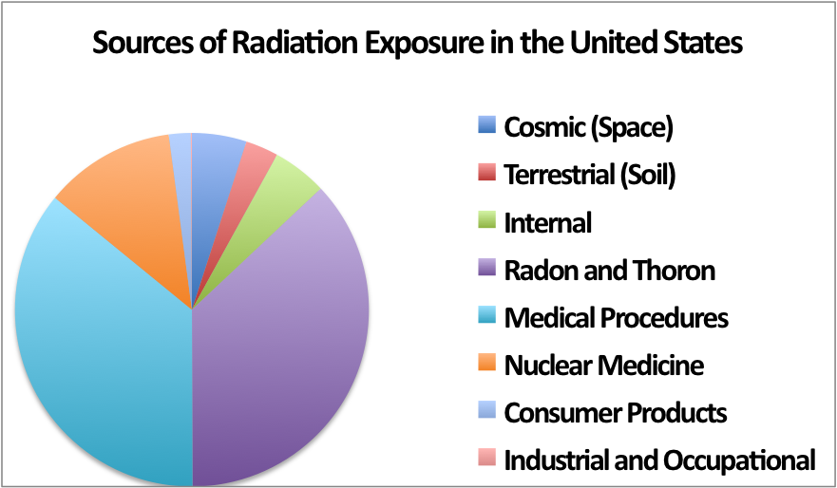
Average radiation exposure
Background levels of radiation every single day, typically less than 20 mSv at a time, accumulating to a few hundred mSv in a lifetime.
Man-made
Natural
Notes:
Humans are exposed to background levels of radiation every single day, typically less than 20 millisieverts at a time, accumulating to a few hundred millisieverts in a lifetime [1].
To study the effects of radiation on human health, experts turn to data from human subjects, typically atomic bomb survivors that were exposed to high dose rate acute radiation.
Half man-made, half natural – full body scan ~100Sv

Slide 9
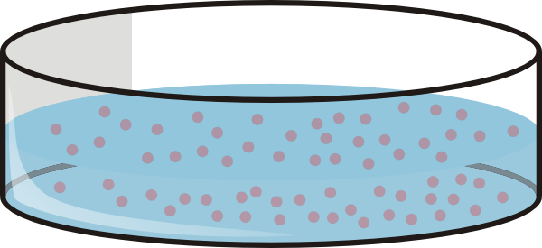
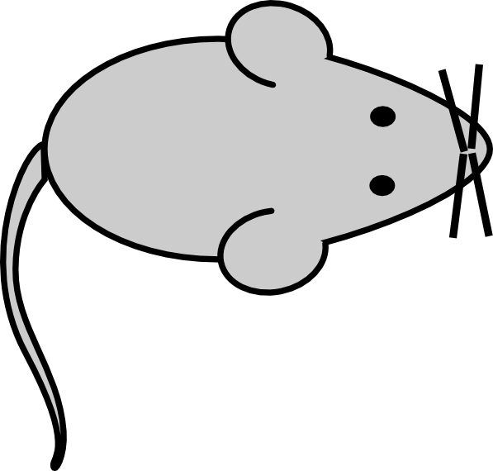

Types of radiation studies
Types of studies | Pros | Cons
 | Controlled experiment Economically advantageous | Not as physiologically accurate
 | Controlled experiment Varying doses Varying dose rates Can test multiple species | Not species of interest
 | Species of interest | Confounding factors Lack of diversity in population Low numbers Mostly acute exposures

Slide 10
Major findings to date
Types of studies | Major source of data | Major findings
 | ERA Janus Lovelace
 | Atomic bomb survivors Uranium miners US nuclear tests Chornobyl Thyroid cancer after external radiation Nuclear industry workers Medical personnel

Slide 11
Dose and Dose Rate Effectiveness Factor (DDREF)
The DDREF quantifies the fold change in risk between acute and protracted radiation exposures.
The latest report from the United States Nuclear Regulatory Commission (NRC) used a linear-quadratic statistical model of atomic bomb survivor data to estimate a 3-12% increase in lethal cancer cases per Sievert of low dose rate or protracted ionizing radiation.
Notes:
To calculate overall risk, most often a linear-quadratic formula is used. The linear-quadratic model is based on chromosomal aberration rates – the linear non-threshold model of cancer induction.
The large range of confidence from the NRC and the additional mixed reports from other research institutions concluding that the risk is either higher or lower than the NRC’s estimate clearly demonstrates the need for further studies.

Slide 12
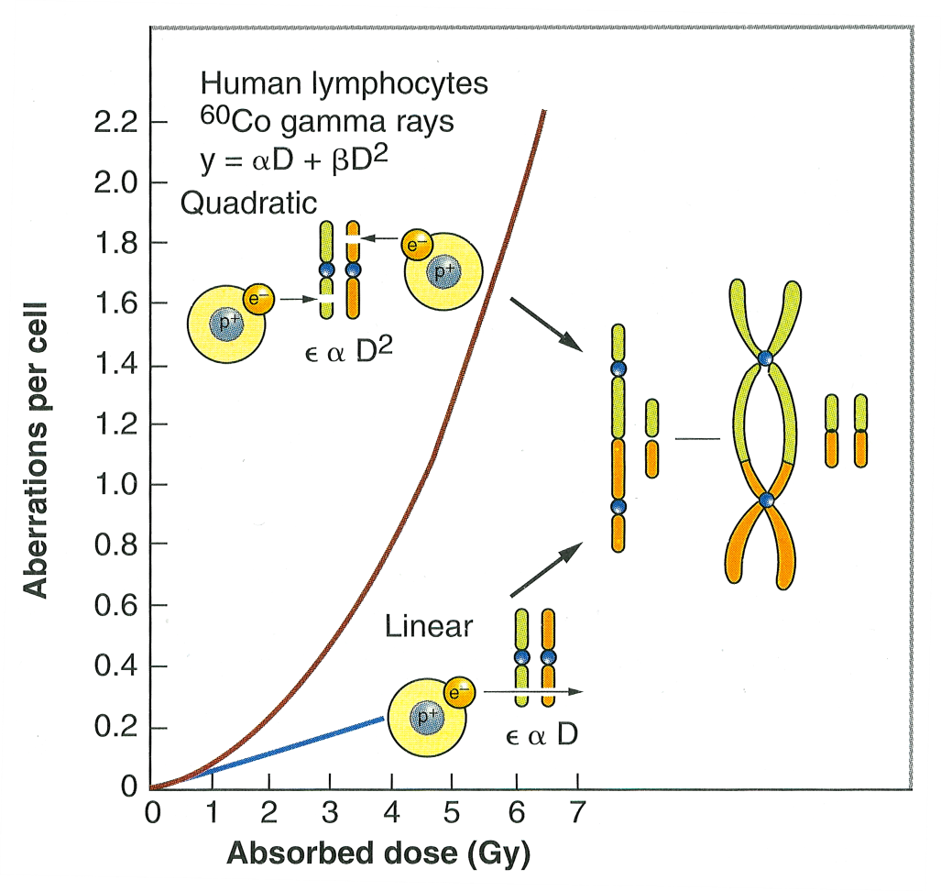
Notes:
FIGURE 2.20 The frequency of chromosomal aberrations (dicentrics and rings) is a Iinearquadratic function of dose because the aberrations are the consequence of the interaction of two separate breaks. At low doses, both breaks may be caused by the same electron; the probability of an exchange aberration is proportional to dose (D). At higher doses, the two breaks are more likely to be caused by separate electrons. The Q probability of an exchange aberration is proportional to the square of the dose (D²).
Mike Cornforth

Slide 13
DDREF estimates
Research Institution | DDREF Value
United States Nuclear Research Commission (NRC) | 1.5
United Nations Scientific Committee on the Effects of Atomic Radiation (UNSCEAR) | 1.2-2.85 (2006) NA (2012)
French Academy | Very high
International Commission on Radiological Protection (ICRP) | 2.0
National Council on Radiation Protection (NCRP) | 2.0-10.0

Slide 14
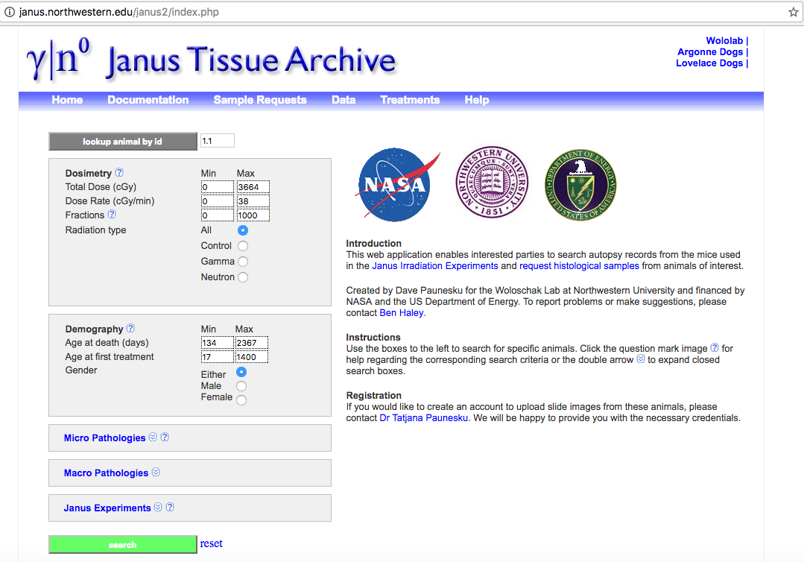
Janus Tissue Archive

Slide 15
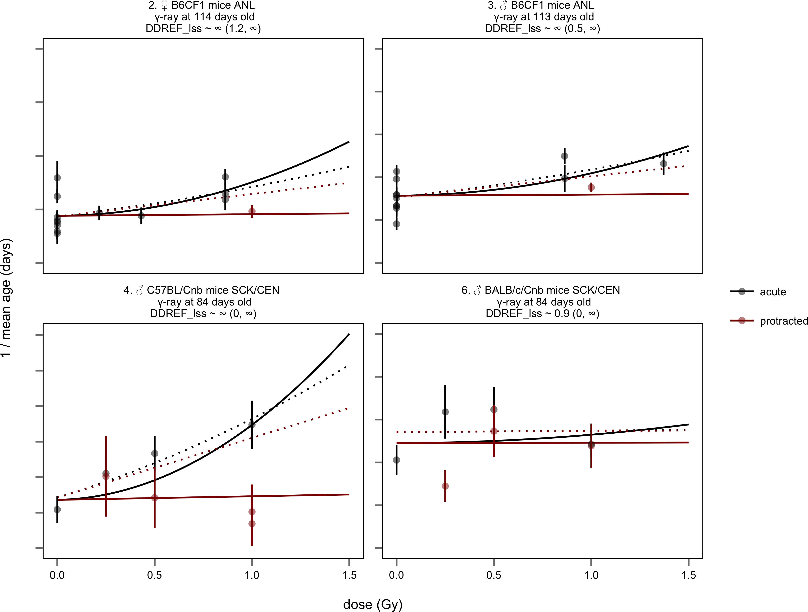
Biological Effects of Ionizing Radiation (BEIR VII) underestimates DDREF

Slide 16
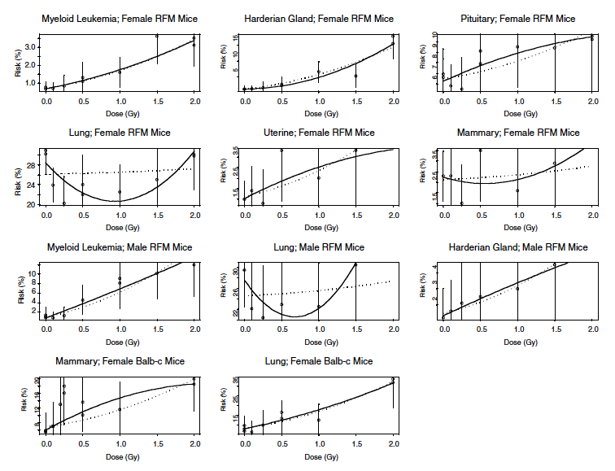
BEIR VII cancer associated DDREF

Slide 17
Thesis research project
Hypothesis: DDREF estimates can be improved through rigorous statistical modeling with large data sets that include low and high dose data.
Aim 1: Calculate DDREF using cancer associated terminal endpoints from mice treated with varying radiation exposures.
Aim 2: Determine if harderian gland cancer formation in response to radiation exposure is a proper representation for other cancer models

Slide 18
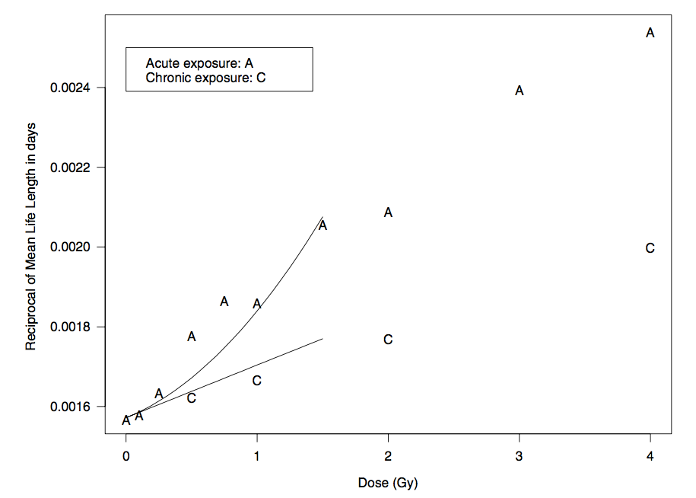
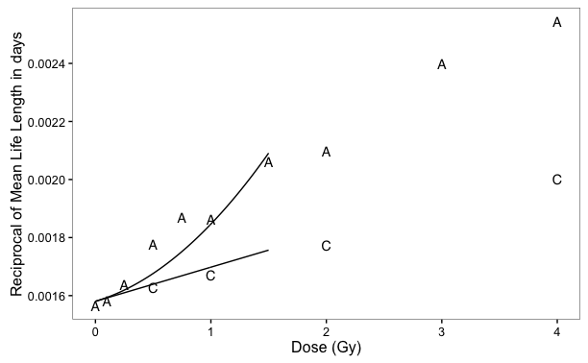

Slide 19
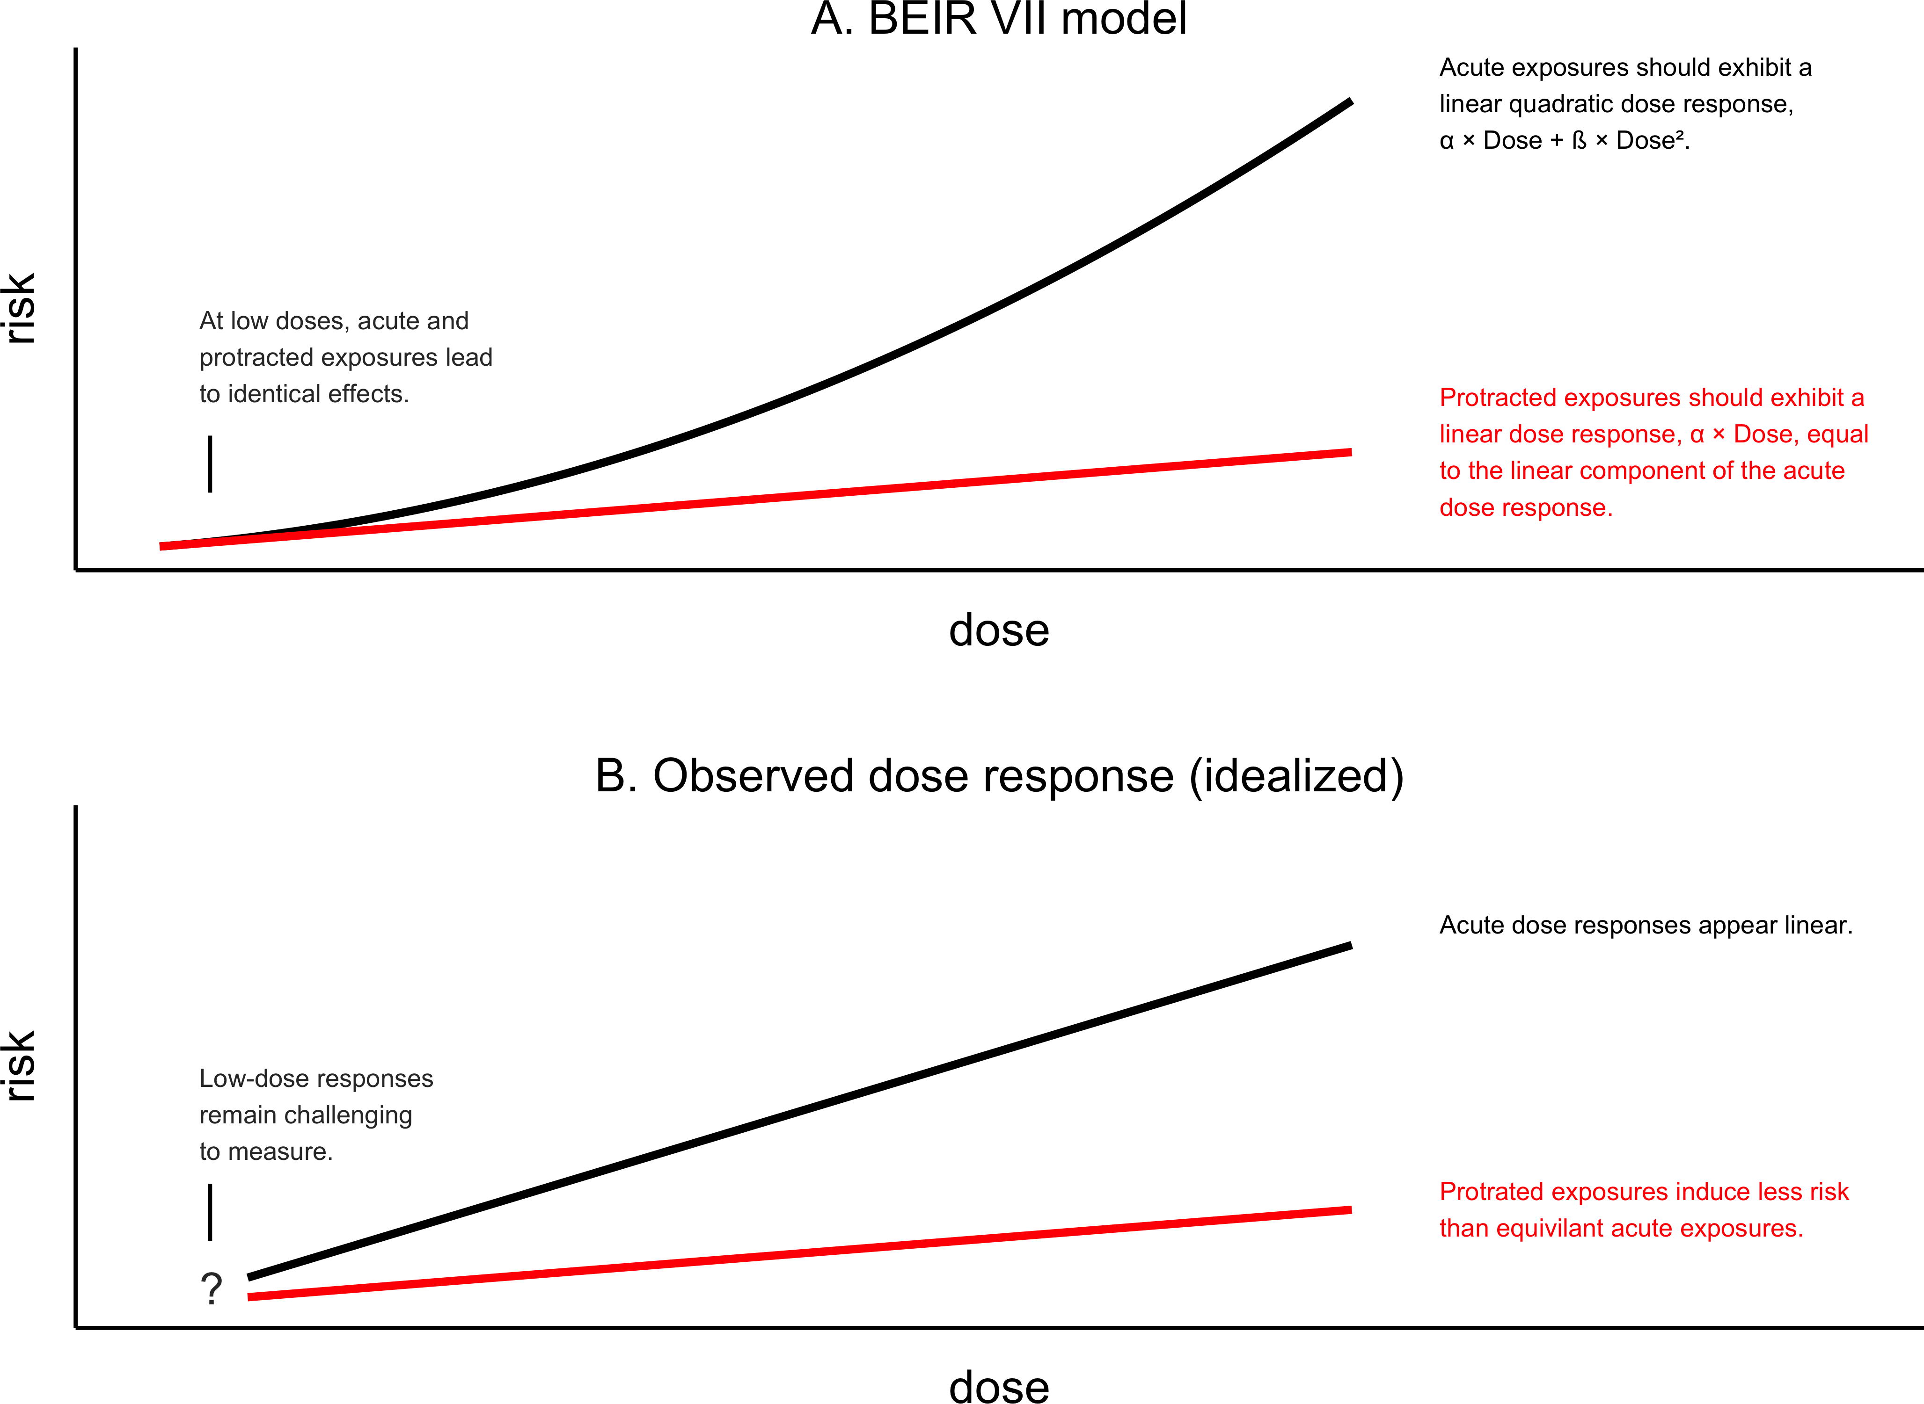

Slide 21
Summary
A variety of human populations have been used to estimate cancer risks from radiation exposure.
Risks are age-dependent at the time of exposure and dose- and dose-rate dependent
Radiation has been associated with the development of some secondary malignancies in the field
A variety of different national and international agencies are charged with assessing the risks of radiation exposure as they relate to cancer induction.

Slide 22
Major Human Population Exposures
1. Japanese A-bomb
- very important group for risk estimates
- 120,000 people followed long term
- registry of exposures
no + γ-rays → precise dosimetry gave rise to ↑ risk estimates of cancer
2. Alkylosing Spondylitis
- x-radiotherapy to spine--↑ leukemia
-Radium salt injections—bone tumors
Thymus enlargement radiotherapy – radiotherapy lead to ↑ thyroid cancer
Radiotherapy for adenoids, tonsils—thyroid cancer
5. Tinea capitis (immigrants from N. Africa to Israel)
- x-ray treatment of scalp for fungus
→ thyroid cancer
→ skin cancer
Also had meningiomas, other brain tumors, leukemia, salivary gland tumors
American experience had lower incidence of tumors: thyroid, skin
Fluoroscopy of TB patients - ↑ breast cancer
Thorotrast patients--Liver tumors
Thorotrast (contrast material for x-rays) – radioactive Thorium α-particles
8. Peptic ulcer—patients irradiated for peptic ulcer, higher risk for stomach cancer in those getting <10Gy
Notes:
Never with doses over 10 Gy for stomach cancer (8)

