Slide 1
How fractionation affects ionizing radiation risks and DREF estimations
Alia Zander
December 15, 2016
Committee Meeting

Slide 2
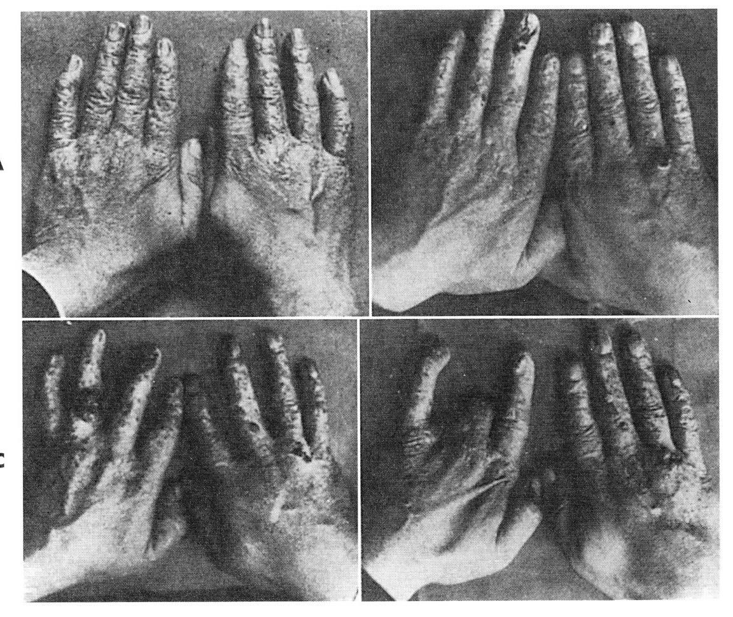
Significance for understanding risks associated with radiation
Appropriate policies
Improved protection
Reduce excess costs
Improved medical treatment/detection
Decreased fear of nuclear energy
Notes:
Understanding the risks of radiation exposure at different doses and dose rates is important for determining safe levels of exposure and the proper level of caution when considering general population exposures to ionizing radiation. ICRP report 103 – limits for general population and workers are 1mSv and 20mSv, respectively (lowered in 1991 after realization of stochasticity). If these values are too high, the population is in danger. If these values are too low, we are spending billions of dollars on radioactive waste disposal that could be better spent in other areas of research, there could be more medical tests used freely, and the stigma associated with nuclear energy and waste could be improved.
$35 billion dollars for nuclear waste fund as of 2012? 1.7 trillion dollars for DOE cleanup according to Berkley National Labs
http://www2.lbl.gov/LBL-PID/Galvin-Report/GalvinReport5.html#RTFToC34
http://www.forbes.com/sites/jamesconca/2014/07/13/absurd-radiation-limits-are-a-trillion-dollar-waste/#27a7ac20127d

Slide 3
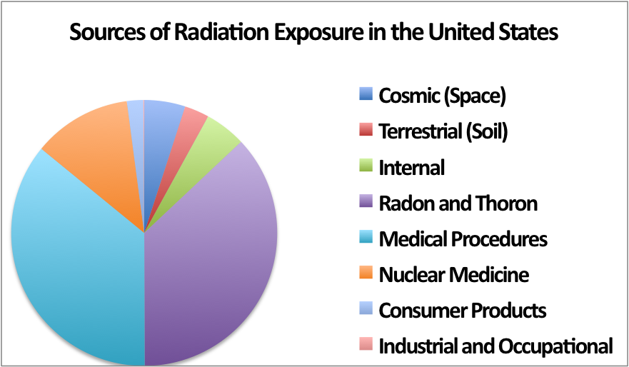
Average radiation exposure
Background levels of radiation every single day, typically less than 20 mSv at a time, accumulating to a few hundred mSv in a lifetime.
Man-made
Natural
National Regulatory Commission
Notes:
Radiation is unavoidable. Humans are exposed to background levels of radiation every single day, typically less than 20 millisieverts at a time, accumulating to a few hundred millisieverts in a lifetime [1]. Half of this radiation comes from natural sources like space and soil, while the other half is man-made used for nuclear medicine and medical procedures

Slide 4
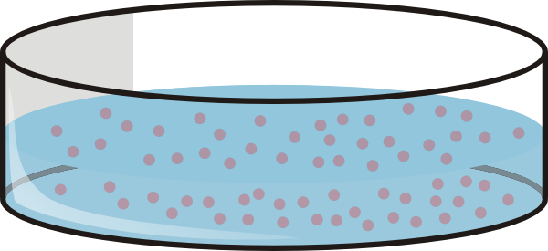
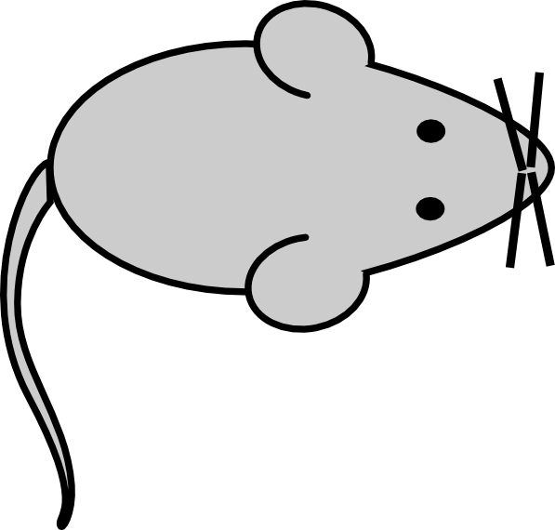

Types of radiation studies
Types of studies | Pros | Cons
 | Controlled experiment Economically advantageous Ease of genetic manipulation | Not as physiologically accurate
 | Controlled experiment Varying doses Varying dose rates Can test multiple species Ease of genetic manipulation | Not species of interest
 | Species of interest | Confounding factors Lack of ethnic diversity Small sample size Mostly acute exposures
Notes:
To understand how these low doses of radiation received at low dose rates are effecting our health, researchers use data from cell culture, animal studies, and epidemiological studies.
The pros and cons associated with cells under tissue culture are similar between radiation experiments and most other biological experiments – genetic manipulation, low costs, and good control are all advantages, but it’s not as physiologically accurate.
STOMACH, COLON, LIVER, LUNG, BREAST – substantially different between US and Japan
With radiation though, there’s also the comparison of animal experiments and human epidemiology.
Animal experiments have fewer confounding factors and the exact doses and dose rates can be set by the researcher. It’s also possible to test multiple species and genetically manipulate the animals. On the downside, the data is not from the main species of interest.
Epidemiology studies are most often used because humans are the main species of interest. However, the confounding factors such as genetic variability associated with these studies make it very difficult to find statistically significant changes in human health due to low doses of radiation. Furthermore, most data is from acute exposures to a distinct population, such as those affected by the atomic bombings in Japan.
Atomic bomb survivor data is the most popular data used for epidemiology studies. All of that data is on acute exposures and mostly high doses of radiation. To determine the effects of low dose and dose rates, we turn to the DDREF.

Slide 5
Dose and Dose Rate Effectiveness Factor (DDREF)
The DDREF quantifies the fold change in risk between acute and protracted radiation exposures.
Typically, a linear-quadratic formula is used to model radiation risk for DDREF calculations
Notes:
The dose and dose rate effectiveness factor – DDREF – quantifies that fold change in risk between acute and protracted radiation exposures. So if the DDREF is 2 – that means that acute exposures are twice as dangerous as protracted exposures.
To calculate overall risk, most often a linear-quadratic formula is used.

Slide 6
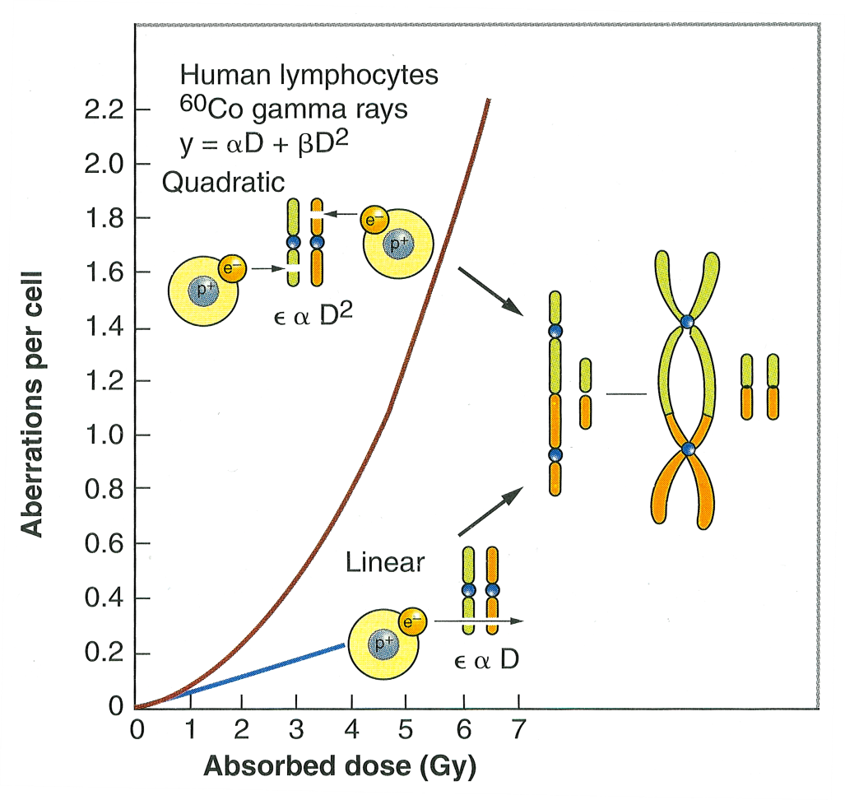
DDREF foundation
Eric Hall, 6th edition
Notes:
The linear-quadratic model is based on chromosomal aberration rates – the linear non-threshold model of cancer induction. These dicenrics occur after two separate breaks in the DNA. For lower doses, both breaks are most likely from the same electron, so the break frequency is proportional to dose. At higher doses, it’s most likely that the separate breaks are from separate electrons, making the break rate proportional to dose squared. The issue with using this reasoning for DDREF calculations is that dicentrics result in cell death, and dicentrics do not correlate with translocations or cancer. There are a lot of people in the field arguing against the linear quadratic model, and we have some information on this from our lab that I’ll touch on in a few slides.
FIGURE 2.20 The frequency of chromosomal aberrations (dicentrics and rings) is a Iinearquadratic function of dose because the aberrations are the consequence of the interaction of two separate breaks. At low doses, both breaks may be caused by the same electron; the probability of an exchange aberration is proportional to dose (D). At higher doses, the two breaks are more likely to be caused by separate electrons. The Q probability of an exchange aberration is proportional to the square of the dose (D²).
Mike Cornforth

Slide 7
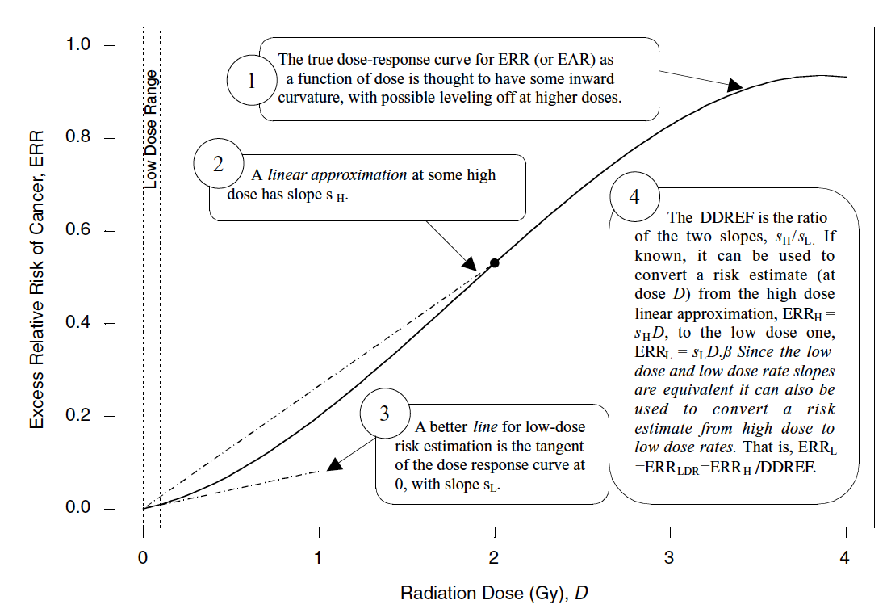
DDREF mathematically
BEIR VII
Notes:
Mathematically, the DDREF is the ratio of slopes for the high doses/low doses.
One is representing the true dose response, the linear quadtratic with some inward curvature and leveling off at higher doses
2. A linear approximation at some high dose
3. A linear approximation for the lose dose
4. DDREF is the ratio of the high dose slope/low dose slope
Which dose is used?????

Slide 8
DDREF estimates
Research Institution | DDREF Value
United Nations Scientific Committee on the Effects of Atomic Radiation (UNSCEAR) | 1.2-2.85 (2006) NA (2012)
SSK German Commission on Radiological Protection | 1
French Academy of Sciences | Very high
International Commission on Radiological Protection (ICRP) | 2.0
National Council on Radiation Protection (NCRP) | 2.0-10.0
National Academy of Sciences (NAS) - Biological Effects of Ionizing Radiation (BEIR VII) | 1.5
Notes:
There has been a lot of research done on DDREF estimates and this is a sample of some of the main findings. The United Nations Scientific Committee on the Effects of Atomic Radiation estimated a large range of 1.2-2.85 in 2006 and their most recent report concluded that they could not properly estimate. NCRP gives a range of estimates from 2-10. SSK German commision on Radiological Protection wants to abolish DDREF claiming it’s unneccessary, the value is one, there is no difference between risk in acute and protracted exposure. Biological Effects of Ionizing Radiation – BEIR VII was the 7th report in a seris from the National Research Council and our goal standard. They estimated a DDREF of 1.5 using atomic bomb survivor data and animal data

Slide 9
Biological Effects of Ionizing Radiation (BEIR VII)
3-12% increase in lethal cancer cases per Sievert of low dose rate or protracted ionizing radiation
Limited to crude analysis
No access to data
Some scientists no longer alive for reference to reproduce study
Notes:
Greatest impact on policy – 2006, last one was in 1990
A little more on BEIR VII – they concluded a 3-12% increase in lethal cancer cases per sievert of low dose rate or protracted ionizing radiation. Their analysis was crude, and it is difficult to reproduce because not all of the data is publicly accessable and the scientists that perfomred these studies are no long around for follow up questions. The large range of confidence from the BEIR VII and the additional mixed reports from other research institutions concluding that the risk is either higher or lower than BEIR VII’s estimate clearly demonstrates the need for further studies.
How old is BEIR VII, relevance
Talk more about the a

Slide 10
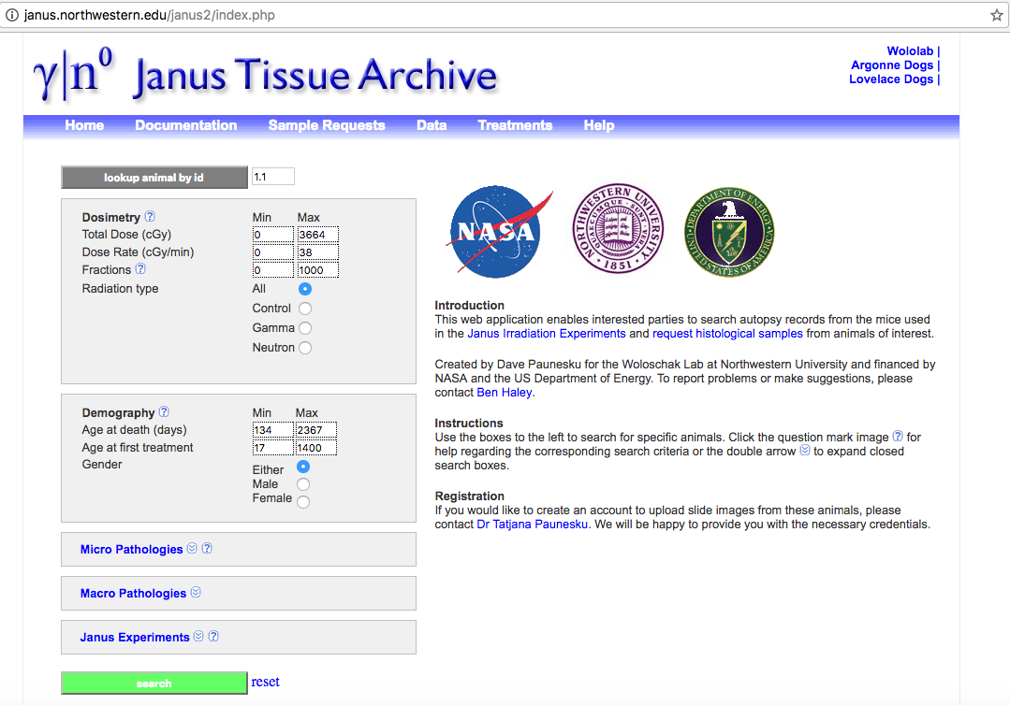
Janus Tissue Archive
Notes:
A phd student in the lab about to graduate, Ben Haley, began working to improve the BEIR VII estimate by including more data, and using a better statistical approach. Ben used data from the Janus Tissue Archive and European Radiobiology Archive. The Janus Tissue Archive includes 11 studies exploring the effects of neutron and gamma irradiation on 49,000 animals. Exposures were acute, fractionated, and protracted, and doses varied low to high.
Gamma ray doses 90-5,111cGy Cobalt 60 multiscource irradiator
Neutrons 1-470 cGy .85 MeV Janus reactor

Slide 11
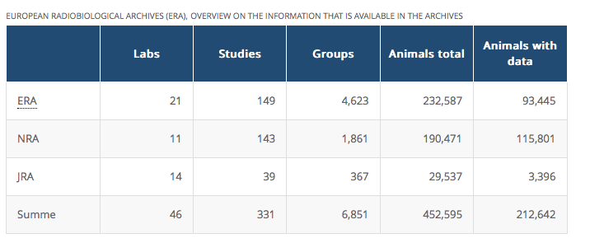
European Radiobiological Archives (ERA)
Notes:
National Radiobiology Archives
Japanese Radiobiology Archives
Studies between 1960-1998
ERA look into it – make sure animals died naturally

Slide 12
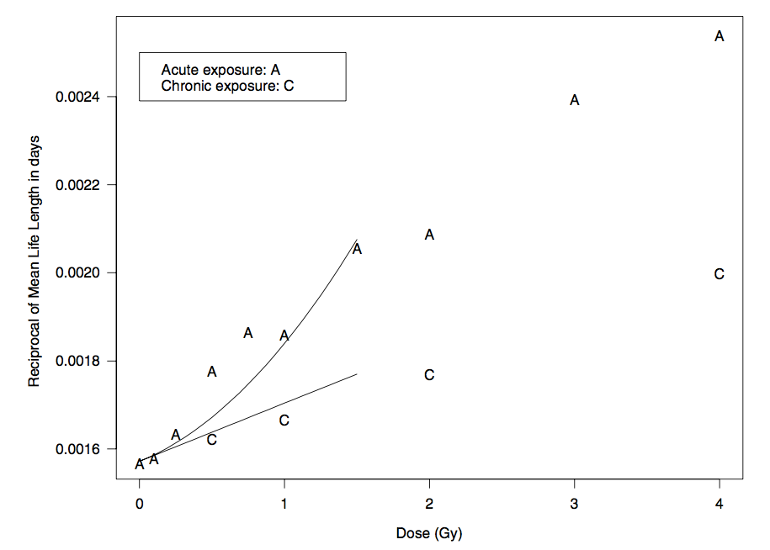
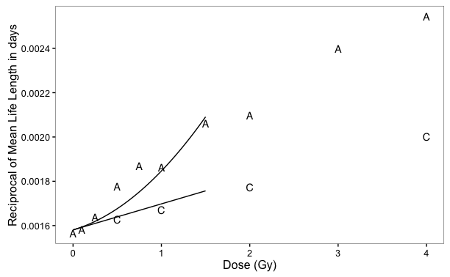
Reproducing important figures from BEIR VII as a benchmark
BEIR VII’s model
My reproduction
BEIR VII
Notes:
Similar to Ben’s approach, I will be first using BEIR VII as a benchmark. The y-axis shows the reciprocal of life length and the x-axis is dose.

Slide 13
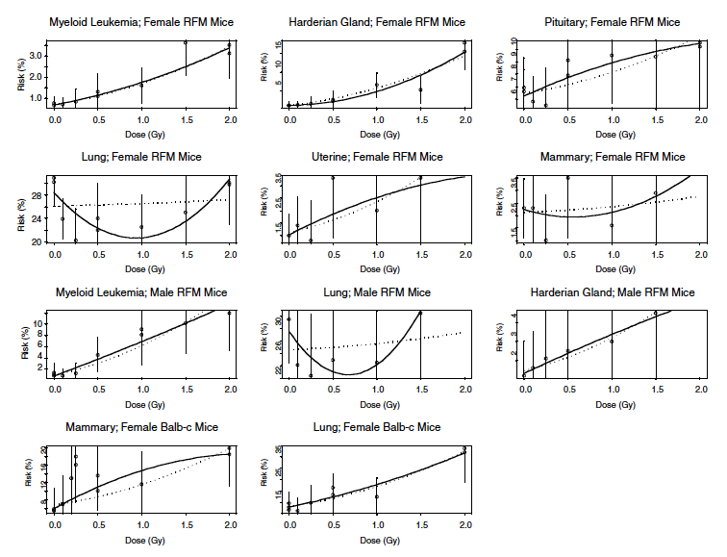
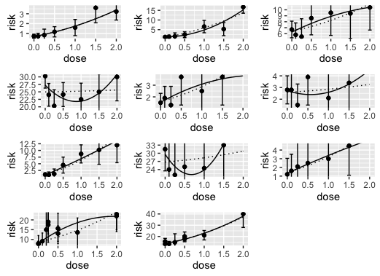
BEIR VII cancer associated DDREF
BEIR VII model
My reproduction
BEIR VII
Notes:
BEIR VII also created cancer models and this will be the next figure that I work to reproduce before delving into cancer associated DDREF with my own data set. The y-axis represents Risk percentage and the x-axis is Dose. Discuss stratification – sex specific cancers, strain
Cutoff makes a big difference – redoing dosimetry
WHAT DDREF did they come up with???

Slide 14
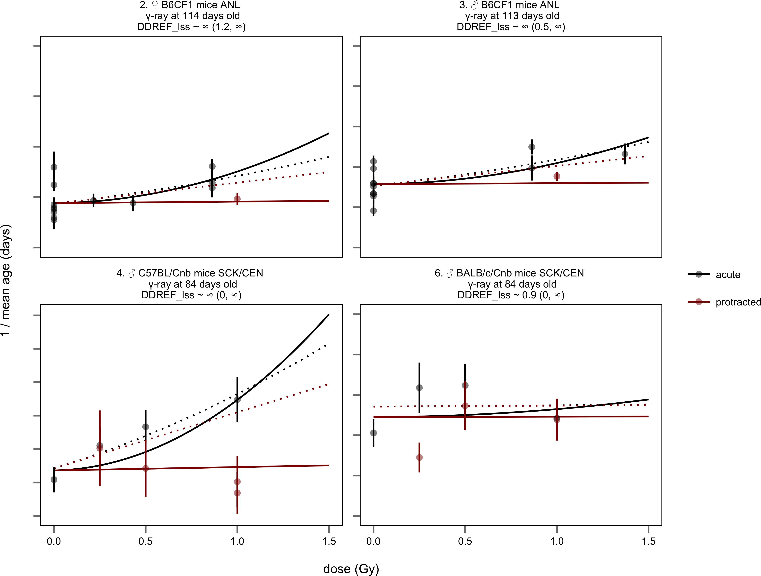
BEIR VII underestimates DDREF
Haley 2015
Notes:
To begin, Ben reproduced several key figures to prove that he was using the same modeling approach. This first figure shows 1/mean age on the y-axis (all of Ben’s work were lifespan studies) and dose in Gray on the x-axis. The black lines are acute exposures, the red lines are protracted exposures. When he added the extra animal data from Janus and ERA, he found that the DDREF was equal to infinity, meaning there is no risk from protracted exposures. We do not believe this is true, which led us to believe that the BEIR VII model was inaccurate. One way Ben tested this was looking at the 4 sets of Janus data where there was available data with matched acute AND protracted exposures. He compared a model that included both sets of data, to a model that only included acute data and used the linear quadratic model to extrapolate proctracted exposures. Doing this shows that the BIER VII model, the dotted lines, underestimates DDREF consistently. That means we are overprotecting, wasting billions of dollars on radioactive waste disposal.
BEIR VII approach – DDREF of .9 to 3.0
Ben’s approach with acute and protracted – DDREF 4.8 to infinity

Slide 15
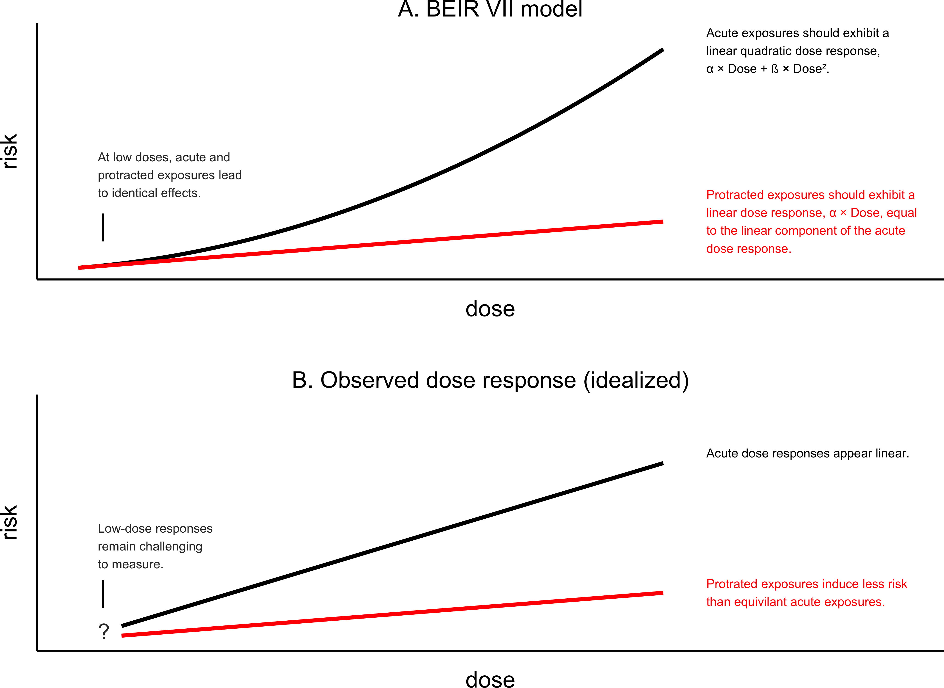
Linear-linear models fit the data better than linear-quadratic models
Haley 2015
Notes:
Additionally, another major flaw that Ben found in the BEIR VII model was the use of a linear quadratic. For many cases, a linear linear model with different slopes for acute and protracted exposures, fit the data much better than the linear quadratic.
There is clearly a lot more research needed to understand the risks associated with radiation exposures and how to quantify this risk.

Slide 16
Thesis research project
Hypothesis: Human radiation risk estimates can be improved through rigorous statistical modeling with large, detailed mouse data sets that include protracted and acute dose data.
Aim 1: Calculate DDREF using lethal cancer endpoints from mice treated with varying radiation exposures.
Aim 2: Determine if harderian gland tumor (benign) formation in response to radiation exposure is a proper representative model for other cancer types.
Aim 3: Calculate the risks of fractionated versus acute ionizing radiation exposures to estimate the risks associated with fractionated exposure conditions of utility workers in the nuclear power industry.
Notes:
We hypothesize that… blah blah
To do that, we aim to specifically calculate DDREF using lethal cancer end points from mice treated with varying radiation exposures.

Slide 17
Thesis research project
Hypothesis: Human radiation risk estimates can be improved through rigorous statistical modeling with large, detailed mouse data sets that include protracted and acute dose data.
Aim 1: Calculate DDREF using lethal cancer endpoints from mice treated with varying radiation exposures.
Aim 2: Determine if harderian gland tumor (benign) formation in response to radiation exposure is a proper representative model for other cancer types.
Aim 3: Calculate the risks of fractionated versus acute ionizing radiation exposures to estimate the risks associated with fractionated exposure conditions of utility workers in the nuclear power industry.
Notes:
We hypothesize that… blah blah
To do that, we aim to specifically calculate DDREF using lethal cancer end points from mice treated with varying radiation exposures.

Slide 18
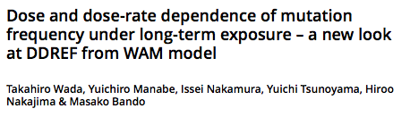
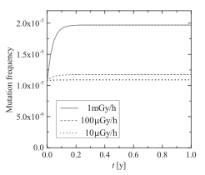
Bando Lab in Japan

Slide 19
Work flow
Data validation and filtering
Data exploration/descriptive analysis
Data stratification
Linear-linear modeling
Calculating credible intervals
Calculating DREF
Notes:
So, after reproducing those figures to prove that I am faithfully using their model, I will use data from Janus and ERA to create an improved model

Slide 20
Work flow
Data validation and filtering
Data exploration/descriptive analysis
Data stratification
Linear-linear modeling
Calculating credible intervals
Calculating DREF
Notes:
So, after reproducing those figures to prove that I am faithfully using their model, I will use data from Janus and ERA to create an improved model

Slide 21

Inclusion criteria
Janus database – all individual level data
External radiation exposures
Low – LET, whole body exposures (gamma radiation only)
No other treatments (e.g. no chemical exposures from JM14)
Digitized data on treatment and cancer incidences confirmed by primary literature – Janus data well trusted
Cancer associated cause of death
Statistically insignificant differences in controls

Slide 22
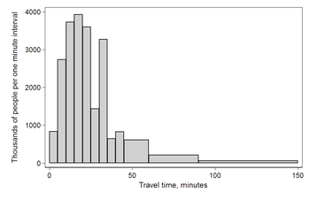
Work flow
Data validation and filtering
Data exploration/descriptive analysis
Data stratification
Linear-linear modeling
Calculating credible intervals
Calculating DREF
Notes:
So, after reproducing those figures to prove that I am faithfully using their model, I will use data from Janus and ERA to create an improved model

Slide 23


Work flow
Data validation and filtering
Data exploration/descriptive analysis
Gender
Data stratification
Age
Linear-linear modeling
Calculating credible intervals
Calculating DREF
Notes:
So, after reproducing those figures to prove that I am faithfully using their model, I will use data from Janus and ERA to create an improved model

Slide 24
Work flow
Data validation and filtering
Data exploration/descriptive analysis
Data stratification
Linear-linear modeling
Calculating credible intervals
Calculating DREF
Notes:
So, after reproducing those figures to prove that I am faithfully using their model, I will use data from Janus and ERA to create an improved model

Slide 25
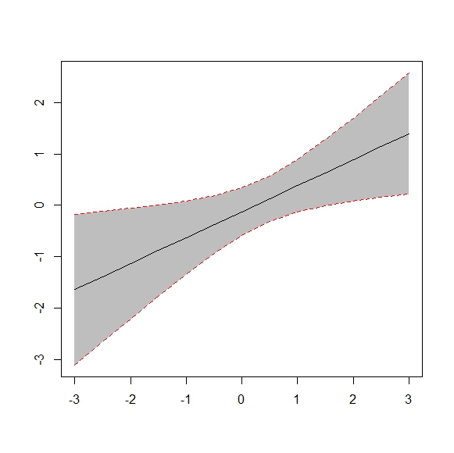
Work flow
Data validation and filtering
Data exploration/descriptive analysis
Data stratification
Linear-linear modeling
Calculating credible intervals
Calculating DREF
Notes:
So, after reproducing those figures to prove that I am faithfully using their model, I will use data from Janus and ERA to create an improved model

Slide 26
Work flow
Data validation and filtering
Data exploration/descriptive analysis
Data stratification
Linear-linear modeling
Calculating credible intervals
DREF = β/α
Calculating DREF
Notes:
So, after reproducing those figures to prove that I am faithfully using their model, I will use data from Janus and ERA to create an improved model

Slide 27
Questions?

