Slide 1
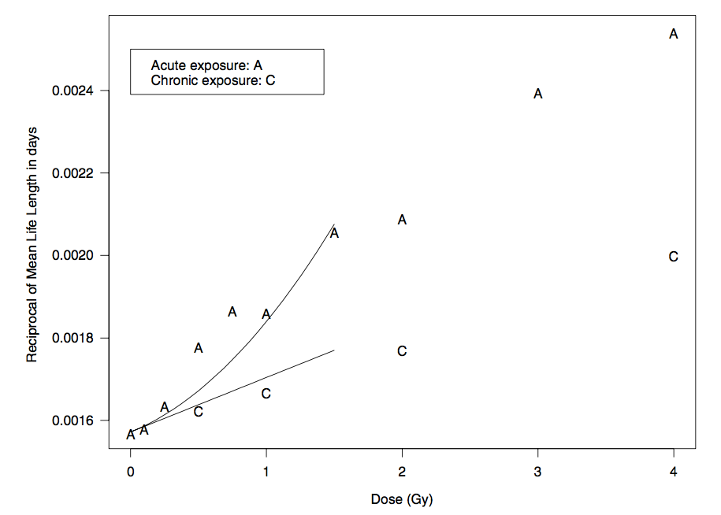
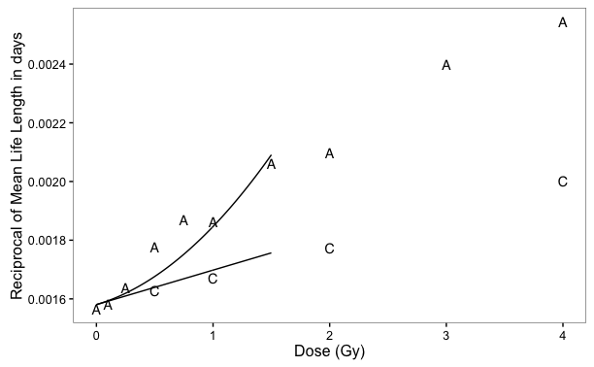
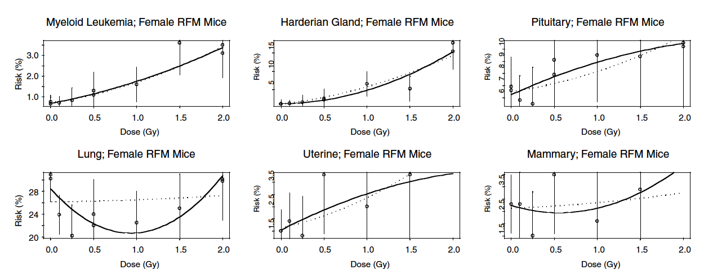
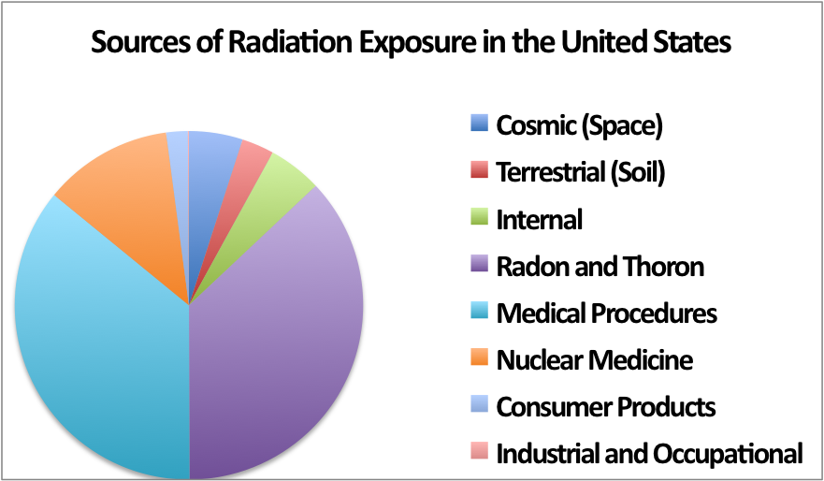
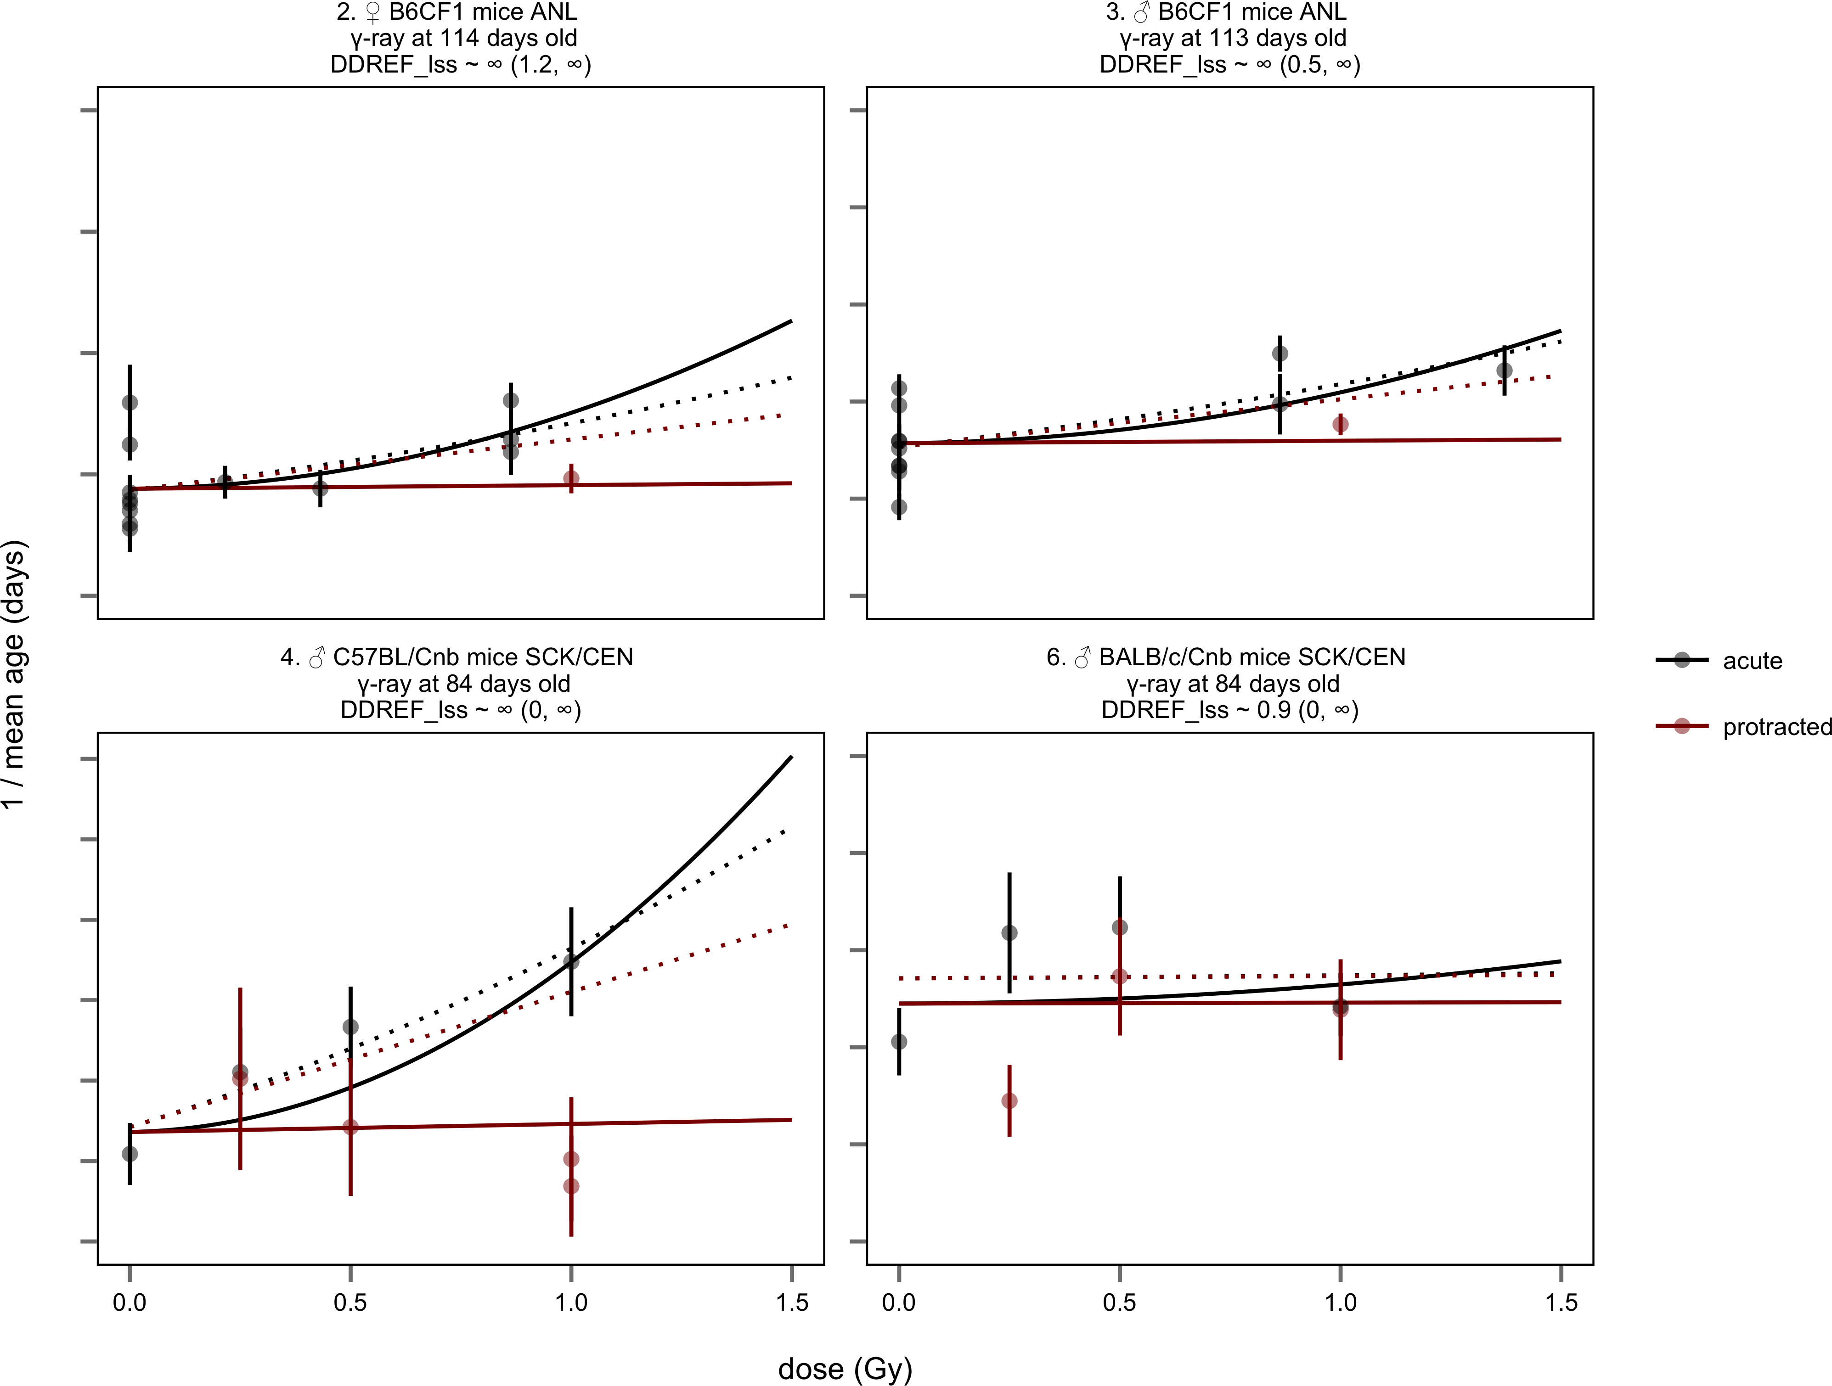
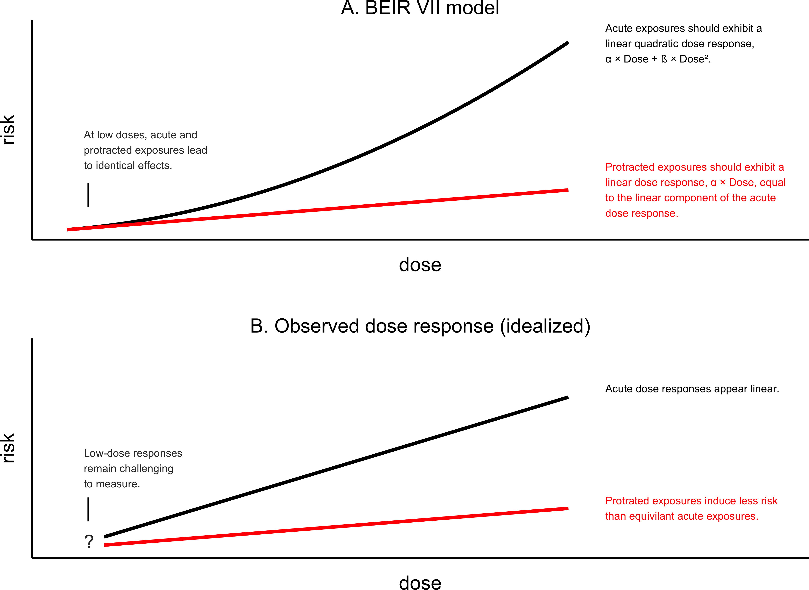
Modeling DDREF from animal data on high and low LET ionizing radiation exposures
Alia D. Zander, Benjamin M. Haley, Tatjana Paunesku and Gayle E. Woloschak
Department of Radiology Oncology, Northwestern University
Feinberg School of Medicine, Chicago, IL USA
Abstract
Life shortening DDREF
Cancer specific DDREF
Understanding the risks of radiation exposure at different doses and dose rates is important for determining safe levels of exposure and the proper level of caution when considering general population exposures to ionizing radiation. Calculating this risk is typically done through statistical modeling with data from atomic bomb survivors and animal studies. Unfortunately, because the effect of low dose exposures is small, there is not enough statistical power in most epidemiologic studies to determine the precise risk associated with low dose/low dose rate exposure conditions. Instead, it is common practice to calculate the dose and dose rate effectiveness factor (DDREF) – the ratio that extrapolates the risk from high dose to low dose exposures and high dose rate to low dose rate. There has been a great deal of debate over which type of model best represents the physiological consequences of radiation exposure; the clinically used linear-quadratic model is often used as a basis for these statistical models designed for risk assessment. We recently showed that protracted exposure risk cannot be extrapolated directly from acute exposure data and that data for both conditions are necessary in order to arrive at the DDREF; moreover, we find that this factor can be modeled the best by using a linear-linear (rather than a linear-quadratic) model. We are now expanding this study to investigate the risk associated with specific cancers following radiation exposure in order to calculate a cancer associated DDREF value. In addition, we are investigating the differences in dose rate response following high linear energy transfer (LET) and low LET radiation exposures. A more detailed knowledge of the risks posed by different types of radiation exposure may improve the safety of the general population and simultaneously reduce excess costs linked to superfluous safety regulations.
Reproducing BEIR VII data analysis as proof of concept for linear-quadratic models and DDREF calculations
The main danger associated with radiation exposure is cancer induction, making a cancer specific DDREF important to investigate. Furthermore, we aim to narrow in on individual cancer types that pose the greatest threats to human health due to radiation exposure to enhance our understanding of radiation risks.
For our cancer specific DDREF calculation, we plan to use external beam data from the Janus archive. We will only use data from mice with a cancer associated terminal endpoint. Additionally, the cutoff dose for consideration in our analysis will be 1.5Gy – the same cutoff BEIR VII used.
To calculate the cancer specific DDREF, we will employ two different benchmarks as a tool to validate our model. The first will be the BEIR VII model – we will reproduce key figures from their report (figure 4) to prove our method is comparable and to serve as a baseline against all other models. The second benchmark will be using our model on data from high linear energy transfer (LET) and low LET for a direct comparison. We expect that high LET exposures will not show a large difference in risk between acute versus protracted exposures and it serves as a negative control.
A
B
C
Figure 2 - Life span study data over varying doses administered acutely, or chronically and DDREF calculations. A. Reprinted from figure 10B-3 of “Health risks from exposure to low levels of ionizing radiation: BEIR VII phase 2” [2]. A graph of the reciprocal of the mean life lengths for RFM female mice versus the dose of exposure for chronically (C) and acutely (A) exposed groups. A linear-quadratic model was fit to data within the 0-1.5 Gy dose range. The data came from Tables 1, 2, and 3 of Storer and others. B. A reproduction of figure 10B-3 from BEIR VII produced from our lab. The data and code used for generating this figure can be found at https://github.com/aliazander/Thesis/tree/master/BEIR-VII_10B3. C. Calculations for DDREF used with linear-quadratic model of risk. DDREF is dependent on the ratio of coefficients and dose. The coefficients are estimated from the linear-quadratic model and the dose is set at 1Gy.
Directly comparing acute and protracted radiation exposure data reveal issues with extrapolation of protracted risk given acute data using the linear-quadratic model
Introduction
Studies | Treatments | Animals | Criteria
302 | 6,810 | 452,595 | All animal data from ERA and Janus archives
124 | 2,611 | 205,758 | Individual – level animal data available
35 | 827 | 116,542 | External radiation exposures
35 | 457 | 76,096 | Low – LET, whole body exposures
34 | 230 | 45,730 | Total dose equal to or below 1.5 Sv
32 | 175 | 43,043 | No other treatments (e.g. no chemical exposures)
26 | 119 | 34,439 | Digitized data on treatment and lifespan confirmed by primary literature
16 | 91 | 28,289 | At least three distinct treatment groups per stratum so that a linear-quadratic model could be fitted
Humans are exposed to background levels of radiation every single day, typically less than 20 millisieverts at a time, accumulating to a few hundred millisieverts in a lifetime [1].
To study the effects of radiation on human health, experts turn to data from human subjects, typically atomic bomb survivors that were exposed to high dose rate acute radiation.
The DDREF quantifies the fold change in risk between acute and protracted radiation exposures. To calculate overall risk, most often a linear-quadratic formula is used. The linear-quadratic model is based on chromosomal aberration rates – the linear non-threshold model of cancer induction.
The latest report from the United States Nuclear Regulatory Commission (NRC) used a linear-quadratic statistical model of atomic bomb survivor data to estimate a 3-12% increase in lethal cancer cases per Sievert of low dose rate or protracted ionizing radiation [2].
The large range of confidence from the NRC and the additional mixed reports from other research institutions concluding that the risk is either higher or lower than the NRC’s estimate clearly demonstrates the need for further studies.
Manmade
Natural
Table 2 – Data used to expand the study from BEIR VII in an attempt to improve their DDREF estimate. The number of distinct studies, treatment groups, and individual animals that remained eligible for analysis after application of each of the inclusion criteria. Criteria here match the criteria from the original BEIR VII report. [7]
Figure 1: Sources of radiation exposure in the United States. Figure adapted from US National Research Council (NRC)
A
B
Figure 4 – Cancer risk models from mouse experiments. SOURCE: Data from A.A. Edwards(1992). Reprinted from a subset of figure 10B-2 of “Health risks from exposure to low levels of ionizing radiation: BEIR VII phase 2” [2]. Vertical bars extend two standard errors above and below each estimate. Solid lines are linear-quadratic fits with individual estimates. Dashed lines are linear-quadratic fits with curvature constrained to be the same for all data sets. DDREF ~ 1.4 (1.1, 2.6) for 95% confidence interval.
Data analysis methods | Reasoning
Eliminate hormetic paradox | Linear-quadratic model founded by chromosomal aberrations – does not allow for hormetic effects
Account for heterogeneity between treatment groups | Random effects model is preferred to account for variation between and within studies
Stratification by study | Data was already stratified by strain, sex, and age at exposure in BEIR VII. Stratification by study will take into consideration differences in cage crowding, pathogen environment, ambient temperature, etc.
Survival | Model mortality using Cox proportional hazards model – described by a baseline hazard over time and explanatory covariates
Figure 3 – The linear-quadratic model does not fit the data and it overestimates DDREF [7]. A. The x-axis represents dose in Grey, the y-axis represents the reciprocal mean age in days. Solid lines show best fit lines for the linear-quadratic BEIR VII model applied only to protracted-acute direct comparisons – DDREF ~ ∞ (4.8, ∞). The dotted lines represent the best fit using only acute data – DDREF ~ 1.3 (.9, 3.0). Red lines are for protracted exposures, black lines are for acute exposures. The four graphs are the only four studies (out of 16) with matched acute and protracted data available. The increase in DDREF with direct comparisons is significantly higher than the estimate based only only curvature in acute dose response (p < 0.01). B. Two possible dose response models based on linear-quadratic model (top) and linear-linear model (bottom). The x-axis represents dose, the y-axis is excess risk of organism mortality. Black lines represent acute exposures, red liens represent protracted exposures.
Table 3: Additional analysis for linear-quadratic models we will use to calculated cancer specific DDREF.
Acknowledgments
Conclusion
Research Institution | DDREF Value
United Nations Scientific Committee on the Effects of Atomic Radiation (UNSCEAR) | 1.2 – 2.85 (2006) N/A (2012)
French Academy | Very high
NRC | 1.5
International Commission on Radiological Protection (ICRP) | 2.0
National Council on Radiation Protection (NCRP) | 2.0 – 10.0
This project is supported in part by NIH grant R01OH010469
References
Mettler FA. Effective doses in radiology and diagnostic nuclear medicine: a catalog. Radiology. 2008
Board on Radiation Effects Research Division on Earth and Life Studies National Research Council of the National Academies. Health risks from exposure to low levels of ionizing radiation: BEIR VII Phase 2. Washington, D.C.: National Academies Press; 2006
UNSCEAR. Effects of ionizing radiation Annex A: Epidemiological studies of radiation and cancer. UNSCEAR 2006 Report to the General Assembly. 2006.
UNSCEAR 2012 Report Annex B. Uncertainties in risk estimates for radiation-induced cancer. New York; 2012.
ICRP Publication 99: Low-dose extrapolation of radiation-related cancer risk. Annals of the ICRP. 2005.
National Council on Radiation Protection and Measurements. Influence of dose and its distribution in time on dose-response relationships for low-LET radiations. 1980.
Haley B. The increase in Animal Mortality Risk following Exposure to Sparesly Ionizing Radiation Is Not Linear Quadratic with Dose. PLoS One. 2015.
Determining a cancer specific DDREF and testing linear-linear model fits will further improve our understand of the risks associated with protracted and chronic radiation exposures. Increased certainty in the exact risks caused by radiation exposure will allow the proper level of caution to be taken for radiation exposure guidelines and policies regulating worker exposures at nuclear power plants, nuclear waste disposal sites, decisions on use of medical diagnostics instruments that produce ionizing radiation, and thresholds for workers in the field in an effort to decrease cancer development.
Table 1: DDREF values at different national and international research institutions and protection agencies [2-6]
Notes:
1

