Slide 1

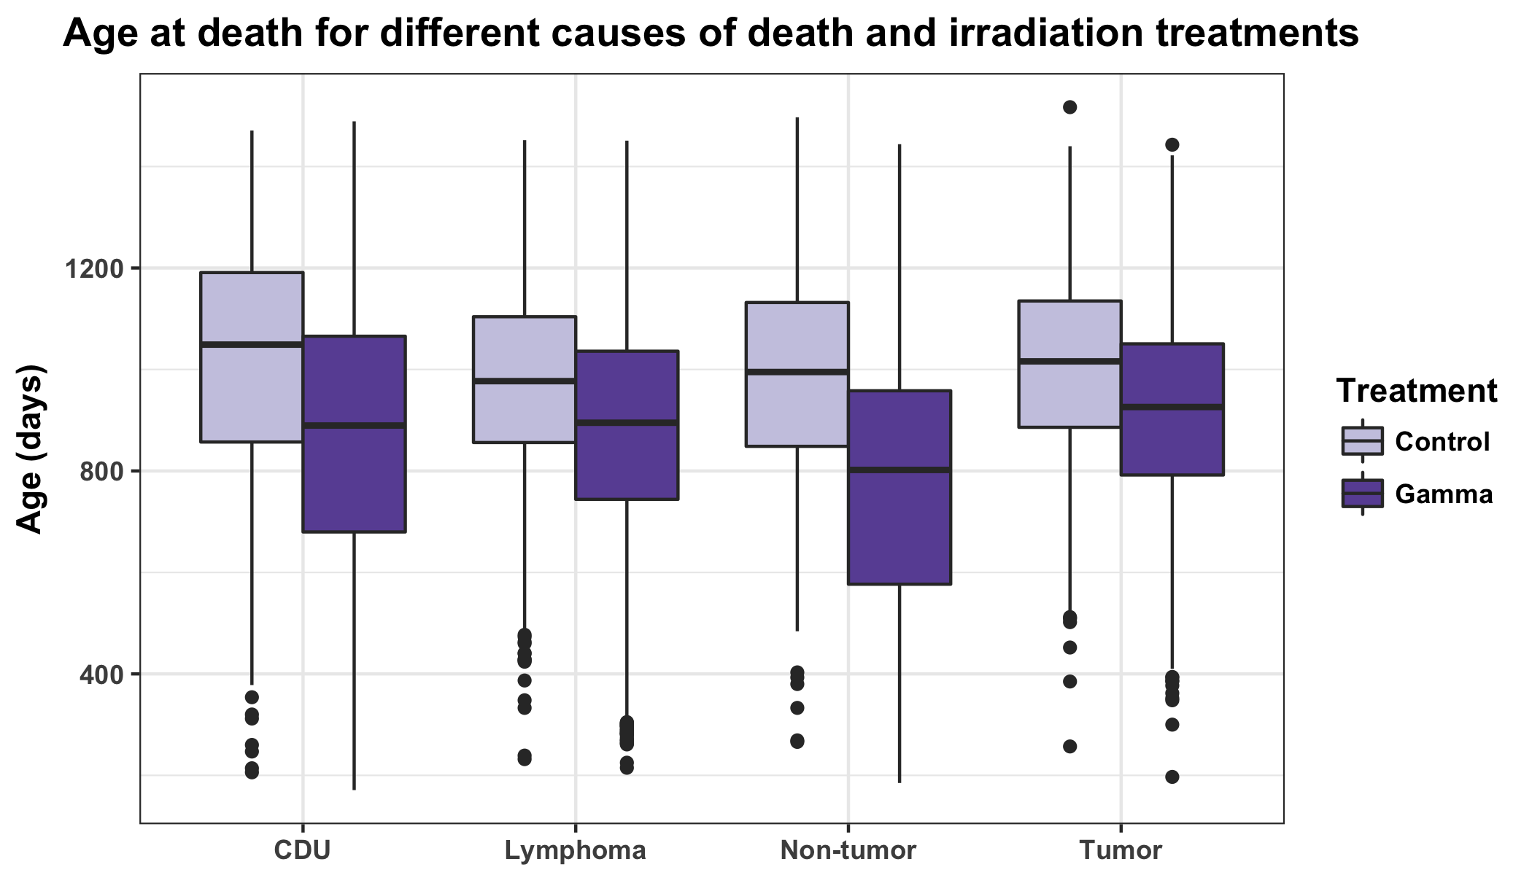
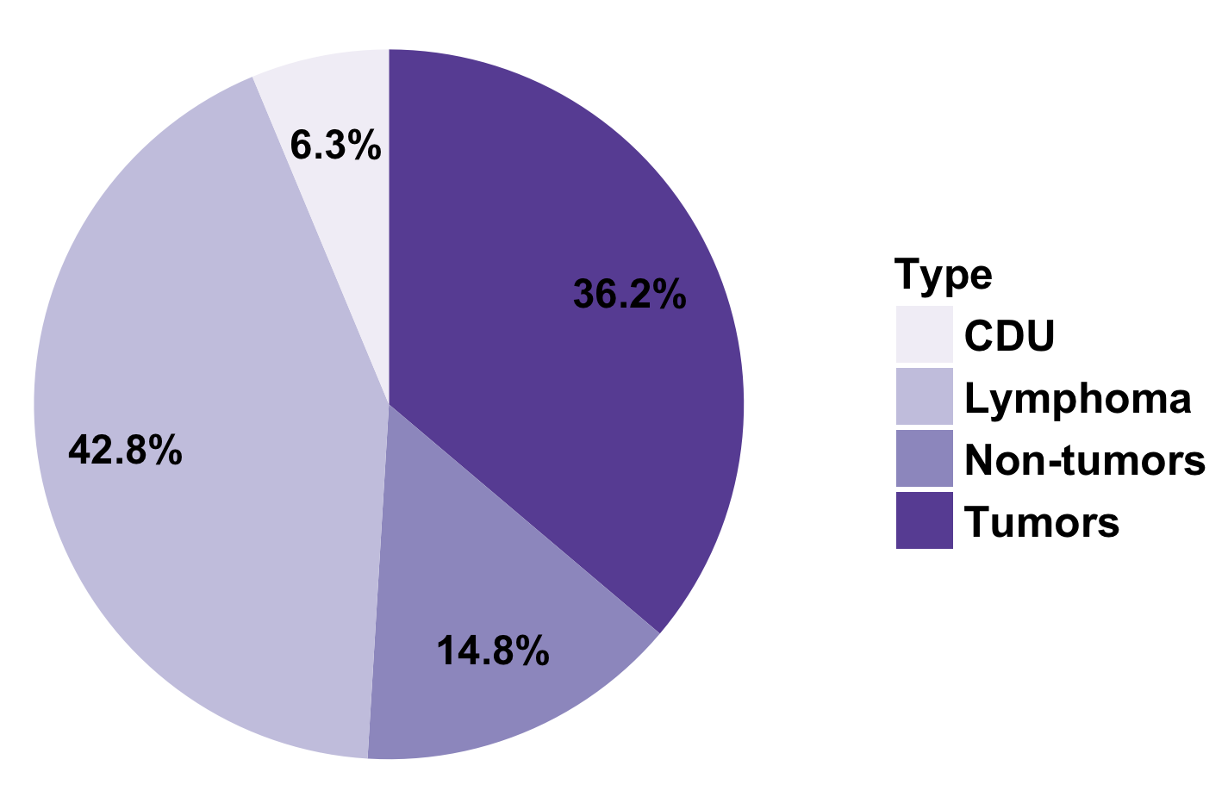
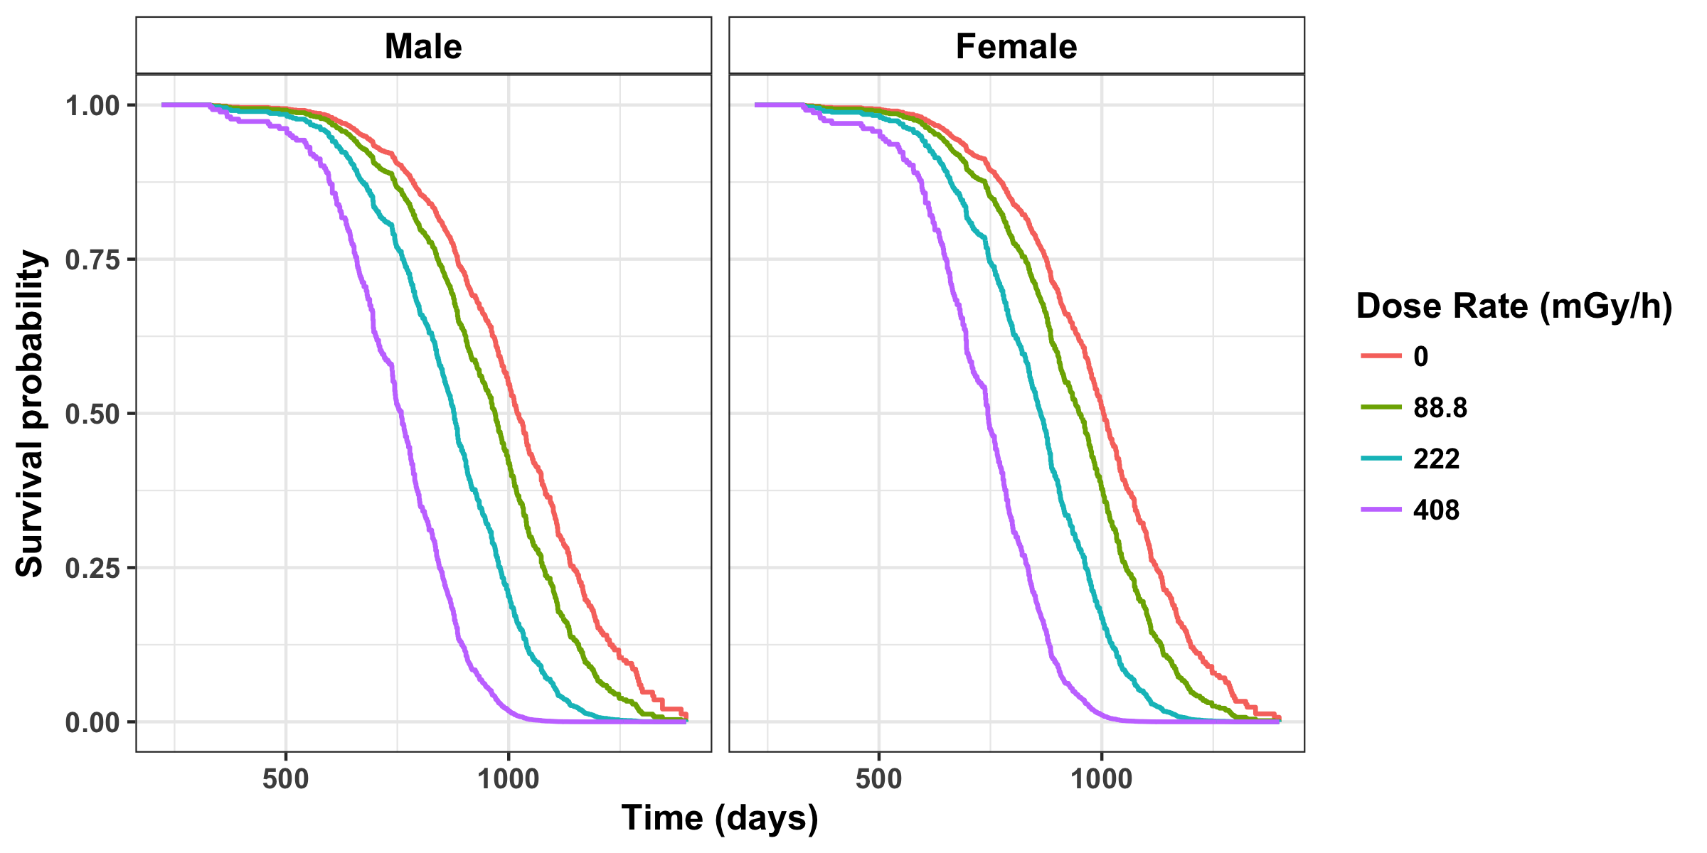
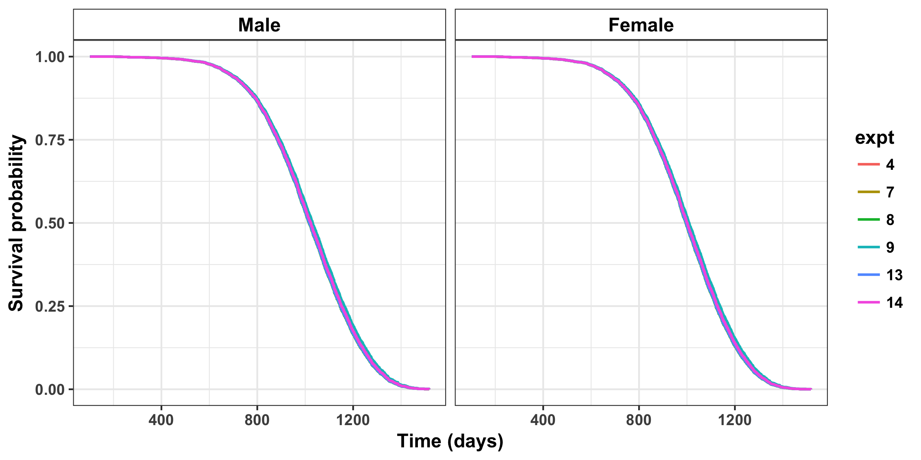
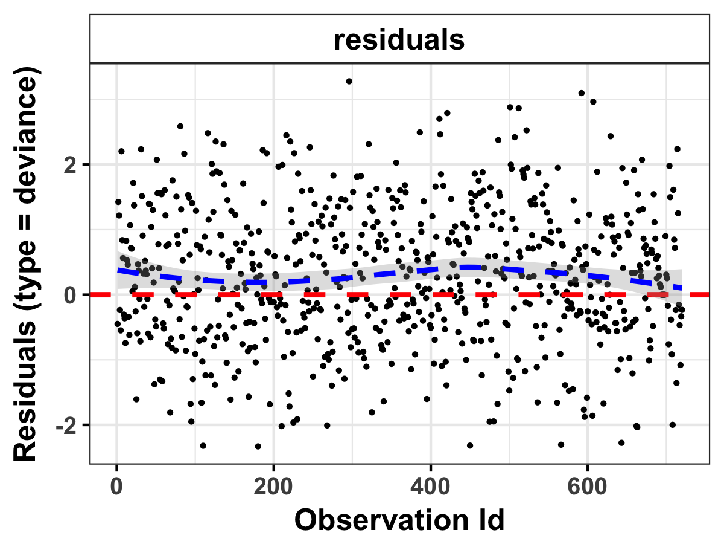
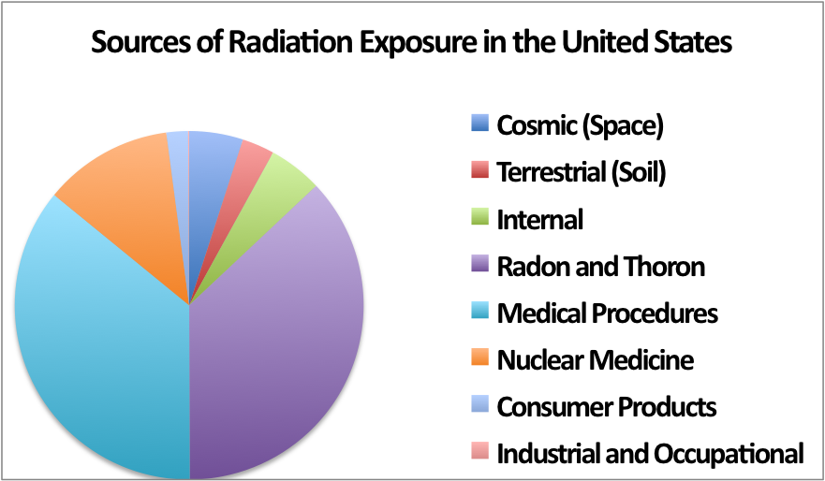
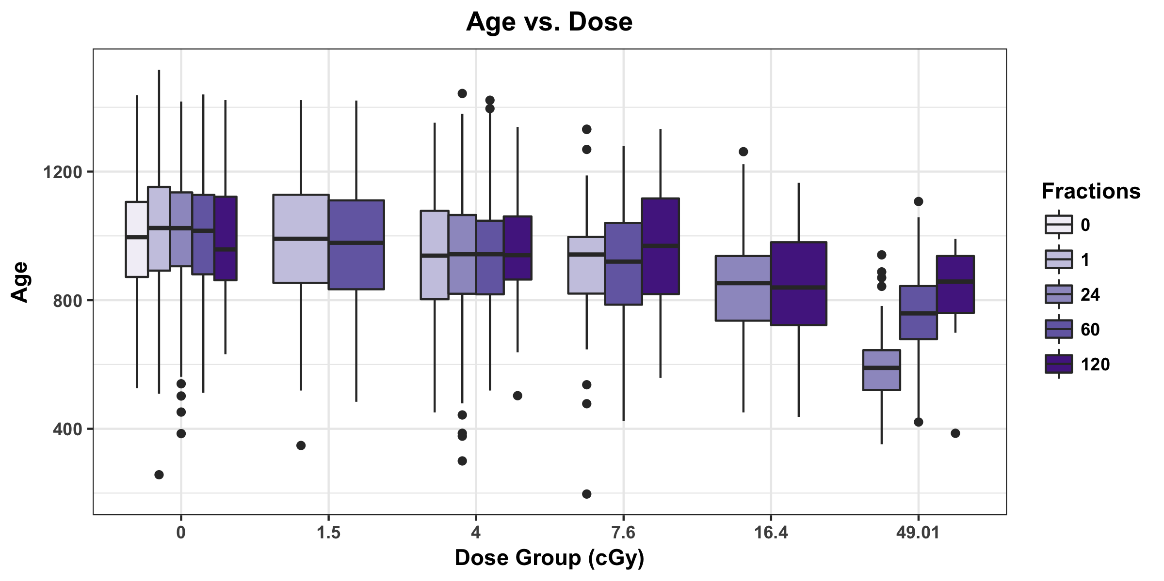
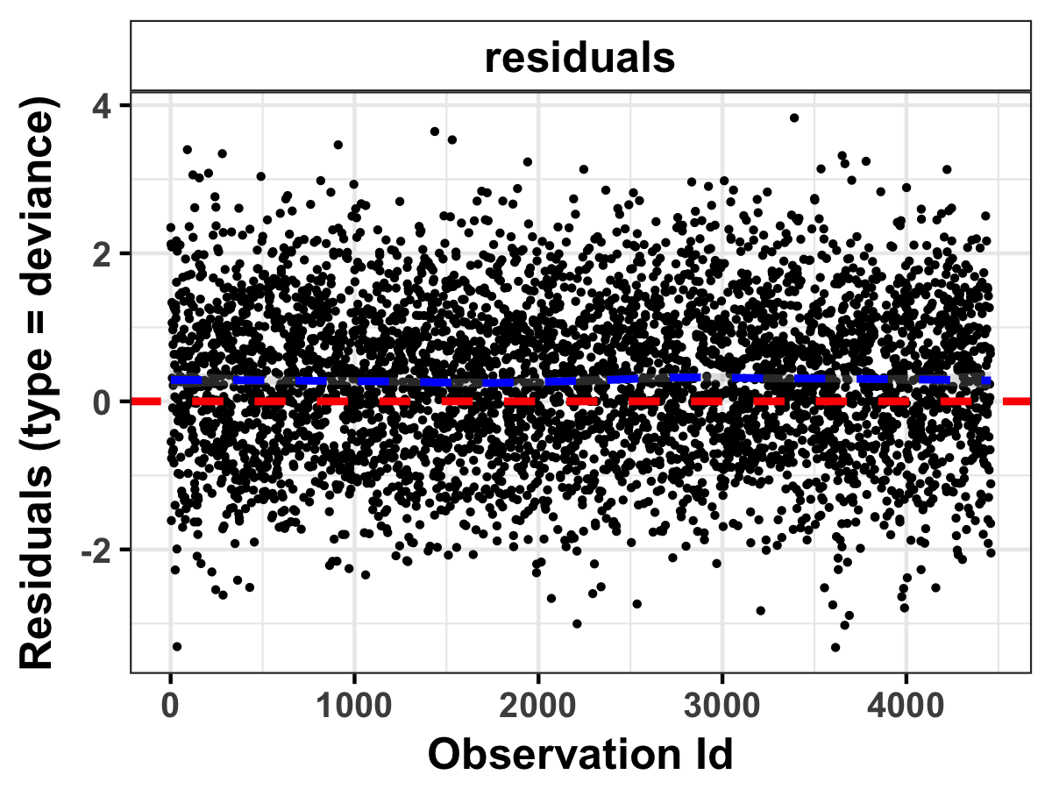
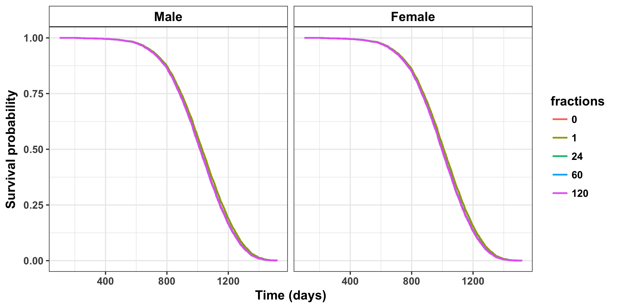
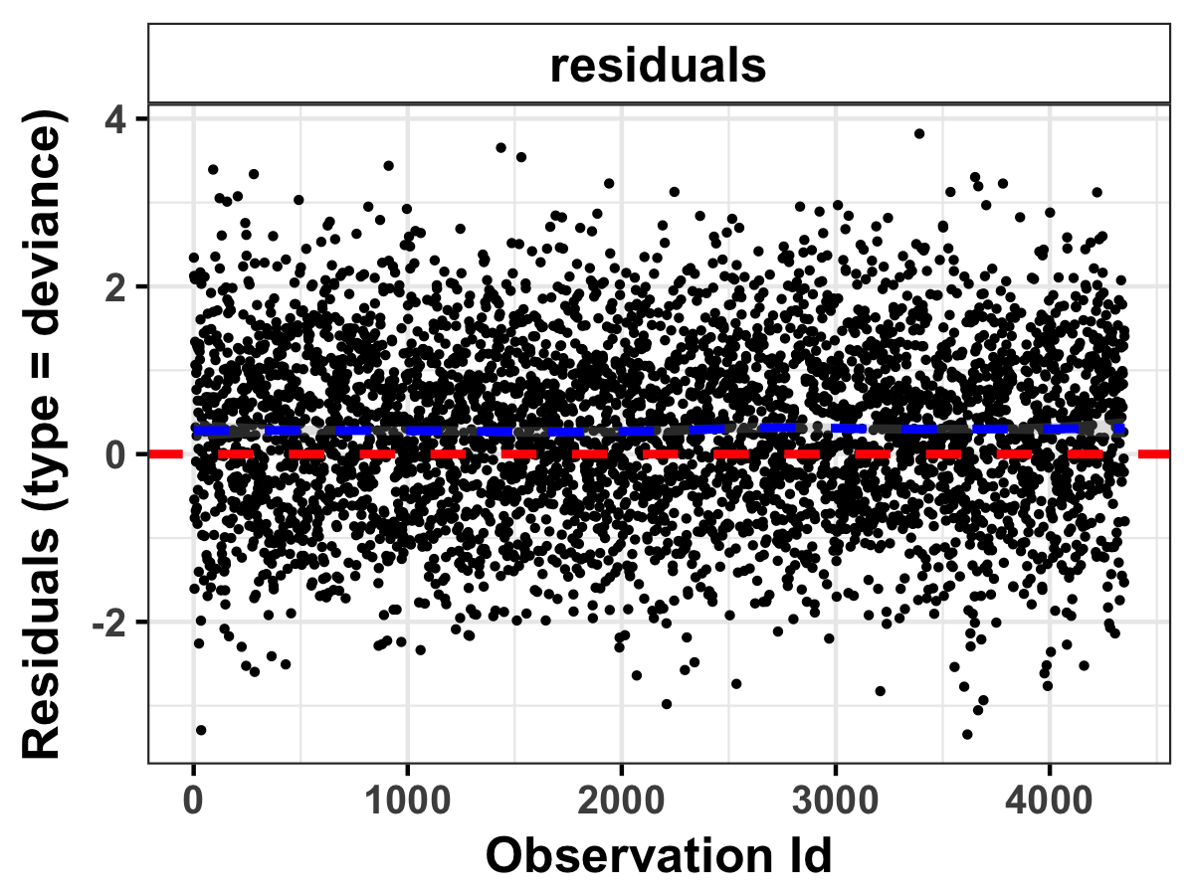
How Fractionation Affects Ionizing Radiation Risks and DREF estimations Alia Zander, Benjamin Haley, Tatjana Paunesku, Gayle Woloschak Northwestern University Feinberg School of Medicine, Chicago, IL Department of Radiation Oncology
Abstract
Data Selection
Descriptive analysis
Ionizing radiation is an unavoidable risk throughout our daily lives. Quantifying the risks associated with ionizing radiation exposure can improve current policies surrounding radiation safety to improve human health and potentially conserve resources. Radiation exposure from many sources, such as space and soil, is inevitable. Workers in the field have an additional risk associated with their increased exposures throughout their lives. The exact risks associated with different doses and dose rates of ionizing radiation are still being investigated around the world with much debate centered on the dose and dose rate effectiveness factor (DDREF). Because low dose/low dose rate radiation may have a small impact on health, it is difficult to measure these effects with enough statistical power to gain meaningful results. DDREF is used to extrapolate low dose/low dose rate effects given data on high dose and high dose rate effects through a linear quadratic model. One of the most important data sets for this type of study is derived from atomic bomb survivors that received acute exposures of radiation. Our lab has examined animal data that contained matched low and high dose rate radiation exposures and found that a dose rate effectiveness factor (DREF) calculated with a linear-linear model is more accurate and that low dose rate effects cannot be extrapolated from high dose rate effects. Using this method, we are now exploring the impact of fractionation compared to single dose exposures on life shortening and cancer specific death. We are exploiting the Janus Archives for our study. The Janus Archives contain data on over 40,000 mice with information on cause of death, lifespan, dose, dose rate, and number of fractions. The ten large-scale experiments within the archive had been designed so that they could all be compared to one another, which allows additional flexibility for an in-depth analysis on the effects of fractionated ionizing radiation exposure. By determining the consequences of fractionation, we can more accurately set safety protection for radiation workers. The influence these studies have on policy will help protect the population from the harmful effects of radiation exposure in the most efficient way.
Data removed | Reasoning | Total # of mice
- | - | 50110
JM11 | Not a true data set | 49225
JM10 | Different species - peromyscus | 46835
Neutron irradiated mice | Beyond the scope of our project | 25425
JM14 mice treated with radioprotectors | Beyond the scope of our project | 24225
Breeder mice | Held under different conditions | 24107
JM2 mice | Held under different conditions | 17317
COD – removal to another experiment | Mice listed under different experiment, do not want to double count | 15137
JM12 mice | Controls analysis showed significant difference | 15017
JM3 mice | Controls analysis showed significant difference | 13423
Mice irradiated with 300 fractions | Controls analysis showed significant difference | 12898
A
B
Figure 4: (A) Pie chart representing the causes of death due to lymphoma, tumors, non-tumors or cause of death unknown (CDU). (B) Age at death plotted against the four main causes of death and separated out by irradiation treatment condition. Censored mice were excluded from this graph.
Table 2: Description of mice that were removed from our analysis, the reasoning behind their removal, and the total number of mice after each stage of filtering data. The original number includes all mice from 11 Janus experiments.
Preliminary dose rate and fractionation analysis
Mice Censored | # of mice | Mice Censored | # of mice
COD – Accidental death | 47 | COD - Missing | 29
COD – Escaped during irradiation | 8 | COD – Sacrifice, programmed | 19
COD - Discarded | 207 | No lethal disease listed | 936
COD – Improper irradiation | 77
A
B
Factor | P-value
sexM | 0.361
Dose-rate 88.8 | 0.676
Dose-rate 222 | 0.870
Dose-rate 408 | 0.865
Global | 0.898
Table 3: Description of mice that were censored and the total number of mice in each category.
Controls analysis - experiment
C
Figure 5: (A) Survival curves using data only from experiment 8. Mice were treated weekly at the dose rate listed until death. A Cox Proportional Hazard model was used with age as a time scale and stratified by sex and dose rate. The overall model and changes in dose rate were significant, while sex was not significant. Compared to a dose rate of 0 mGy/hr, the hazard rates increased by 31%, 62%, and 85% for 88.8, 222, and 408 mGy/hr, respectively. (B) Results from the Schoenfeld Residuals Test used to test for independence between residuals and time. (C) Deviance residuals plotted for each point to test for
A
B
Factor | P-value
sexM | 0.708
expt7 | 0.701
expt8 | 0.447
expt9 | 0.603
expt13 | 0.447
expt14 | 0.294
Global | 0.850
Background
Humans are exposed to background levels of radiation every single day, typically less than 20 millisieverts at a time, accumulating to a few hundred millisieverts in a lifetime [1].
The DDREF quantifies the fold change in risk between acute and protracted radiation exposures.
The latest report from the United States Nuclear Regulatory Commission (NRC) used a linear-quadratic statistical model of atomic bomb survivor data to estimate a 3-12% increase in lethal cancer cases per Sievert of low dose rate or protracted ionizing radiation [2].
The importance of clinical fractionation is well studied for increasing therapeutic index, however, the effects of fractionation with low doses are unknown.
D
influential observations. (D) Age vs. dose group stratified by fractions for all non-censored data. The trend shows a decrease in age at death as dose increases and an increase in age at death as the number of fractions increase.
C
Figure 2: (A) Survival curves using all data filtered above with a total dose of 0Gy. A Cox Proportional Hazard model was used with age as a time scale and stratified by sex and experiment. The overall model was significant due to sex, but individual experiments were not significantly different from one another. (B) Results from the Schoenfeld Residuals Test used to test for independence between residuals and time. No significance indicates that the proportional hazards assumption is supported. (C) Deviance residuals plotted for each point to test for influential observations.
Figure 1: Sources of radiation exposure in the United States. Figure adapted from US National Research Council (NRC).
Controls analysis - fractions
Conclusions and futures directions
A
B
Janus experiments can be compared across studies for a more comprehensive analysis of how dose, dose rate, and fractionation influence mortality from specific causes of death.
Lower dose rates and increased fractionation tends to decrease risk.
Next, we will focus on specific causes of death for more detailed analysis on fractionation, dose rate, and DREF estimates.
Factor | P-value
sexM | 0.235
Fractions1 | 0.208
Fractions24 | 0.307
Fractions60 | 0.277
Fractions120 | 0.202
Global | 0.286
Research Institution | DDREF Value
United Nations Scientific Committee on the Effects of Atomic Radiation (UNSCEAR) | 1.2-2.85 (2006) N/A (2012)
French Academy | Very high
NRC | 1.5
International Commission on Radiological Protection (ICRP) | 2.0
National Council on Radiation Protection (NCRP) | 2.0-10.0
Acknowledgments
C
This project is supported in part by NIH grant R01OH010469.
References
Mettler FA. Effective doses in radiology and diagnostic nuclear medicine: a catalog. Radiology. 2008
Board on Radiation Effects Research Division on Earth and Life Studies National Research Council of the National Academies. Health risks from exposure to low levels of ionizing radiation: BEIR VII Phase 2. Washington, D.C.: National Academies Press; 2006
UNSCEAR. Effects of ionizing radiation Annex A: Epidemiological studies of radiation and cancer. UNSCEAR 2006 Report to the General Assembly. 2006.
UNSCEAR 2012 Report Annex B. Uncertainties in risk estimates for radiation-induced cancer. New York; 2012.
ICRP Publication 99: Low-dose extrapolation of radiation-related cancer risk. Annals of the ICRP. 2005.
National Council on Radiation Protection and Measurements. Influence of dose and its distribution in time on dose-response relationships for low-LET radiations. 1980.
Code for analysis available at: https://github.com/aliazander/Thesis/tree/master/Janus
Figure 3: (A) Survival curves using all data filtered above with a total dose of 0Gy. A Cox Proportional Hazard model was used with age as a time scale and stratified by sex and fractions. The overall model was significant due to sex, but individual fractions were not significantly different from one another. (B) Results from the Schoenfeld Residuals Test used to test for independence between residuals and time. No significance indicates that the proportional hazards assumption is supported. (C) Deviance residuals plotted for each point to test for influential observations.
Table 1: DDREF values at different national and international research institutions and protection agencies [2-6]. The large range of confidence from the NRC and the additional mixed reports from other research institutions clearly demonstrates the need for further studies.

