Slide 1
Factory & Abstract Factory Design Pattern

Slide 2
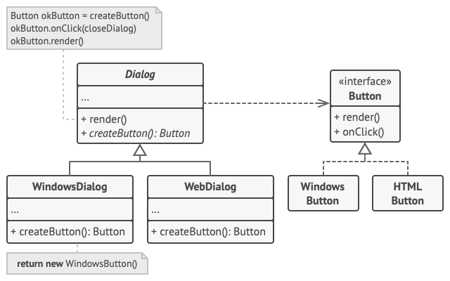
Factory
Identity
Solution
Category | Creational
Difficulty | Easy
Frequency of use | High
Main Idea | Separate creation from use
Why | D.R.Y
Problem
Consider we want to implement a notification
service through email, SMS, and push notifications that has a send method.

Slide 3
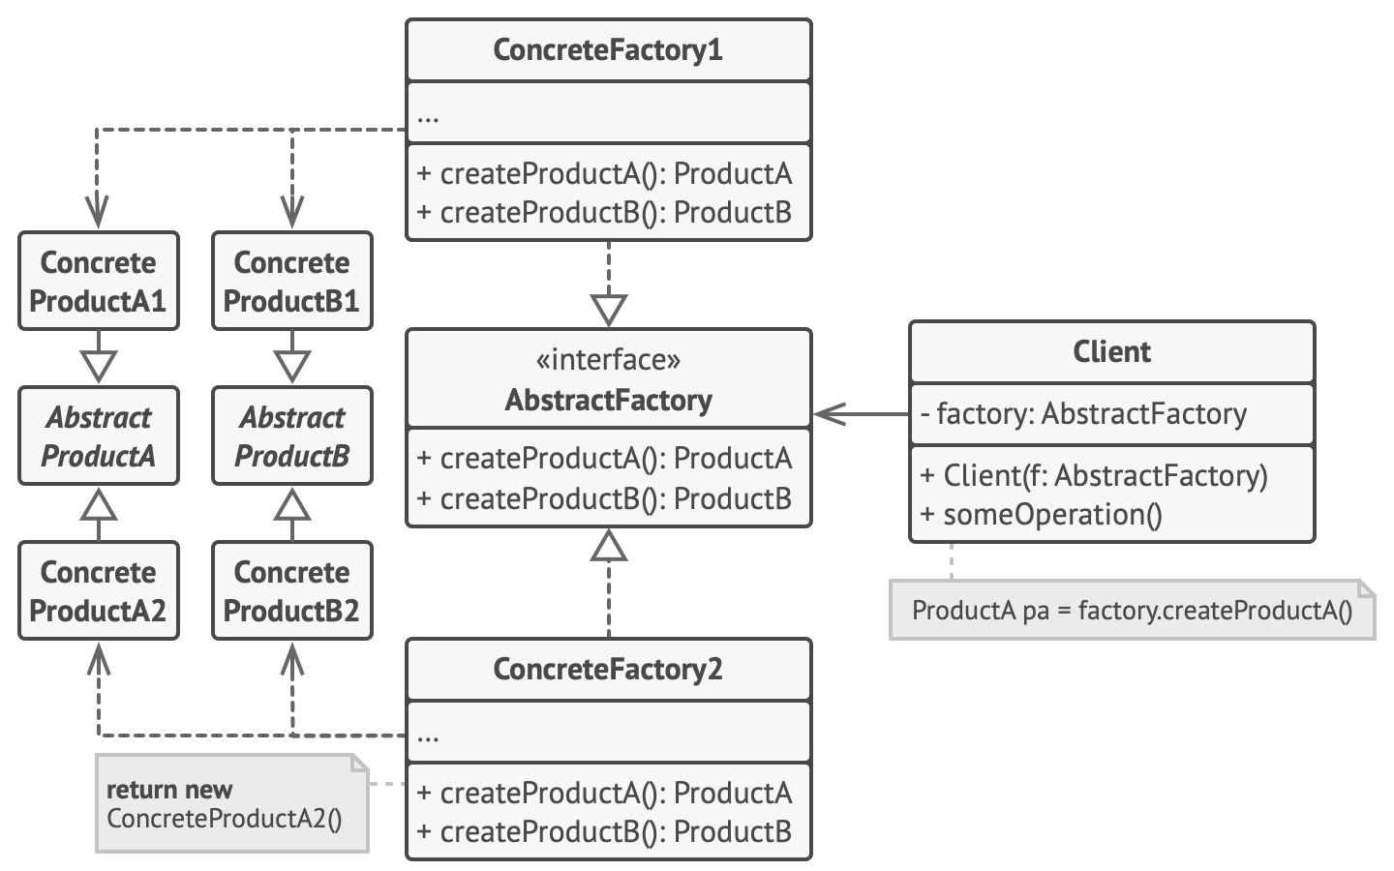
Abstract Factory ( Factory of Factories)
Identity
Solution
Category | Creational
Difficulty | Easy
Frequency of use | High
Main Idea | Separate concrete creation from use
Why | D.R.Y , Abstraction
Problem
Consider we need a way to create individual objects so that they match other objects of the same family.

Slide 4
Talk is cheap Show me the Code

