Slide 1
Community detection
Presented by: ali bagheri
Advisor: Dr. amini
CLASS OF: dr. fardmanesh

Slide 2

random graph

Slide 3
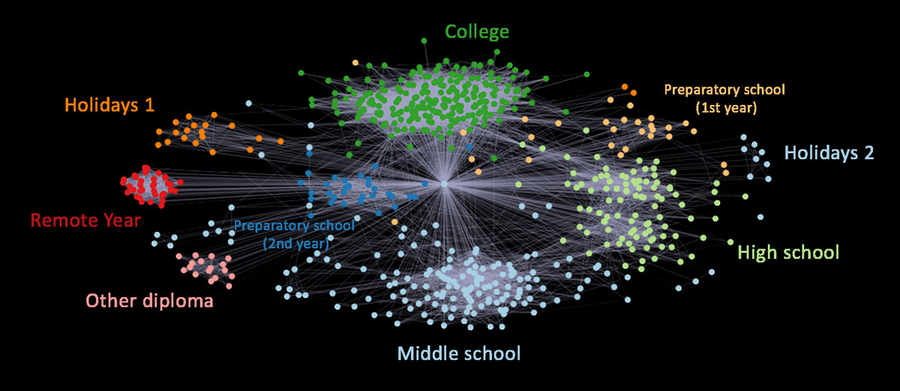
Community

Slide 4
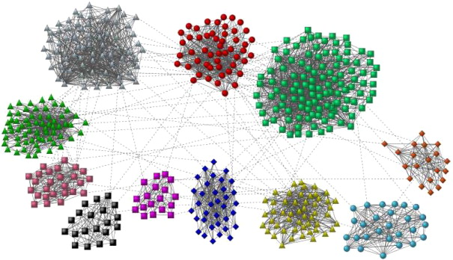

Slide 5




Slide 6
algorithms
Random Walk
Louvain
Leiden
Spectral Cluster
Random Graph
Growing Network Models

Slide 7
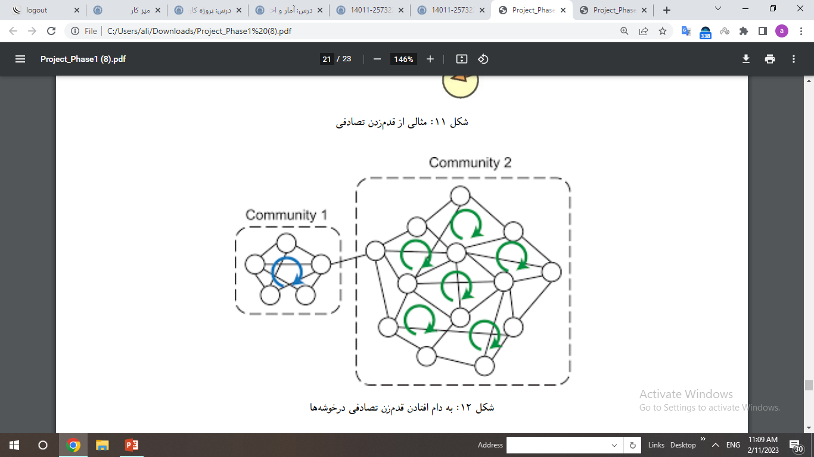
Random walk

Slide 8
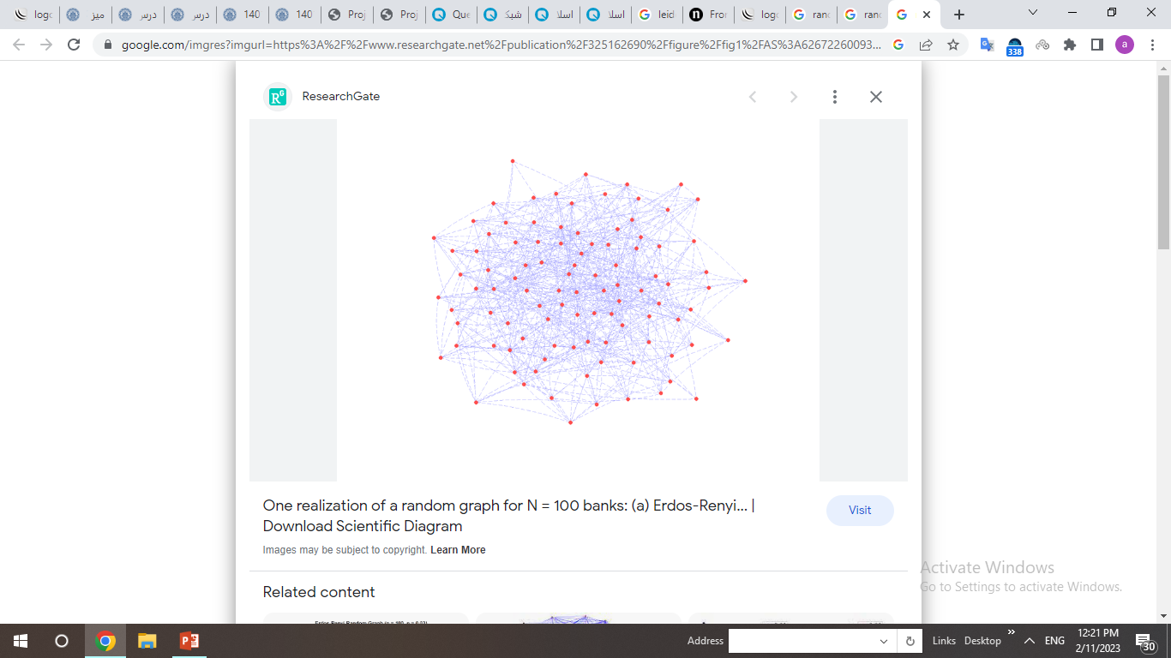
Random graph

Slide 9
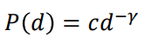
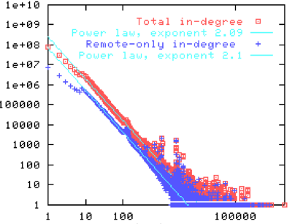
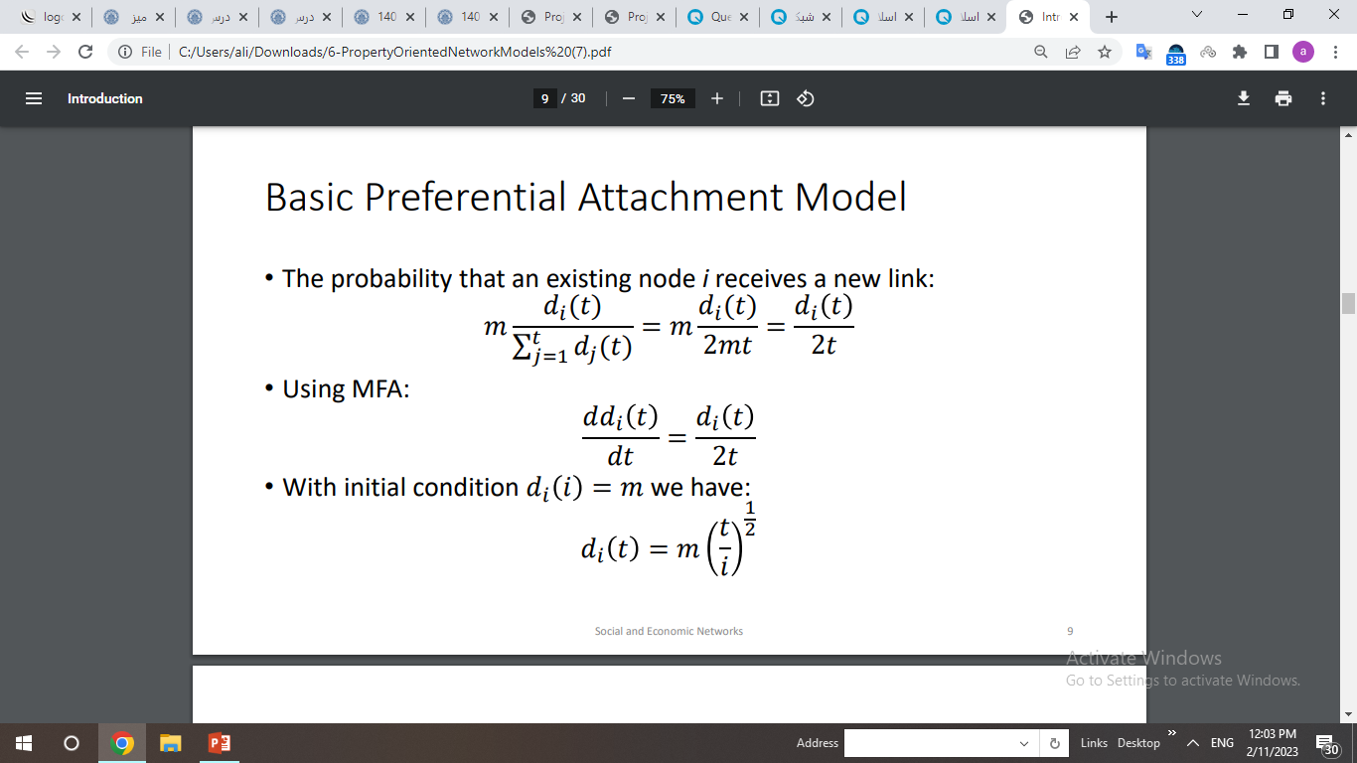
Growing Network Models
Power Law Degree Distribution
Richer get richer

Slide 10
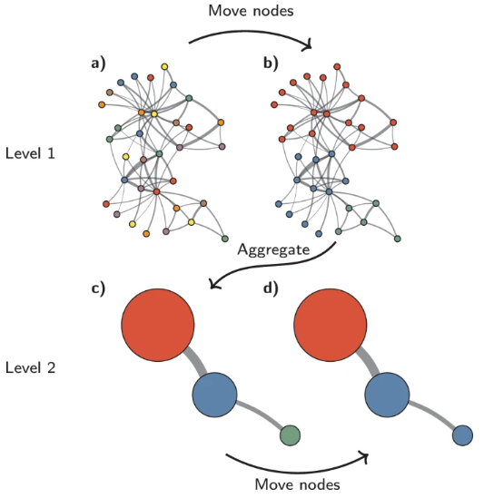
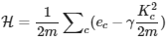
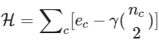
Louvain and leiden

Slide 11
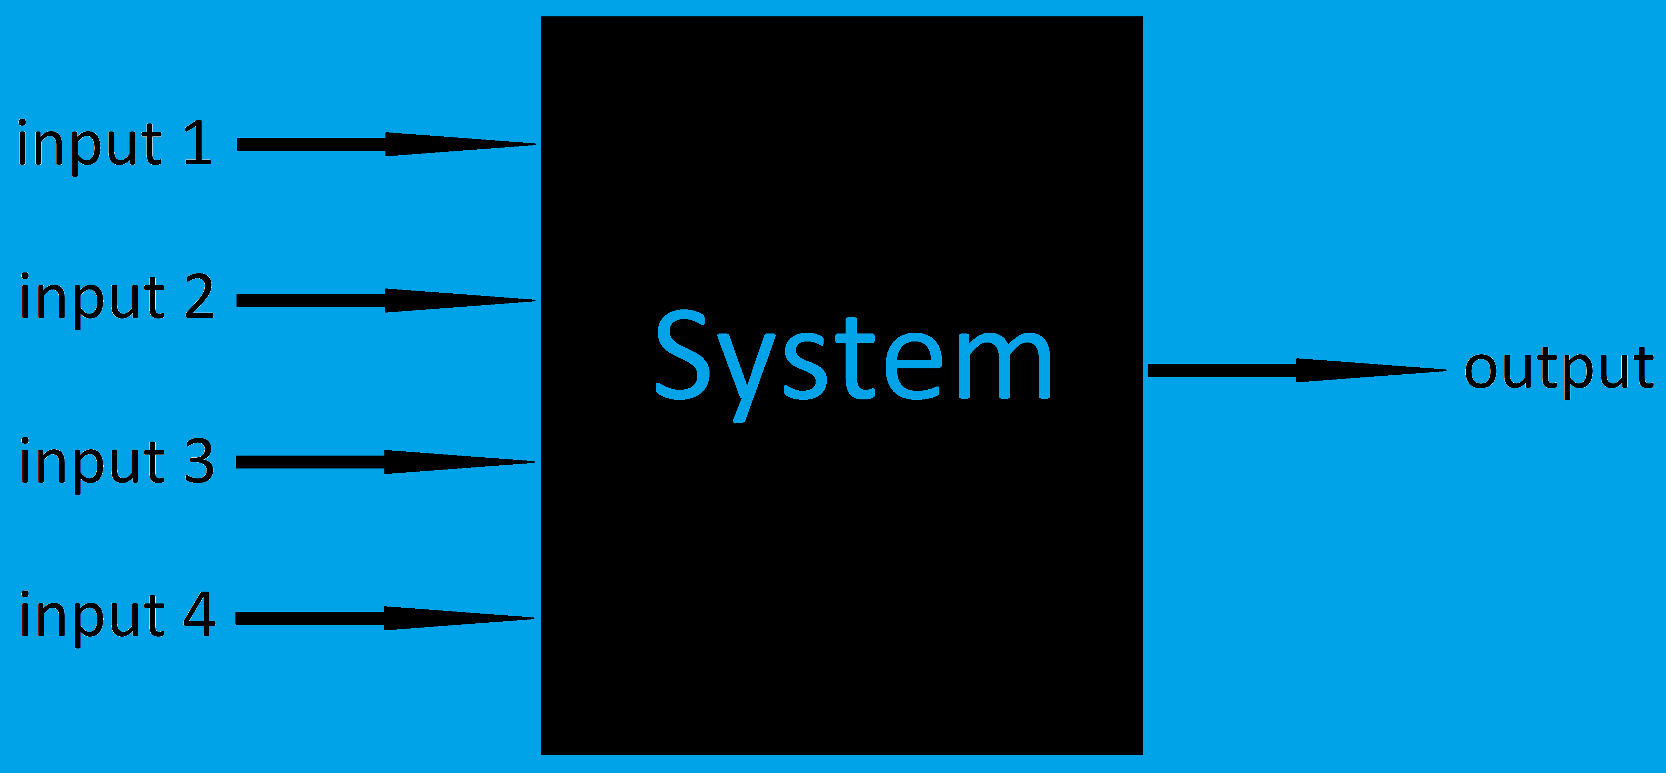

Slide 12



Slide 13



Slide 14
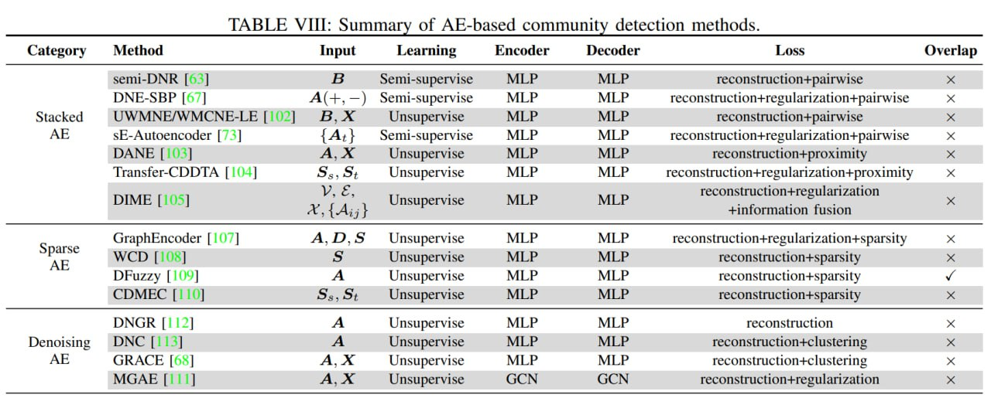
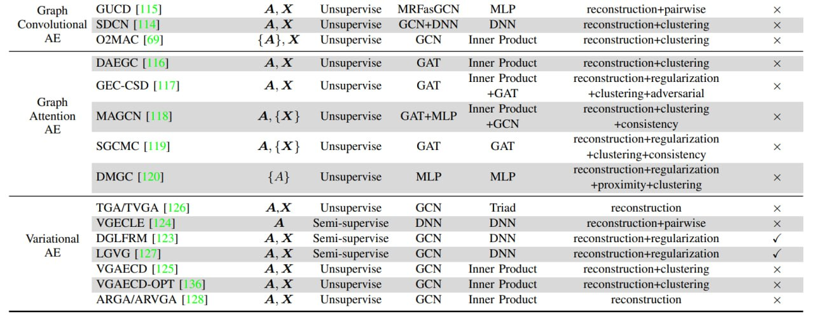

Slide 15
thanks for your attention

