Slide 1
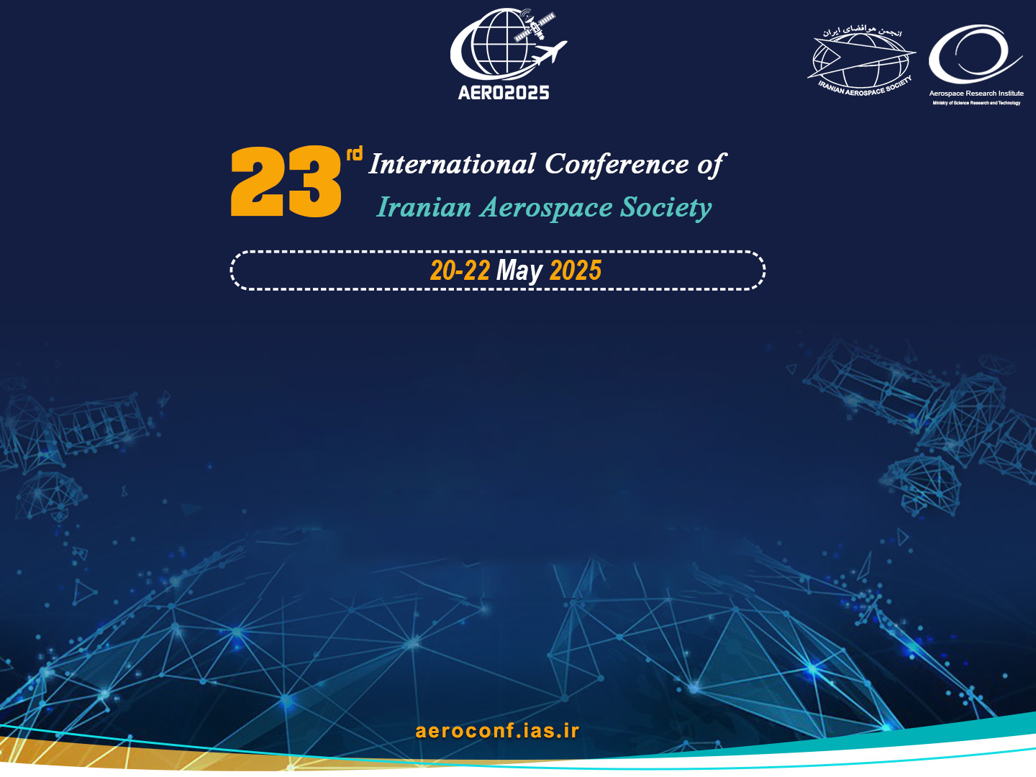

Title
Robust DDPG Reinforcement Learning Differential Game Guidance in Low-Thrust, Multi-Body Dynamical Environments
Authors
Ali Baniasad, M.Sc. Student, Department of Aerospace Engineering
Hadi Nobahari, Professor, Department of Aerospace Engineering
AERO2025-01540280

Slide 2

Contents
Why On‑board Autonomy?
Traditional vs. RL‑Based Guidance
Key Idea of the Paper
Problem Setting
Low‑Thrust Guidance Challenge
Differential‑Game Formulation
DDPG‑DG Architecture
State, Action & Reward
Trajectory Result
Robustness Tests

Slide 3

Why On‑board Autonomy?
Deep‑space missions face long communication delays & limited ground support
Multi-body environments (e.g., Earth–Moon) are highly nonlinear
Need real-time, model-agnostic guidance running on flight computers

Slide 4
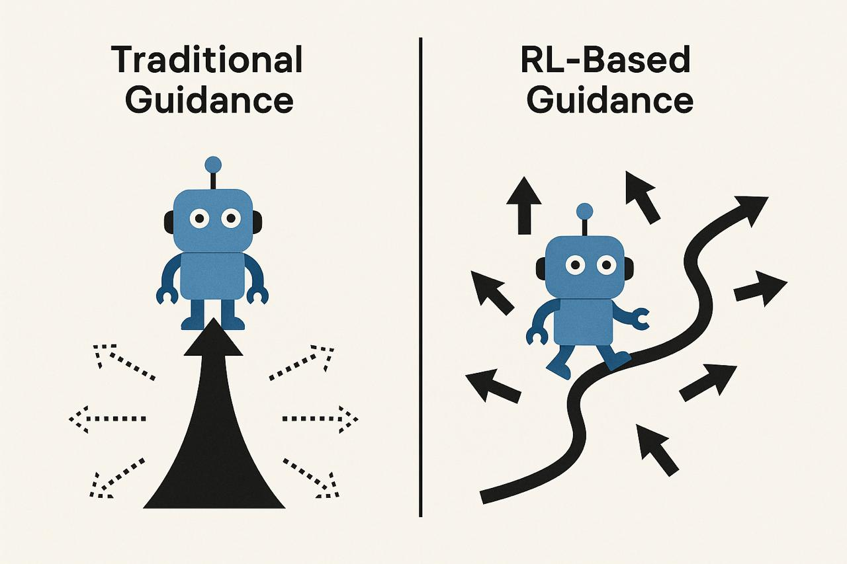
Traditional vs. RL‑Based Guidance
Traditional targeting | RL / Neural Controller
Relies on simplified 2‑body models or large trajectory banks | Learns directly from full nonlinear dynamics
Heavy ground computation | Lightweight feed‑forward evaluation on board
Limited adaptability | Re‑plans instantly when disturbed

Slide 5

Key Idea of the Paper
Blend Deep Deterministic Policy Gradient (DDPG) with Differential‑Game (DG) theory
Train a competitive two‑agent controller that is more robust than vanilla DDPG

Slide 6
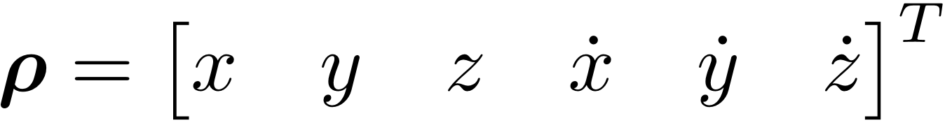
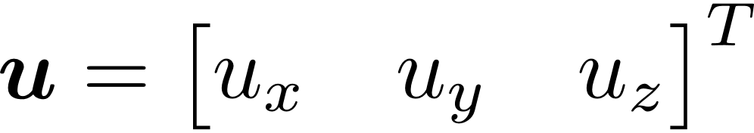
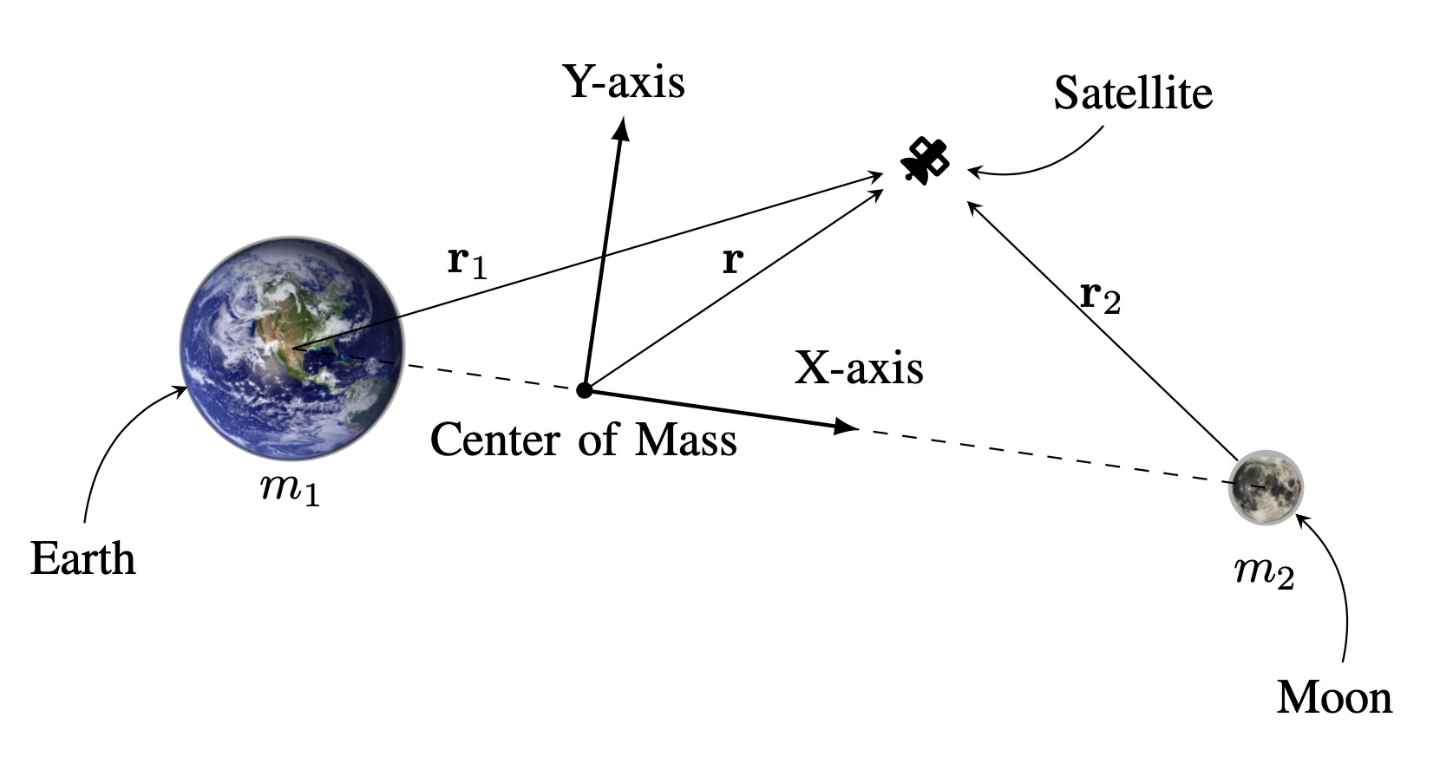
Problem Setting
Dynamical model: Circular Restricted Three‑Body Problem (CR3BP) with low‑thrust terms
State
Control – continuous thrust

Slide 7
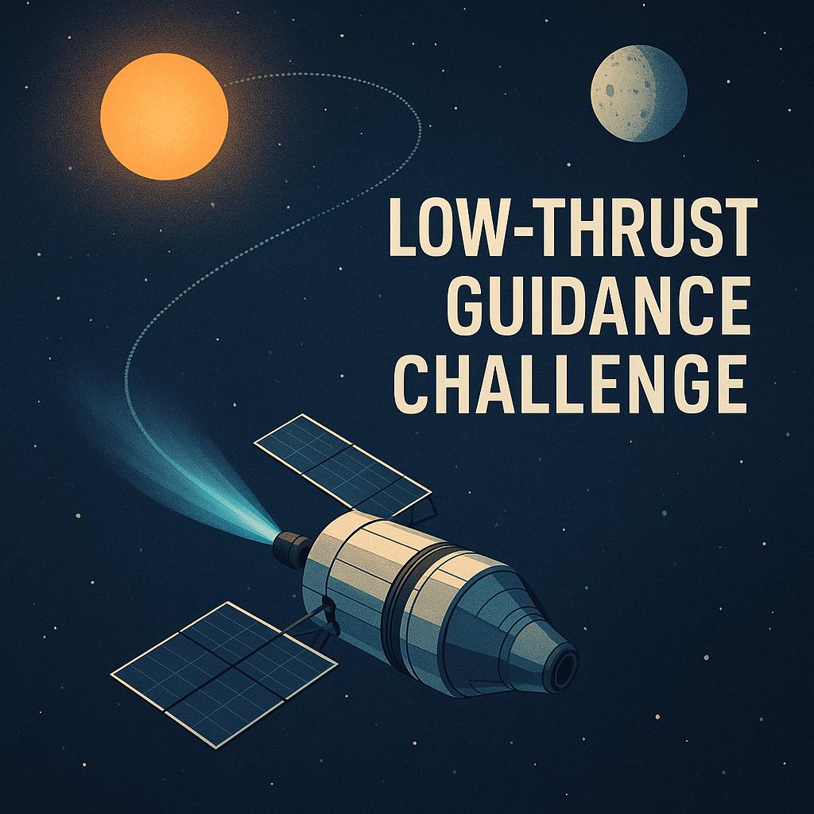
Low‑Thrust Guidance Challenge
Continuous burn → small, frequent corrections
High sensitivity to disturbances & mass variation
Real‑time solution must respect tight CPU & memory budgets

Slide 8
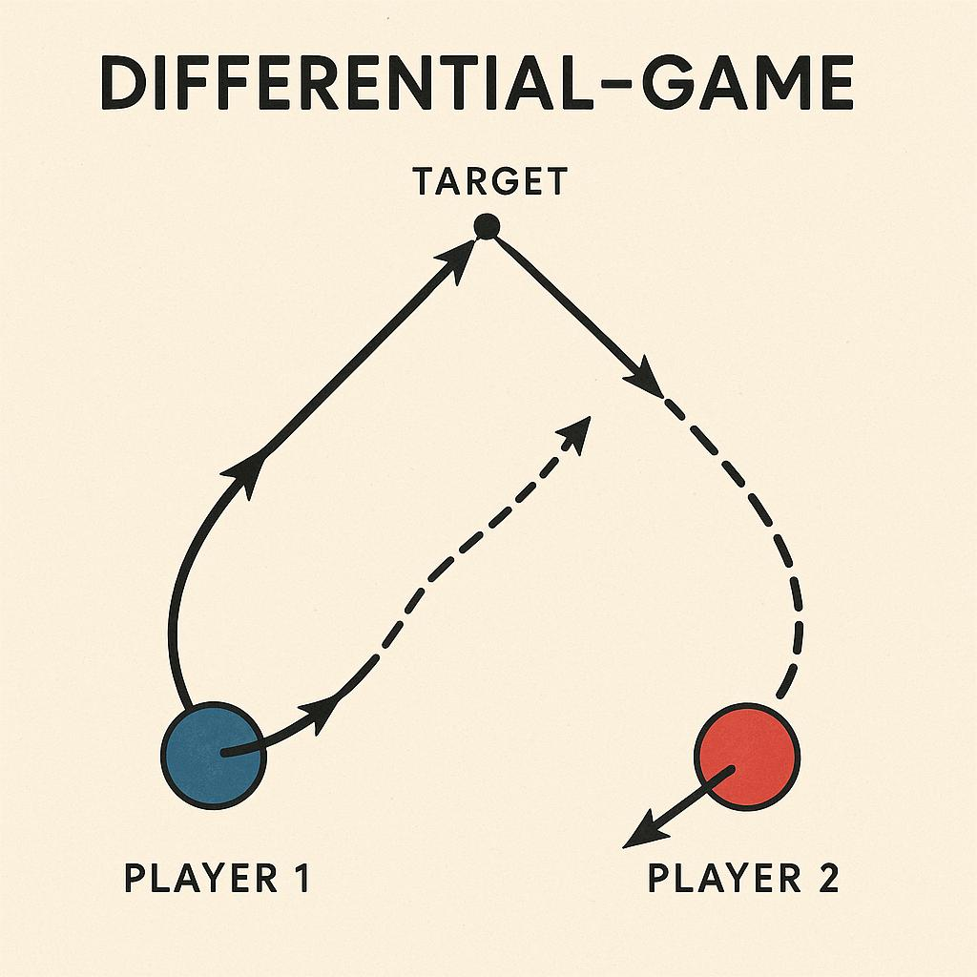
Differential‑Game Formulation
Two virtual “players” act on the spacecraft:
Controller #1 tries to minimize tracking error
Disturber #2 injects worst‑case deviations
Zero‑sum cost → policy converges to Nash equilibrium robust to adversarial inputs

Slide 9
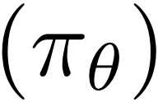
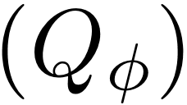
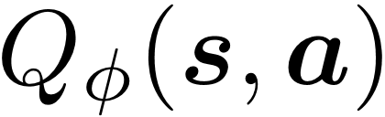
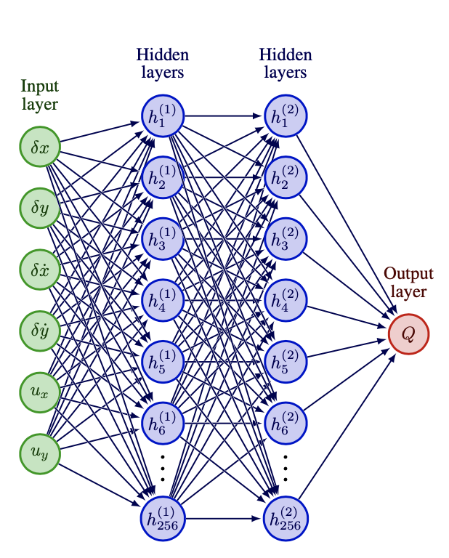
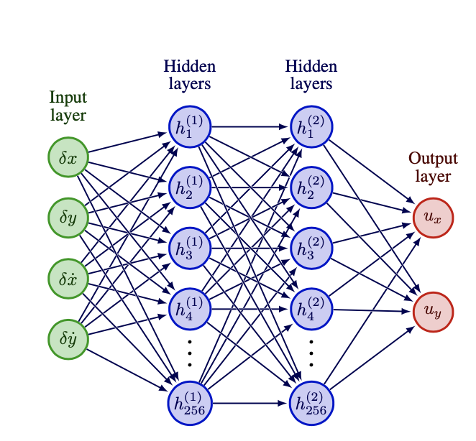
DDPG‑DG Architecture
Actor : maps
Critic : estimates return

Slide 10
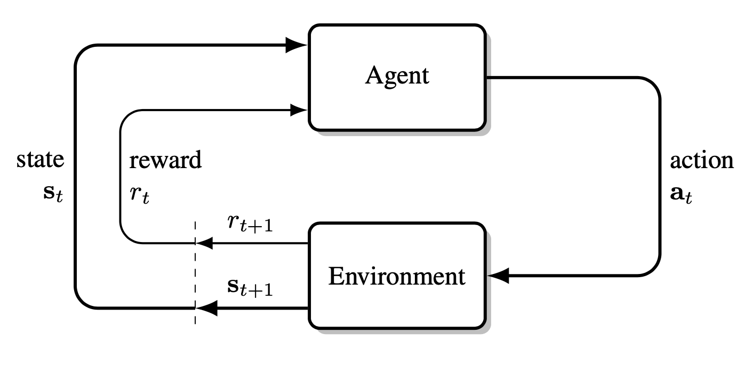
State, Action & Reward
deviations from nominal Lyapunov orbit
2‑D thrust vector
Reward

Slide 11
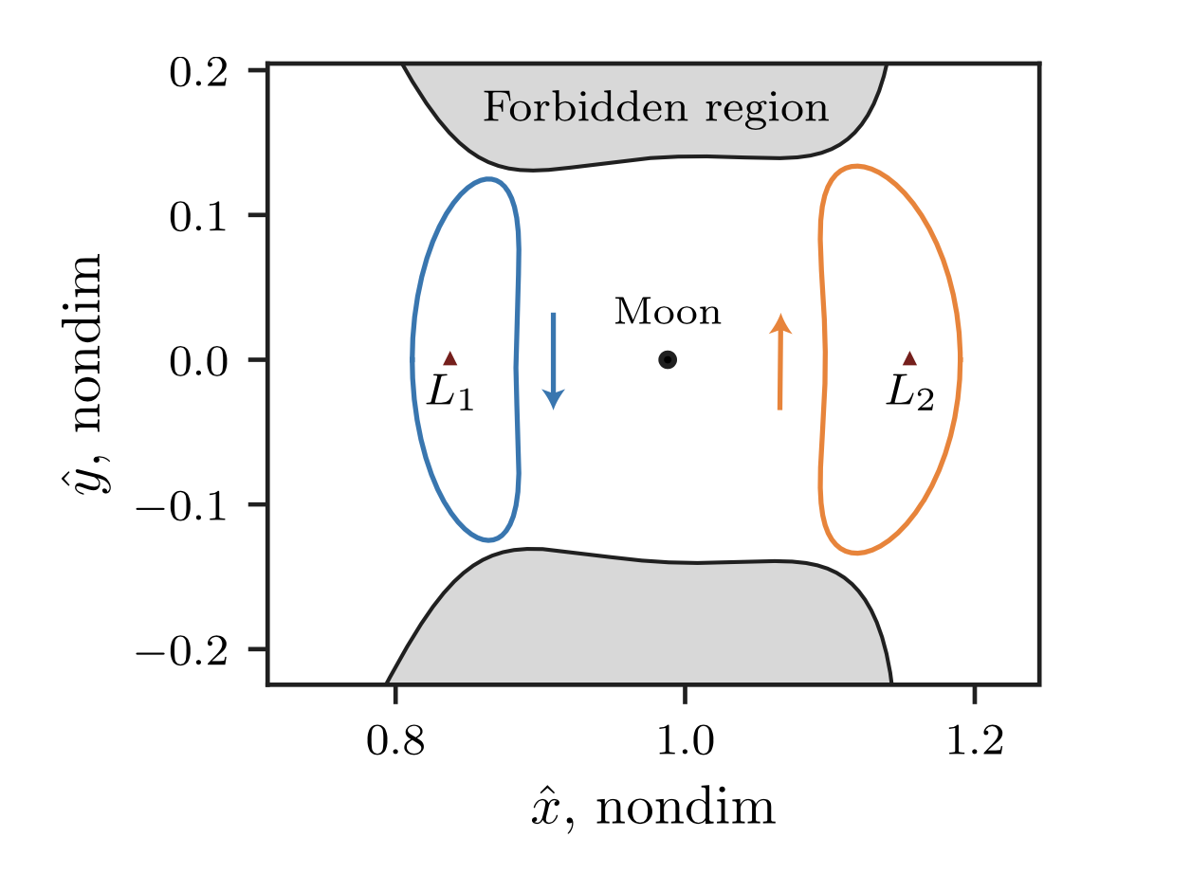
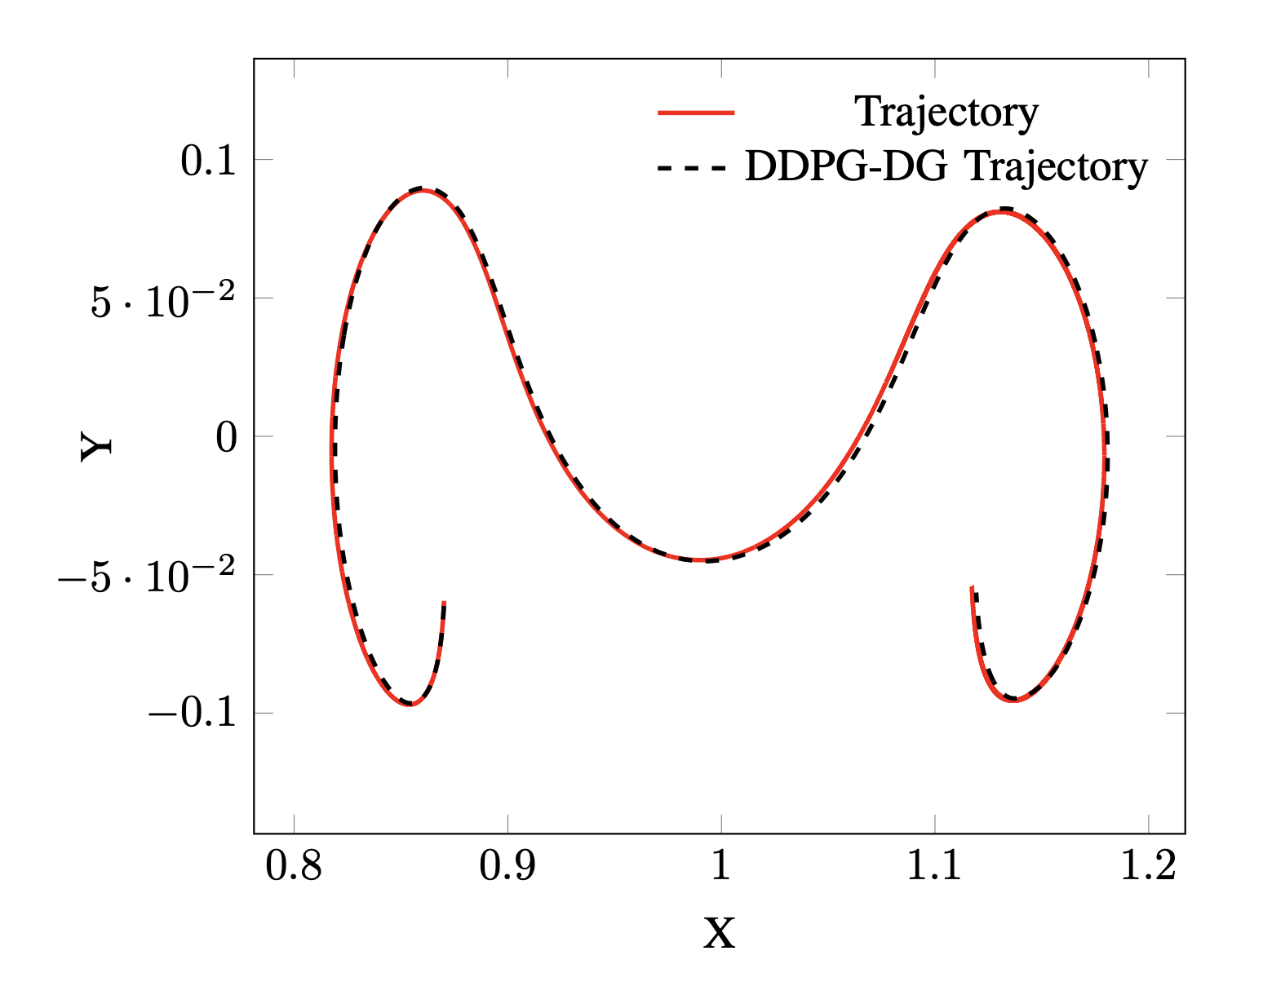
Trajectory Result

Slide 12
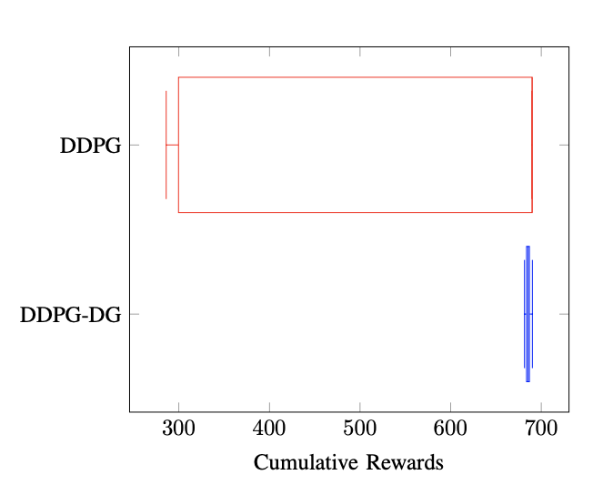
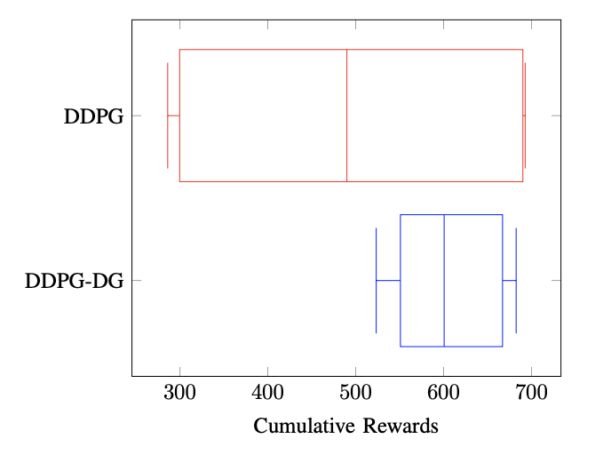
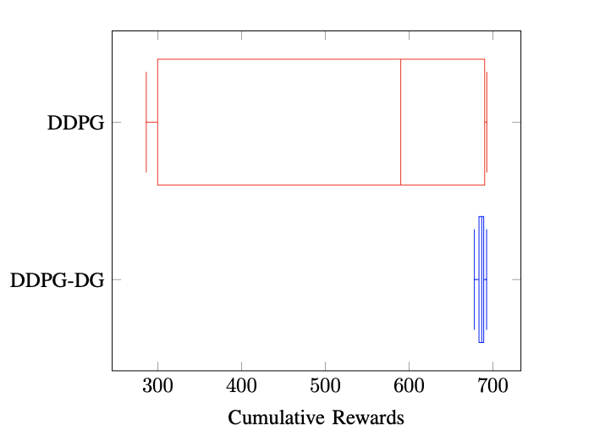
Robustness Tests
presence of gravitational parameter variation
presence of non-ideal thrust engine models
presence of disturbances

Slide 13

Q&A

Slide 14

Thanks for Your Time

